Slide 1
Property Tax Burden Report
Eric Willette
Minnesota Department of Revenue
March 3, 2010

Slide 2
Measuring Property Taxes
Net tax amount – the amount of property taxes paid net of any property tax refunds (PTR).
Effective tax rate – the percentage of the homestead’s market value paid in property taxes in one year (net tax after PTR divided by base parcel estimated market value).
Tax burden – the percentage of homesteaders’ income paid in property taxes in one year (net tax after PTR divided by the income of all homesteaders).

Slide 3
About the data
2007 property taxes, values, and refunds
Base parcel only
2006 income of homesteaders
taxable and nontaxable income
Four counties failed to report
Agricultural homesteads, relative homesteads and mobile homes excluded
97 % of remaining records had income match
1.3 million homesteads with income

Slide 4
Determinants of Property Taxes
Parcel share of tax base and total local levies
These are affected by:
Level of public services
Intergovernmental aid and other non-property tax resources
Tax base composition and property tax classification system
Property tax refunds, credits, exclusions

Slide 5
Findings
Market Values
Net Tax
Effective Tax Rates (Tax / Value)
Income
Value / Income ratio (consumption)
Tax Burden (Tax / Income)
Tenure
Senior homesteads
PTR participation

Slide 6
1. Homestead Market Values

Slide 7
2. Net Tax

Slide 8
Property Tax Refunds and Net Tax
 | Net Tax Before PTR (mean) | PTR (mean) | Net Tax After PTR (mean) | Net Tax After PTR (median)
High (Southwest Hennepin) | 4,272 | 120 | 4,152 | 3,257
Low (Southwest Minnesota) | 998 | 64 | 934 | 726
Metro | 2,945 | 213 | 2,732 | 2,279
Greater Minnesota | 1,510 | 110 | 1,400 | 1,210
Statewide | 2,311 | 167 | 2,144 | 1,810

Slide 10
3. Effective Tax Rate (Tax / Value)

Slide 11
Effective Tax Rate (Tax / Value)

Slide 12
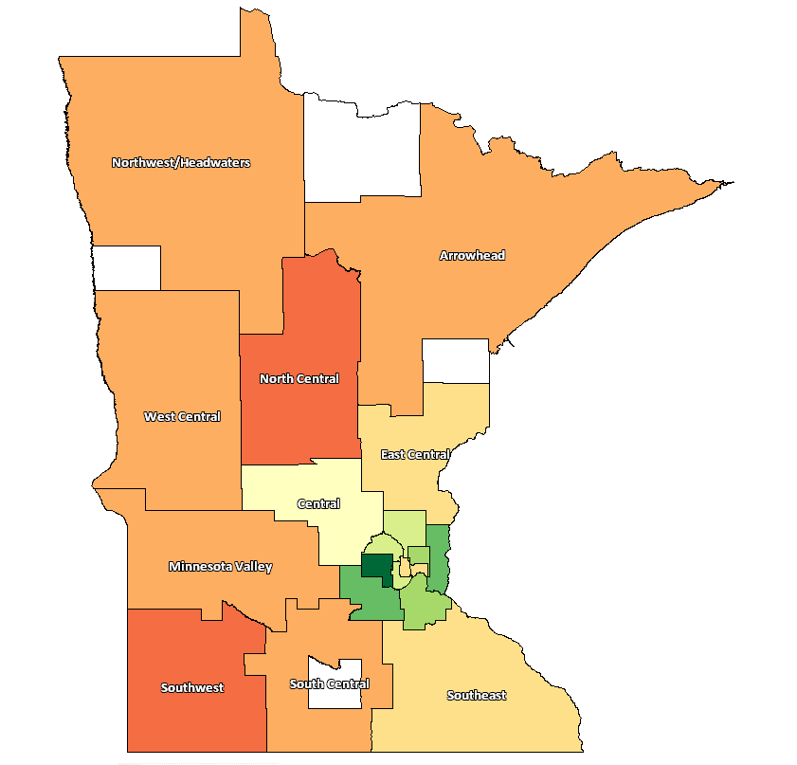
4. Homesteader Income
 |  | Median Income | Indexed to State Median
 | Statewide | $ 63,551 | 100
 | Metro | 72,779 | 115
 | Greater Minnesota | 54,027 | 85
M | Southwest Hennepin | 96,414 | 152
M | Carver/Scott | 82,655 | 130
M | Washington | 80,677 | 127
M | Dakota | 77,050 | 121
M | Suburban Ramsey | 72,922 | 115
M | Southeast Hennepin | 72,159 | 114
M | North Hennepin | 69,729 | 110
M | Anoka | 68,825 | 108
G | Central | 63,781 | 100
G | Southeast | 59,232 | 93
M | Minneapolis | 57,877 | 91
M | Saint Paul | 56,762 | 89
G | East Central | 54,948 | 86
G | South Central | 52,002 | 82
G | West Central | 51,468 | 81
G | Minnesota Valley | 51,475 | 81
G | Arrowhead | 49,292 | 78
G | Northwest/Headwaters | 47,560 | 75
G | Southwest | 46,171 | 73
G | North Central | 45,824 | 72

Slide 13
5. Value / Income ratio

Slide 14
6. Tax Burden (Tax/Income)

Slide 15
Burden Greater than 5% of Income Homesteads with income over $10k

Slide 16
Tax Burden by Income
Income range* | Median burden before MVHC | Median burden before PTR | Median burden after PTR
$10,000 -$30,000 | 7.4% | 6.2 % | 3.7 %
$30,000 - $45,000 | 4.7 | 4.1 | 3.3
$45,000 - $65,000 | 3.6 | 3.3 | 3.0
$65,000 - $90,000 | 3.0 | 2.8 | 2.7
$90,000 - $125,000 | 2.6 | 2.4 | 2.4
$125,000 or more | 1.9 | 1.8 | 1.8
*Homesteads with Income under $10,000 not shown due to data issues

Slide 17
Average Credit and Refund by Income
Income Range | Average MVHC | Average PTR | MVHC + PTR
$10,000 - $30,000 | $213 | $415 | $628
$30,000 - $45,000 | 211 | 303 | 514
$45,000 - $65,000 | 200 | 182 | 382
$65,000 - $90,000 | 179 | 68 | 247
$90,000 - $125,000 | 146 | 16 | 162
$125,000 or more | 87 | 13 | 100

Slide 18
Average Credit and Refund by Region
 | Average MVHC | Average PTR | MVHC + PTR
Greater MN | $212 | $110 | $322
Metro | 144 | 213 | 357
Statewide | 174 | 167 | 341

Slide 19
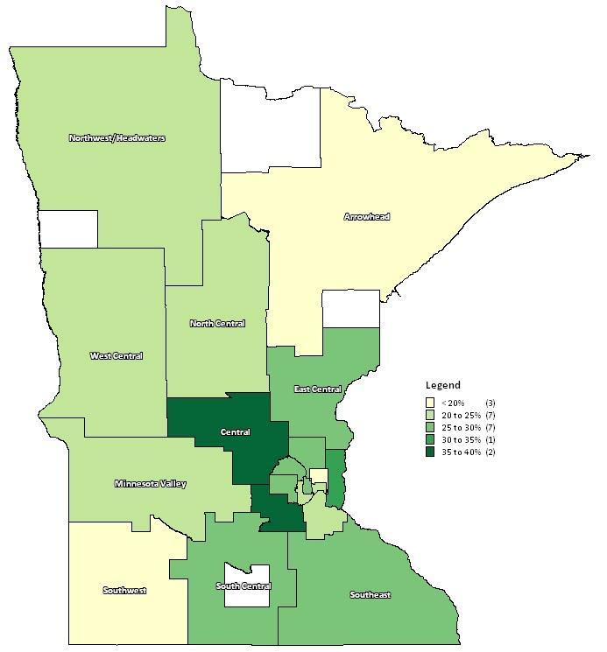
7. Tenure (not in report)
Percent of homesteads with tenure of less than five years

Slide 20
8. Senior status (not in report)
Senior homestead: at least one homesteader aged 65 or more
 | Median burden before PTR | Median burden after PTR
All homesteads | 3.0% | 2.8%
Senior homesteads | 3.6 | 3.0
Non-senior homesteads | 2.9 | 2.8
Minneapolis seniors | 5.7 | 4.0
Minneapolis non-seniors | 3.9 | 3.5

Slide 21
9. PTR participation (preliminary)

Slide 22
Questions?
Eric Willette
Director of Property Tax Research
Minnesota Revenue
651-556-6100
Eric.Willette@state.mn.us

