Slide 1
Budget Overview – Legislative Session 2011

Slide 2
Mission
“Our mission is to make the revenue system work well for Minnesota.”
Vision
“Everyone pays the right amount,
no more, no less.”

Slide 3
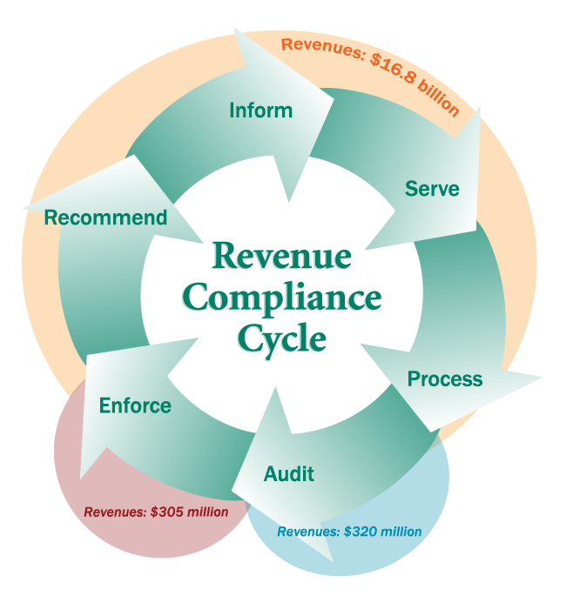
Compliance Cycle
Interpret the law, inform taxpayers of their obligations and rights.
Provide taxpayers with the service and information they need to meet their obligations.
Process returns and payments, issue refunds, and manage taxpayer accounts.
Audit to resolve discrepancies, discourage tax evasion, and identify levels and patterns of noncompliance.
Enforce the tax laws for those who do not comply voluntarily.
Identify and recommend improvements to the revenue system.

Slide 4
FY2012-2013 Base Budget*
Fund | FY2012 | FY2013 | Total 2012/13 | Percent
General | $134,032,000 | $137,769,000 | $271,801,000 | 97.0%
Health Care Access | $ 1,749,000 | $ 1,749,000 | $ 3,498,000 | 1.3%
Hwy Users Tax | $ 2,183,000 | $ 2,183,000 | $ 4,366,000 | 1.6%
Environmental | $ 303,000 | $ 303,000 | $ 606,000 | 0.1%
Totals | $138,267,000 | $142,004,000 | $280,271,000 | 100%
*Does not include open collection appropriations , integrated tax system loan transfer funds or special revenue funds.
*Amounts include Governor’s Recommendation.

Slide 5
Governor’s Recommendation – Change Items: FY2012 - 2013
The Governor has recommended an operating budget reduction of $4.368 million for FY2012/2013
The Governor has recommended a Tax Compliance Initiative that will generate $43.5 million in revenue and provide an appropriation of $11.37 million in FY2012/2013
Change Item pages have been distributed

Slide 6
Direct Compliance vs. Compliance Support Budget
2000 – 2001
Biennium
2012 – 2013
Biennium
52% 48%
31% 69%

Slide 7
Integrated Tax System Project Update
An Integrated Tax System is a software product that supports all tax processing, enforcement and reporting functions performed by a tax agency.
Our Integrated Tax System will provide the following:
accurate, timely and complete information from a single system;
provides citizens and employees with a single source of information;
permits taxpayers to directly access information and the Department to greatly expand and enhance services to them;
reduces costs to maintain systems; and
enhances capabilities to detect non-compliance and increase tax collections without raising taxes.

Slide 8
Integrated Tax System Project Update
Before - A patchwork of applications, technologies and platforms
Each color represents a unique application that, in many cases, provides similar business functionality

Slide 9
Integrated Tax System Progress
Progress:
Request For Proposal was issued in August 2007
Contract with Fast Enterprises was signed February 2008
Work began in March 2008 (20-25 contractors on-site)
Rollout One: Completed on December 15, 2008
Included the following tax types:
Sales and Use Tax
MinnesotaCare Tax
Petroleum Taxes
Insurance Taxes
Mortgage Registry & Deed Taxes
Converted 648,000 taxpayers (includes owners and officers) to GenTax
Converted 3,355,000 prior tax returns (2004 to current) to GenTax

Slide 10
Integrated Tax System Progress (cont’d)
Rollout Two:
Completed December 2009 and included the following tax types:
Withholding Tax
Corporate Franchise Tax
S-Corporation Tax
Fiduciary Tax
Partnership Tax
Other Business Income Tax
Rural Electric Co-ops
Drycleaner Tax
Rollout Three:
Completed December 2010 and included the following tax type:
Individual Income Tax
Rollout Four:
To be completed February 2012 and will include the following tax types:
Cigarette Tax
Gambling Tax
Liquor Tax
Non-Tax Debt

Slide 11
Integrated Tax System Project Summary
Summary:
Project Start Date: March 2008
Rollout 1: Complete December 2008
Rollout 2: Complete December 2009
Rollout 3: Complete December 2010
Rollout 4: On-track February 2012
All major taxes are complete (Income, Sales, Corporate, Withholding)
DOR will complete project on-time and on-budget

Slide 12
Integrated Tax System Project Update
After – Integrated Tax System Project

Slide 13
Department Successes
Integrated Tax System:
Provided DOR the opportunity to review all our processes and look for way to leverage technology, streamline processes, and remove those that were no longer necessary or not adding value.
Promoting/implementing electronic filing:
Enabled DOR to process returns and refunds more efficiently and accurately
Allowed DOR to redirect resources to other value added activities
Allowed our taxpayers to receive refunds quicker
Partnering with other Government Agencies (State & Federal):
Other Agency Debt; Revenue Recapture
Counties: Electronic Certificate of Real Estate Value Automation Project

Slide 14
Department Successes
Shared Services Agreement (DOR & OAH)
Shared Service agreement has worked well for both agencies
Data Warehouse:
Provided DOR the ability to capture and combine data from various sources and streamline some of our analysis, audit selection and reporting functions in DOR
Video Conferencing:
Enables DOR to minimize travel expenditures and reduce some taxpayer burden
Telecommuting:
Enables DOR to reduce office space needs

Slide 15
Department Future Enhancements
Taxpayer Access Point (TAP):
allows businesses to see their transactions, copies of letters, and file/pay returns. Eventually this will include information for individual taxpayers too. It allows DOR to meet the needs of the taxpayer (walk-in, call-in, and click-in)
Extranet:
DOR is currently looking at technology solutions that will enable businesses to share data more efficiently, securely and confidentially.
Audit Selection Tools:
Once fully integrated, DOR plans to look at all methods of audit selection and planning
Integrated Tax System
Once fully integrated, DOR will explore all opportunities to become more efficient in operations and customer service

Slide 16
Department Future Enhancements
Auditor and Collector Training
DOR is actively developing new training programs for our auditors and collectors that will cover not only audit and collection skills but also the “soft” skills that are needed when dealing with taxpayers
Return Mail (LEAN Process):
Streamline DOR’s address information and reduce return mail
Streamline Audit Process & Expanded Quality Reviews:
Sending audit information to the taxpayer before the audit to better serve and make the audit more efficient for both parties
Discuss timeline with the taxpayer so they know what to expect
Audit quality reviews with taxpayers input
Our goal is to improve, expand and formalize this process

Slide 17
Department Challenges:
Complete the integrated tax system while running old systems
Loss of institutional knowledge
Growing stress on “compliance support” relative to “direct compliance” activity
More diverse population of employees and taxpayers
Training over 1,200 employees in financial code of conduct annually
Training and housing growing numbers of auditors and collectors

Slide 18
Questions?

