Slide 1
Budget Presentation – Legislative Session 2011

Slide 2
Mission
“Our mission is to make the revenue system work well for Minnesota.”
Vision
“Everyone pays the right amount,
no more, no less.”

Slide 3
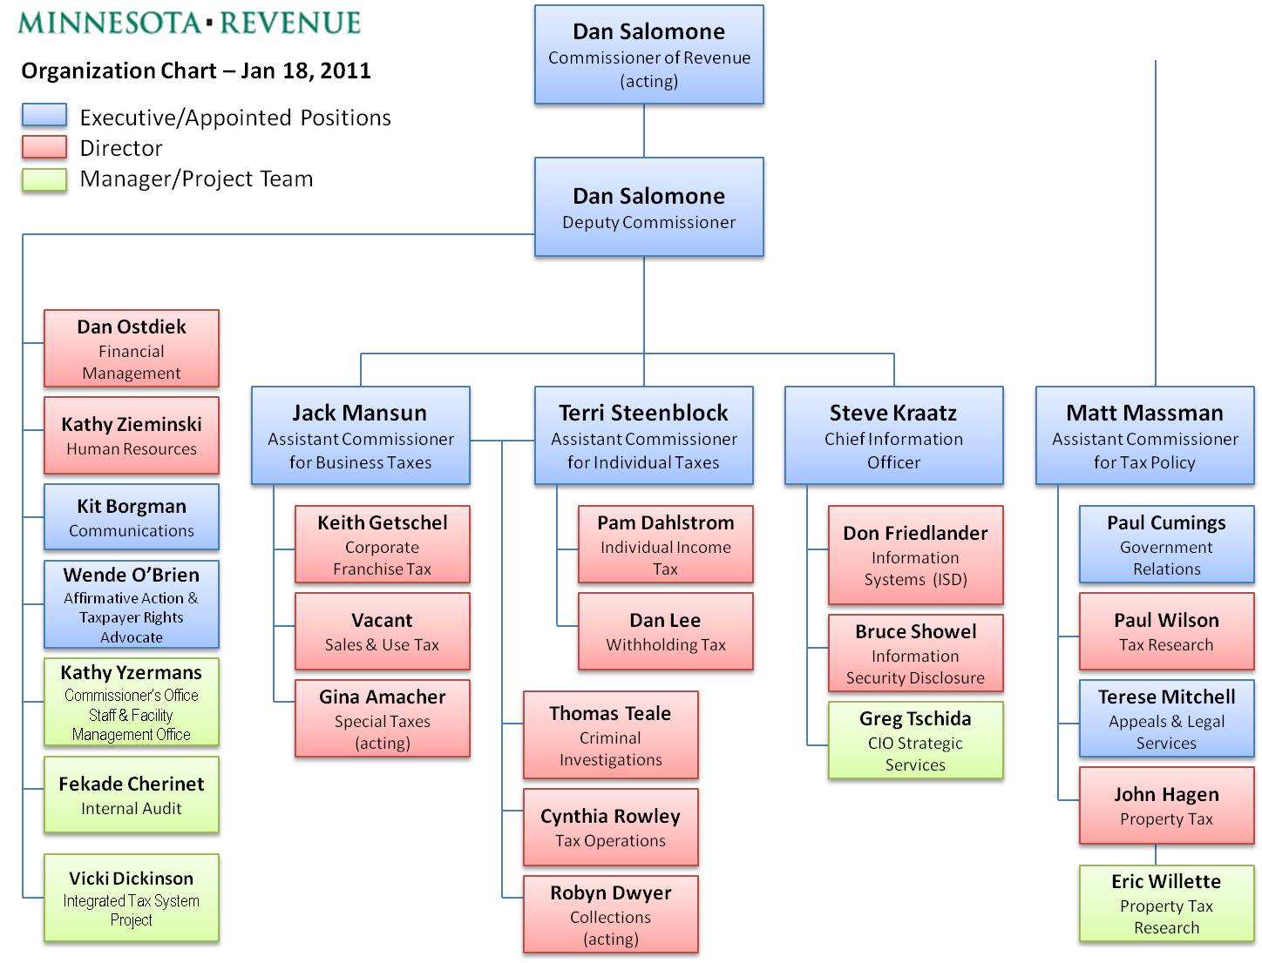

Slide 4
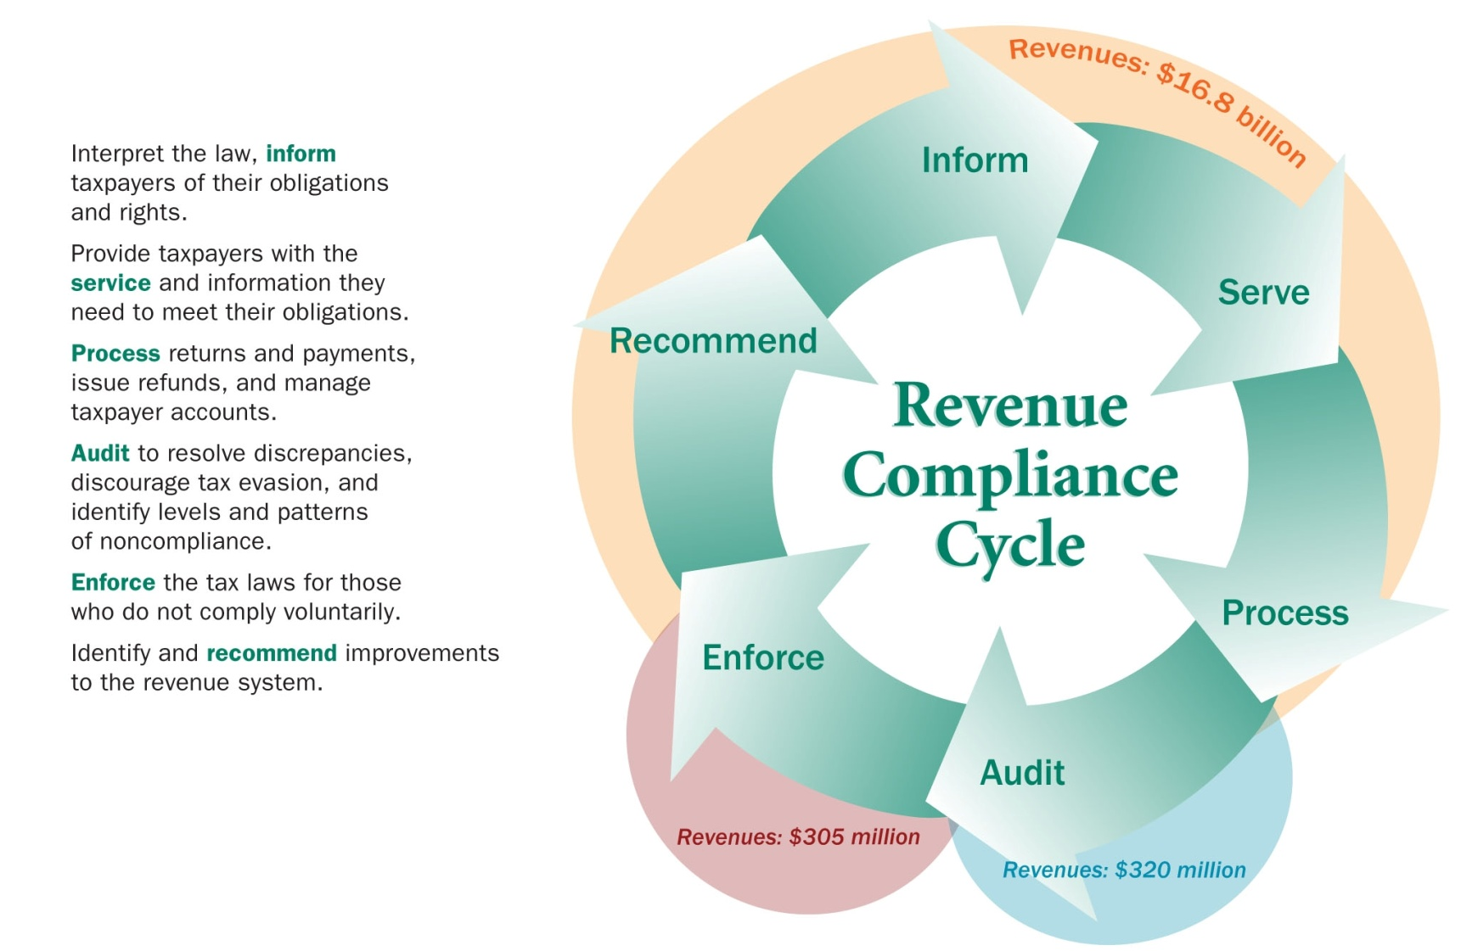
Compliance Cycle

Slide 5
We serve:
3.7 million individual income taxpayers
165,000 withholding taxpayers
786,000 property tax refund claimants
8,000 professional tax preparers
284,000 business that collect and remit sales tax
204,000 corporations, S corporations and partnerships that pay corporate franchise tax and income taxes
48,000 fiduciary income taxpayers
1,700 estate taxpayers
7,800 hospitals and health care providers
5,000 hazardous waste generators and 800 solid waste management services
3,300 local units of government

Slide 6
Annually we:
provide forms and instructions to over 4 million taxpayers;
process over 9.2 million filing and payment transactions;
answer over 678,000 phone calls;
conduct over 142,000 audits and assess approximately $642 million;
collect approximately $625 million from compliance efforts;
respond to over 41,000 e-mail inquiries

Slide 7
Direct Compliance vs. Compliance Support
Direct Compliance Compliance Support
Collection Enforcement Appeals & Legal
Corporate Tax Commissioner’s Office
Criminal Investigations Communications
Income Tax Financial Management
Petroleum Tax Human Resources
Property Tax Information Systems Services
Sales & Use Tax Tax Operations (Filing & Pay)
Special Taxes Tax Research
Withholding Tax

Slide 8
Direct Compliance vs. Compliance Support Budget
2000 – 2001
Biennium
2012 – 2013
Biennium
52% 48%
33% 67%

Slide 9
Number of Employee (FTEs), FY1996-2010

Slide 10
FY2012-2013 Base Budget*
Fund | FY2012 | FY2013 | Total 2012/13 | Percent
General | $132,373,000 | $132,423,000 | $264,796,000 | 96.9%
Health Care Access | $ 1,749,000 | $ 1,749,000 | $ 3,498,000 | 1.3%
Hwy Users Tax | $ 2,183,000 | $ 2,183,000 | $ 4,366,000 | 1.6%
Environmental | $ 303,000 | $ 303,000 | $ 606,000 | 0.2%
Totals | $136,608,000 | $136,658,000 | $273,266,000 | 100%
* Does not include open collection appropriations or special revenue funds.

Slide 11
Department Challenges:
Complete the integrated tax system while running old systems
Loss of institutional knowledge
Growing stress on “compliance support” relative to “direct compliance” activity
More diverse population of employees and taxpayers
Training 1,173 employees in financial code of conduct
Training and housing growing numbers of auditors and collectors

Slide 12
Department Challenges (Cont’d)
DOR has completed seven distinct and successful compliance initiatives since 2002 but there is a down side to compliance initiatives:
More aggressive compliance actions pit revenue goals against customer service and taxpayer fairness (i.e., training, educating and informing).
The stress of meeting ambitious revenue goals is changing the culture of the agency - e.g. competition, instead of cooperation, among auditors and collectors.
Initiatives can be addictive – an easy way to avoid difficult budget or political problems.
Taxpayers have complained about increased frequency of audits and more aggressive stance of auditors and collectors.

Slide 13
Integrated Tax System Progress
Progress:
Request For Proposal was issued in August 2007
Contract with Fast Enterprises was signed February 2008
Work began in March 2008 (20-25 contractors on-site)
Rollout One: Completed on December 15, 2008
Included the following tax types:
Sales and Use Tax
MinnesotaCare Tax
Petroleum Taxes
Insurance Taxes
Mortgage Registry & Deed Taxes
Converted 648,000 taxpayers (includes owners and officers) to GenTax
Converted 3,355,000 prior tax returns (2004 to current) to GenTax

Slide 14
Integrated Tax System Progress (cont’d)
Rollout Two:
Completed December 2009 and included the following tax types:
Withholding Tax
Corporate Franchise Tax
S-Corporation Tax
Fiduciary Tax
Partnership Tax
Other Business Income Tax
Rural Electric Co-ops
Drycleaner Tax
Rollout Three:
Completed December 2010 and included the following tax type:
Individual Income Tax
Rollout Four:
To be completed February 2012 and will include the following tax types:
Cigarette Tax
Gambling Tax
Liquor Tax
Non-Tax Debt

Slide 15
Tax Compliance Initiatives – Summary
Fiscal Years | Approp. | Actual Expenditures | Target Revenues | Actual Revenues | Return on Investment
FY2002/03 | $10.3 | $9.7 | $60.1 | $97.2 | 10 to 1
FY2004/05 | 12.8 | 12.3 | 59.8 | 92.2 | 7.5 to 1
FY2006/07 | 17.8 | 17.8 | 90.7 | 114.3 | 6.4 to 1
FY2008/09 | 27.5 | 27.0 | 123.4 | 163.5 | 6.1 to 1
FY2010/11 | 10.4 | 10.4* | 41.5 | 41.5* | 4 to 1
FY2010/11 | 6.7 | 6.7* | 26.8 | 26.8* | 4 to 1
-------------------------------------- (millions) -----------------------------------------------
* Estimates

Slide 16
Compliance Revenue as a Percent of Total Net Tax Revenue

Slide 17
Questions?

