Slide 1
Heading Home Corps
Human Services Finance and Policy Committee
March 29, 2022

Slide 2
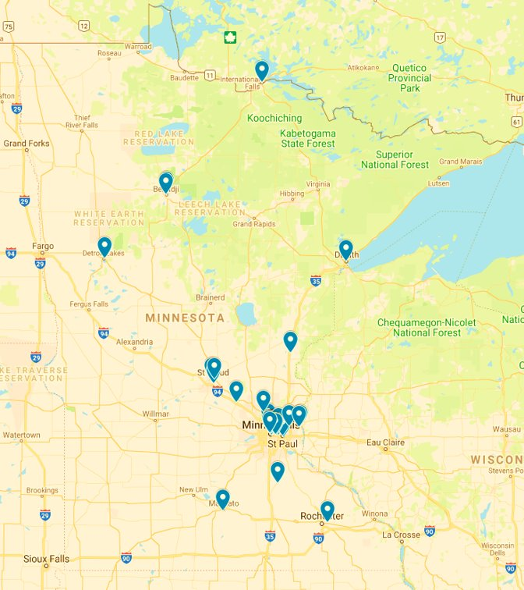

Locations
We have 50 sites across Minnesota including the metro area and greater Minnesota.
Notes:
55 different locations (some sites have multiple locations)

Slide 3

What Do Housing Resource Navigators Do?
AmeriCorps members serve as Housing Resource Navigators to:
Work with individuals who are experiencing homelessness
Establish trusting relationships with individuals and use motivational interviewing skills
Provide individualized planning, goal-setting, action planning, and support
Meet immediate needs of participants, provide resources, and connect to opportunities
Ultimate goal: help individuals experiencing homelessness obtain safe housing and needed resources

Slide 4

Heading Home Corps Members
By the numbers
84%
are women
33% are ages 18-24
53% are BIPOC
26% have lived experience

Slide 5
Heading Home Corps Data Highlights
Implementation Goal | Goal Percentage | Actual Percentage
Individuals with 2 or more sessions | 45% | 59% ✓
Individuals with 3 or more sessions | 30% | 39% ✓
602
people served
1,728 documented instances of services
990 total hours of documented services
460 people have successfully accessed at least one resource as a result of member services
On average members have provided housing support to 15 participants

Slide 6
Heading Home Corps members help people access resources
77% of participants have successfully accessed at least one resource as a result of member activities
Direct Housing Support
Obtaining subsidized housing, housing vouchers, and/or public housing
Obtaining necessary documentation for housing
Other means associated with housing procurement
Indirect Housing Support
Employment resources
Financial assistance
Food
Healthcare (including mental health)
Substance-use resources

Slide 7
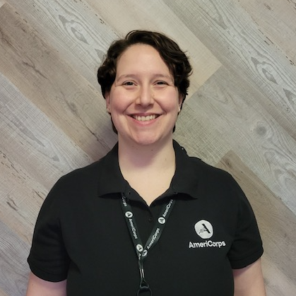
Impact Story
Robyn, Housing Navigator in Brooklyn Center, MN
“Heading Home Corps has given me the opportunity to assist the families in my community with finding the resources they need to achieve their housing needs.”
“I want to continue to contribute to making my community more equitable after my service term. Heading Home Corps has provided me with job skills that I can use when furthering my career.”
Notes:
“In the summer of 2021, I participated in the Reading and Math Corps program at my local elementary school. During my summer there, I met many wonderful students who brought me hope and inspiration.
My time at the elementary school also thrust the housing crisis of my community to the forefront of my mind. How are these beautiful souls being impacted by the unmet housing needs of their families? What is it like for their parents, wondering where they are going to stay at night?
These questions drove me to ask myself; what can I do to make a difference? How can I help these families in their time of greatest need? The answer to those questions was Heading Home Corps. Heading Home Corps has given me the opportunity to assist the families in my community with finding the resources they need to achieve their housing needs.”

Slide 8

Thank you
Alana Stimes
Director of Program Development
alana.stimes@ampact.us

