Slide 1
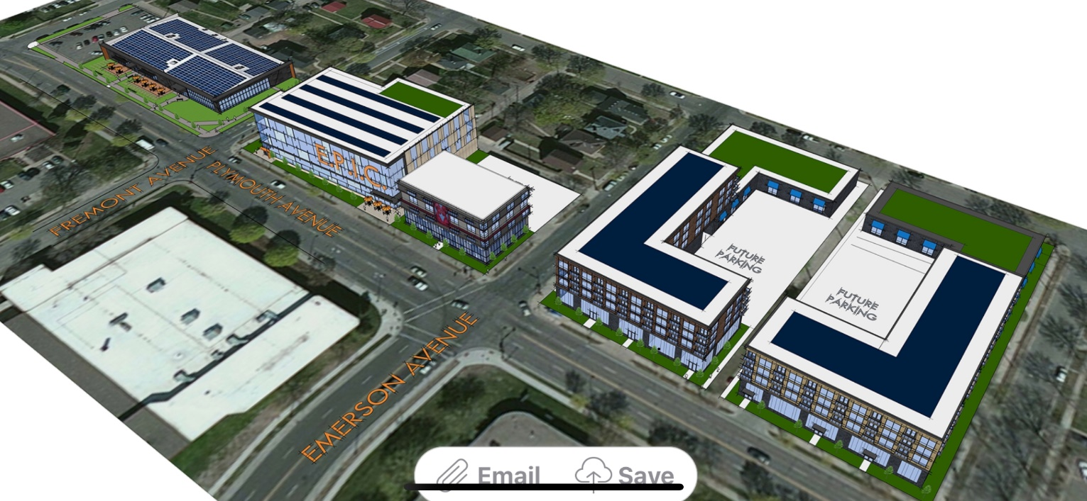
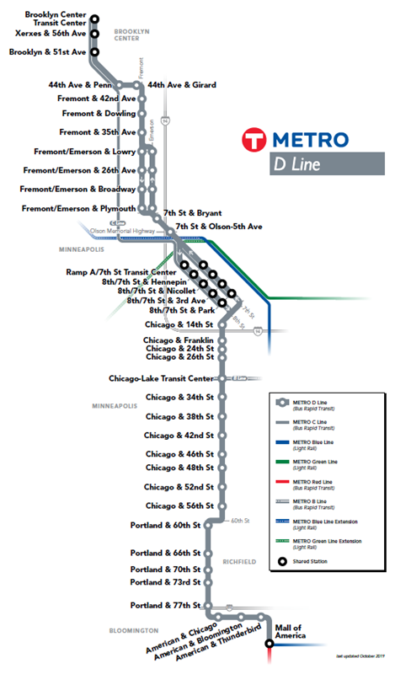
East Plymouth Innovation Corridor (EPIC)
Phase II Redevelopment Funding in North Minneapolis

Slide 2
Phase I: Regional Apprenticeship Training Center
Public-private partnership between the region’s public and alternative, community and technical colleges, local governments, businesses, trades and non-profit employment services.
Tuition-free skills and technical training for students and young adults, with paid on-the-job training, focused on emerging career fields in energy, IT, construction and related sustainability and STEM technologies.
2021 Legislative Session
Clean energy sector career training pilot project for underserved youth and young adults received funding of $2.5 million
22,000-square-foot building at 1200 Plymouth Ave. N.
The site is in a federal Opportunity Zone, in the heart of Minneapolis’ Promise Zone and Minneapolis Public Schools’ STEM Learning Cluster.

Slide 3
Funders/Supporters, Partners and Collaborators
Gov
Metropolitan Council
US Department of Energy
City of Minneapolis
State of Minnesota
Hennepin County
Avivo
Project for Pride in Living
MN Stem Partnership
University of Minnesota
Minnesota State
Midwest Renewable Energy Association
Building Performance Institute
US Bank
Xcel Energy
3M
NGO
Private

