Slide 1


Slide 2

Building HOPE Project
Youth homelessness is REAL.
HOPE 4 Youth has continually expanded to meet the needs of young people experiencing homelessness in Anoka County, but we’ve outgrown our footprint. We’re ready to do more in a facility built with an eye to the future.
The Building HOPE Project will allow us to share our successful programs with even more 16- to 24-year-olds who find themselves experiencing homelessness.

Slide 3


OUR MISSION
To provide pathways to end youth homelessness
OUR VISION
All youth will feel safe, valued, and supported while reaching their full potential. This begins with meeting their basic needs and leads to giving them the tools to thrive.
OUR STRATEGIC PRIORITIES
  Deepen our impact through high quality, high-impact programs and services
  Create a diverse, equitable, and inclusive organization
  Strengthen business practices to support high performance
OPERATIONAL FACILITIES
    Drop-In Center
    HOPE Place

Slide 4
2021 Drop-In Center Impact
314 youth served, 45% Increase in visit over 2020
61% Anoka Cty * 19% Hennepin Cty * 13% Ramsey Cty * 7% Other Cty
Youth Demographics
  20% Under 18
  20% Young parents
  58% BIPOC
  56% Female
  42% Male
  2% Nonbinary
  19% LGBTQ
Services and Support
200 youth helped through 1,100 hours of case management
1,450 Meals served
1,422 Grab-and-go food/hygiene
840 Visits to clothing closet
250 hours of internet access
162 On-site partner services
350 Referrals to outside agencies

Slide 5

Our Approach
The young people we see at HOPE 4 Youth carry many burdens. We recognize that every young person is on their own journey — no two stories are the same. We are one touchpoint on their journey. As such, we have a four-fold approach when walking alongside youth. 1
    Trauma-Informed Care (TIC)
    Strengths-Based
    Client-Centered
    Harm Reduction
1 - Informed by “Measuring Up: Youth-level Outcomes and Measures for Systems Response to Youth Homeless- ness” from the University of Chicago, and the 2014 publication “9 Evidence-Based Principles to Help Youth Overcome Homelessness.

Slide 6

HOPE 4 Youth FUTURE
    Our ability to support even more young people with our proven strategies is constrained only by an existing rental facility with no capacity for expansion.
A new center would also expand access to our life-changing services that
focus on creating:
       Ongoing basic-needs support
       Stable housing
       Employment
       Education
      Healthy connections
      Social and emotional
      well-being

Slide 7
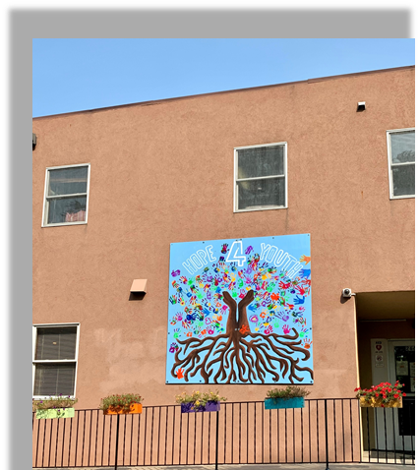
Building HOPE Vision
Located in Anoka County
10,000-15,000 Square Foot facility
Primary site of Drop-in Center
Primary site of Administrative office
Expansion in partner collaboration and youth engagement
Site – on public transportation
Expansion for growth in future years
$8M purchase and renovation

Slide 8
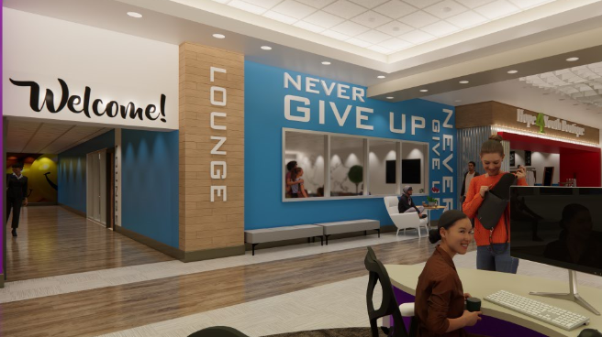
HOPE 4 Youth Serves youth who:
Have no place to call home
Have unresolved trauma
Are attempting to flee domestic violence or sex trafficking
Have mental health and/or chemical use concerns

Slide 9
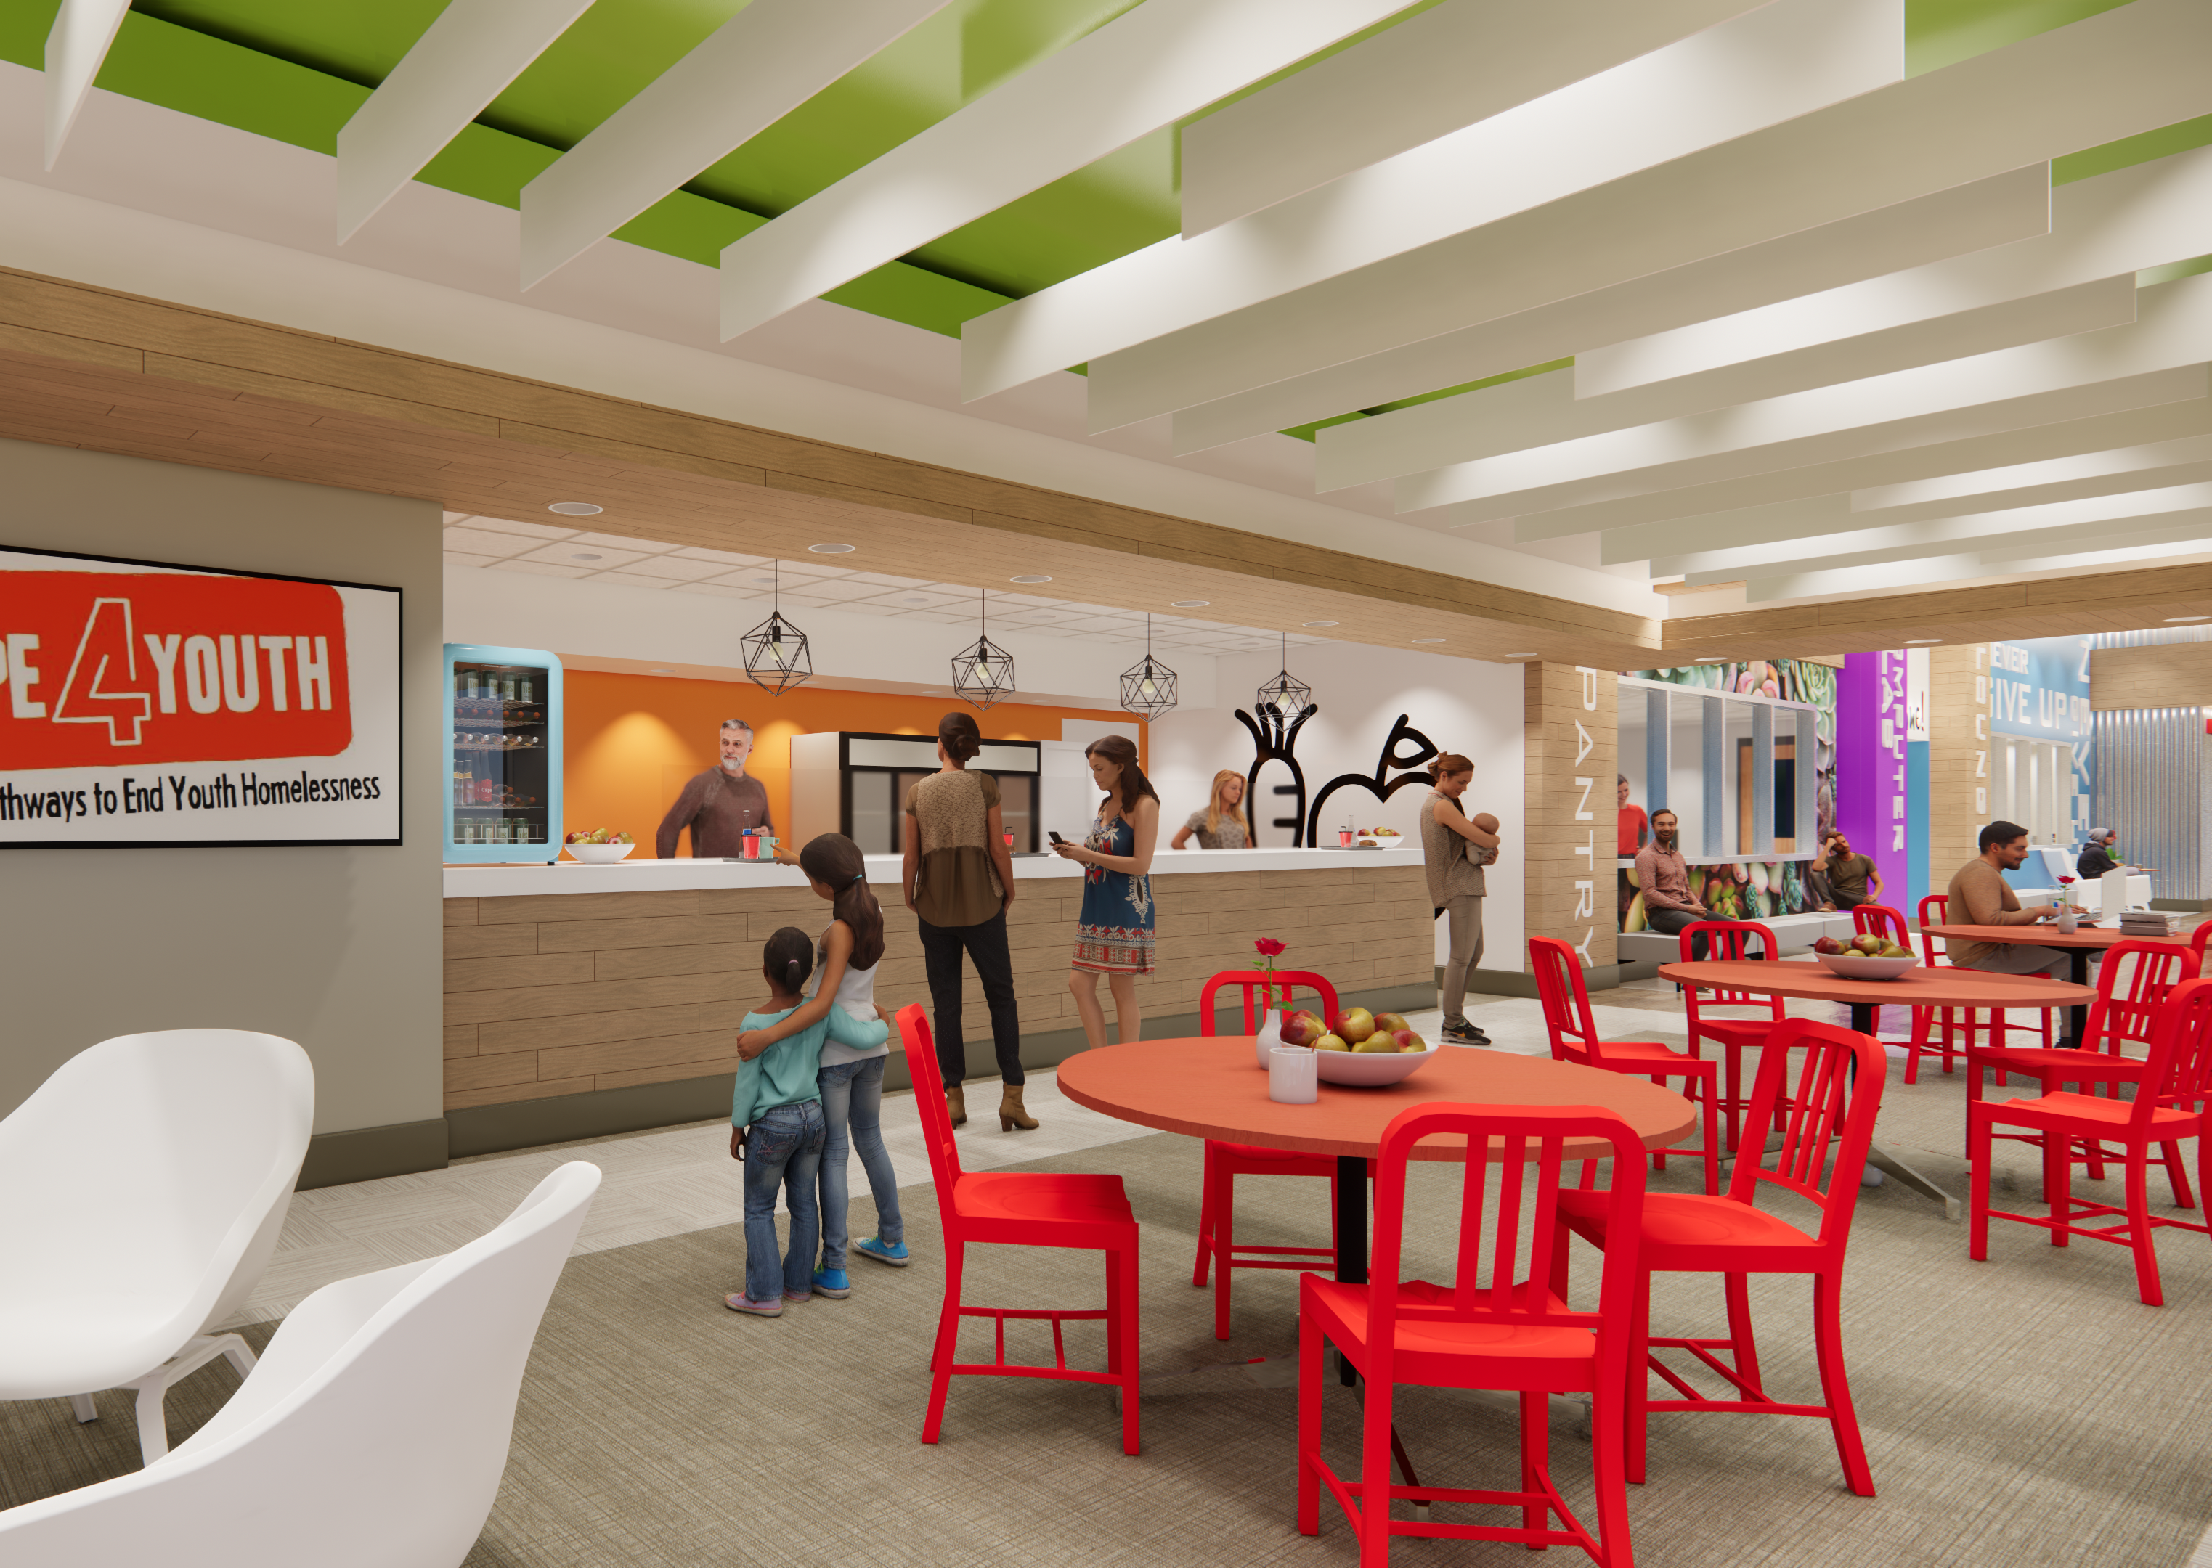
Youth Services
Basic needs
Case Management
On-site services
Referrals to other services and providers
Housing Supports
Parenting supports

Slide 10
Driving Toward Outcomes
(4 Focus Areas)
Long Term Sustainable Housing
Education/Employment
Social Emotional Well Being
Connectedness
HOPE 4 Youth is here to guide young people to be productive, positive, self-sustaining members of the community.

Slide 11
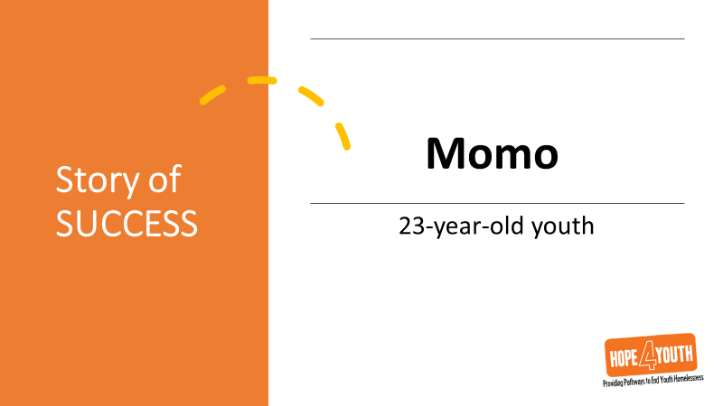
Story of SUCCESS

Slide 12

Story of SUCCESS

Slide 13

Building HOPE
Project
Questions?

