Slide 1
Elections
Legislative Briefing
January 4, 2023

Slide 2
2022 Recap
Redistricting
Congressional District 1 Special Election
Mis/Disinformation
Recounts
Post Election Review - OSS
Onboarding/Training refresh

Slide 3
Office of the Secretary of State’s Duties
Chief state election official
Train and certify county election administrators
Administer the Statewide Voter Registration System (SVRS)
SVRS interfaces with:
Driver & Vehicle Services (DVS) database
Social Security Administration database
Department of Health database
ERIC files (shared information with other states)

Slide 4
OSS Duties
Administer database of candidates and election results
Certify that election equipment meets state standards
Provide election administration guides
Voter education and outreach
Post election audits
Rulemaking authority
Not a legal advisor or enforcement agency (no guns and badges)

Slide 5
County Duties
Elections is one of many responsibilities for county auditors
Voter registration: data entry, verification, and maintenance
Ballots: layout, proofing, and printing for state elections
Voting equipment: purchase, program, test
Absentee voting: issue ballots, AB board (review, processing & counting)
Training and certification: city/school district/township clerks and election judges
Election results: compile, transmit to OSS website, review and proof
Post-election: canvass, hand count audit, post voting history and enter Election Day registrations; forward potential violations to county attorney as appropriate

Slide 6
Municipal Duties
Elections one of many city clerk duties
Determine precinct boundaries, polling locations
Hire election judges & assign to precincts
Train and certify election judges if duty delegated by county
Health care facility absentee voting
Administer absentee balloting, if delegated by county

Slide 7
Cyber Navigator Program
Started late 2019
Bill Ekblad
Retired naval cryptologist stationed in the Middle East and Germany to fight cyberattacks coming from around the world
Focus on connecting county elections staff with their I/T staff
Partnered with federal intelligence agencies
Classified security briefings

Slide 8
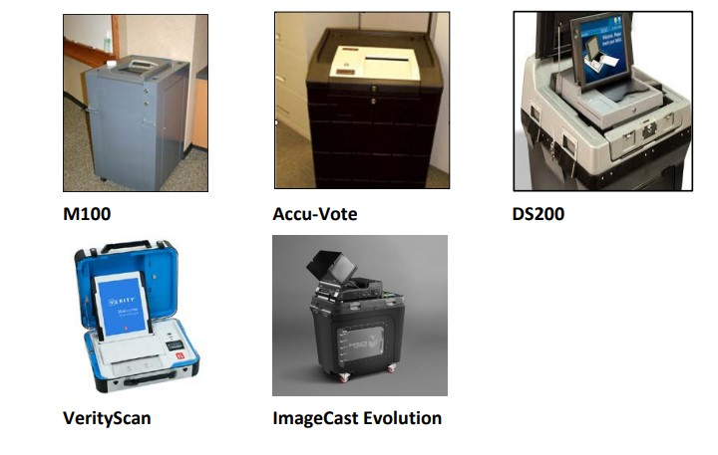
Minnesota Voting Equipment
All voting systems must be certified by the OSS before it can be used in an election
Public accuracy tests

Slide 9
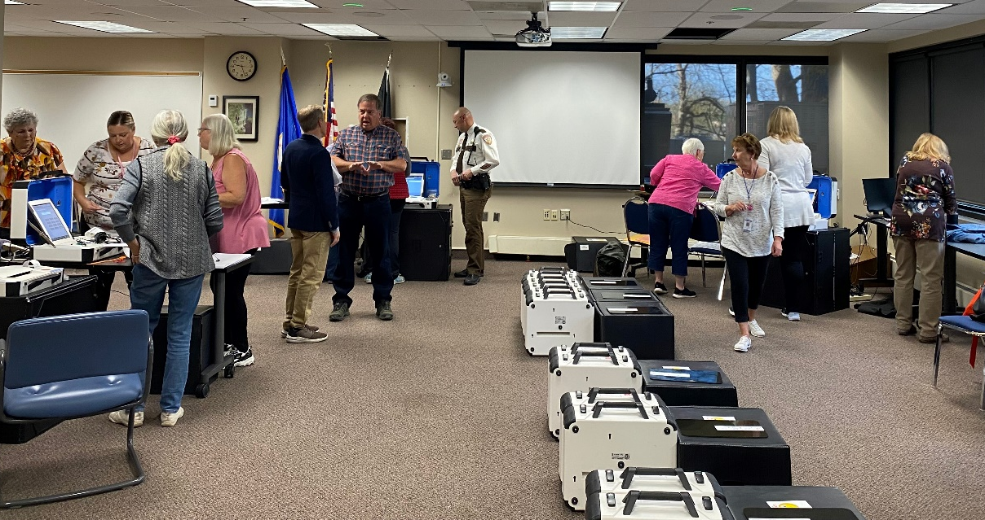
Voting System Testing
Thorough pre- testing of tabulators and assistive voting devices
Public Accuracy Test
Within 14 days of the election
Two election judges of different major political parties
Pre marked ballots and results spreadsheet
Must be 100 percent accurate

Slide 10
Statewide Voter Registration System
Housed and maintained by the OSS
Voter records are updated daily by the counties
Voters are who they say they are and live where they say they live
Identity verification - checked against other databases:
DVS, Corrections, Department of Health, SSN, ERIC
Address verification - postal verification cards
Rosters (paper and electronic)
Post-election data entry – voting history and Election Day registrations
Annual list maintenance

Slide 11
Absentee Voting
Absentee ballot applications entered/verified in SVRS
Every ballot tied to a record; ensure duplicate ballots are not cast
Voter must provide identifying information on application and AB signature envelope
Absentee ballot board reviews AB signature envelopes before they are accepted/counted
Information is immediately recorded in SVRS
Reflected on polling place rosters

Slide 12
Polling Places
Party balanced election judges manage polling places
Only authorized persons allowed in the polling place
No electioneering within 100 feet
Physical controls – voting equipment locks, seals
Election judges conduct audits to verify the number of ballots cast matches the number of voters
Closing of the polls open to the public
Official results tapes printed/signed at the polling places

Slide 13
Post-Election Activities
Unofficial results posted on OSS website, updated every 10 minutes
Results include polling place and absentee/mail ballots
Materials returned to city clerk/county auditor
Counties verify official results tapes and summary statements and prepare abstracts
Election results are certified by canvassing boards
Cities/Townships/School Districts Boards
Counties and State Canvassing Boards
Data entry – posting voting history and entering Election Day registrations

Slide 14
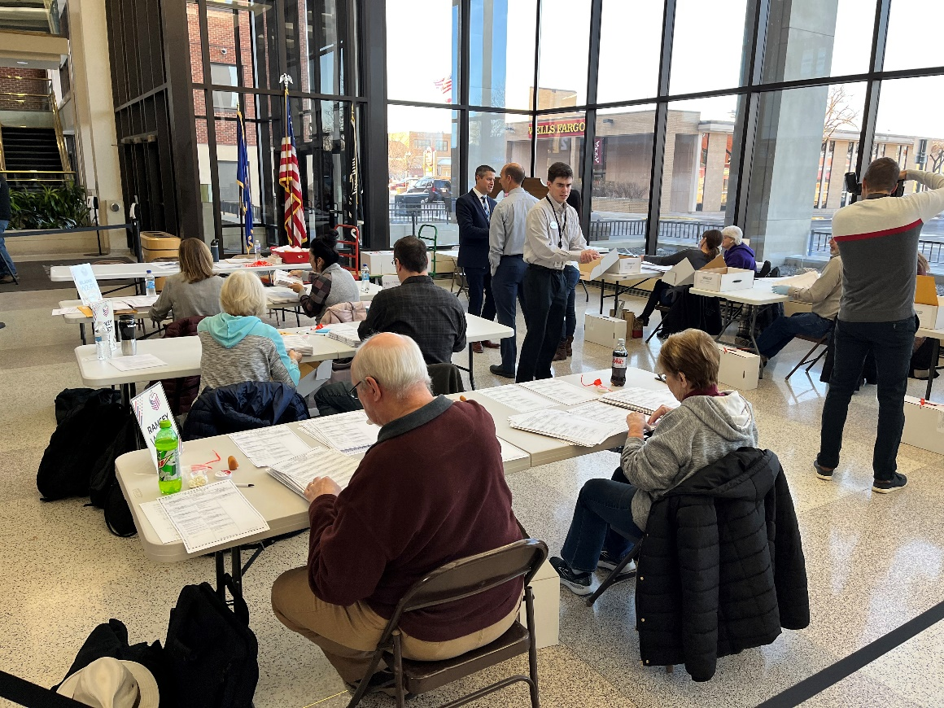
Post-Election Review (Hand Count Audit)
Every county randomly selects precincts to be reviewed
The number of precincts depends on the number of registered voters in the county
Each congressional district in the state must have at least four precincts drawn
The contests for President/Governor, U.S. Representative, and U.S. Senator are counted by hand by election judges
Reviews are open to the public

Slide 15
Post-Election Review
Additional precincts are reviewed if the hand count differs from the certified results by more than:
2 votes in a precinct where fewer than 1,200 voters cast ballots,
3 votes in a precinct where between 1,200 and 1,599 voters cast ballots,
4 votes in a precinct where between 1,600 and 1,999 voters cast ballots, or
5 votes in a precinct where 2,000 or more voters cast ballots
Any changes in results from post-election reviews are incorporated into official results totals
OSS further audits four randomly selected precincts in each congressional district

Slide 16
Questions?
David Maeda
Elections Director
651-556-0612
David.Maeda@state.mn.us
Paul Linnell
Deputy Elections Director
651-556-0647
Paul.Linnell@state.mn.us
Nicole Freeman
Government Relations Director
651-201-1334
Nicole.Freeman@state.mn.us
Elections Hotline
1-877-600-VOTE (8683)
Web
mnvotes.gov

