Slide 1
The Forever Green Agriculture Initiative HF 3625 Donald Wyse, Professor, Department of Agronomy and Plant Genetics, and Codirector Forever Green Initiative, University of Minnesota wysex001@umn.edu 651 470 9878

Slide 2
Forever Green Agriculture Initiative
Develop Winter Annual and Perennial Crops along with associated cropping systems to Diversify Food/Feed/Energy Agricultural Systems while providing new economic opportunities and protection of natural resources.
New Food/Feed/Fuel Ingredients
New Economic Opportunities
Ecosystem Services

Slide 3
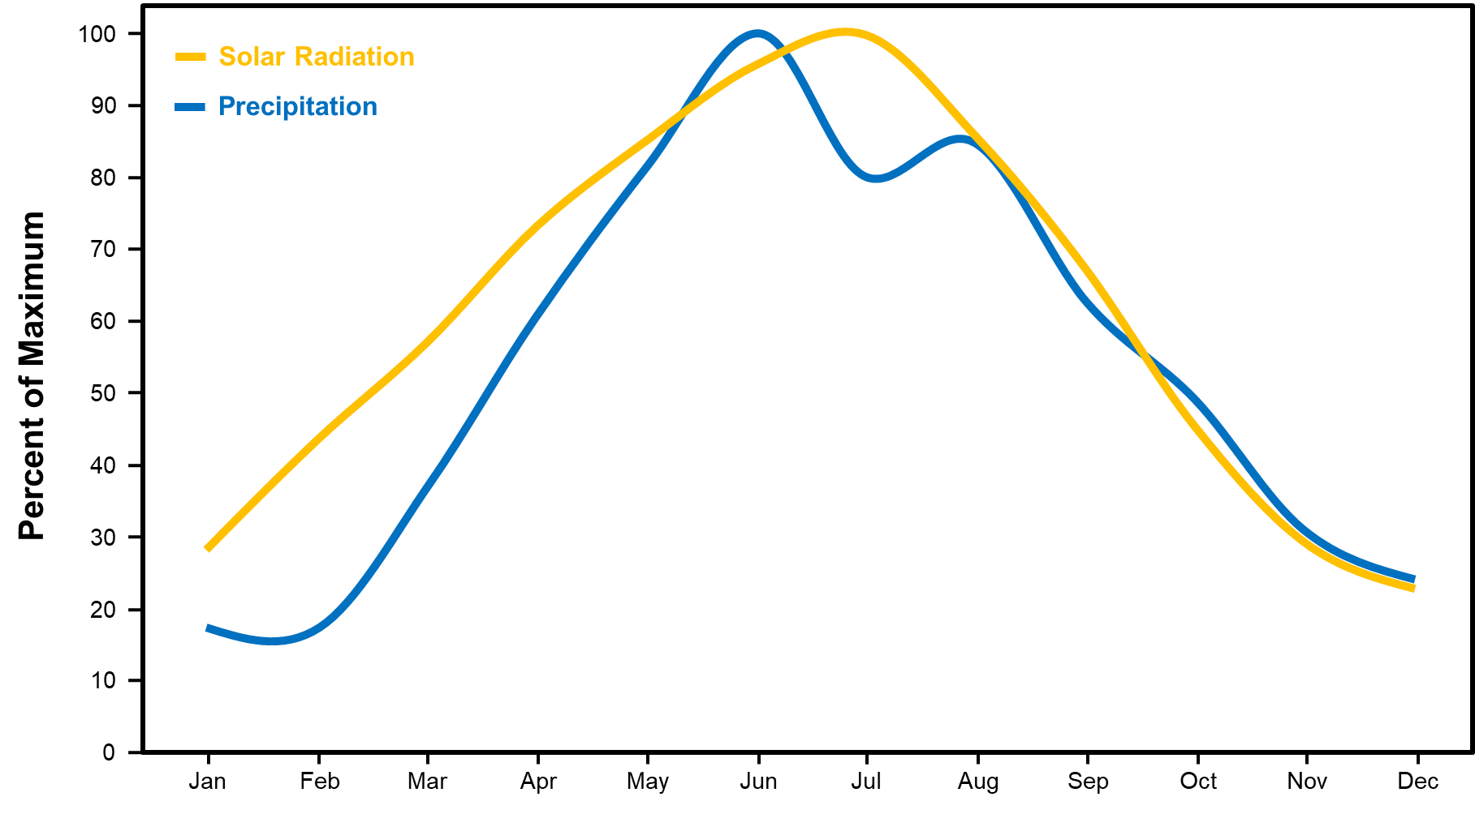
Current Seasonal Midwest Landscape Cover
Slide: Mitch Hunter

Slide 4
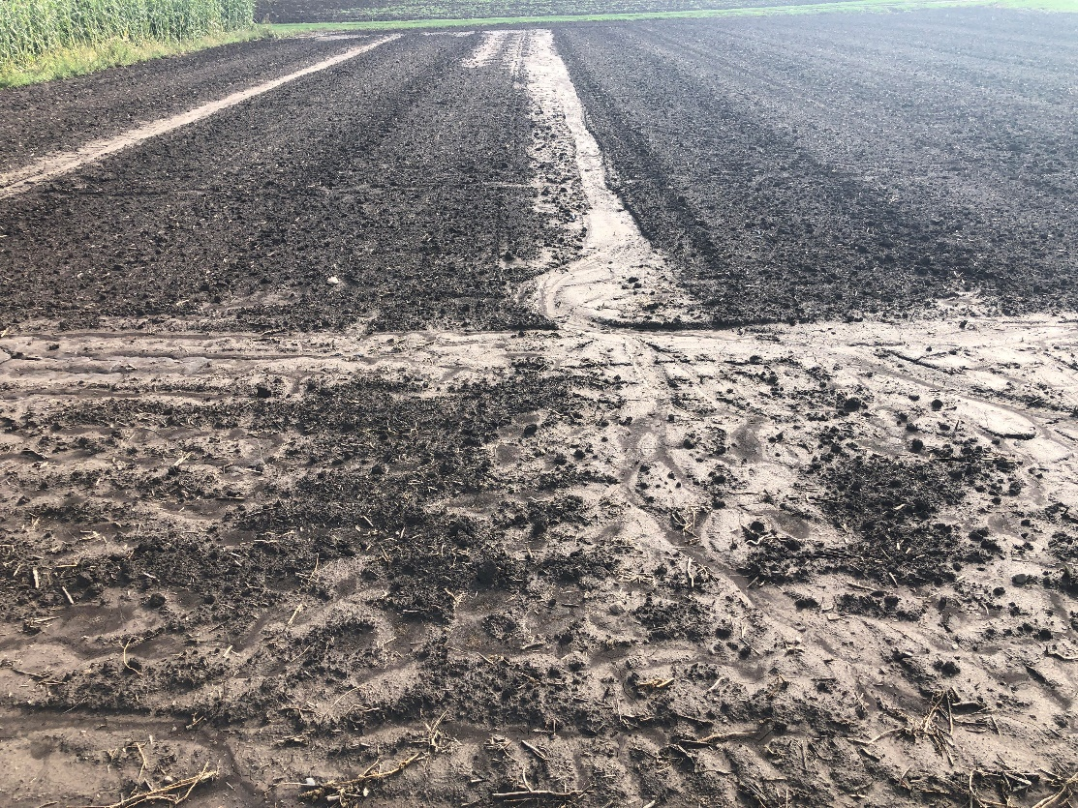
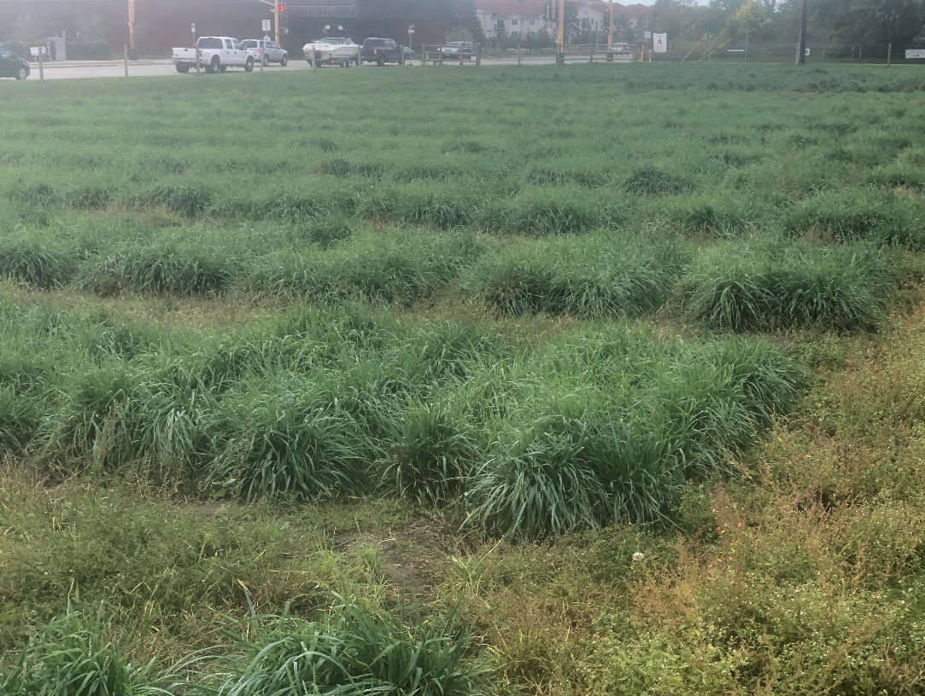
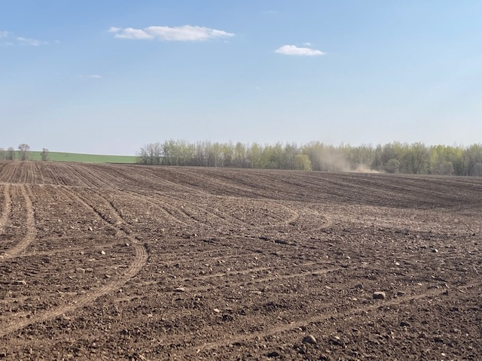
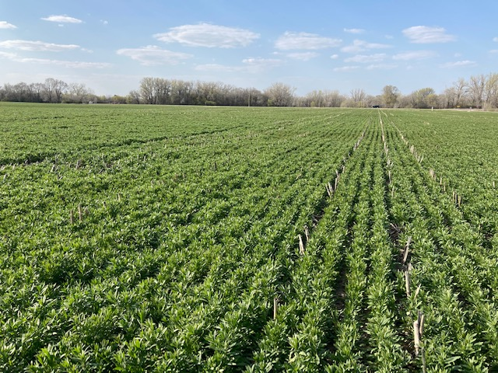
Continuous Living Cover Cropping Systems
Fall tilled field following 1” rainfall
Fall Kernza following 1” rainfall
1. Less erosion and P loss
2. Less nitrate leaching
April field prep for summer annual crops
April winter Camelina
1. Less erosion and P loss
2. Less nitrate leaching

Slide 5
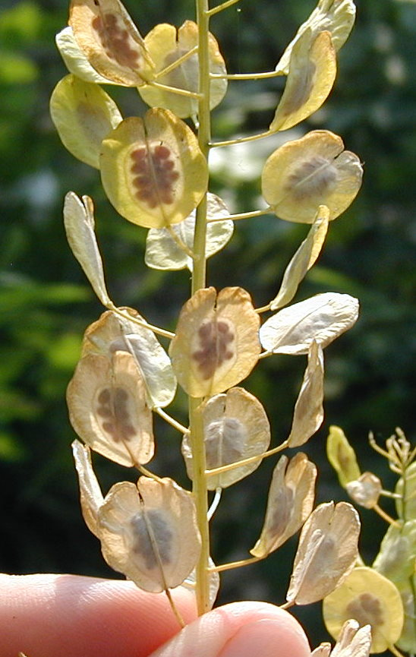
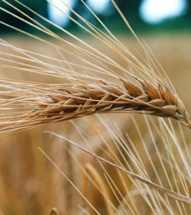
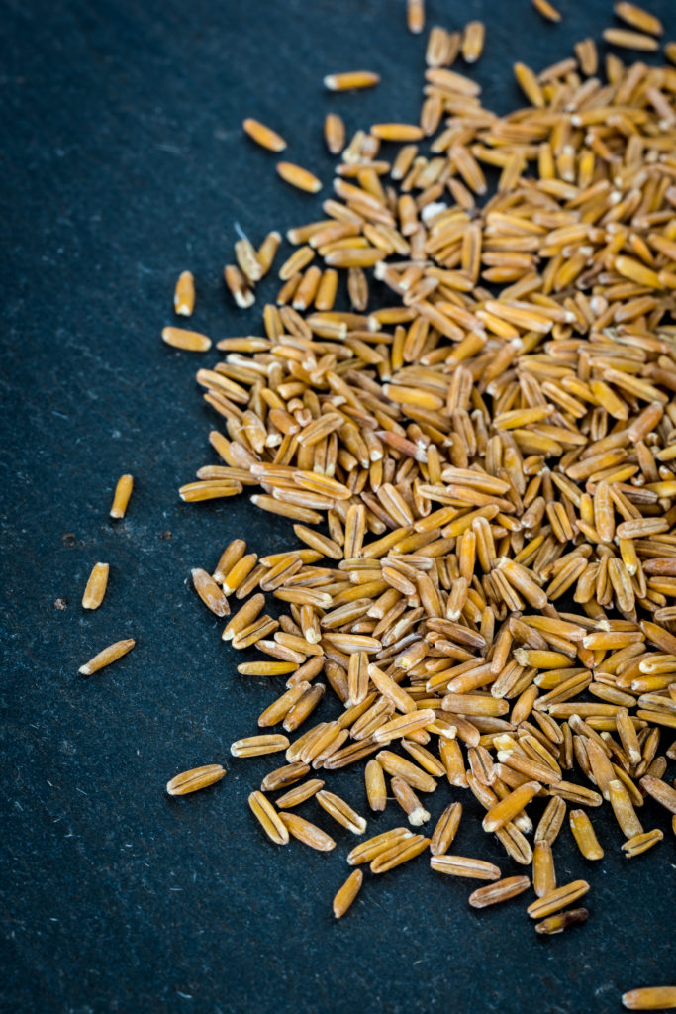
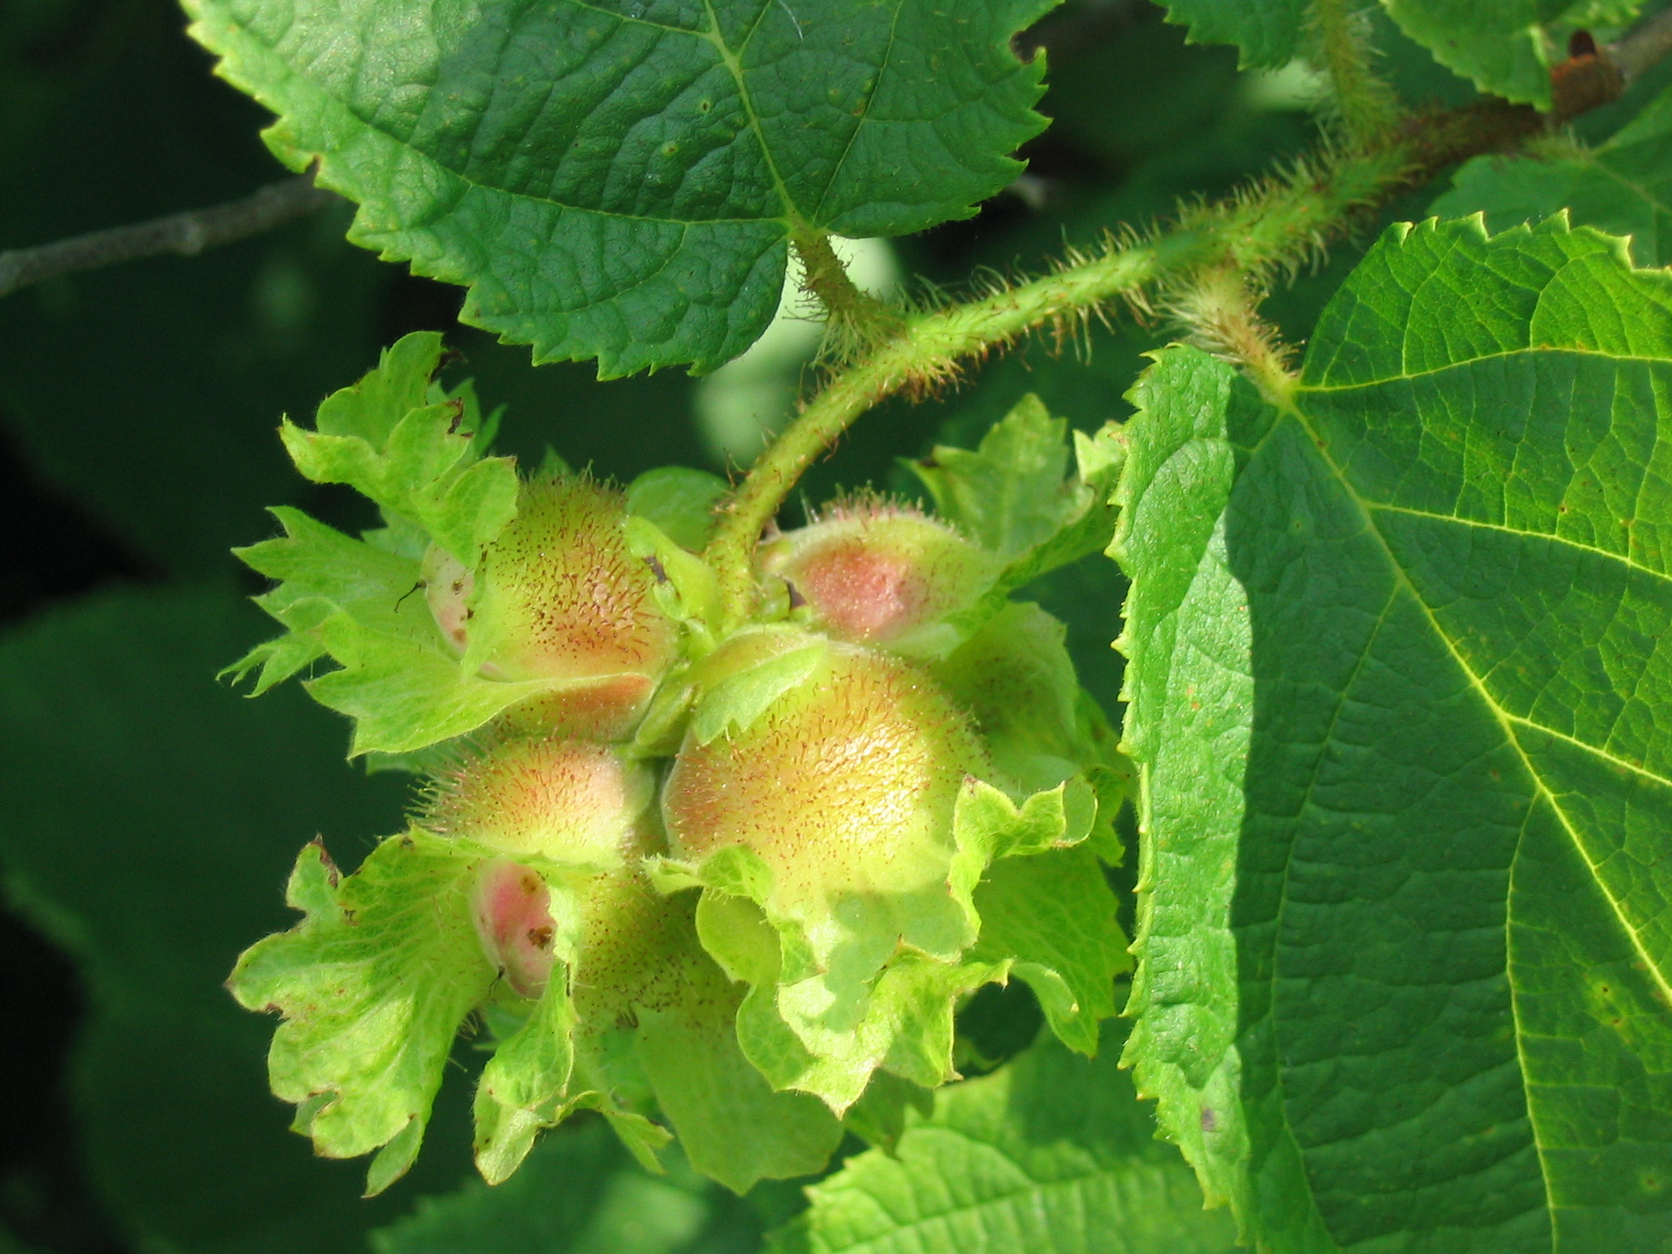
Forever Green Crops Provide: New, Unique Food, Feed and Energy Products for Commercialization
Oils
Fiber
Protein
Phytonutrients
Notes:
Proteins
Fiber
Oils
Phytonutrients

Slide 6
Forever Green Crops and Cropping Systems Provide: New Economic Opportunities
High Value Food, Feed and Energy Ingredients
Green Marketing: Ecosystem Services, Green House Gas Reduction
Innovative Healthy Food Products
New Economic Opportunities for Farmers and Rural Communities

Slide 7
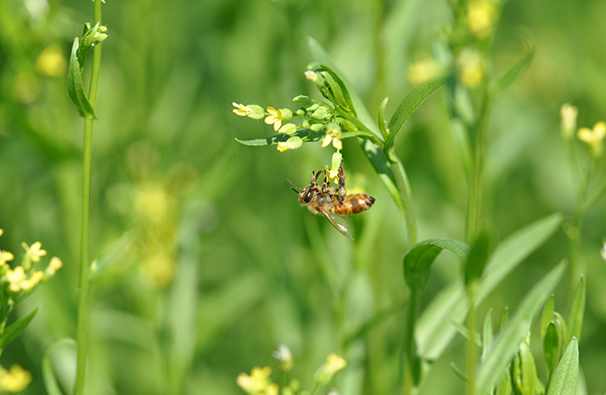
Forever Green Crops Also Provide: Environmental Services
Soil health
Clean water
Nutrient management
Pollinator habitat
Carbon sequestration
Soil protection

Slide 8
How do we get these plants on the landscape? Collaboration across disciplines in both public and private sectors
Plant Breeding and Genomics
Agronomics
Food Science
Commercialization
Supply Chain Development

Slide 9
WINTER ANNUAL CROPS:
Pennycress – edible oil & protein, biofuel
Camelina – edible oil & protein, biofuel
Winter barley – food, malting barley
Hairy vetch – N-fixing cover crop
Winter and spring field pea – food grade protein
Winter Hybrid rye—food and feed grain
NATIVE WOODY CROPS:
Hazelnuts – edible nut with oil/protein
Shrub willow – biomass
Elderberry – antioxidant-rich fruit
Agroforestry – woody, herbaceous crop mixtures for feed, food, and fuel
PERENNIAL CROPS:
Intermediate wheatgrass “Kernza” – grain, forage, biomass
Perennial sunflower – edible seeds, oil & protein
Native polyculture grassland mixtures – biomass, forage natural products
Perennial flax – edible oil and protein
Kura clover – N-fixing cover crop
Silphium – edible oil and protein
Alfalfa – food grade protein and feed
Perennial Cereal Rye--food and feed grain

Slide 10
Brief summary of outcomes supported in-part by Previous State of Minnesota Funds
State funds leveraged 5-fold
16 coordinated Forever Green Crop development platforms
MN-Clearwater Kernza variety
Winter barley variety
Winter hardy hairy vetch variety
6 hazelnut lines for on farm evaluation
Short season winter camelina line
Domesticate pennycress, a winter hardy oil seed crop
Coordination of FGI with MN communities, seed companies, farmers, grain processors, and commercialization and supply chain network.

Slide 11
Projected five-year outcomes from proposed investment:
2 varieties of Kernza for commercialization
2 short season winter Camelina varieties for commercialization
2 varieties of full domesticated pennycress varieties for commercialization
10 Hazelnut lines for commercialization
3 lines of winter hardy field pea for commercial evaluation
2 varieties of winter hardy barley for commercialization
3 varieties of perennial flax varieties for commercialization
Incorporate Forever Green Crops into thousands of acres of cropping systems in Minnesota
Expand coordination of FGI with MN communities, seed companies, farmers, grain processors, and commercialization and supply chain network.
Educational and workforce development opportunities for many Undergraduate Students, Graduate Students, Postdoctoral Researchers and Research Technicians to support Agriculture and Food Industry in Minnesota

Slide 16
Thank you, for your support on behalf of the undergraduate students, graduate students, postdoctoral researchers, faculty, farmers, processors and end users that have been or will be associated with the Forever Green Initiative.

