Slide 1
Minnesota Department of Agriculture House Committee on Agriculture Finance
Matthew Wohlman, Deputy Commissioner
January 26, 2017

Slide 2
Agenda
Overview of Minnesota Agriculture
Overview of the MDA
Ag Marketing and Development
Pesticide and Fertilizer Management
Dairy and Meat Inspection
Food and Feed Safety
Plant Protection
Laboratory Services
Governor’s FY 18-19 Budget Proposals

Slide 3
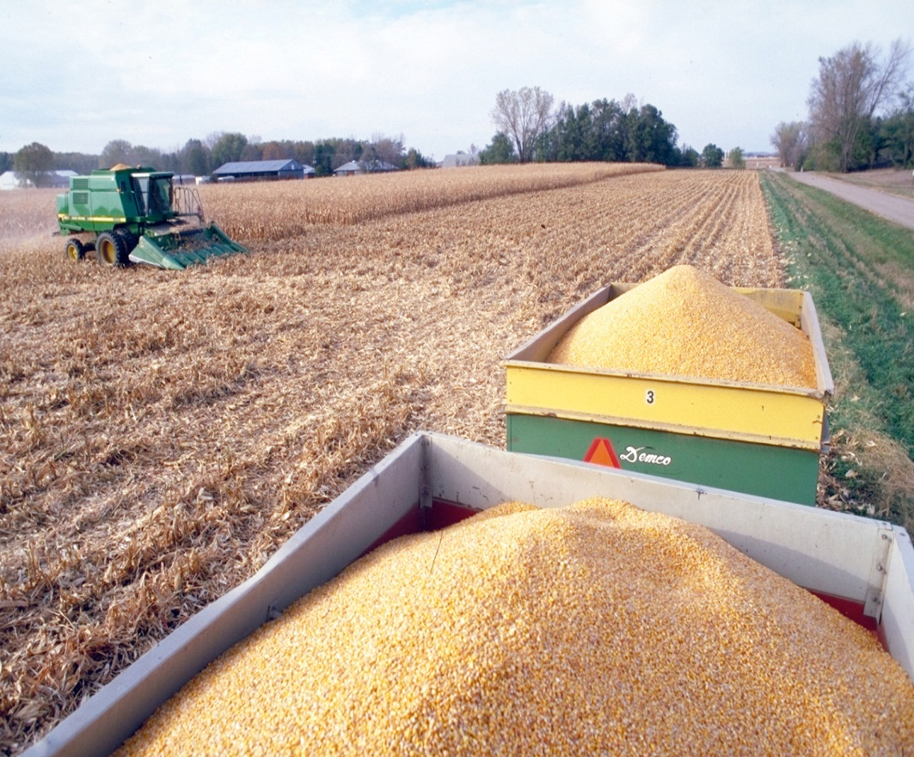
Minnesota Agriculture
Agriculture is the cornerstone of Minnesota’s economy
90 billion – total output generated
340,000 – total jobs supported
73,600 farms
352 acres – average farm size

Slide 4
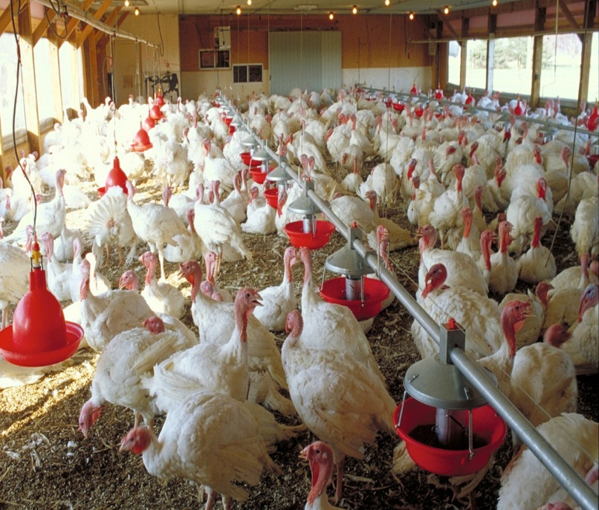
Minnesota Agriculture
Our agriculture sector is successful because of its diversity
Minnesota ranks 5th in crop production and 7th in livestock production
Major commodity top rankings:
#1 in turkeys, sugar beets
#2 in hogs
#3 in soybeans, spring wheat
#4 in corn
#6 in red meat, milk cows, cheese
#9 in potatoes
#10 in cattle

Slide 5
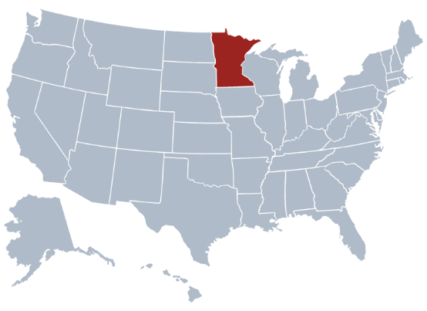
Minnesota Agriculture
Minnesota is home to leading food companies and agribusinesses
Fortune 500 Forbes
CHS Cargill
Supervalue Rosen’s Diversified
General Mills Schwan Foods
C.H. Robinson Worldwide
Land O’ Lakes
Hormel Foods
Mosaic

Slide 6
Minnesota Agriculture
Trade is critical to Minnesota’s ag economy
Total agricultural exports: $6.3 billion
Soybeans $1,599M
Corn $1,275M
Pork $740M
Wheat $459M
Sugar/Products $359M
MN ag exports generate:
$8.7 billion in total business activities
Over 46,000 jobs in all economic sectors

Slide 7
Minnesota Agriculture

Slide 8
Minnesota Agriculture
Trends in 2017:
Consumer expectations for safe food
Increased focus on environment
Growth in local, organic foods
Growth in international trade
Emergence of new biofuels
Growing consumer interest in where their food comes from

Slide 9
MDA Mission
Our mission is to enhance Minnesotans’ quality of life by ensuring the integrity of our food supply, the health of our environment and the strength of our agricultural economy.

Slide 10
MDA Mission
We have two main areas of responsibility:
We are the primary state agency responsible for protecting the state’s food supply and a key player in protecting the state’s natural resources.
We are the primary agency responsible for supporting and promoting the state’s ag industry and economy.

Slide 11
Minnesota Department of Agriculture
MDA Funding Sources – 2017 – not including loan programs

Slide 12
Minnesota Department of Agriculture
Commissioner
Dave Frederickson
Deputy Commissioner
Matthew Wohlman
Assistant Commissioner
Susan Stokes
Assistant Comissioner
Andrea Vaubel
Finance & Budget
Steve Ernest
Rural Finance Authority
Matt McDevitt
Human Resources
Mandy Papenguth
Dairy & Meat Inspection
Nicole Neeser
Food & Feed Safety
Ben Miller
Pesticide & Fertilizer Management
Joshua Stamper
Laboratory Services
Gary Horvath
Ag Marketing & Development
Mary Hanks
Plant Protection
Geir Friisoe

Slide 13
Ag Marketing and Development
Paul Hugunin, Section Supervisor

Slide 14
Ag Marketing and Development
What we do:
The Ag Marketing and Development Division promotes the production and marketing of Minnesota food, fiber, feed and fuel.
We work to foster profitable agricultural pursuits that protect our natural resources while meeting the demands of the marketplace.

Slide 15
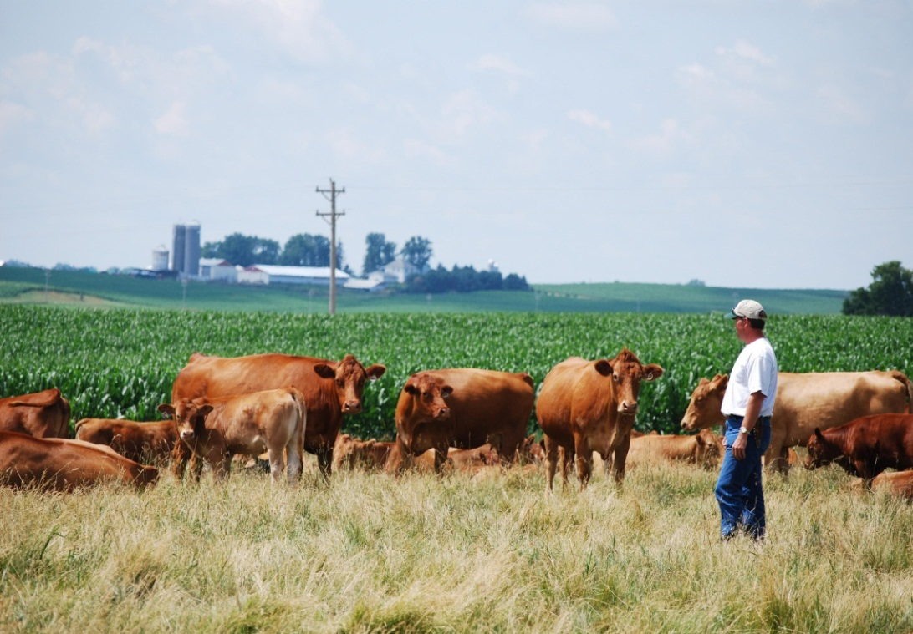
Ag Marketing and Development
Production Assistance
Access to Markets and Business Development
Education

Slide 16
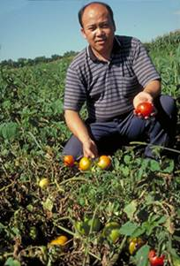
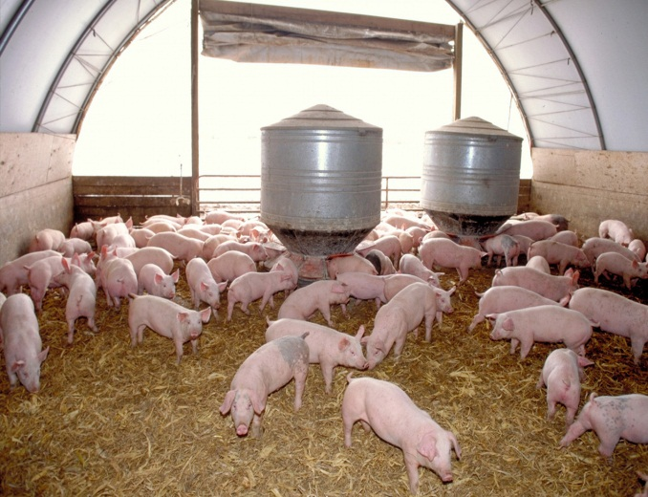
Ag Marketing and Development
Production Assistance
Livestock
Emerging ag water and conservation technology
Immigrant and underserved farmers
Biofuels
Local and organic foods
Crop research

Slide 17
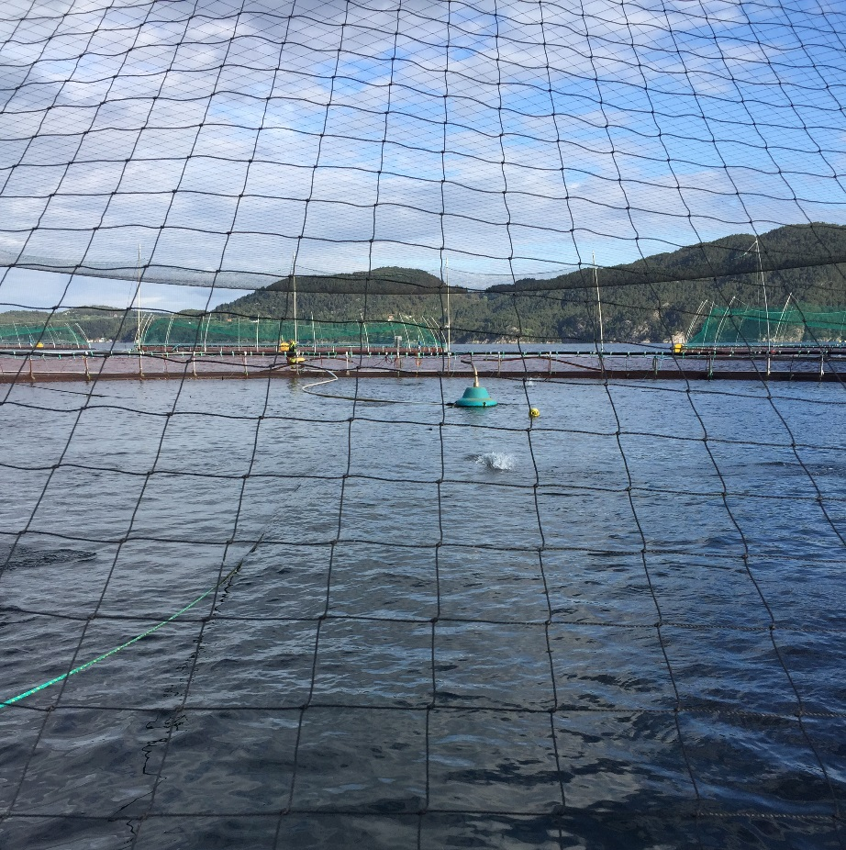
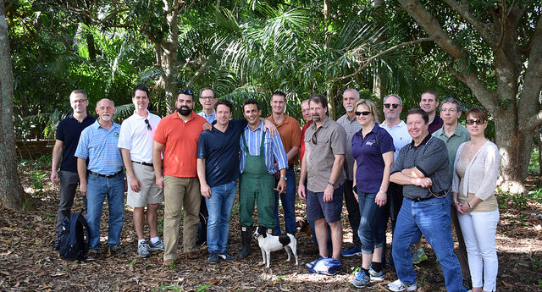
Ag Marketing and Development
Access to Markets
Minnesota Grown International Marketing

Slide 18
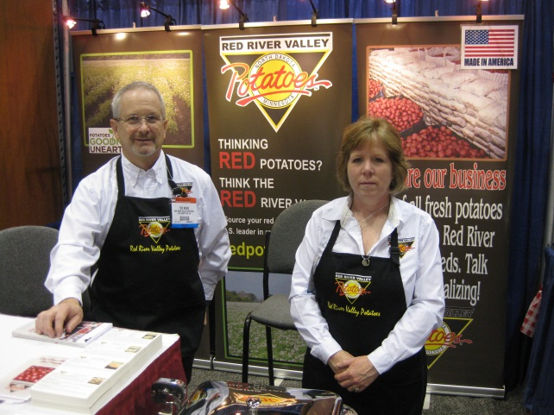
Ag Marketing and Development
Business Development
Information resource and support
Agricultural Growth Research and Innovation Grant Program (AGRI)
Livestock Investment
Value Added Business
Farm to School
Beginning and Transitioning Farmer
Trade Show Support
Blender Pumps

Slide 19
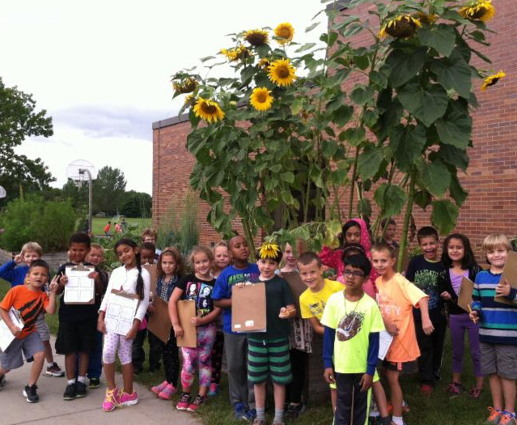
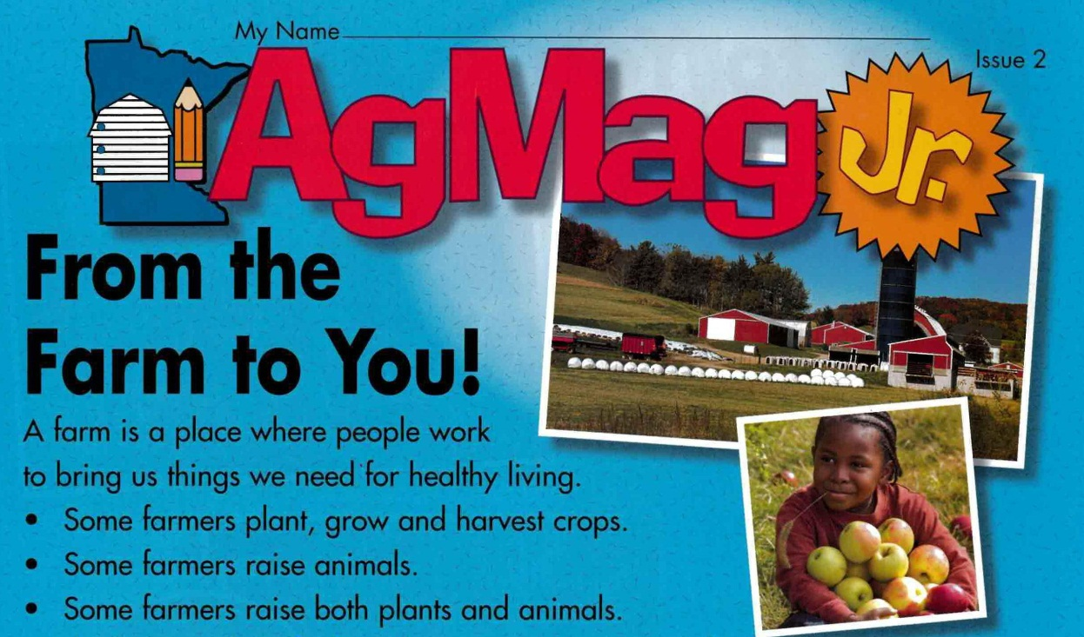
Ag Marketing and Development
Education
Minnesota Agriculture in the Classroom

Slide 20
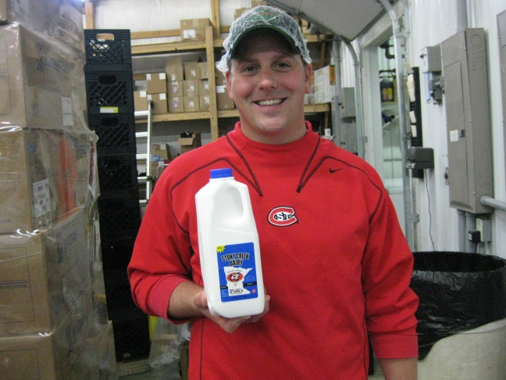
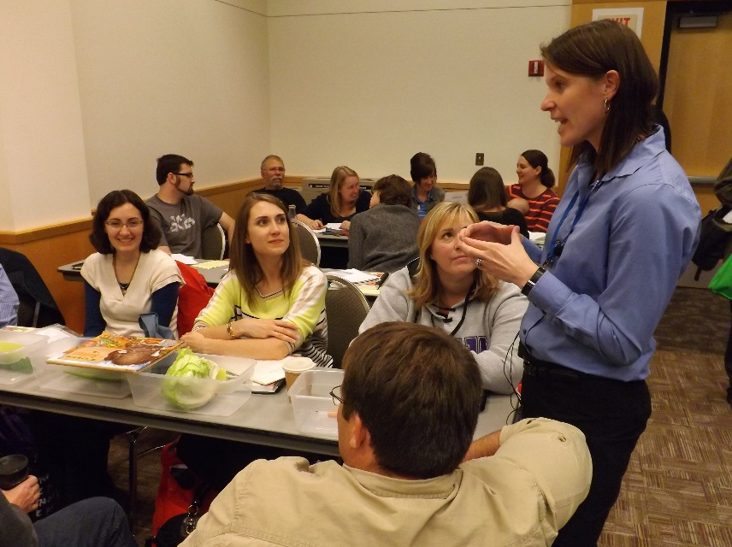
Ag Marketing and Development
Performance Measures
Percent of elementary and middle schools using Ag in the Classroom’s Ag Mag increased from 40% in 2012 to 46% in 2016
Unique visitors to the MN Grown Directory website increased from 240,000 in 2011 to 308,000 in 2015

Slide 21
Ag Marketing and Development
Highlights at Glance
612 farmers and processors attended the 2016 Organic Conference hosted by MDA
75 farmers are using Farm Link to assist with transition of farm ownership

Slide 22
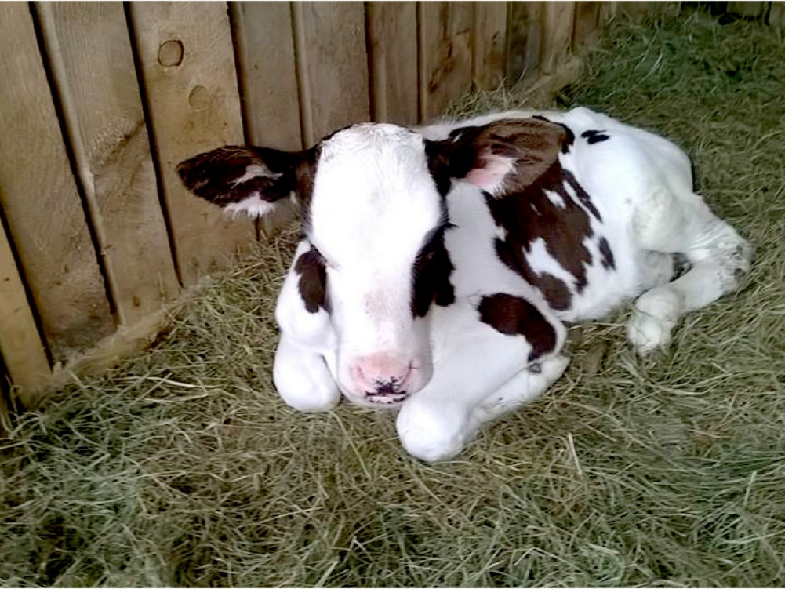
Ag Marketing and Development
Highlights At A Glance
Annual $10.235 million investment in AGRI matched by $60.3 million in private investment
118 livestock operations assisted with Livestock Investment Grants, 100 were beginning farmers

Slide 23
Ag Marketing and Development
FTE’s: 38.2

Slide 24
Pesticide and Fertilizer Management
Joshua Stamper, Director

Slide 25
Pesticide and Fertilizer Management
What we do:
Pesticide regulation
Fertilizer regulation
Protection of groundwater from ‘ag chemicals’
Emergency response
Spills and clean-up
Waste pesticide collection
Minnesota Agricultural Water Quality Certification Program (MAWQCP)

Slide 26
Pesticide and Fertilizer Management
How we do this:
We work with farmers, regulated industry and interested parties
We employ 123 agronomists, soil scientists, and hydrologists (40% in greater MN)
Many staff have graduate degrees, a farm background, and some still farm
PFMD Budget ~$27 million/year, mostly from fees and Clean Water Fund

Slide 27
Pesticide and Fertilizer Management
Our regulatory activities include:
Pesticide/fertilizer product registration
Applicator licensing
Complaint response
Facility inspection
Emergency response
Anhydrous ammonia regulation

Slide 28
Pesticide and Fertilizer Management
Our incident response activities include:
Emergency site cleanup
Long-term site cleanup
Voluntary cleanup
Agricultural Chemical Response Reimbursement Account (ACCRA)
Superfund

Slide 29
Pesticide and Fertilizer Management
We are also responsible for addressing:
Non-point source impacts to groundwater from nitrate from fertilizer
Non-point source impacts to surface water and groundwater from pesticides
Other health or environmental risks from pesticides
Water quality monitoring for pesticides and nitrate

Slide 30
Pesticide and Fertilizer Management
We seek to:
Make decisions based on best available science
Protect water resources AND support a strong agricultural economy
Involve the agricultural community and other stakeholders in developing practical solutions
Build relationships and coordinate with other programs and plans

Slide 31
Pesticide and Fertilizer Management
Pesticide non-point activities:
Pesticide Management Plan for water resource protection
Pesticide Best Management Practices
Product registration

Slide 32
Pesticide and Fertilizer Management
Fertilizer non-point activities:
Nitrogen Fertilizer Management Plan for nitrate in groundwater
Fertilizer best management practices (BMPs)
Technical assistance for impaired waters
Funding priority research
Certification of Soil and Manure Testing Labs

Slide 33
Pesticide and Fertilizer Management
Water monitoring activities:
Long-term pesticide monitoring (25 years)
Edge-of-field and tile line monitoring
Monitoring private wells for nitrate
Coordinate with other monitoring programs
Annual monitoring reports

Slide 34
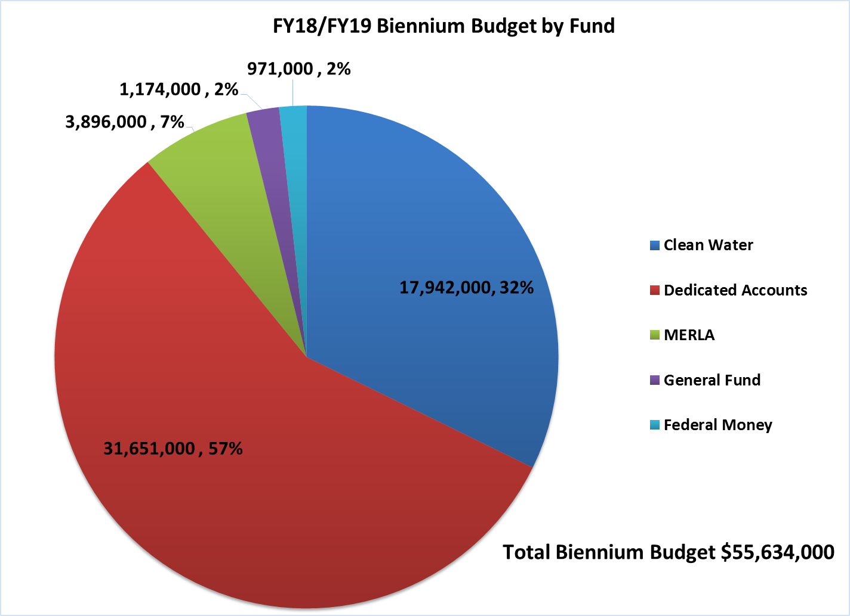
Pesticide and Fertilizer Management
MDA Budget by Fund:

Slide 35
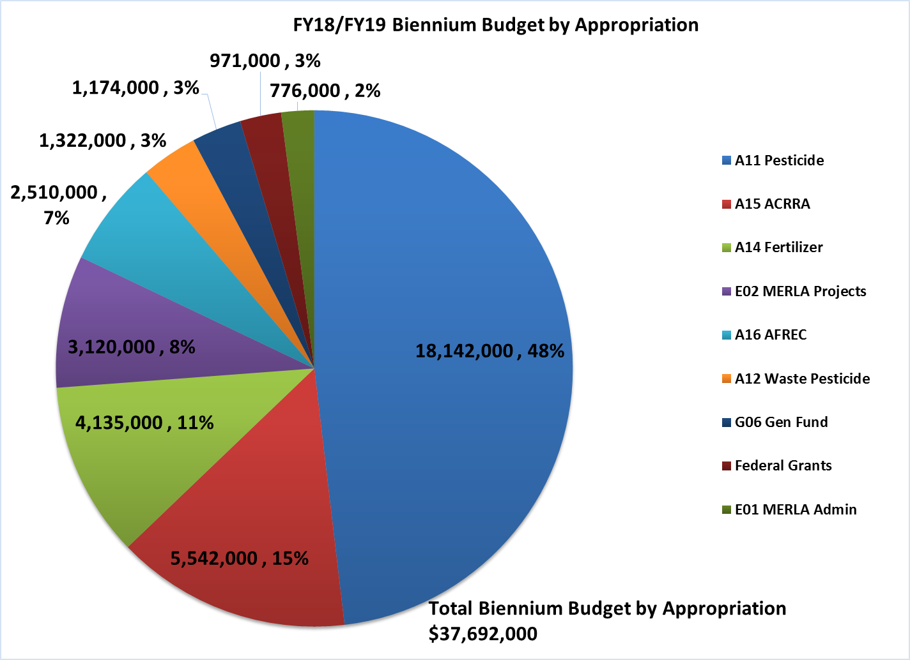
Pesticide and Fertilizer Management
Dedicated Accounts:

Slide 36
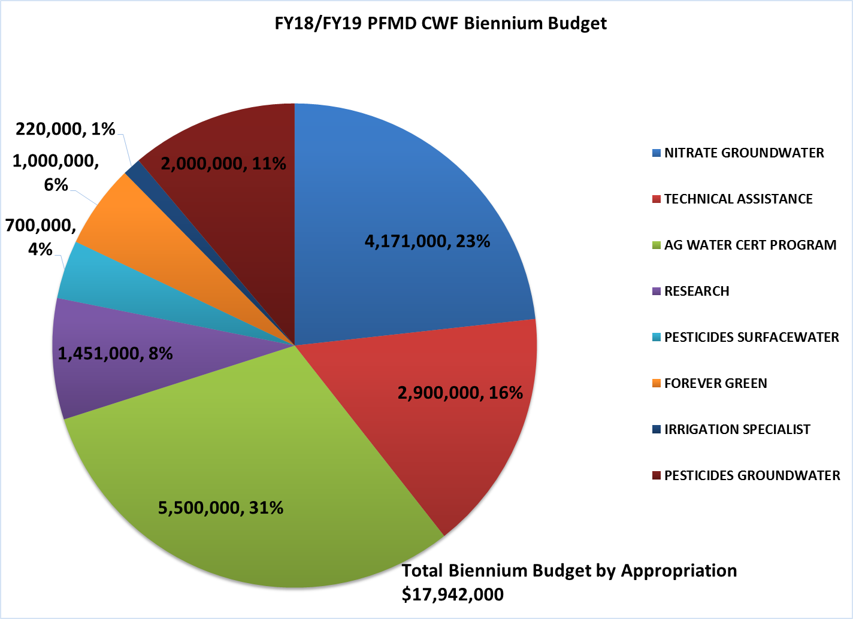
Pesticide and Fertilizer Management
Clean Water Fund:

Slide 37
Dairy and Meat Inspection
Dr. Nicole Neeser, Director

Slide 38
Dairy and Meat Inspection
What we do:
Ensure the safety of the food supply by conducting regulatory based inspection work for dairy, meat, poultry and egg products
Ensure dairy and meat products and our associated regulatory programs meet the standards necessary for commerce
Interstate commerce of dairy products
Intrastate commerce of meat and poultry products
Respond to emergencies and outbreaks

Slide 39
Dairy and Meat Inspection
How we do this:
Ensure safe food handling practices are used from the farm to manufacturer during on-site inspections
Collect samples to monitor product safety
Conduct outreach and educational activities with farmers and manufacturers
Certify industry personnel to conduct temporary or cooperative inspection work
Provide guidance to prospective or new operators on how to meet the requirements
Issue certificates to Minnesota dairy and meat companies so that they can sell their products internationally

Slide 40
Dairy and Meat Inspecction
Dairy and Meat Inspection are major program areas
Major funding sources are General Fund, fees and Federal
53.4 FTE’s, many support functions cross programs
Dairy: 14.25 Field Inspection FTE’s conducted over 8,800 inspections
Meat: 16 Field Inspection FTE’s conducted over 11,000 inspections
Compliance officers, operations, outreach, audits, supervision, veterinarian

Slide 41
Dairy and Meat Inspection
Dairy Inspection
Dairy Farms
3026 Grade A, 232 Grade B
Manufacturing (62) and Grade A (30) Plants
Tankers and Haulers (about 900 licensed)
FY 18-19 Budget:
$2,406 General Fund (35%)
$4,421 Agricultural Fund - Fees (65%)
Current Trends: Small dairy manufacturing plants, goat milk production increasing
Inspection for Safety, Required for Interstate Commerce
Inspection Type | Number of Inspections CY 2016
Dairy Farm | 7140
Dairy Plant | 1308
Tankers | 405
Haulers | 399
Total | 8883

Slide 42
Dairy and Meat Inspection
Meat Inspection
State ‘Equal To’ Meat Inspection Program
Small plants can wholesale product in MN
Requirements similar to USDA Food Safety Inspection Service
Daily Inspection (Continuous) per the Federal Meat Inspection Act
Custom Exempt (Not for Sale, for Farmers, Direct Marketing)
Budget FY 18-19
$2,280 General Fund, $2,722 Federal
Approximately 50%/50% split
Trends are increasing ‘Equal To’ plant numbers, more ethnic/nontraditional slaughter and processing
Inspections for safety, required to wholesale products
Calendar Year | Number of New Plants
2014 | 3
2015 | 1
2016 | 6
2017 | +10 (expected)

Slide 43
Dairy and Meat Inspection
Other Programs | Source of Funding | FY 18-19 Amount (1,000’s)
Northeastern Regional Correctional Institute, Butcher Training Pilot Program Coordination | General Fund | 150
USDA Shell Egg Surveillance | Rest. Special Revenue, 100% Reimbursement Program | 38
Poultry Grading | Rest. Special Revenue, 100% Reimbursement Program | 212
State Egg Inspection | Agricultural Fund, Fees | 84
Drug Residue Prevention Outreach | Federal, FDA Cooperative Agreement (Sept 2016 – Aug 2018) | 125
Venison Donation | Misc Agency (Transfer from DNR) | 156

Slide 44
Questions?
Matthew Wohlman
Matthew.Wohlman@state.mn.us
651-201-6551

