Slide 1
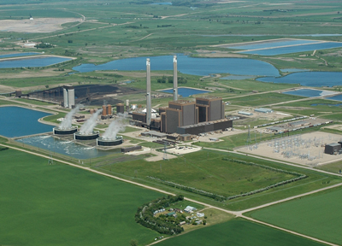
DryFiningTM Technology
Notes:
1
I am briefly going to describe a commercially available technology developed and patented by GRE which is being used on coal consumed 2 of our coal plants in ND. The technology involves an innovative use of waste heat to reduce moisture in the coal prior to combustion as well as a segregation technology removing higher density impurities in the coal prior to combustion. These two improvements (moisture removal and contaminant removal through segregation) primarily using waste heat is increasing plant efficiency, decreasing air emissions and saving the plant money in O&M costs through less wear and tear.

Slide 2
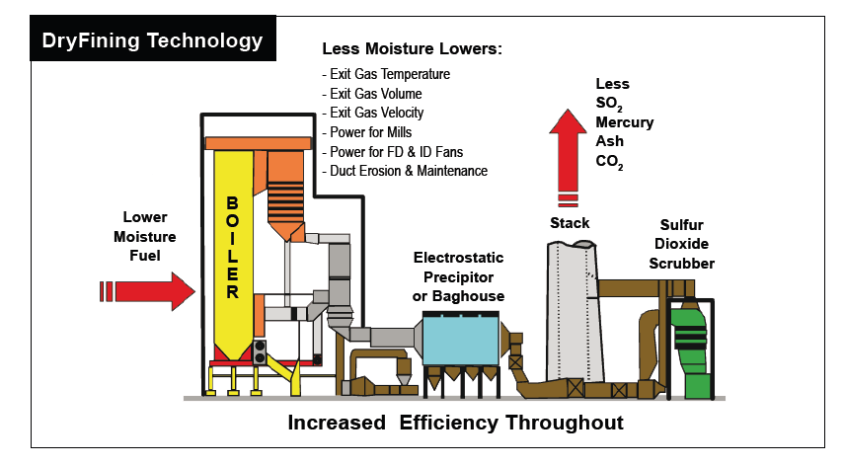
DryFiningTM improvements
Less Moisture and
Contaminants means:
Contaminant
Removal
NOx
Notes:
100 tons go into the coal dryer. In the first stage, 10 tons are segregated by density and go to the air jigs for removal of the heavier material (pyrites, clays, etc.). One ton is segregated out and disposed of in the ash ponds. The other nine tons are either sent to Spiritwood, or put back in the dried coal stream for use at Coal Creek. Of the 90 tons that remain in the dryer, eight tons of water are removed and go up the stack as vapor. This leaves 82 tons of coal dryer product, 91 tons if the air jig product is not going to Spiritwood, for consumption in the CCS boilers

Slide 3
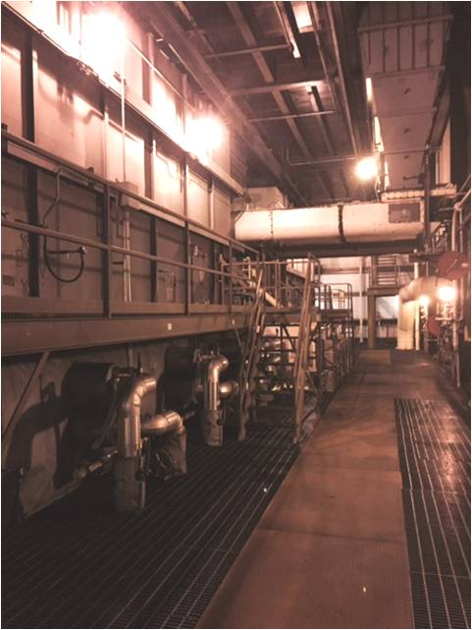
How it works
Notes:
100 tons go into the coal dryer. In the first stage, 10 tons are segregated by density and go to the air jigs for removal of the heavier material (pyrites, clays, etc.). One ton is segregated out and disposed of in the ash ponds. The other nine tons are either sent to Spiritwood, or put back in the dried coal stream for use at Coal Creek. Of the 90 tons that remain in the dryer, eight tons of water are removed and go up the stack as vapor. This leaves 82 tons of coal dryer product, 91 tons if the air jig product is not going to Spiritwood, for consumption in the CCS boilers

Slide 4
DryFining impacts
10% less fuel – reduces O&M on fuel handling
54% less SO₂ - Segregation of ash minerals, plus improved collection efficiency
40% less Hg- Segregation of ash minerals, plus improved collection efficiency
32% less NO_{X}- Reduced volumetric release rate, improved air & fuel distribution to furnace
4% less CO₂- 4% improved cycle efficiency
$20+ million in annual O&M savings

Slide 5
Efficiency improvement

Slide 6
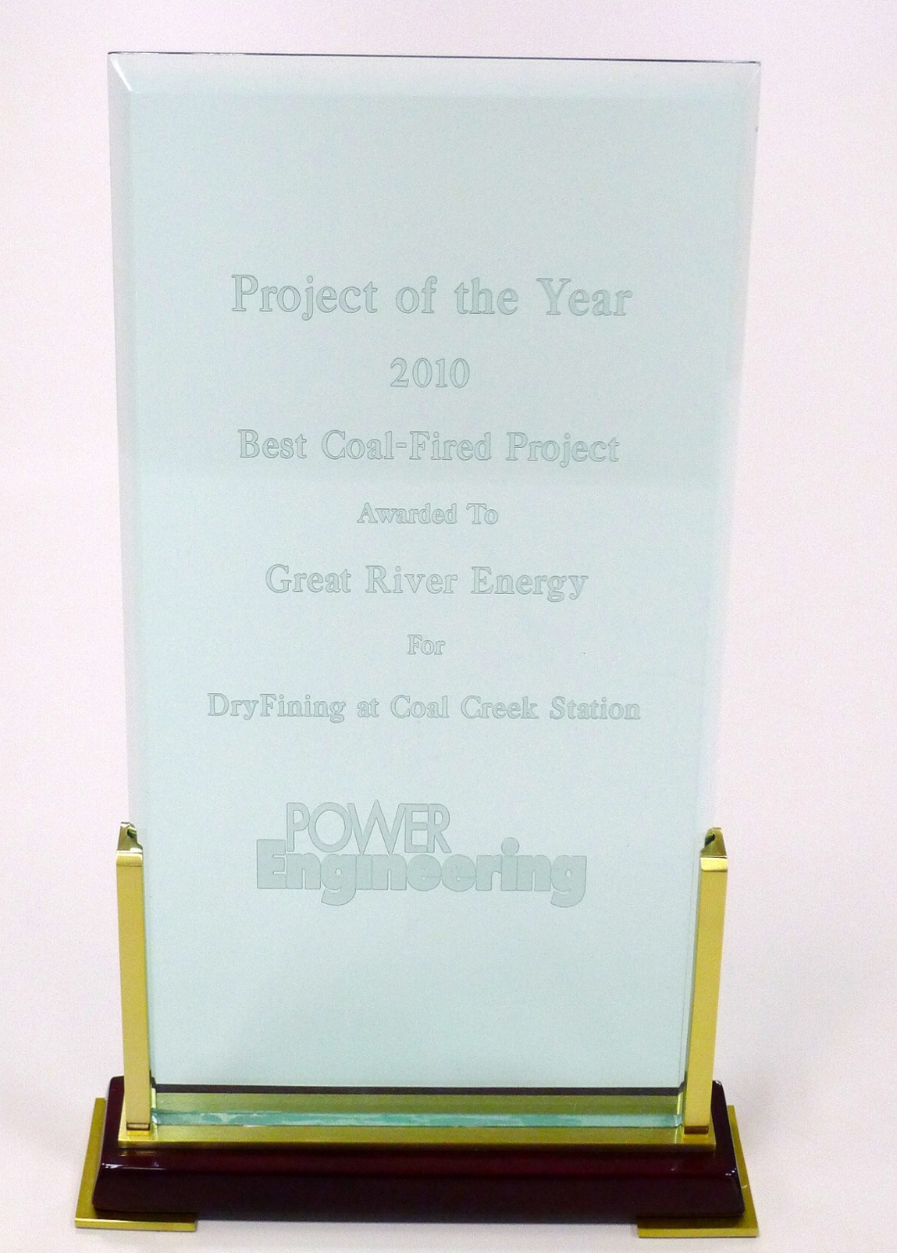
DryFining results at Coal Creek
Conferences, journal articles & awards
Marketing agreements:
Black & Veatch
In discussion with others
International recognition

Slide 7
Thank you!

