Slide 1
Minnesota Department of Public Safety
Commissioner John Harrington
BCA Superintendent Drew Evans

Slide 2
Department of Public Safety
Transportation
Policy and Finance Committees
Public Safety and Criminal Justice Reform Finance and Policy Committee
Minnesota State Patrol
Alcohol and Gambling Enforcement
Fire Marshal Division
Office of Traffic Safety
Office of Justice Programs
Driver and Vehicle Services
Emergency Communication Networks
Office of Pipeline Safety
Homeland Security and Emergency Management
Administration and Related Services
Bureau of Criminal Apprehension

Slide 3
Minnesota bureau of criminal apprehension

Slide 4
History
Established in 1927
Assist Minnesota peace officers in solving local crimes and apprehending criminals
Became part of DPS in 1969
Saint Paul Headquarters built in 2003
$65 million facility
226,000 sq. ft.
436 employees

Slide 5
BCA Mission
The Bureau of Criminal Apprehension prevents, investigates and solves crimes in collaboration with our criminal justice partners.

Slide 6
BCA Vision and Values
Delivering exceptional law enforcement services for a safer Minnesota.
Integrity – Excellence – Ingenuity - Partnerships

Slide 7
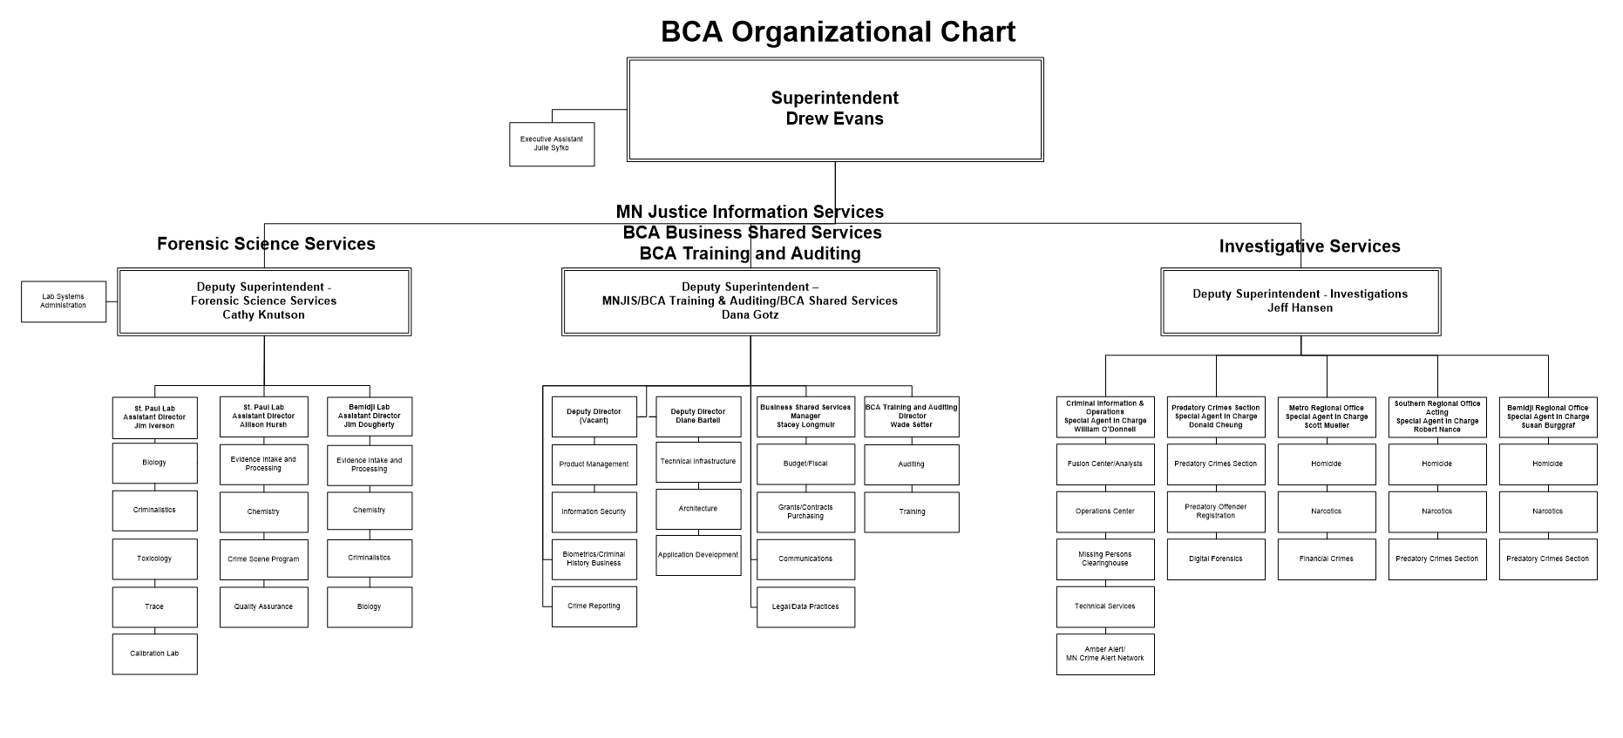
Organization

Slide 8
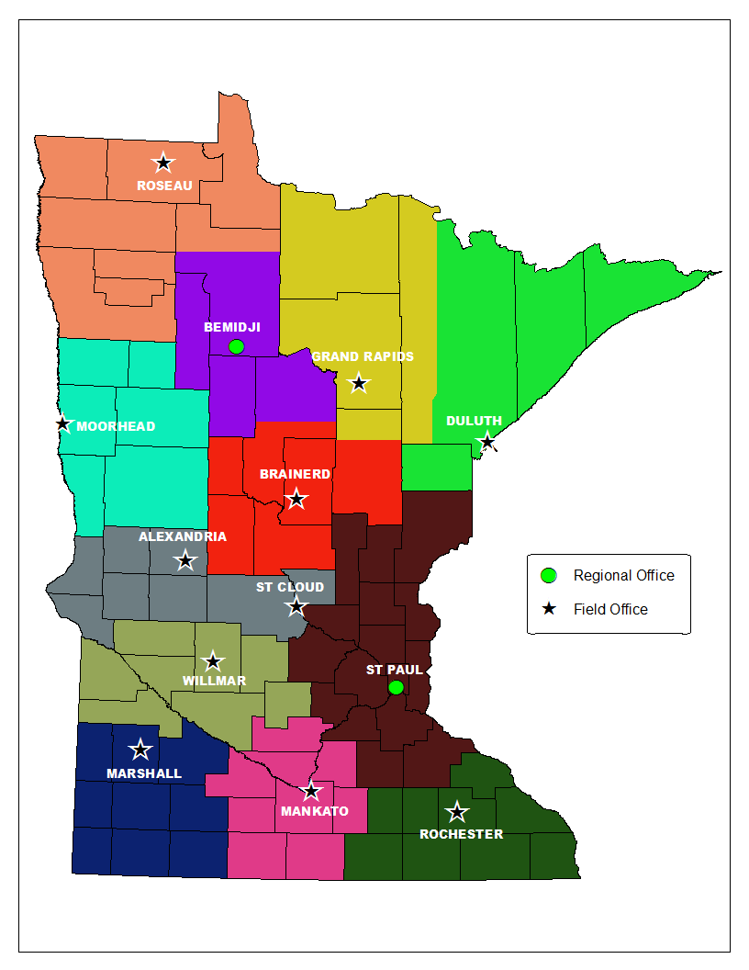
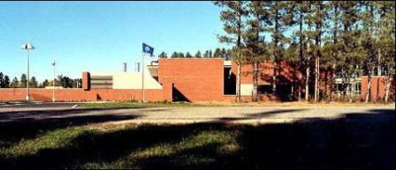
Statewide coverage
11 field offices
Bemidji Regional Office and Lab - 2001
St. Cloud field office - 2016

Slide 9
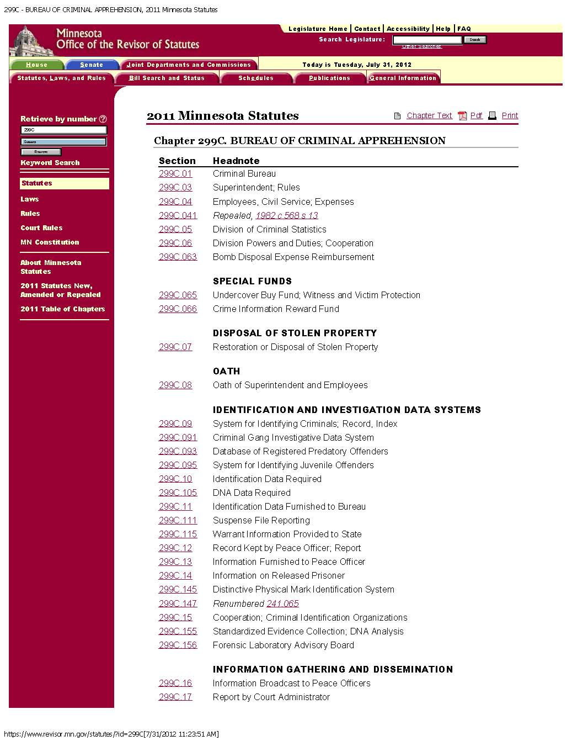
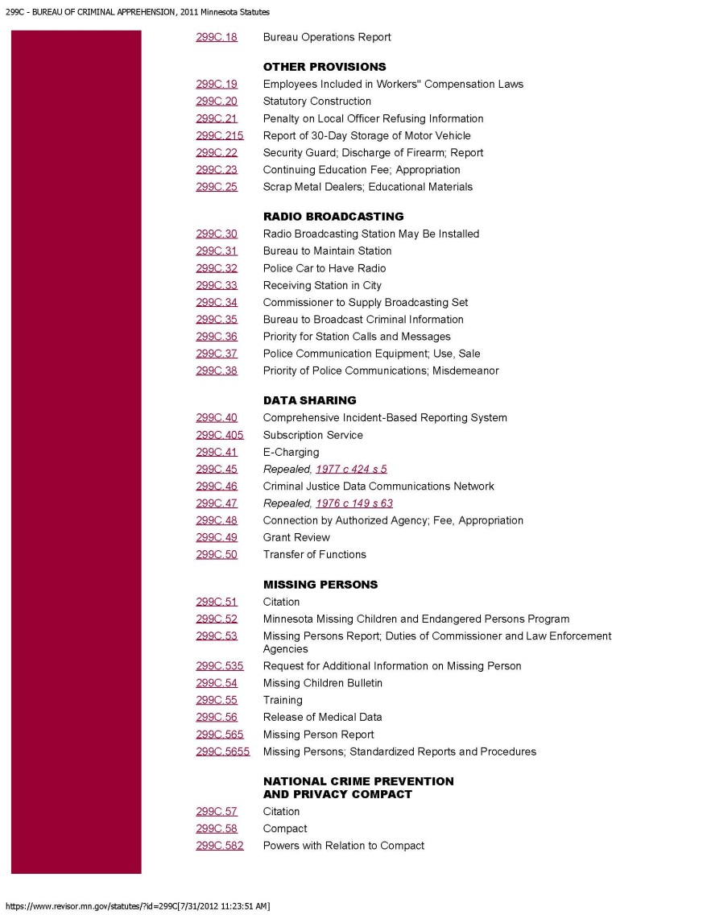
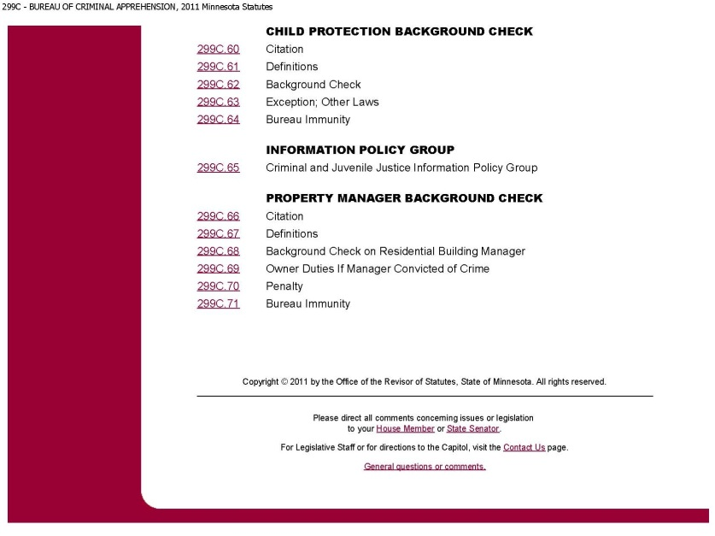
Minnesota Statute 299C
Notes:
Enabling Legislation – Grants the power to the agency

Slide 10
Bca budget – fy18 $59,960,000

Slide 11
BCA Staffing

Slide 12
Investigations Division
Deputy Superintendent Jeff Hansen

Slide 13
BCA Investigative Section
Predatory Crimes Section
Regional Offices
Homicide – Violent Crimes
Missing Persons
Special Investigations Unit
Task Force Agents
Technical Services Unit
Financial Crimes Task Force
Minnesota Human Trafficking Task Force
Minnesota Fusion Center

Slide 14
BCA Investigations Regional Offices
Violent Crime
Death investigations
Assist with cold case investigations
Officer involved shooting investigations
Conflict investigations
Critical incidents
Crime scene processing

Slide 15
BCA Investigations Regional Offices
Narcotics Investigations
Investigate high level narcotics traffickers
Perform undercover operations
Participate in Task Forces

Slide 16
BCA Investigations Task Force Operations
Federal Task Forces
Drug Enforcement Agency
Metro and Outstate
FBI Safe Streets Task Force
Safe Trails
Northern MN
US Marshal’s

Slide 17
BCA Investigations Predatory crimes section
Internet Crimes Against Children (ICAC)
Predatory Offender Investigations (POI)
Predatory Offender Registration (POR)
Human Trafficking

Slide 18
BCA Investigations Special Operations
Technical Services Unit
Pen registers
Conduct wiretap investigations
Install covert cameras
Electronic surveillance
Cellular tracking
Crime Scene response

Slide 19
Criminal Information and Operations
Minnesota Fusion Center
BCA Operations Center
BCA Duty Officer
Reactive Criminal Intelligence Analysts
Minnesota Missing Persons Clearinghouse
MN AMBER Alert Program
MN Crime Alert Program
MN Blue Alert Program
Notes:
Minnesota Fusion Center
Collect, analyze, disseminate information of data on organized criminal, terrorists and all-hazards activity in MN
State-based point of contact to coordinate information sharing between federal, state and local agencies (www.icefishx.org)
Moved into BCA HQ in 2013
Department of Homeland Security
secure communications room
Crime Alert – Approximately 250 alerts issued each month
RECENT ALERTS
Credit card skimming at gas pumps
Missing autistic child
Verizon store armed robberies
ID assist – Woodbury, St. Paul, Ramsey Co.
Duty Officer
Initiating Call Category
Air Quality
Bomb Squad
CAT/ERT
Information Call
FM Investigator
Methamphetamine Lab
Mutual Aid
National Guard/CAP/Aircraft
Nuclear Plant/Accident
Pipeline Incident (Break/Leak) SARA Title III Release
Search and Rescue
Spills
Supplemental
Tank Pulls (Contaminated Soil)
Waste Water Bypass
Weather Incident
WMD Threat
* A call may be recorded in more than one category
AMBER Alert program receives no funding.
All costs are covered by donations from Minnesota AMBER Alert Fundraiser, a non-profit group which raises approximately $20,000 each year. This money is dedicated to cover the costs during an AMBER Alert (MN Crime Alert Network) and to provide missing persons training statewide.

Slide 20
Forensic science services division
Deputy Superintendent Catherine Knutson

Slide 21
BCA Forensic Science Services
St. Paul
Full Service
Evidence Intake / Processing
Biology/DNA
Drug Chemistry
Latent Prints
Firearms and Toolmarks
Crime Scene
Digital and Multimedia
Trace / Chemical Testing
Toxicology
Calibration Laboratory
Bemidji
Targeted Service
Evidence Intake / Processing
Biology
Drug Chemistry
Latent Prints
Firearms and Toolmarks
Crime Scene
Digital and Multimedia
St. Cloud
Targeted Service
Evidence Intake / Processing
Drug Chemistry
*Spring 2019

Slide 22
BCA Forensic Science Services Additional Services Provided
Administers the Minnesota Breath Testing Program
Expert Testimony in Court
Training to Stakeholders
Technical Guidance
Research, Development and Validation of Up to Date Technology
Guidance in Quality Assurance Requirements
Serve on National Forensic Science Committees / Boards (SWG's/OSAC's/ASCLD)

Slide 23
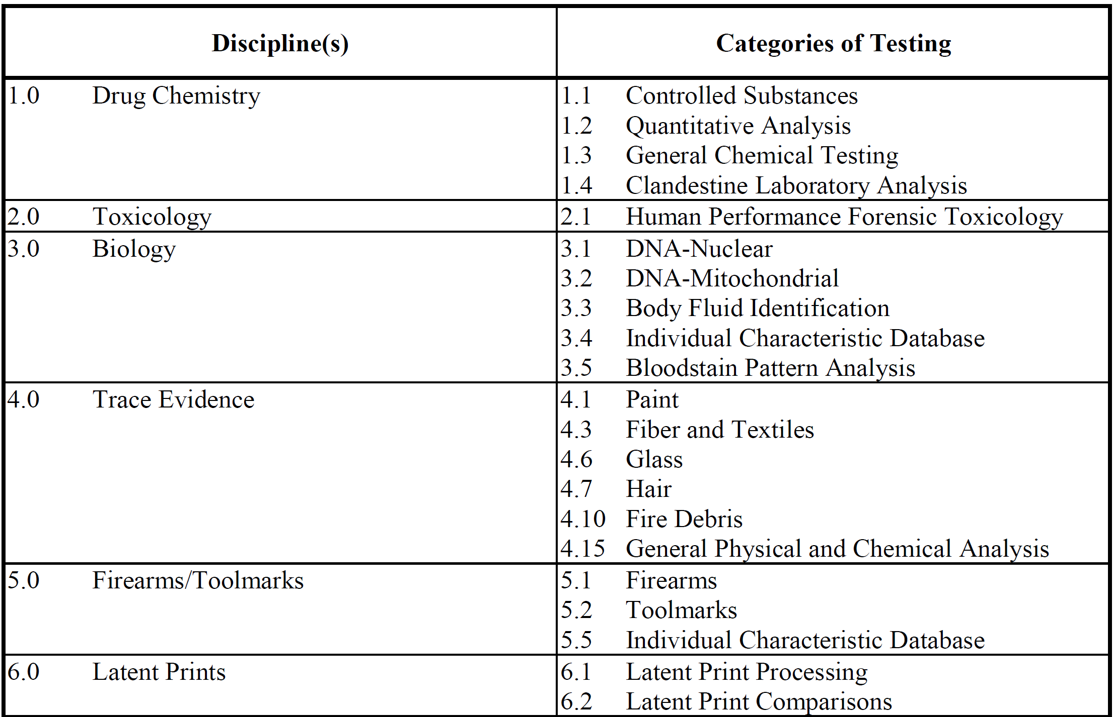
ASCLD/LAB Accreditation since 1994

Slide 24
LAB Case Submission Trends

Slide 25
Minnesota justice information services (MNJIS)
Deputy Superintendent Dana Gotz

Slide 26
MN Justice Information Services
State’s gateway to criminal justice information
More than 50 computer applications and services that provide data to criminal justice practitioners in Minnesota
142 Employees (53% IT, 47% Business)
Goal: To deliver accurate, timely, and complete information to criminal justice partners and citizens - for better decision-making

Slide 27
MNJIS Data Includes:
Criminal History (arrests, convictions, court dispositions)
Predatory Offenders
Law Enforcement Incidents
Driver & Vehicle Data
Fingerprints
Wanted/Missing Persons
Orders for Protection
Prison, Jail and Detention
Domestic Abuse No Contact Orders
Arrest/Booking Photos
Stolen Property
Charging Data (complaints, citations, incidents)
Other States’ Criminal History, Driver & Vehicle
Probation & Supervision

Slide 28
Other MNJIS Services
Criminal History Background Checks
Fingerprinting
Information Security
Statewide Crime Statistics
Service Desk
Data Practices
Educating and Marketing

Slide 29
Training and Auditing

Slide 30
Training and auditing
BCA statutory requirement to provide statewide training (M.S. 626.848)
Approximately 200 courses to 8,000+ students (2017)
Audit criminal justice agencies every 3 years for appropriate access and use of FBI and BCA data.

