Slide 1
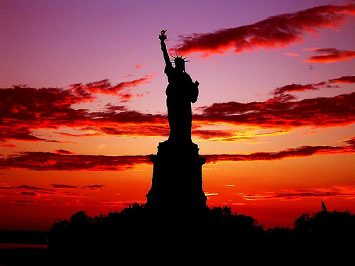
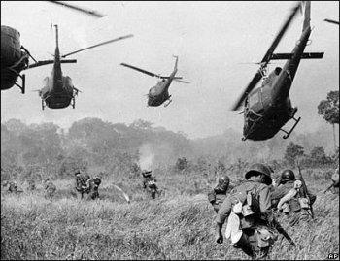
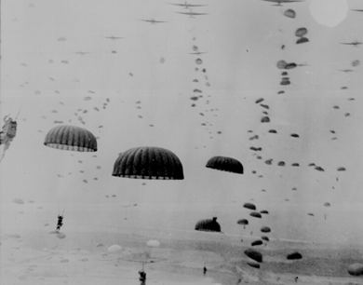
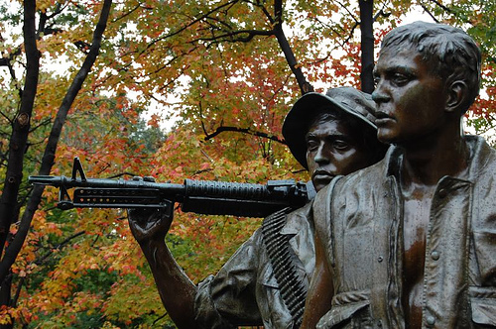


Fillmore County Veteran Services
Jason Marquardt, Veterans Service Officer
President MACVSO

Slide 2

Mission Statement
To promote the interests and welfare of veterans, their dependents and survivors and to enhance their quality of life through counseling, claims assistance, education, advocacy and special projects.
The Veterans Service Office assists county residents, who have served under honorable conditions in the Armed Forces of the United States, in securing federal and state benefits which they are provided by law. It further assists them in accessing these benefits through the Veterans Transport Van Program.
Assistance is also provided to
all residents, regardless of the
character of their service, in
securing mental health
counseling and treatment for
alcohol and/or drug dependency.

Slide 3
Minnesota Statutes that govern CVSO’s
197.60 – 197.608

Slide 4


Something to think about
Nationwide, there are 22.2 Million living veterans
Approximately 361,000 Veterans in Minnesota (or about seven percent of the states population)
Since 9/11, over 66,000 Minnesota Veterans have been discharged from active duty, of which 43,000 have served in a combat zone

Slide 5
Where are CVSO’s
Serving Veterans in all 87 counties
Strong partnerships with Minnesota Department of Veterans Affairs
CVSO’s assist in the $2.6 billion annually in federal benefits and services for Minnesota Veterans
To find a Service Officer go to http://www.macvso.org

Slide 6
What benefits and services do we assist our veterans with?
Assistance for Recently Discharged Veterans
Recording of military discharge
Applications for VA medical/dental care
Conversion of Servicemen’s Group Life Insurance
to Veteran’s Group Life Insurance
State and Federal benefit counseling
Employment and re-employment rights
Military discharge review and correction boards
Survivor and Death Benefits
Service connected death benefits
(Dependency and Indemnity Compensation)
Non-service connected death benefits
(Widow/Widower Pension)
VA burial allowances
Government burial markers/headstones
Bronze star grave flag holders
Government life insurance claims
U.S. burial flags
Ft. Snelling National Cemetery
Minnesota State Veteran’s Cemetery
Replacement medals
Disabled Veteran Benefits
Service connected VA compensation claims
Non-service connected VA disability pension claims
Service disabled veteran’s life insurance
VA vocational rehabilitation
VA appeals assistance
Special Adaptive Housing Grants
Automobile and Special Adaptive Equipment Grants
Education Benefits
GI Bill for college, vocational and apprenticeship training
Dependent & Survivor Education (Chapter 35)
Minnesota State War Orphans Education Grants
Minnesota State Veterans Educational Assistance Grant
Health Benefits
VA medical care enrollment
(inpatient & outpatient)
Chemical dependency treatment
TRICARE
CHAMPVA (Civilian Health And Medical Program VA)
Minnesota veterans homes
Prosthetics
Minnesota State Assistance Programs
for Veterans and their Families
Minnesota Department of Veterans Affairs,
State Soldiers Assistance Program:
Temporary financial assistance for disabled veterans
Dental care
Optical care
Financial assistance for medical emergencies
AND MUCH MORE
Home Loan Guarantee
VA certificates of eligibility
Release of liability
VA repossessed houses

Slide 7
Other work
All CVSO’s Offices are unique and are molded to assist the Veterans in that area.
CVSO’s also work with ALL other County Departments to unsure that the Veterans and families are receiving the needed benefits.
CVSO’s are and should be the Veterans and families go to because they are their true advocate and will find ways to assist.

