Slide 1
Preschool Development Grant Overview
Mission
By focusing on children facing racial, geographic, and economic inequities, children in Minnesota will be born healthy and able to thrive within their families and communities.
Goal
Minnesota’s Preschool Development Birth through Five (PDG B-5) grant and related activities will support the overall goal to more efficiently align and coordinate our systems in order to ease navigation through the system for families.

Slide 2
Quick Facts: One Year Planning Grant (Phase I)
Partnership between the departments of Education, Health, Human Services and the Children’s Cabinet. Education is the fiscal host.
45 states and territories awarded
Award Amount equals $4,705,605
Timeline:
Project Start Date is December 31, 2018
Project End Date is January 30, 2020
Notes:
Be sure to stress that this is a PLANNING grant and is not meant to serve additional children or create increased access to programs.
All state except those asking for less than a million dollars were asked to reduce their budget by 29% - of which MN did.
Due to technical difficulties at the federal level with sending our official award letters the end data has already been extended by one month.

Slide 3
Quick Facts: Three-Year Implementation Grant (Phase II)
Preschool Development Renewal Grants:
Competitive–estimate that half of applicants will be awarded
Application window is August–October 2019
If funded, award will be for three years
Requires a state match of 30 percent
Must submit renewal application that contains a plan to award sub-grants

Slide 4
Minnesota Preschool Development Grant Activities and Priorities
Conduct Needs Assessment
Statewide stakeholder engagement
Explore cross-agency data systems development
Develop Strategic Plan
Summarize data from Needs Assessment and engage community stakeholders in the development of a Strategic Plan
Improve Overall Quality of Programs
State, regional and local P-3 professional learning and quality improvement opportunities
Design Mixed Delivery System
Promote Best Practices
Maximize parental choice and involvement
Develop local Communities of Practice
Review data practices laws and advise on cross-agency data sharing agreements
Explore hub/central intake model
Expand P-3 Leadership Series
Enhance ECCE professional development system
Expand training on trauma-informed care
Develop and implement Kindergarten Transition Profile
Dissemination of ESSA menu of evidence-based practices
Develop communications outreach strategy for parents
Prioritize community-developed solutions
Identify priorities for Parent Aware
Support ECCE workforce
Build state capacity to support dual language learners
Promote culturally relevant local policies, practices and programs
#3
#5
#1
#2
#4
Notes:
DHS Talking Point:
Authentic engagement with impacted communities in our needs assessment work plan is critical. Minnesota is commonly at the top of state rankings of overall health, education, and economic outcomes. But underneath the surface and averages lie deep disparities in wellbeing that fall primarily along racial lines, with African American and American Indian communities experiencing most of these inequities. One recent study ranked Minnesota as having the second worst racial inequities in the nation in terms of employment and economic outcomes and those inequities can be seen starkly in metrics of early childhood health and wellbeing. There are enduring gaps in infant mortality, poverty rates, third grade reading proficiency, and a host of other indicators between white children and children of color.
Our needs assessment process will build upon what we do know about the quality and availability of existing state programs and services, while simultaneously engaging families and communities in defining quality early care and education in a way that aligns with their cultural values and lived realities, to inform a cross-comparison of how our current array of programs and services meets those needs, where we need to bolster supports and services to better meet those needs, and where we need to discontinue services because they aren’t in alignment with communities needs or are not working to decrease disparities.

Slide 5
Planning and Advisory Committee
Co-create work in activities one and two and provide guidance and feedback on activities three, four and five as requested through needs assessment analysis and synthesis, community meetings, and development of a strategic plan.
Members:
Including, but not limited to:
The Southwest Initiative Foundation, the Southern Minnesota Initiative Foundation, The Initiative Foundation, The Northland Foundation, The Northwest Minnesota Foundation, West Central Initiative Foundation, Children’s Defense Fund – Minnesota, The Minnesota Indian Women’s Resource Center, Minnesota Tribal Resources for Early Childhood Care, and Indigenous Visioning

Slide 6
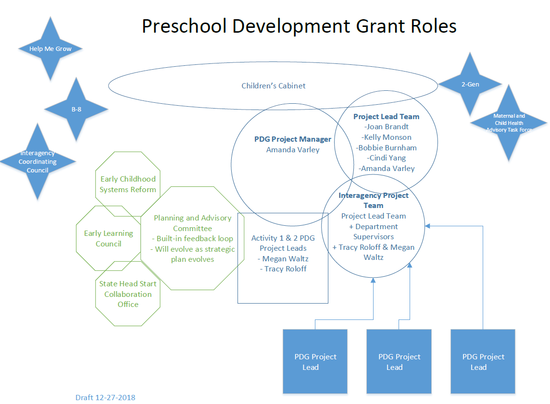
Governance

Slide 7
More Information
Website: https://education.mn.gov/MDE/dse/early/preschgr/
Amanda Varley
Preschool Development Grant Project Manager
Amanda.varley@state.mn.us

Slide 8
Thank you!
Preschool Development Grant Project Manager
Amanda Varley
Amanda.varley@state.mn.us
651-582-8519
Notes:
For further information and follow-up questions, please contact Amanda Varley, PDG Project Manager

