Slide 1
Minnesota Credit Union Overview
January 2021

Slide 2
Minnesota Credit Unions
100 credit unions |  | 396 branches |  | 1.9 M members |  | 4,933 employees |  | 29B assets

Slide 3
MN Credit Unions by Asset Size

Slide 4

What is a credit union?
A member-owned, not-for-profit financial cooperative
Operated on a not-for profit basis
Members elect the board of directors
Dividends are paid to members, not stockholders
Notes:
Every credit union is restricted to serving a specific field of membership. All members must be connected by a common bond. There are three types of bonds that exist:
1) Occupational
2) Associational
3) Community
The first Minnesota credit union was chartered in 1925.
The Federal Credit Union Act was enacted in 1934.
The legislation allowed credit unions to incorporate under either state or federal law. This system of dual chartering continues today.

Slide 5
Financial Benefits
Minnesota Credit Unions provided $171 million in direct financial benefits to the state’s 1.9 million members
  Lower Loan rates = $136 million
  Higher savings rates = $16 million
  Fewer/lower fees = $19 million
These benefits are equivalent to $90 per member or $189 per household
Calculated for the 12 months ending September 2020.

Slide 6
Who can belong to a credit union?
Live
Many credit unions service anyone that lives in a defined geographic area such as a specific county or region.
Work
Companies sponsor credit unions as a benefit for employees; and some credit unions are organized for special trade groups - like aviation or healthcare workers.
Belong
Membership in a group such as a place of worship, school, labor union or homeowners’ association may qualify you to join a credit union. And, most credit unions encourage members families to join.

Slide 7
History of Credit Unions
1925
The first Minnesota credit union was chartered in 1925.
1934
The Federal Credit Union Act was enacted in 1934.
The legislation allowed credit unions to incorporate under either state or federal law. This system of dual chartering continues today.

Slide 8
Federal vs. State Chartered
Federal
Governed by the Federal Credit Union Act
Regulated by the National Credit Union Administration
State
Governed by MN Statute Chapter 52
Regulated by the NCUA and the Minnesota Department of Commerce
State Chartered credit unions pay yearly assessments as well as hourly exam fees to the Department of Commerce
Notes:
Risk-Focused Examinations
Based on CAMEL code (Capital Adequacy, Asset Quality, Management, Earnings and Liquidity)
Quarterly Call Reports
Supervisory Committees
All Minnesota credit unions are federally insured.
NCUSIF is backed by the full faith and credit of the United States Government.
Members’ shares are insured up to a minimum of $250,000.
Not one penny of insured savings has ever been lost by a member of a federally-insured credit union.
No federal tax dollars have ever been placed in the share insurance fund.

Slide 9
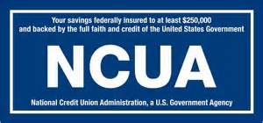
National Credit Union Administration (NCUA)
The NCUA is an independent federal agency with the primary mission to ensure the safety and soundness of credit unions.
Administrator of the National Credit Union Share Insurance Fund (NCUSIF).
All Minnesota credit unions are federally insured and backed by the full faith and credit of the United States Government.
Members’ shares are insured up to a minimum of $250,000.

Slide 10
Examinations
Risk-Focused Examinations
Quarterly Call Reports
Supervisory Committees

Slide 11
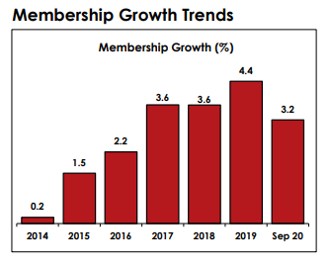
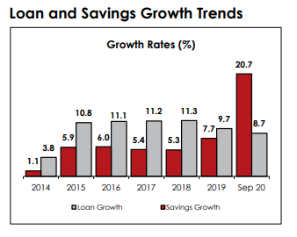
Economic Performance

Slide 12

Financial Literacy
10 school credit union branches provide money management and career skills for students
Credit unions cooperatively provide college scholarships
Credit union employees conducted over 1,500 classroom presentations, reaching over 20,000 Minnesota students the last reporting year
Notes:
Median Account Balance
$355
Number of State-wide Prizes
622
Total Dollars Awarded in State-wide Prizes
$86,000
Number of participating Credit Unions
14

Slide 13


WINcentive Savings
Number of Accounts | 8,400
Total Dollars Saved | $9,606,599.76
Median Account Balance | $402
Average Account Balance | $1,144
YTD Total Dollar Amount of Prizes in MN | $145,000 +
Number of Credit Unions | 23

Slide 14


Slide 15

COVID-19 Assistance
Credit unions are helping members affected by the Pandemic
  Loan payment extensions
  Mortgage forbearance
  PPP loans
  Emergency loans
  Debt consolidation and refinancing
  Fee waivers
  Financial counseling

Slide 16
Minnesota Credit Union Network
www.mncun.org
Mark Cummins
President & CEO
mcummins@mncun.org
Ryan Smith
Director of Government Affairs
rsmith@mncun.org

