Slide 1
Department of Revenue Overview – House State Government Finance Committee
January 10, 2023

Slide 2
Mission/Vision/Values
Purpose
Administer and enforce the assessment and collection of taxes
Mission
Working together to fund the future for all of Minnesota.
Vision
Everyone reports, pays, and receives the right amount: no more, no less.
Values
Accountability, Excellence, Inclusion, Integrity, Partnership, and Service

Slide 3
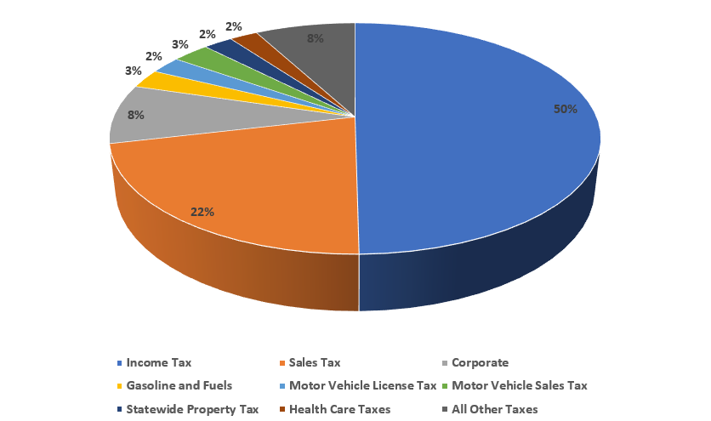
Tax Revenue
The $33 billion collected annually by the Department provides vital resources for services and programs around the state.

Slide 4

Services
Tax revenue funds vital programs that benefit Minnesotans:
Education
Infrastructure
Healthcare & Public Health
Public Safety
Roads/bridges/transit
Natural Resources

Slide 5
Who Do We Serve?
Our broad base of customers around the state
All 87 counties
3.1 million individual income tax filers
Over 800,000 property tax refund filers
800 licensed property tax assessors
More than 500,000 businesses
More than 300,000 sales tax filers

Slide 6

Who Do We Serve?
The Governor and Legislature
We consult and confer with the Governor regarding taxation
We recommend to the legislature appropriate changes in law necessary to help serve Minnesota taxpayers.

Slide 7
Enforcement through Education
A large part of the department’s role is helping customers understand their obligation and working to get – and keep – them in compliance.
To do that, we provide education and outreach to customers through:
Training and Outreach events
Videos
Website content
Phone, emails, letters, and in-person customer contact

Slide 8
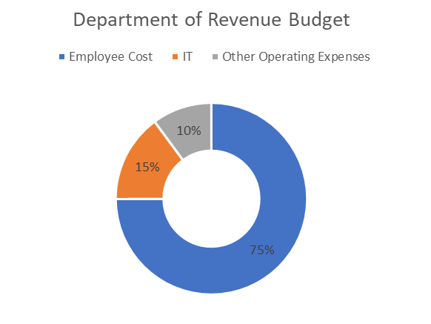
Revenue by the Numbers
More than 1,400 employees administering 30 different tax types.
$188 million annual budget

Slide 9

Employee Roles
Auditors
Return processors
Collections officers
Taxpayer assistance representatives
Tax aid administrators
Researchers
Attorneys
Outreach and Communications

Slide 10
Efficiencies and Increased Costs
Revenue continually seeks ways to most efficiently use our existing resources to manage costs.
Physical office space reduction
Printing and mailing
Revenue will continue to maximize efficiencies in FY 2024 and FY 2025.
Rising costs expected for IT and cybersecurity needs

Slide 11
Our Workforce Model
Hybrid working model - business needs of the agency dictate where our employees perform their duties.
Allows us to hire from across the state, more accurately represent Minnesota
Productivity has not suffered
Continue to process approximately 6.3 million total tax returns each year
Over 90% of them processed in a timely manner

Slide 12

Data Security
Virtual Private Network
Multi-Factor Authentication
Encryption
GenTax

Slide 13
Contact Information
Paul Marquart, Commissioner
Paul.Marquart@state.mn.us
651-556-6003
Lee Ho, Deputy Commissioner
Lee.Ho@state.mn.us 651-556-6003
Marina Herrera-Heintz, Legislative Coordinator
Marina.Herrera-Heintz@state.mn.us
651-556-6213

Slide 14
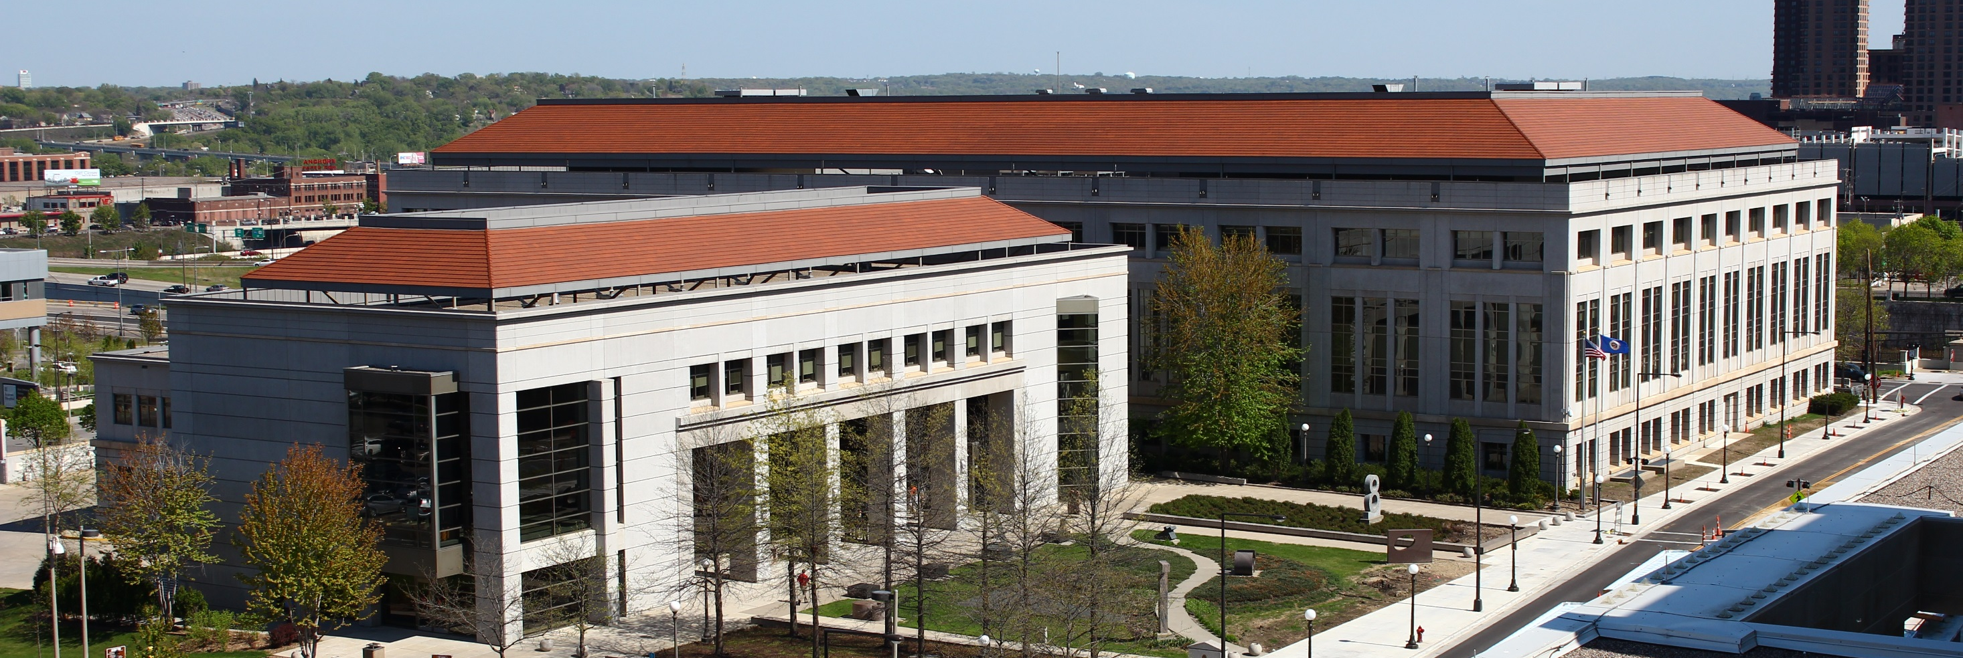
Thank you!

