Slide 1
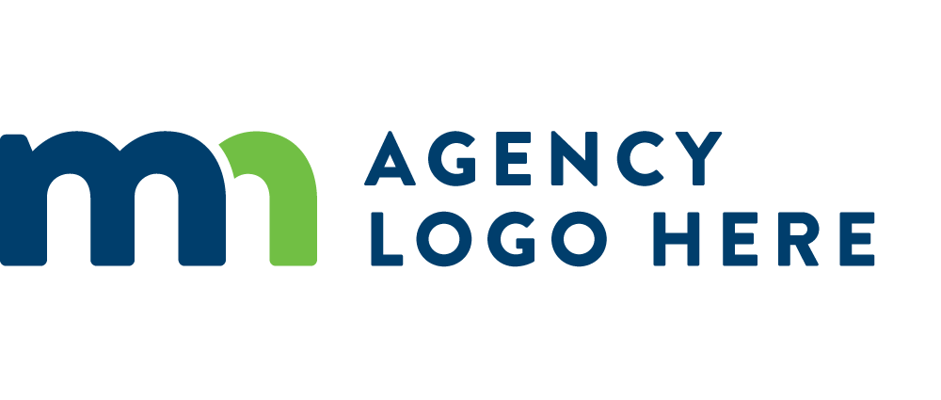
MN Indian Affairs Council
Melanie Franks| Executive Assistant / Education Liaison

Slide 2
Minnesota Indian Affairs Council

Slide 3
Eleven Tribal Nations in Minnesota
Dakota Communities
Lower Sioux Indian Community
Prairie Island Indian Community
Shakopee Mdewakanton Sioux Community
Upper Sioux Community
Ojibwe Reservations
Bois Forte Band of Chippewa
Grand Portage Band of Ojibwe
Fond du Lac Band of Lake Superior Chippewa
Mille Lacs Band of Ojibwe
Leech Lake Band of Ojibwe
Red Lake Nation
White Earth Nation

Slide 4
Tribal Nations
MN Tribal Nations
MN Tribal

Slide 5
Where are Minnesota’s Tribal Nations Located?

Slide 6
Indian Affairs Council Background
Established in 1963 as the first council of its type in the nation (!)
Authority under MN Stat. 3.922
Official liaison between eleven Tribal Nations and State of Minnesota
Work closely with state agency Tribal liaisons to assist agencies
Plays a central role in the development of state legislation
Plan and facilitate annual Governor/Tribal Leader Summit

Slide 7
Minnesota Indian Affairs Council Team
Executive Director
Shannon Geshick
(September, 2019)
Vacant
Grants & Contracts
Vacant
Office Manager
Melissa Cerda
Cultural Resources Specialist Sr. (2013)
MIAC Board of Directors:
Board Chairman, President Robert L. Larsen
Board Vice Chair, President Shelley Buck
Chairwoman Cathy Chavers, Chairman Kevin Dupuis, Chairman Robert Deschampe, Chairman Faron Jackson, Chief Executive Melanie Benjamin, Secretary Sam Strong, Chairman Keith Anderson, Chairman Michael Fairbanks
(Voting Members)
Dylan Goetsch
Cultural Resource
Specialist (2019)
Mario Uribe
Cultural Resource
Specialist (2020)

Slide 8
Indian Affairs Council Executive Board
Voting members – Tribal Elected Officials (Chair/President/Chief Executive)
Bois Forte Band of Chippewa
Grand Portage Band of Lake Superior Chippewa
Mille Lacs Band of Ojibwe
Fond du Lac Band of Lake Superior Chippewa
Red Lake Nation
Leech Lake Band of Ojibwe
White Earth Nation
Lower Sioux Indian Community
Prairie Island Indian Community
Shakopee Mdewakanton Sioux Community

Slide 9
Board Member Agencies, Legislature, Governor’s Office
Executive Branch Agencies (12)
Education
Corrections
Health
Human Rights
Human Services
Natural Resources
Employment and Economic Development
IRRRB
Housing Finance Agency
Veterans Affairs
Transportation
Administration
Governor’s Office Representative (1)
One member
Senate (2)
Two members, appointed by its Subcommittee on Committees
House of Representatives (2)
Two members, appointed by the Speaker

Slide 10
Urban Indian Advisory Board (UIAB)
Subcommittee of the Indian Affairs Council
6 members representing four Minnesota cities with significant American Indian populations:
Minneapolis (2)
St. Paul (2)
Bemidji
Duluth
UIAB provides a forum for urban Indian communities to raise issues, discuss potential solutions, and request action regarding identified issues
Meets quarterly and reports quarterly to the full MIAC board

Slide 11
Cultural Resource Department
Minnesota became one of the first states in the nation to initiate collaboration with Tribal Nations in addressing protection and preservation of human remains and burial grounds
Authority under:
MN Stat. 307.08
MN Stat. 138.31 to 138.42
PL 101-60
Works closely with Office of State Archaeologist (OSA) to protect American Indian gravesites and burial mounds statewide
Osteology Lab housed at Hamline University
New MIAC layer to the OSA Portal

Slide 12
Native Burial Traditions

Slide 13
Grants Department
Legacy Amendment appropriation – Arts & Cultural Heritage Fund for revitalizing the most enduring language(s) in Mni Sota (Dakota)
First appropriated in 2009 for the 2010-2011 biennium
FY20 & FY21 appropriation of $3,410,000 supports 34 language grants
All 11 Tribal Nations (first time non-competitive)
Five Immersion Schools
Eight Competitive Grants (Educational Institutions, Non-Profits or State Agencies)
Volunteer Language Working Group
Report to the legislature in 2011; Strategic plan for language revival 2013, updated 2016
$50,000 per fiscal year with task of developing assessment tool of state appropriated language grants impact and overall language revitalization in the state
Notes:
MIAC is a re-granter of Legacy Amendment Arts and Cultural Heritage funds because the state is in need of the revitalization of the Dakota and Ojibwe Indian languages. Administers the grants; adheres to guidelines of the Legacy amendment. The language grants program has continued growth, indicating an increasing interest in the revitalization of Minnesota’s most enduring languages. MIAC was granted 3.4 million for fy 20-21 – with three distinct appropriations: Tribal nations, immersion schools and competitive grants. MIAC also oversees the Dakota and Ojibwe language working group with delegates from the tribal nations and urban communities.

Slide 14
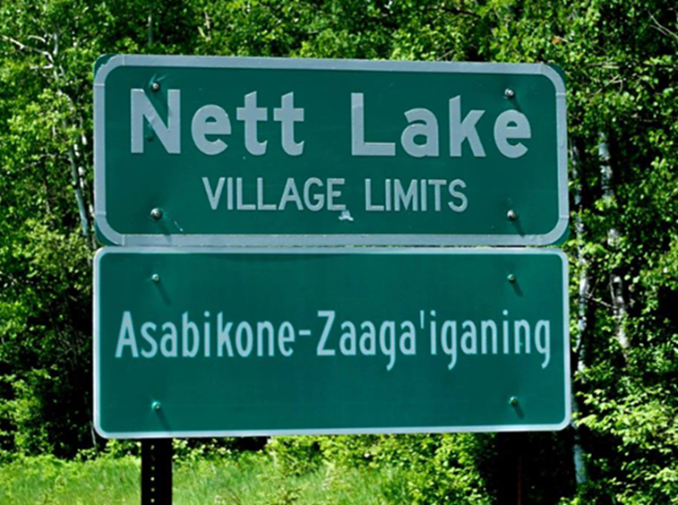
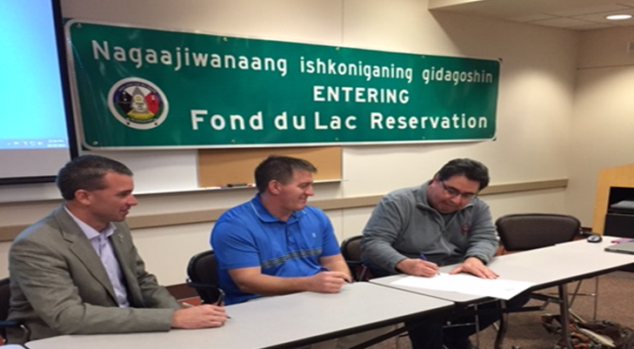
Grants Department
Awarded millions of dollars in grant funding
Requests for funding double our allocation
Indicates interest in Dakota and Ojibwe language acquisition
Indicates successful state and tribal nations partnership
Dual Language Signs
Aided in the first dual language road signs in the state
Set precedent for bilingual signage.
Now several Dakota or Ojibwe language signs in the state.

Slide 15
Why Treaties Matter Exhibit
Partnership with Minnesota Humanities Center and Smithsonian National Museum of the American Indian
Over 80,000 people have engaged with the exhibit at over 110 sites in 60 cities
Permanent exhibit in new public space at the Capitol
Pilot projects with Minnesota K-12 public school districts with educator guides.
Outcomes so far…
Broadened worldviews around treaties
Strengthened relationships with community
Supplemental Educator Guides aligned to 2011 MN Social Studies Standards
www.treatiesmatter.org
“A Day in the Life of Minnesota Tribal Nations” Video

Slide 16
Governor Walz’s Executive Order 19-24
Input from all 11 tribes in MN, tribal liaisons, and MIAC
Governor Walz’s EO is a big step forward toward improved state & tribe relations
MIAC staff participate in weekly meetings with governor’s office on best practices for EO 19-24
MIAC executive director reviewed and provided feedback to all 24 agency consultation policies along with governor’s staff, select tribal liaisons and tribal leaders.
Meaningful and timely consultation between the State of Minnesota and the Minnesota Tribal Nations will facilitate better understanding and informed decision making by allowing for collaboration on matters of mutual interest and help to establish mutually respectful and beneficial relationships between the State and Minnesota Tribal Nations

Slide 17
Governor Walz’s Executive Order 19-24
The State has instituted Tribal State Relations Training ("TSRT") which will be the foundation and basis of all other tribal relations training sources. All agencies must direct certain staff to complete training to foster a collaborative relationship between the State of Minnesota and Minnesota Tribal Nations. In addition to all Commissioners, Deputy Commissioners, and Assistant Commissioners, all agency employees whose work is likely to impact Minnesota Tribal Nations will attend TSRT training. Tribal Liaisons will actively support and participate in the TSRT.

Slide 18
Tribal-State Relations Training
Unique partnership between MnDOT, University of Minnesota-Duluth CE, state agency tribal liaisons, Minnesota Indian Affairs Council
State Government Innovation Award Winner – 2016
Award Video

Slide 19
Tribal-State Relations Training
Goals
Educate state employees about American Indian people and sovereign tribal governments.
Create unique, mutually-beneficial partnerships
Build respectful relationships between the state and tribal nations.
Create an enduring commitment by the state to learn about tribal governments.

Slide 20
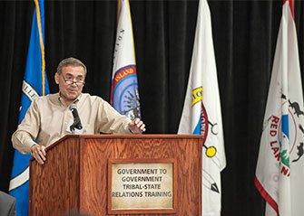
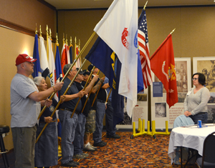
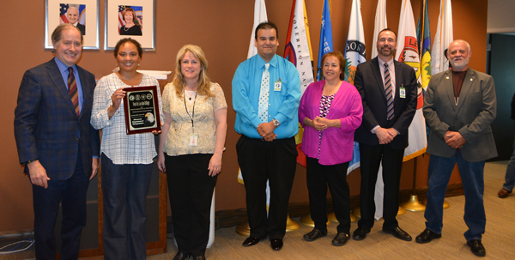
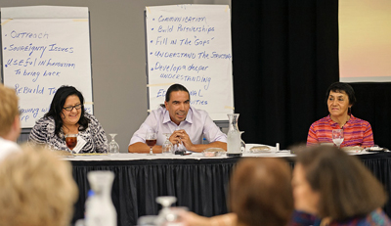
Tribal-State Relations Training

Slide 21
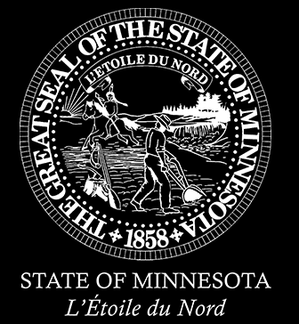
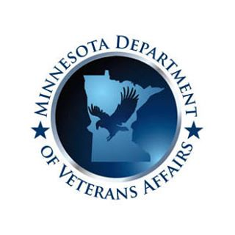
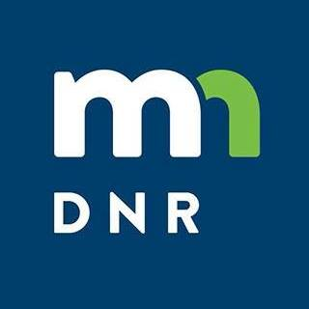
Governor Walz’s Executive Order 19-24
Each agency must designate a Tribal Liaison to assume responsibility for implementation of the tribal consultation policy and to serve as the principal point of contact for Minnesota Tribal Nations. The Tribal Liaison must be able to directly and regularly meet and communicate with the Agency's Commissioner and Deputy and Assistant Commissioners in order to appropriately conduct government-to-government conversations.

Slide 22
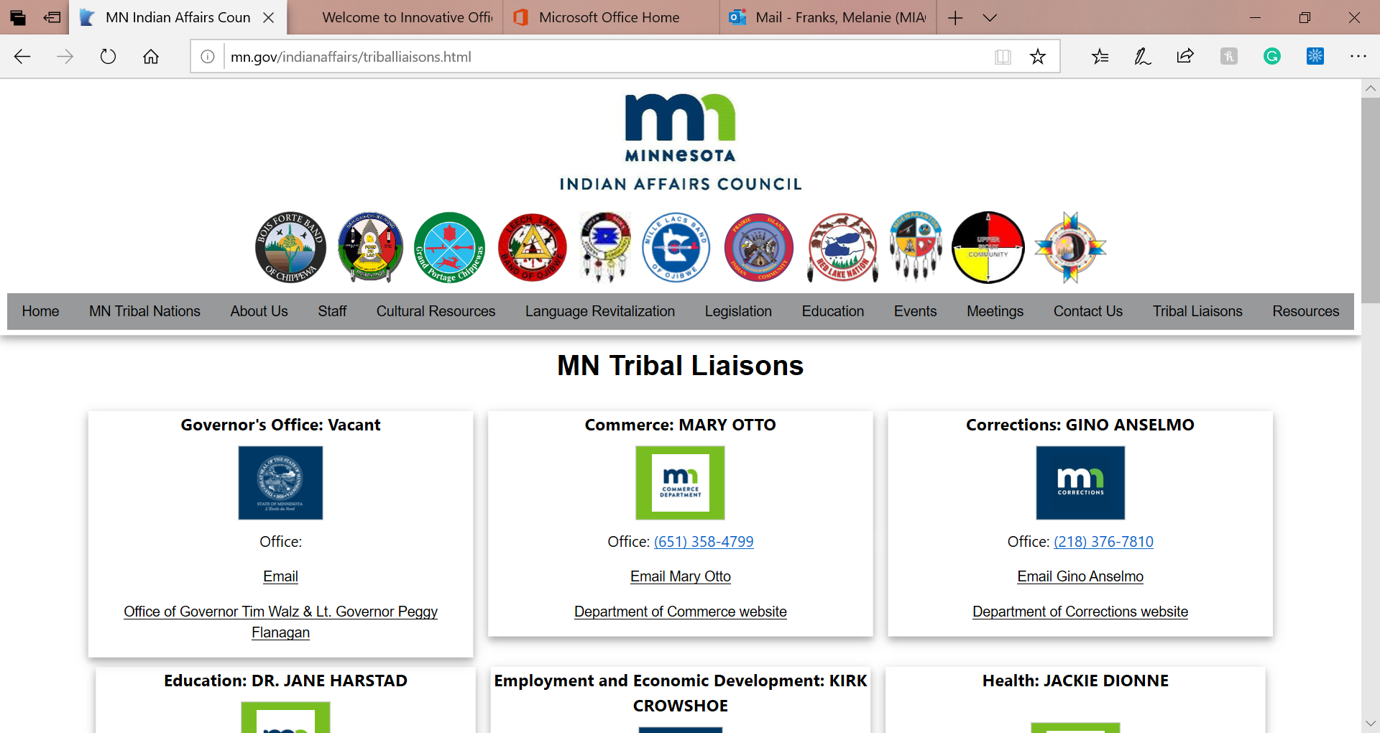
Tribal Liaisons http://mn.gov/indianaffairs/triballiaisons.html

Slide 23
Tribal-State Relations Training Partnership Event 2018

Slide 24
Pidamayaye (Dakota) Miigwech (Ojibwe)
Shannon Geshick
Shannon.Geshick@state.mn.us
651-249-0160

