Slide 1
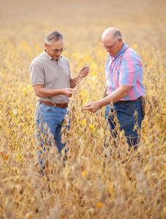
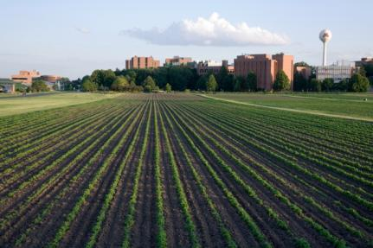
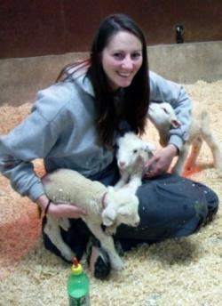
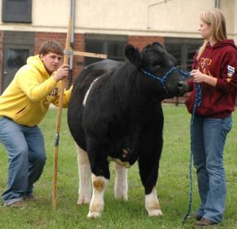

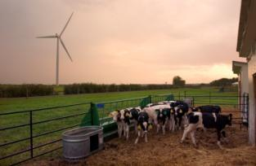
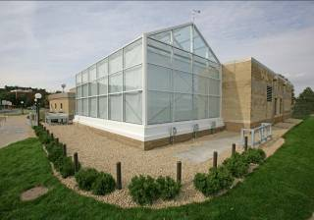
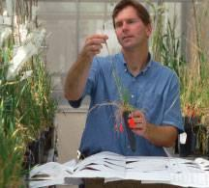
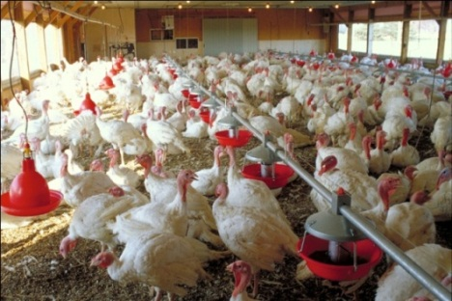
Agricultural Research, Education, Extension and Technology Transfer (AGREETT)
Update Presented to Minnesota House Agriculture and Food, Finance and Policy Division, January 17, 2019

Slide 2
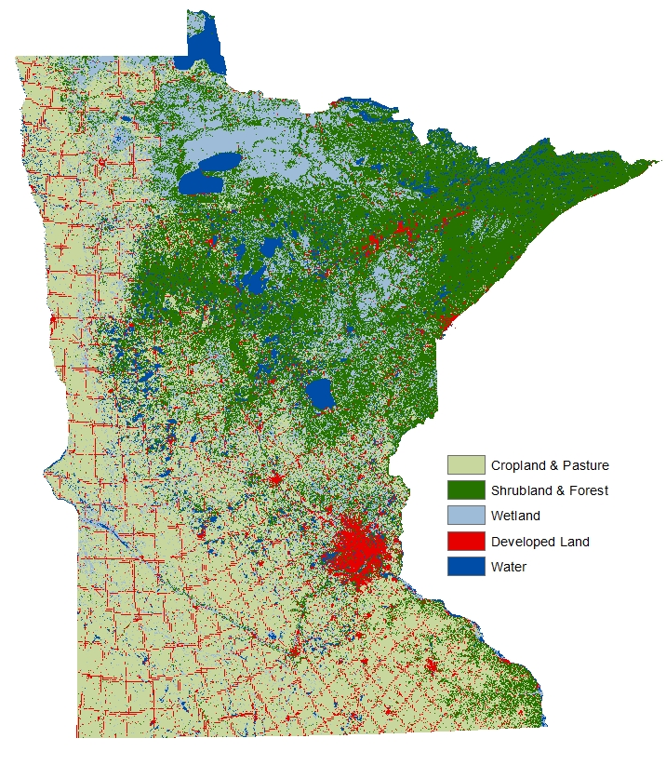
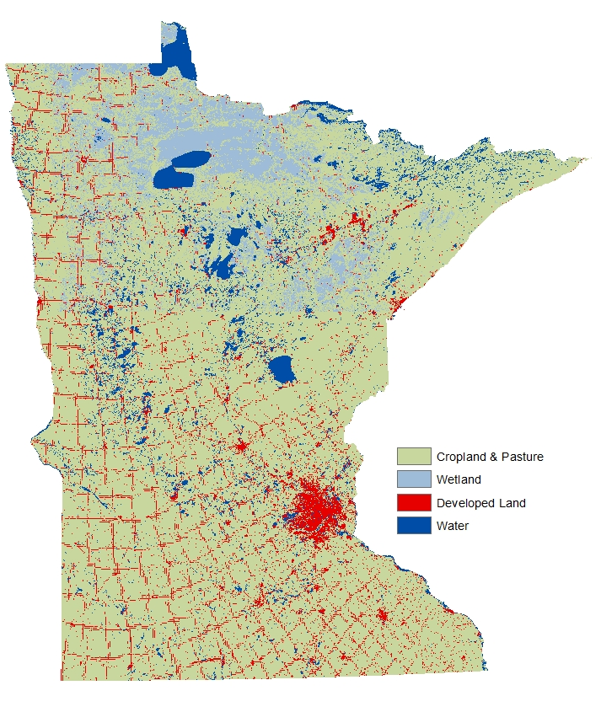
Investments in Agricultural Productivity Research….
Reduce Natural Resource Footprint of Agriculture
Total Acres: 51 million
Farmed
Acres
Farmed
Acres
26.9
Mill.
57.5
Mill.
Reality
No Ag R&D
Notes:
Minnesota is not big enough to produce all food necessary under an alternative reality of no agricultural R&D.

Slide 3
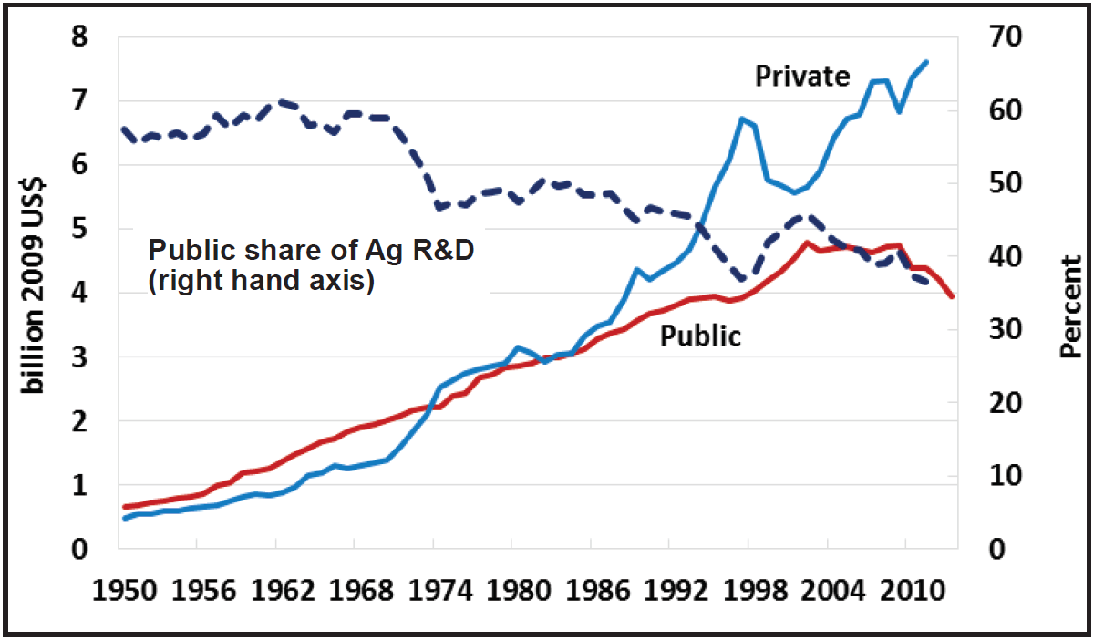
Trends in Agricultural Research and Development Investment

Slide 4
Minnesota Chooses to Invest in Ag R&D
AGREETT: Mn. Stat. 2015 Supplement Section 41A.14, Amended 2016
Key Features:
  Purpose: support agricultural productivity growth through research, education and extension through long-term base funding.
  Priority: “human infrastructure” - deploy technology to use
  Advisory Panel:
    Co-Chaired: Commissioner and College of Food, Agricultural and Natural Resource Sciences representative.
    Panel Representatives: MSCU, Farm Bureau, Farmers Union, Statewide Ag, Commodity Councils, Forest Products, Organic or Sustainable Ag, Statewide Env. And Nat. Res.
    Panel Role: Advisory on agricultural positions and investment, prioritization, engagement with UMN on selection and review, advisory financial.

Slide 5
AGREETT Funds Appropriated
Total Funds $9.3 million per year to Dept. of Agriculture.
Designations:
  ~$4.8 million delegated to consultative prioritization – MDA, UMN, AGREETT Advisory Panel
  $2 million for MAELC Grants FBM
  $1 million for research on Avian Influenza
  $450,000 Wild Rice Breeding and $350,000 Potato Breeding
  $600,000 for Rapid Agricultural Response Funding.

Slide 6
Investment Strategy: Doing the Most Good for the Most People
Crop and Livestock Genetics for Productivity and Improved Traits
Microbial Science Research for Soil, Plant, Human and Animal Health
Advancing Soil Fertility and Water Quality and Availability Through Managed Crops and Forestry
Agro-Ecological Innovation in Managed Crops to Improve Biodiversity
Decision Agriculture: Aligning measurement technologies, Information Technologies and Economics for Improved Management
Nutrient Recycling and Management for Improved Utilization and Resource Efficiency
Technology Stewardship of Pest and Disease Resistance and Adaption to Climate Change
Sustaining Growth in Agricultural Productivity

Slide 7
AGREETT Investment Summary: Personnel Hiring Completed
CFANS:
  Cultivated WR (appropriation)
  Potato (appropriation)
  Crop Systems (NCROC, Ext.)
  Manure Mgmt/Water (Ext.)
  Soil Fertility
  Farm Mgmt (Ext/CFFM)
  Livestock Housing (Ext.)
  Animal Nutrition and Microbiome (Vet)
  Precision Ag-Informatics (Vet)
  Beef Phys/Repro. (Ext)
$250k Research Technicians in Support of Existing Research
CVM:
  Veterinary Parasitology (CFANS)
  Bioinformation Animal Systems (Ext.) (CFANS)
  Antimicrobial Resistance (Ext.)
  Animal Microbes in Health and Disease (CFANS)
Extension Educators:
  Manure Mgmt.
  Crop Systems (Morris)
  Swine Prod.
  Food Safety (2)
  Hort Food Crops
  Farm Management

Slide 8










CFANS AGREETT Faculty
Andres Gomez
Animal Science
Microbiome &
Animal Nutrition
Erin Cortus
Bio-Engineering
Lvst. Facilities
Joleen Hadrich
Applied Econ.
Farm Mgmt.
Yuxin Miao
Soil, Water, Climate
Crop Nutrients
Zhenong Jin
Bio-Engineering
Agro-Informatics
Melissa Wilson
Soil, Water Climate
Manure Mgmt.
Laura Shannon
Horticulture
Potato Breeding
Lindsay Pease
SWC/NWROC
Nutrient
Management
Jenny Kimball
Agronomy
Wild Rice Breeding
Megan Webb
Animal Science
Beef Production

Slide 9
AGREETT Faculty – Veterinary Medicine
Matthew Aliota –
Veterinary
Parasitology
Kim VanderWaal -
Bioinformatics
Animal Systems
Peter A.
Larsen –
Genomics and One Health
Dr. Noelle Noyes –
Antimicrobial
Resistance

Slide 10
AGREETT Extension Educators
Diane K. DeWitte
Swine Production
Jared Goplen
Crop Systems
Annie Klodd
Fruit and Vegetable
Chryseis Modderman
Crop Systems
Anne Sawyer
Food Safety
Annalisa Hultberg
Food Safety

Slide 11
AGREETT Investment Summary: Personnel Hiring In Process
CFANS:
  Turkey Repro Physiology
  Cropping Systems Agronomy
  Agricultural Climatology (Ext.)
  Weed Scientist (Ext.)
  Forest Biometrics and Productivity
  Functional Genomics Entomology
CVM:
  Food Animal Pharmacologist & Toxicologist (Ext.)
Extension Educators:
  Agricultural Water Quality
  Food Systems Agriculture
  Cattle Production

Slide 12
Rapid Agricultural Response Fund Grant Program
Purpose:
Responses to current and emerging agricultural threats that have economic, environmental, and biological consequences.
Status:
20 Projects FY18-FY19 and 10 More Announced this Week
Examples of Work Funded:
Entomology – Resistance Management in Soybean Aphids
Animal Science – Food Safety Interventions for Salmonella in Turkeys
Applied Econ/Extension – Helping Financially Stressed Farmers Identify Options
Forest Resources/Extension – Landscape Risks and Management of Emerald Ash borer
Veterinary Medicine – Surveillance to Control Influenza in Swine

Slide 13
Avian Influenza Grant Program
Purpose:
Determine the causes , susceptibility and treatment of avian influenza
Status:
  Twenty Researchers Awarded Projects in Two Rounds of Funding
Examples of Work Funded:
Veterinary Medicine:- Genome Sequencing to Determine if Gulls Carry Influenza
Bio-Engineering – Evaluate Low-Thermal Heating of Barns to Sterilize Strains of Airborne AI
Veterinary Medicine – Investment in Veterinary Diagnostic Lab Upgrades and Willmar Testing Facility – Led to Rapid Detection in 2018.
Emergency Preparedness Training with U of MN, Mn. Dept. of Ag., and Board of Animal Health
Extension Biosecurity Education and Training Mobile Facility

Slide 14
Bridge & Development Grants
Purpose:
Help Faculty Start and Align Grants for Federal Funding that Support AGREETT Issues
Status:
Six faculty members have received Bridge & Development grants in support of their work.
Third round will be awarded in February.
Examples of Work Funded:
Soil Water Climate/Extension - Faculty member performed preliminary experiments to support Federal grant application awarded for integrating cover crops with Fall manure.
Agronomy and Plant Genetics – Faculty bridged NSF grant on genetic variants in grains reducing yields – enabled keeping personnel on project through grant transition.

Slide 15


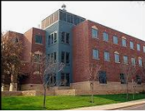

Facilities Investment

Slide 16

Meet AGREETT Faculty
Joleen Hadrich
CFANS/Applied Econ.
Farm Management Extension
Noelle Noyes
Vet. Population Med.
Antimicrobial Resistance
Management Extension

Slide 17
Enhancing the economic viability of Minnesota’s Dairy Farms
First project to conduct dairy research using data from multiple large datasets
  94 MN dairy farms participating in project who use DHIA and participate in MN Farm Business Management Association (FINBIN data)
Helps farmers understand and evaluate comprehensive dairy management decisions
  Milk production and quality attributes
  Animal health and welfare
  Financial performance

Slide 18
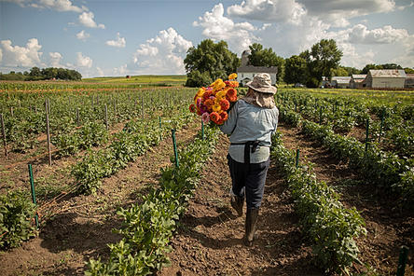
THANK YOU… and our Agricultural and Food Partners
Questions?

