Slide 1
Community Policing & Community Governance Partnerships and Problem Solving For Community Safety

Slide 2
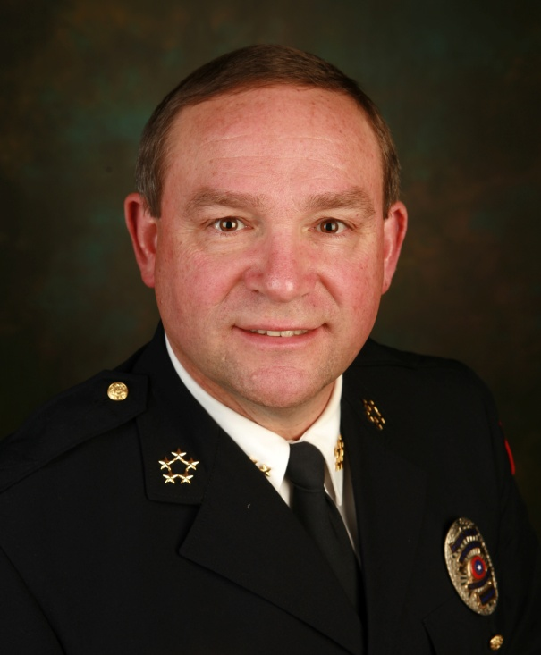
TODD A. MILLER DIRECTOR OF PUBLIC SAFETY MANKATO MN DPS

Slide 3
PROFESSIONAL EXPERIENCE
Chief of Police Since 1976 – 4 States, 8 Departments
Chair – IACP Community Policing Committee 2006-2014
Two Time Winner – IACP & CISCO Community Policing Award – 1999 and 2013
Instructor/Consultant/Speaker on Community Policing/Governance Issues Internationally
Principal - POLICING LEADERSHIP GROUP, LLC - Building Bridges of Trust, Cooperation and Understanding Between Police, Government and the Communities They Serve

Slide 4
COMMUNITY RESPONSIBILITY
Who’s job is:
Solving Crime?
Preventing Crime?
Maintaining or Enhancing Quality of Life?
Shared Responsibility?

Slide 5
WHAT DID WE THE POLICE DO?
For Years, we told the community to give us more money and more officers, and then to stand back and let us do our jobs.
IT DIDN’T WORK!
By doing this, we took ownership of the crime problem

Slide 6
CRIME IS NOT A POLICE PROBLEM –
IT IS A COMMUNITY PROBLEM!

Slide 7
Traditional Policing

Slide 8
Traditional Policing
Incident driven
Reacting to individual events
Invoking criminal justice process
Using aggregate crime statistics to evaluate performance

Slide 9
Traditional Policing Strategies
Preventative patrol
Rapid response
Follow-up investigations
More Police
Crackdowns

Slide 10
Community Oriented Governance
Based on Community Oriented Policing and Problem Solving

Slide 11
C.O.P. DEFINED
Community policing is a policy and a strategy aimed at achieving more effective and efficient crime control, reduced fear of crime, improved quality of life, improved police services and police legitimacy, through a proactive reliance on community resources that seeks to change crime-causing conditions. It assumes a need for greater accountability of police, greater public share in decision-making, and greater concern for civil rights and liberties. Robert R Friedmann 1992

Slide 12
“The Police are the Public, and the Public are the Police. The Police are only those members of the Public who are paid to give full time attention to the duties that are incumbent on every citizen, in the interest of community safety.” Sir Robert Peel

Slide 13
Community Governance Core Components
Building Community Partnerships as a Force Multiplier; Citizen and Govt. Agencies
Problem Solving as a proactive strategy for reducing crime and disorder
Organizational Transformation to support new strategies
Community Outreach and Trust Building

Slide 14
COMMUNITY GOVERNANCE
is a philosophical approach to local governance
seeks to help cities better coordinate their service delivery and collaboratively solve community problems along with citizens and community based groups
focuses on “governance” as a process rather than on “government” as an institution.
relies on municipal agencies to engage each other and work together and with their community to address community problems, improve the quality of life, increase citizen satisfaction, and plan for the future.

Slide 15
WHY COMMUNITY GOVERNANCE?
Each segment of local government has different resources, expertise, and perspectives that it can bring to respond to jurisdiction-wide issues. It is a matter of strategically coordinating these efforts, making them seamlessly experienced by the public, and developing more effective responses that add greater value to the public service being provided.

Slide 16
What C.O.G. Does
Recognizes that the activities of one city department affect other departments.
Provides a holistic approach to local government service delivery that breaks down organizational barriers.
Encourages community and municipal stakeholders to pool expertise and limited resources to address community problems.
Provides a voice for the full range of community stakeholders and input into decision-making processes.

Slide 17
What C.O.G. Does
Engages community members in their own well-being and in improving the community s quality of life.
Adheres to the democratic principles of equality and responsiveness.
Increases the transparency and accountability of local government.
Shares the responsibility for community safety and quality of life between local government and the community.
Stresses community well-being outcomes (e.g., health and safety), rather than mere outputs (e.g., number of persons vaccinated, number of tickets written).

Slide 19
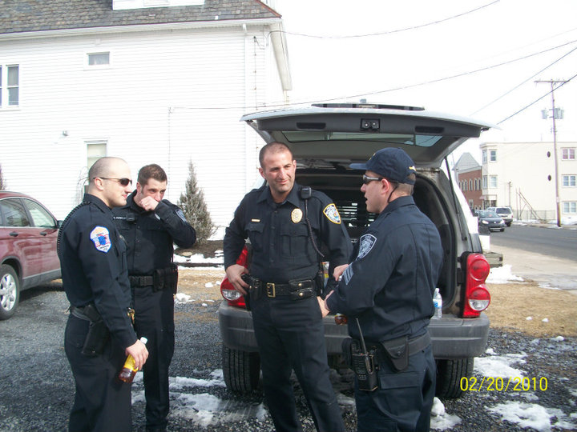
Problem Solving
Problem Solving is best defined by its parts:
1. Identifying crime, disorder and fear problems.
2. Understanding the conditions that give rise to these problems.
3. Developing and implementing long-term solutions tailored to the problems.
4. Determining the solution’s impact on the problems.
Notes:
Handout. Problem-solving is best defined by its parts. It involves:
1. Identifying neighborhood crime, disorder and fear problems.
2. Understanding the conditions that give rise to these problems.
3. Developing and implementing long-term solutions tailored to the problems.
4. Determining the solutions' impact on the problems.
EXPLAIN
Problem-solving has a different meaning in private industry than it does in crime fighting. In crime fighting, it does not mean troubleshooting or seat-of-the-pants guesswork. Problem-solving requires an analytical inquiry into the problem being addressed before devising solutions.

Slide 20
Problem Solving
The SARA Model:
Scanning - Group individual, related incidents as “problems” and define these problems in more precise and useful terms.
Analysis - Information is collected from a variety of public and private sources, not just police data, to illuminate the underlying nature of the problem.
Response - Work with citizens, businesses, public and private agencies, officers tailor a program of action that may go beyond traditional criminal justice remedies.
Assessment - The impact of the response is determined to see if the problem was solved or alleviated.
Notes:
EXPLAIN
Knowing that crime is concentrated helps us (whether we are citizens or the police) to think and act strategically to impact crime. If we can impact multiple offenders, repeat victims and recurring locations, we can have a strong impact on crime, fear and disorder in our communities.
Using the SARA Model and the Crime Triangle
Section Goal:
Participants will be able to identify crime problems appropriate for problem-solving and develop skills in analyzing crime, fear and disorder problems.
Lecturette (50 minutes)
EXPLAIN
SARA is a problem-solving model police officers and researchers developed in Newport News, Va., in the early to mid-1980s. Those engaged in crime control and crime reduction sometimes find it helpful to use a model that offers them a framework for approaching crime problems. SARA is used by community groups and police departments in many parts of the country.
Pass out a copy of the SARA form.

Slide 21
Problem Solving Advantages
Utilizes Officer Expertise and Creativity
Greater Community Involvement/Resources
Information Resources Expand
Reduces Negative Labeling and Finger Pointing
People Work Toward Mutual Goals
Positive Roles for the People with the Problem
Shares Ownership of the Problem
Solutions are More Effective When Developed Together in Partnership

Slide 22
Community Partnership
Community Partnership must include:
1. Positive relationships with the community.
2. Community involvement in the quest for better crime control and prevention.
3. Pooled approaches to address community members’ most urgent concerns.
4. Shared responsibility for finding workable solutions to problems that detract from community safety and security.

Slide 23
Community Partnership
Four keys to the Community Partnership equation:
1. Community contact
2. Communication
3. Trust
4. Information exchange
Notes:
Lecturette (50 minutes)
SAY
During the community-mobilizing module you will explore in more detail what is meant by community and how to form and maintain community partnerships. Let's take a few minutes to examine what we mean by community partnership.
The first core component of community policing is community partnership. Community partnership is an ongoing process of involvement. There are four keys to the community partnership equation, which are listed in the above slide.

Slide 24
Community Partnership
Government
Community
Police
Objective:
To expand the area in which all three
groups collaborate.

Slide 25
Benefits of Collaborative Partnerships
Offers a comprehensive way to address a problem
Increases coordination among public agencies and the community
Represents the needs of all facets of the community
Establishes a broad base of program support
Viewed positively by funding sources
Increases available information
Fosters the feeling that we are not alone

Slide 26
ISSUES IMPACTING COPPS
Agencies say they are doing community policing but they are not. One officer or one team isn’t enough. Bike or foot patrol alone isn’t COP
Some say you need more Officers or more money to implement. You do not! It is a way of doing business.
Crime stats may go up initially. In US, less than half the crime committed is actually reported. As you build trust with community, they will report more of actual crime. Should go back down.

Slide 27
ISSUES IMPACTING COPPS
Current Training/Education Is Not Good Enough!
All Officers Should Be Trained In Philosophy
Higher Education Does Not Focus Enough On It
P.O.S.T. Does Not Require It
Agencies Don’t Focus Enough On It In PTO Training
Recently Lost A Great COP Resource In Minnesota

Slide 28
Award Winning Initiatives & Strategies in Community Policing

Slide 29
TAPESTRY PROJECT – MANKATO MN
Built on community policing philosophy of partnerships, problem solving, outreach
Build trust through interaction
Build strong community through education, mentorship, cross cultural communication
Fully involved the refugee community as equal stakeholder

Slide 30
Tapestry Topics
Health – Health Services in America, Differences between Urgent Care and Emergency Room, Preventative Care
Parenting – Responsibilities, Discipline, Legal Requirements
Government Services – How Local Government Works, Transit and Transportation, Volunteering, Entrepreneurial Opportunities

Slide 31
Tapestry Topics
Housing – Landlord/Tenant Issues, Being a Good Neighbor, How to Use Washing Machines, Livability Issues, Bedbugs
Safety – Food Safety and Refrigeration, Cooking Fires, Crime Prevention, Law Enforcement and Ordinances/Laws in America

Slide 32
TAPESTRY PROJECT
https://www.youtube.com/watch?v=q6Z39D-sU3E

Slide 33
SPEED ISSUES
Minnesota
Complaints of Speeding Vehicles and Dangerous Driving
Speed Summit
Neighbors Involved In Problem Identification
Administrative Citations
Education Over Enforcement
Reduced Traffic Complaints by over 50%

Slide 34
BURGLARY
Highland Village, Texas – Operation Shield
Business Burglary Problem
Evaluation Found Burglars Entering Through Rear Doors with Inadequate Security
Formed Partnership with Business and Volunteers
Installed Latch Guards at Over 108 Businesses at No Cost to Business Community
Stopped 100 Percent of This Type of Business Burglary

Slide 35
DRUG EDUCATION/AWARENESS
Nassau County, New York
Increasing # of Drug Overdoses and Deaths
Prescription Narcotics and Heroin
Youth in Community Were Victims
Met with 56 Public School Districts – Summit
Brought “Too Good For Drugs” Curriculum to all Schools and Project Impact Video
Trained Over 1000 Officers in Use of NARCAN
Saved Over 20 Lives In First Month

Slide 36
HOSPITALITY SECTOR PARTNERSHIP
Albuquerque, NM Partnership With Hotels/Motels
Uses Crime Prevention/Awareness Training to Help Hotels To Be More Aware of Crime And Suspicious Behavior Occurring On Their Property
Teaches How to Engage With Law Enforcement
Theft, Drugs, Prostitution
Utilizes Social Media Technology to Communicate Real Time Between Hotels and Police, and Between Hotels to Share Information

Slide 37
PERSONS IN MENTAL CRISIS
Houston, Texas Police
Responding to Over 23,000 Mental Health Crisis Calls Per Year, Many With Same People
Partnership with Police, Mental Health Professionals and Health Department
Identified Chronic Offenders and Provided Them Intensive Supervision
70% Decrease in Police Contacts, Less Mentally Ill in Jails, Less Visits to Hospital Emergency Rooms

Slide 38
ORGANIZED RETAIL CRIME
Boise, Idaho Police Addressed Concerns With Organized Theft From Major Retailers
Brought Together Major Retailers To Share Information Despite Differing Corporate Policies
Educated Retailers on Emerging Trends
Shared Real Time Information on Suspects
Retailers Experienced a 41% Reduction in Loss to Fraud and Theft Compared to National Rates

Slide 39
REDUCING IMPACT OF TERRORISTS
Andhra Pradesh Police, India
Maoist Influence, Especially On Youth and Women In Attempt To Promote Overthrow Of Government
Committed 18 Murders
Police Led Goodwill March To Bring Services To Remote Villages Where Maoist’s Operate
Partnered with Government and Business to Bring Electricity, Water and Roads to Villages
Employed 500 Youth, 150 Maoists Surrendered, 46 Villages Connected With Roads, 41 Villages With Water, 6 Villages With Electricity

Slide 40
YOUTH DETERRENCE & DEVELOPMENT
Abington, Pennsylvania
Youth Crime Was Skyrocketing
Engaged Community Leaders, Neighborhood Groups, Community Organizations, Schools & Youth
Focused on Diversion, Education, Youth Activities
Reduced Part 1 Crimes by 30%
Reduced Youth Arrests by 33%
Reduced Fear of Crime by 40%

Slide 41
COMMUNICATION WITH CITIZENS
Madison, Alabama
Problem With Youth Fearing Police, Snitching, Afraid to Report Incidents
Partnered to Create ‘Text-to-Protect” a Confidential Way To Share Information With Police
Educated Students and Citizens On How To Use
Received 1435 Texts on Students Contemplating Suicide, Bullying, Drugs, Assault, Theft, Weapons, and Threats of School Violence

Slide 42
SAFE NEIGHBORHOODS
Evanston, Illinois
Problems in a High Crime Housing Development
Partnered with City Service Providers, Citizens, and Property Owners
Utilized CPTED to Address Environmental Concerns
Rebuilt Trust and Collaboration Between Citizens and Police, Reduced Fear
Lowered Crime Rate In Area By 70%

Slide 43
Reducing Gang Violence & Influence
Monrovia, California
Experienced Gang Violence and Homicides
Formative Years Project Where Police Worked With Parents & Children To Provide Life Skills & Education To Families With At-Risk Kids
Classes Provided On Bullying, Media Influences, Internet Safety, Child Personal Safety, Gang & Drug Education and Prevention
Trained High School Students to Mentor Younger Kids
Successful In Keeping Kids Out of Gangs

Slide 44
Reintegration of Offenders
Fort Myers, Florida
Problem With Offenders Returning to Community From Prison Without Support
Created COPE, Community Offender, Probation and Education Unit by Partnering with Service Providers
Supports Offenders with Job Skills Training, Alcohol & Drug Counseling, Life Skills and Basic Education
Provided Intensive Supervision To Recently Released
Reduced Recidivism And Lowered Crime

Slide 45
Safe Summer Program
Prince George’s County, Maryland
Crime Problem During Summer Nights
Partnered With Recreation Department to Provide Late Night (8 PM to Midnight) Sporting Activities for Youth Ages 12-24 in 27 Locations In County
Also Provided Specialized Workshops For Youth
Each Locations had 1-2 Police Officers Participating
79% of Sites Saw Decrease In Crime Throughout Summer

Slide 46
Miami Shield Anti-Terrorism
Miami, Florida
Protects City’s Tourism and Soft Targets By Educating Public on Anti-Terrorism Techniques and Vigilance
Officers and Volunteers Saturate Tourist Areas to Educate Public - Hand Out Anti-Terrorism Brochures
Identified 7 Signs of Terrorism to Educate Public
Partnered with Businesses to Train Them on What Potential Terrorist Activities are and What To Watch For With Suspicious Activity

Slide 47
Hurst Intervention Team
Hurst, Texas
Community Experienced Citizens Living In Unsafe, Unsanitary and Sub-Standard Conditions
Brought Together Police, Code Enforcement, Mental Health, Animal Control and Other Service Providers
Passed Nuisance Ordinance Allowing Inspections
Team Quickly Responds To Abate Sub-Standard Housing and Address Safety Concerns as well as Abuse Issues
Saved Lives and Improved Community Health/Safety

Slide 48
Mall Theft
Leesburg, Virginia
Evidence Based Approach Found That 30% Of All Property Offenses Were Shoplifting Crimes
One Location, A Mall, Was Responsible For 15% Of All Calls For Service, With 64% Being Shoplifting
70% Of Offenders Were Non-Local
Partnered With Prosecutors, Academics, Local Businesses & Security
Deterrence, Detection and Enforcement Approach
Reduced Shoplifting by 31% in 6 Months

Slide 49
OUR CHALLENGE TO LAW ENFORCEMENT:
If what you are doing
does not have a
positive impact or result;
STOP doing it or
do it differently – NOW!

Slide 50
THANK YOU
Todd A. Miller
Cell: 507-340-2804
Cell: 214-616-1230
tmiller@mankatomn.gov
chieftam@gmail.com

