Slide 1
Minnesota’s Long Term Care Workforce
House Aging and Long Term Care Committee
Mark Schoenbaum
Minnesota Department of Health
February 11, 2015

Slide 2
How Big is the Health Care Workforce?
Projected Growth: 7%

Slide 3
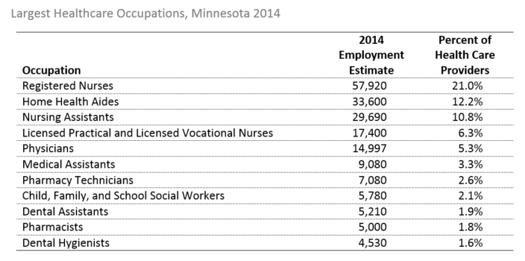

Slide 4
How Big is the Long Term Care Workforce?

Slide 6
Top Healthcare and Personal Service Occupations
in all Nursing and Residential Care Facilities, Minnesota 2012

Slide 7
Top Healthcare and Personal Service Occupations
in Skilled Nursing Facilities
Minnesota 2012

Slide 8
Minnesota’s Long Term Care Workforce Recap
103,000 workers.
Significant increase in demand by 2020
1,800 positions open in registered nurses, LPNs, nursing assistants and dietary aides.
51 percent of graduating nurses were hired by older adult service providers in Minnesota.
76 percent of new graduate nurse hires left after 18 months
Source: MDH, DEED, Long Term Care Imperative

Slide 9
Retooling for an Aging America: Building the Health Care Workforce

Slide 10
Older Persons Use More Services
~80% have a chronic disease
Current 12% of the population use:
26% of physician office visits
35% of hospital stays
34% of prescriptions
38% of EMS responses

Slide 11
Inadequate Workforce
Not Enough Specialists
~7,100 geriatricians and declining
~1,600 geriatric psychiatrists
Less than 1% of nurses and pharmacists and less than 4% of social workers specialize in geriatrics

Slide 12
Registered Nurses
Less than 1% of RNs certified in geriatrics
29% of baccalaureate programs have a certified faculty member
1/3 of baccalaureate programs require exposure to geriatrics
Associate degree programs - unknown

Slide 13
Prevalence of Disability/Limitations
 | Age 18+ | Age 65-74 | Age 75+
Trouble hearing | 16.8 | 31.9 | 50.4
Vision limitations | 9.5 | 13.6 | 21.7
Absence of all natural teeth | 8.0 | 22.8 | 29.4

Slide 15
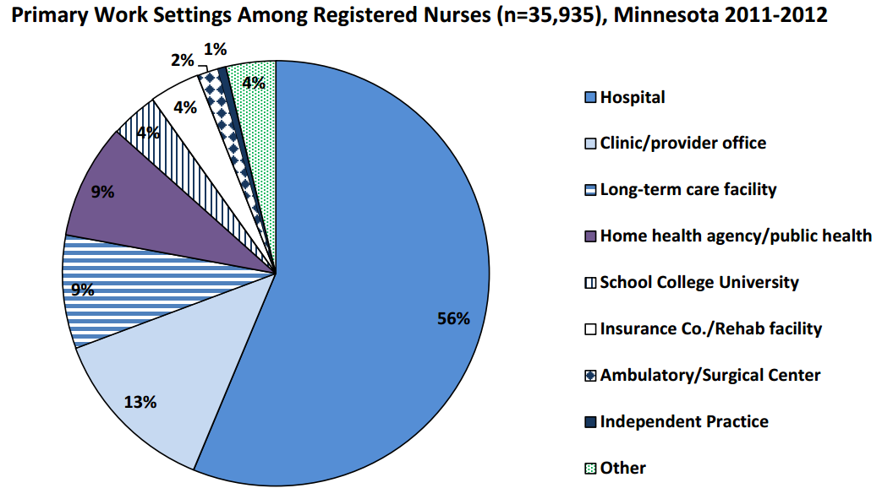
Registered Nurses in Long Term Care
Source: MDH Health Workforce Analysis Program

Slide 16
LPNs in Long Term Care
Source: MDH Health Workforce Analysis Program

Slide 17
Physical Therapists in Long Term Care
Source: MDH Health Workforce Analysis Program

Slide 18
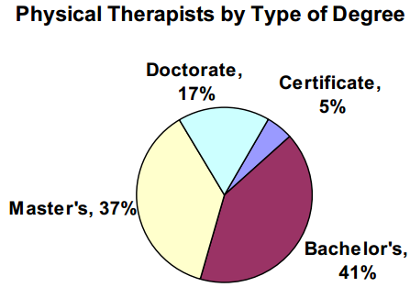
Source: MDH Health Workforce Analysis Program

Slide 19
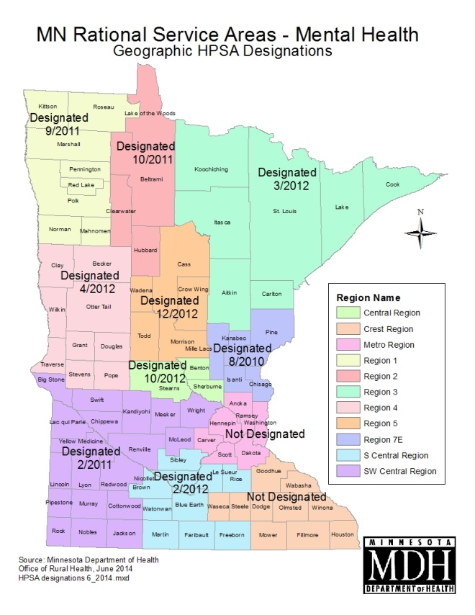
Mental Health HPSA requires a psychiatrist to population ratio of 35,000 to 1

Slide 20
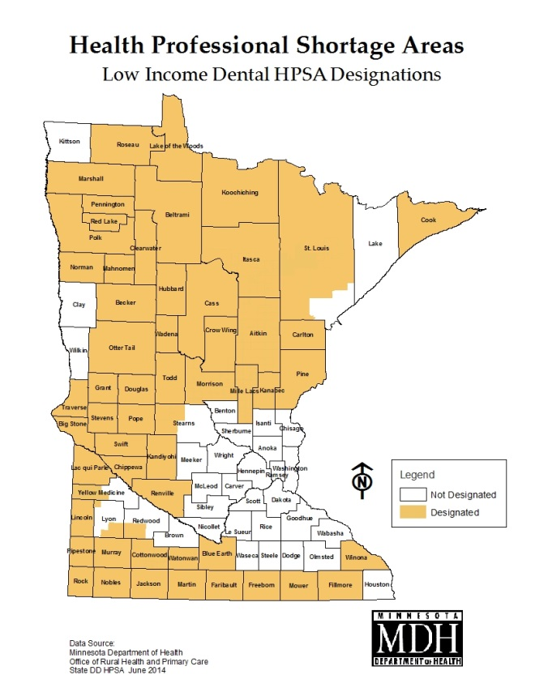
Low Income Dental HPSA requires a dentist to population ratio of 4,000 to 1

Slide 21
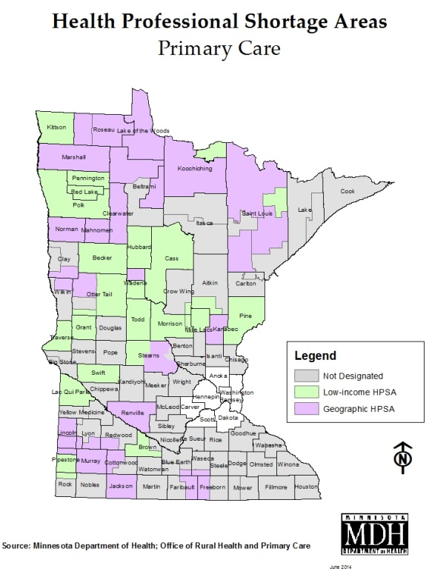
Primary Care Health Professional Shortage Area requires a physician to population ratio of 3,500 to 1

Slide 22
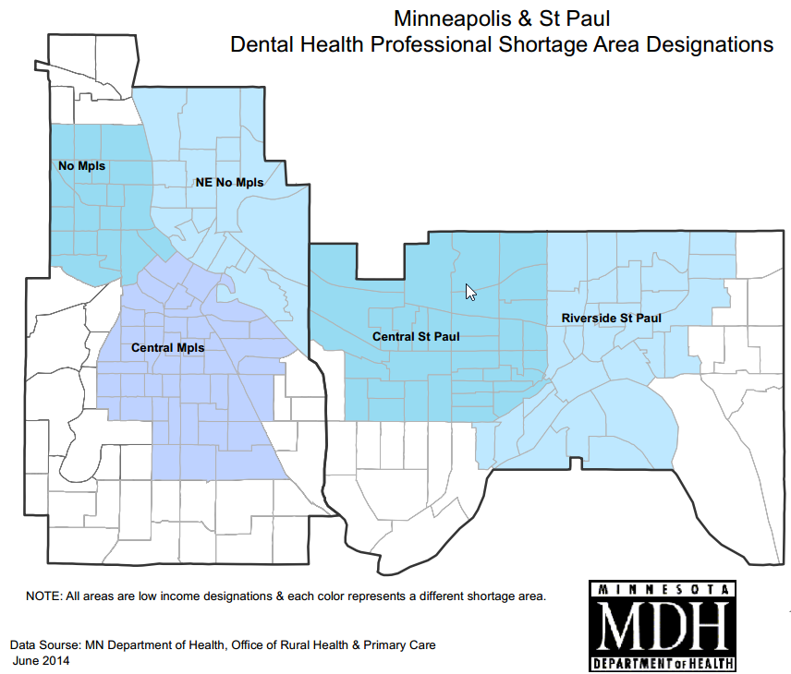
Low Income Dental HPSA requires a dentist to population ratio of 4,000 to 1

Slide 23
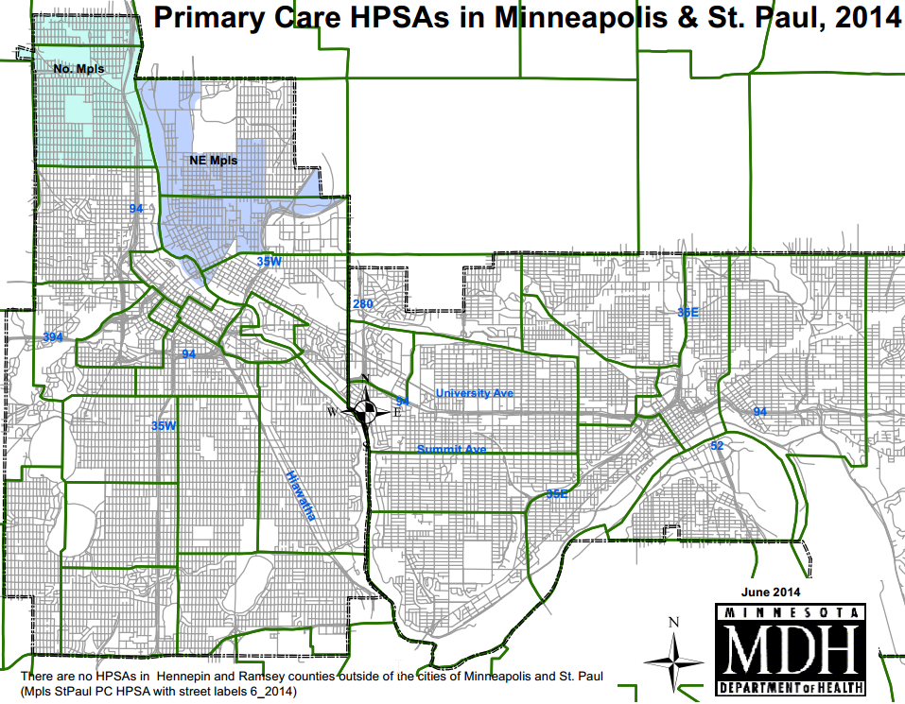
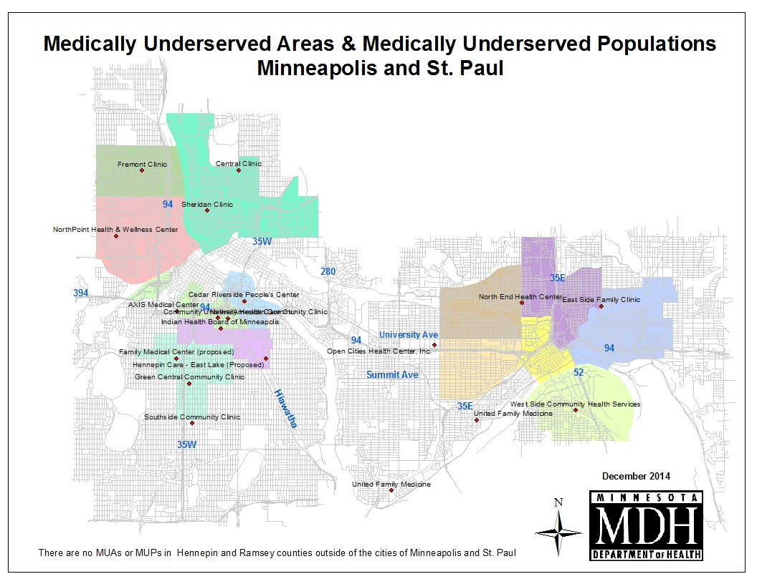
Primary Care Health Professional Shortage Area requires a physician to population ratio of 3,500 to 1

Slide 24
Therapy & Ancillary Professions in Long Term Care in Minnesota
Dietitians and Nutritionists | 84
Speech-Language Pathologists | 41
Occupational Therapists | 162
Physical Therapists | 202
Social Workers & Mental Health Counselors | 979

Slide 26
Loan forgiveness expansion Aging & Long Term Care Committee HF 614 and HF 627

Slide 27
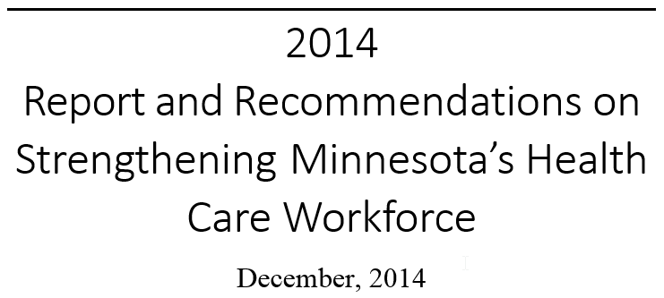

Slide 28
WORKFORCE COMMISSION FINDINGS:
Rural areas in Minnesota face a variety of challenges to attract and retain health professionals in many occupations.
WORKFORCE COMMISSION RECOMMENDATIONS:
The legislature should support continuation, and growth where warranted, of proven programs with measurable outcomes like loan forgiveness.

Slide 29
Bringing Health Care to the Heartland: An Evaluation of Minnesota’s Loan Forgiveness Program
“An effective program that meets its goals of recruiting providers to underserved areas, and that is an influential factor in recipients’ decision of where to practice after graduation.”
88% of physicians and 93% of physician assistants and nurse practitioners are still in the same or a similar location; most remain in rural areas after 15 and 20 years.
Loan forgiveness participants report that the program has a major effect on their choice of practice location.

Slide 30
What the bills do
Increase funding and the number of loan forgiveness participants to rural and underserved areas (both bills)
Revise provisions related to nurses participating in loan forgiveness while working in nursing homes (both bills)
Add more occupations eligible for loan forgiveness while working in long term care settings (HF 627)

Slide 31
Minnesota Loan Forgiveness Program
Profession | Average Student Debt | Annual Award Amount | 4-Year Award Amount
Physician | $169,900 | $25,000 | $100,000
Dentists | $206,100 | $30,000 | $120,000
Pharmacist | $133,700 | $20,000 | $80,000
“Midlevel” Practitioners | $82,900 | $12,000 | $48,000
Nurses/Public Health Nurses* | $34,000 | $5,000 | $20,000
Nurse/Allied Health Faculty | $61,000 | $9,000 | $36,000
Dental Therapists* | $69,000 | $10,000 | $40,000
Mental Health Professionals (Blended)* | $64,000 | $10,000 | $40,000
* Proposed additions in SF 3 – public health nurses, dental therapists, mental health professionals

