Slide 1
Sentencing Commission Mandates and Probation Guidelines
Kelly Mitchell, Executive Director
Robina Institute of Criminal Law and Criminal Justice
University of Minnesota Law School

Slide 2
HF 997
Expands the mandate of the Sentencing Guidelines Commission to require the commission to collect, analyze, and report on probation outcomes and recidivism.
Directs the Sentencing Guidelines Commission to develop probation guidelines.

Slide 3
Sentencing Commissions
Two main types:
Established to develop, implement, and monitor some form of Sentencing Guidelines.
Created to focus on the development and analysis of sentencing and/or criminal justice policy.
A Type 1 commission may also engage in Type 2 activities.

Slide 4
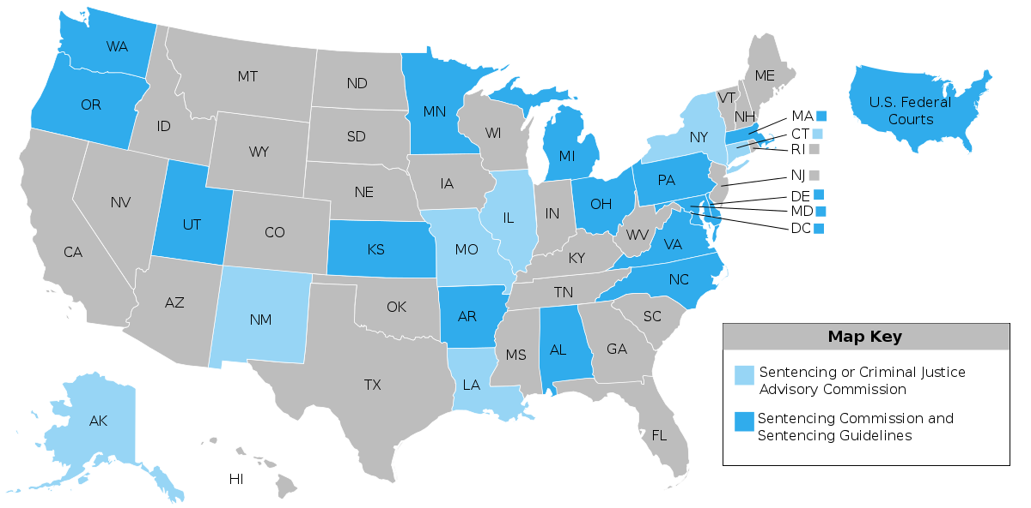
Commissions and Guidelines
Notes:
Nevada is the newest state to establish a sentencing commission. The most recent were Michigan and Massachusetts, both of which in 2014 reconstituted commissions that had gone dormant. The most recent state to establish a completely new commission was Connecticut, in 2011.

Slide 5
Primary Commission Purposes
Recommend or Establish Sentencing Policies and Practices
Protect Public Safety
Manage Correctional Resources
Maintain Judicial Discretion in Sentencing
Avoid Disparity / Increase Equity and Fairness in Sentencing
Achieve Certainty in Sentencing

Slide 6
Guidelines Principles

Slide 8
Like the Minnesota grid, the Oregon grid shows:
In/Out decision
Prison Length
But this grid also shows:
Jail days for probation sentences
Probation terms
Maximum departure limits
Periods of post-prison supervision

Slide 9
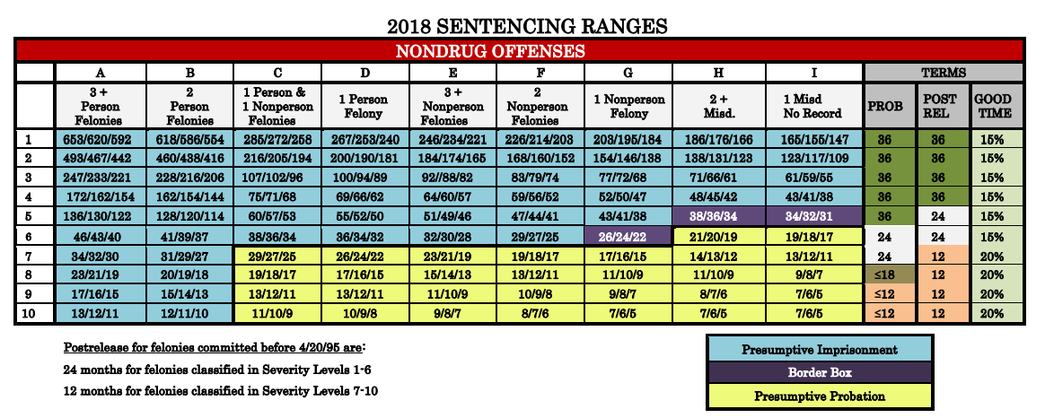
Kansas Sentencing Grid

Slide 10
Both states allow for longer probation terms
Oregon
Kansas
(b) Subject to subsection (e) of this section, the sentencing judge may by departure impose a greater term of supervised probation when necessary to ensure that the conditions and purposes of probation are met;
Note: The max depart column on the grid shows the maximum amount of time that may be added to presumptive probation terms.
5) if the court finds and sets forth with particularity the reasons for finding that the safety of the members of the public will be jeopardized or that the welfare of the inmate will not be served by the length of the probation terms provided in subsections (c)(3) and (c)(4), the court may impose a longer period of probation. Such an increase shall not be considered a departure and shall not be subject to appeal;

Slide 11
Both states have additional nuanced rules
Oregon
Kansas
Probation terms for certain sex offenses are 5 years up to the statutory maximum.
Time on probation tolls when a person absconds.
Court can extend probation at a modification hearing, upon a finding of judicial necessity, for up to 5 years or the maximum sentence that could be imposed.
Court can extend probation for nonpayment of child support or restitution.
Multiple probation sentences must be concurrent (cannot be aggregated or served consecutively).

Slide 12
Questions?
Contact Information:
Kelly Mitchell, Robina Institute
229 19th Avenue South
Minneapolis, MN 55455
(612) 626-4736
mitch093@umn.edu
Visit the Sentencing Guidelines Resource Center
sentencing.umn.edu

