Slide 1

Minnesota Department of Public Safety
FY20-21 Budget

Slide 2


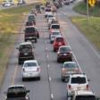
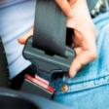


Department of Public Safety
Transportation
Policy and Finance Committee
Minnesota State Patrol
Driver and Vehicle Services
Office of Traffic Safety
Office of Pipeline Safety
Administration and
Related Services

Slide 3
Total DPS Budget Base FY18-19
Transportation Division
Total all funds = $413,456
(in thousands)

Slide 4
FY18-19 Expenses By Category
Transportation Divisions
Total all funds = $413,456
(in thousands)

Slide 5
Budget Requests
Operating Adjustment
GF| $131,000 FY21 : Ongoing
THF| $405,000 FY21 : Ongoing
  Technology Increase
  THF| $2.485M FY20\21 : Ongoing
Application Server Migration
GF| $258,000 FY20 |$174,000 FY21 : Ongoing
HUTD | $774,000 FY20 | $696,000 FY21 : Ongoing
DVS Customer Service
SRF | $7.595M FY20 | $7.488M FY21 | $6.358M : Ongoing
HUTD | $471,000 FY20/21 | $465,000 : Ongoing
Soft Body Armor Reimbursement
GF | $374,000 deficiency for FY19
GF | $45,000 FY20\21 : Ongoing
Capitol Security
GF| $500,000 FY20/21 : Ongoing
Driver and Vehicle Systems Development
GF|$20.335M FY20 | $17.335M FY21
Driver and Vehicle Systems O&M
SRF | $14.66M FY20 | $16M FY 21 : Ongoing
License Plate Administration
HUTD | $5.226M FY20 | $5.226M FY21 : Ongoing

Slide 6
Operating Adjustment
2019 Governor’s Budget Recommendation:
Maintain the current services of the Public Safety Support Division
2.5 FTEs in the Human Resources and Internal Affairs divisions and space rental.
  General Fund | $131,000 FY21 : Ongoing
  Trunk Highway Fund | $405,000 FY21 : Ongoing

Slide 7
Technology
2019 Governor’s Budget Recommendation:
Support existing hardware, software, and MNIT staffing costs for the Driver and Vehicle Services and Public Safety Support divisions
  Trunk Highway Fund | $2.485M FY20\21 : Ongoing
Application Server Migration
  General Fund | $258,000 FY20 |$174,000 FY21 : Ongoing
  HUTD | $774,000 FY20 | $696,000 FY21 : Ongoing

Slide 8
Driver and Vehicle Services
Minnesota Department of Public Safety

Slide 9

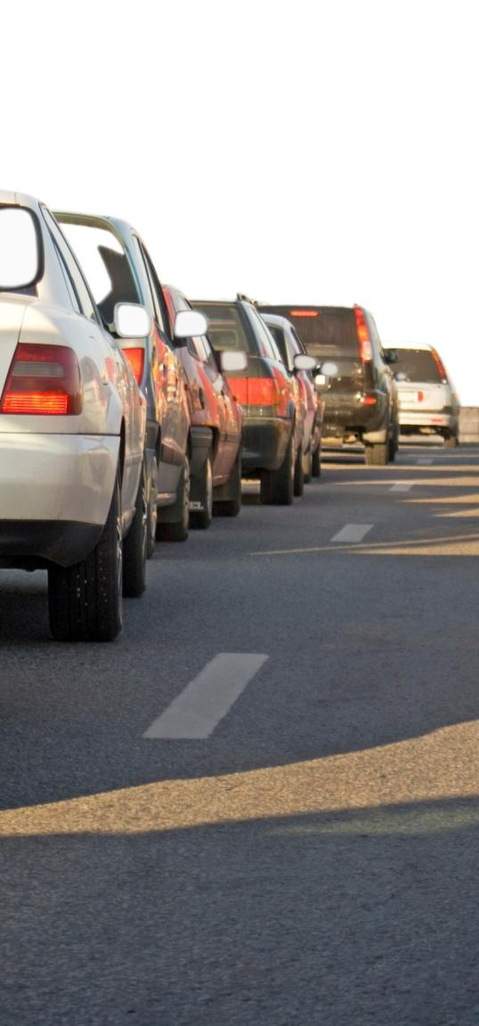
Driver and Vehicle Services
Minnesota Department of Public Safety
DVS has 493 employees working in 95 locations throughout the state
DVS receives an annual appropriation of approximately $75 million from the Special Revenue Fund and the Highway User Tax Distribution Fund
DVS collects more than $1.4 billion in state revenue annually

Slide 10
Driver and Vehicle Development
2019 Governor’s Budget Recommendation:
The Governor’s recommended funding will allow:
MNIT to finish the optimization of the MNLARS vehicle system
Build in the functionality DVS and their business partners (deputy registrars, auto dealers) need
Migrate the remaining systems from the costly mainframe legacy environment
Optimization of Phase 2 of the FAST driver system.
General Fund |$20.335M FY20 | $17.335M FY21

Slide 11
Driver and Vehicle Ongoing Maintenance
2019 Governor’s Budget Recommendation:
Support the ongoing operation and maintenance costs of the new driver system and vehicle system
  $14.66M FY20 | $16M FY 21 : Ongoing
  Funded with a $2.00 transaction fee on vehicle and driver license transactions

Slide 12
Driver and Vehicle Services Staffing
2019 Governor’s Budget Recommendation:
Driver and Vehicle Services Customer Service Improvement
Meet target metrics: Title, driver’s license, and disability certificate turnaround; call center wait time
Enhance financial oversight and auditing capabilities
Review and process refunds owed to customers for overpayment
Increase ability to schedule timely road tests to address increased demand
Add driver evaluators in Greater Minnesota to provide better service and reduce travel time
Improve vehicle inspection services
Ensure access to DVS data is monitored and tightly protected
Issue highly-regulated credentials with all required documents and verification

Slide 13
Special Revenue Fund – Proposed Fee Increases
Single plate: $6.50
  Assessed every 7 years last raised 2007
  Current fee: $4.50
Double plate: $8.40
  Assessed every 7 years last raised 2007
  Current fee: $6.00
Duplicate stickers: $1.50
  Assessed only when a customer loses stickers last raised prior to 2003
  Current fee: $1.00
Special plates: $14.00
  Assessed every 7 years, though some plates are permanent; last raised 2007
  Current fee: $10.00
Drivers license: Add $4.50
  Current fees range from $13.25 for state IDs, up to $59.25 for certain types of commercial driver’s licenses.
  Last raised in 2008
Special Revenue Fund
$7.595M FY20 | $7.488M FY21
$6.358M : Ongoing
HUTD
$471,000 FY20/21
$465,000 : Ongoing

Slide 14
Highway User Tax Distribution (HUTD) Allocation Increase
2019 Governor’s Budget Recommendation:
Costs associated with license plate administration
FY18 manufacturing and distributing license plates, registration renewal notices, and registration stickers:
Costs: $13.462 million
Appropriation: $8.236 million
HUTD | $5.226M FY20 | $5.226M FY21 : Ongoing

Slide 15
State Patrol
Minnesota Department of Public Safety

Slide 16


State Patrol
Minnesota Department of Public Safety
The State Patrol includes 895 full-time personnel
The State Patrol receives an annual appropriation of $112.7 million
  $103.2 million from Trunk Highway Fund
  $876,000 from Highway User Tax Distribution Fund
  $8.6 million from the General Fund
The State Patrol received $8 million in federal funds in FY19

Slide 17
Capitol Security Increase
2019 Governor’s Budget Recommendation:
Ensure sufficient staffing for the security of the Capitol Complex, the Governor’s residence, and executive protection
General Fund | $500,000 FY20/21 : Ongoing

Slide 18
Soft Body Armor (Vest) Reimbursement
2019 Governor’s Budget Recommendation:
Soft Body Armor Reimbursement §299A.38
  Average cost of a vest reimbursement is $509 – an increase of 12 percent since 2014
  Projections for the average reimbursement cost of a vest in FY20 will increase to $524
  1,231 reimbursement requests expected from peace officers and local governments for up to one-half the cost of soft-body armor purchases
  $374,000 deficiency for FY19
  General Fund | $45,000 FY20\21 : Ongoing

Slide 19
Office of Pipeline Safety
Minnesota Department of Public Safety
Notes:
ECN does not have a 2019 budget request, you will see them in an upcoming hearing with a policy request for the committee.

Slide 20
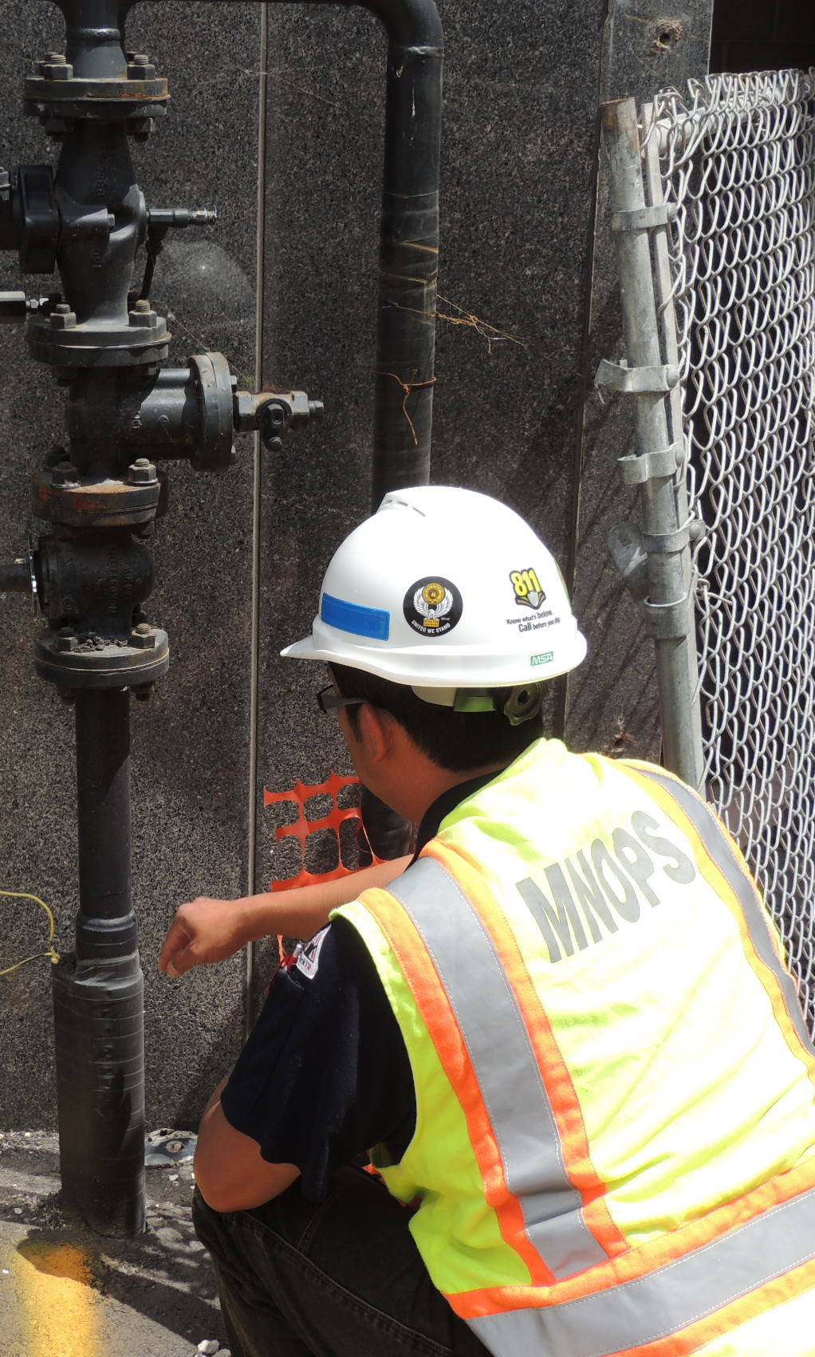
Office of Pipeline Safety
Minnesota Department of Public Safety
MNOPS has annual resources of $3.8 million from Special Revenue and federal funds.
  $1.44 million per year is a direct appropriation derived from inspection fees.
  $2.3 million in federal funds.
  $80,000 in receipts from “One Call” fines.

Slide 21
Office of Traffic Safety
Minnesota Department of Public Safety

Slide 22

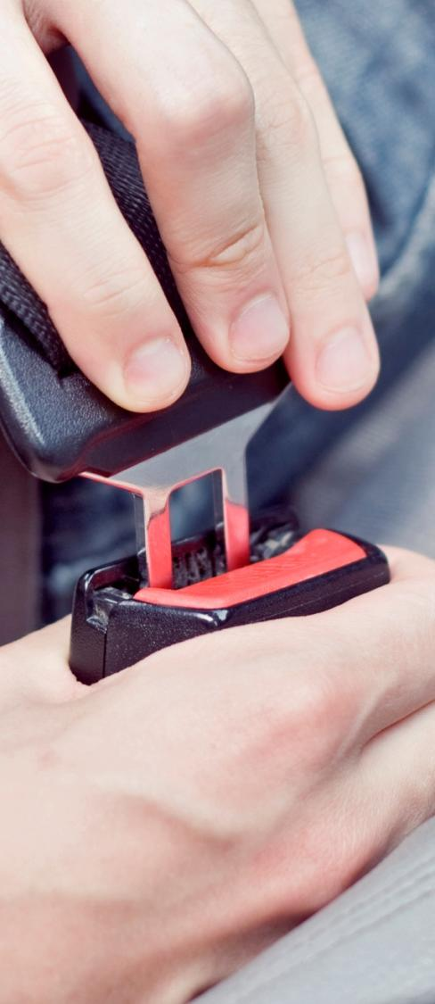
Office of Traffic Safety
Minnesota Department of Public Safety
OTS receives an annual appropriation from the General Fund of $470,000
OTS receives an annual appropriation from the Trunk Highway Fund of $493,000 - leveraged for $32.8 million in federal funds, grants, and one-time monies

Slide 23
Questions?

