Slide 1
Current and Emerging Water Issues
William Arnold
Civil, Environmental, and Geo- Engineering
University of Minnesota
Notes:
Legislative Water Commission on point on a lot of issues

Slide 2

Acknowledgments/Crowd Sourcing
  UMN, CEGE
    John Gulliver
    Paige Novak
    Tim LaPara
    Ray Hozalski
    Paul Capel
  UMN, SWAC
    Brandy Toner
  UMN, IonE
    Kate Brauman
  UMN, HHH
    Bonnie Keeler

Slide 3
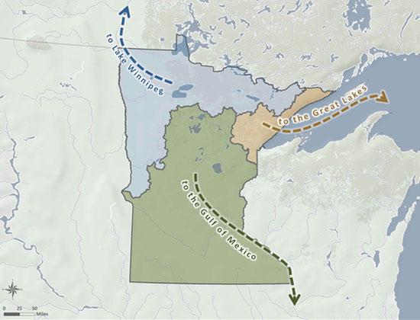

Population Growth & Land Use
Climate Change
Water Quantity
Water quality
Infrastructure, Treatment Needs, Environmental Health
Public Trust

Slide 4
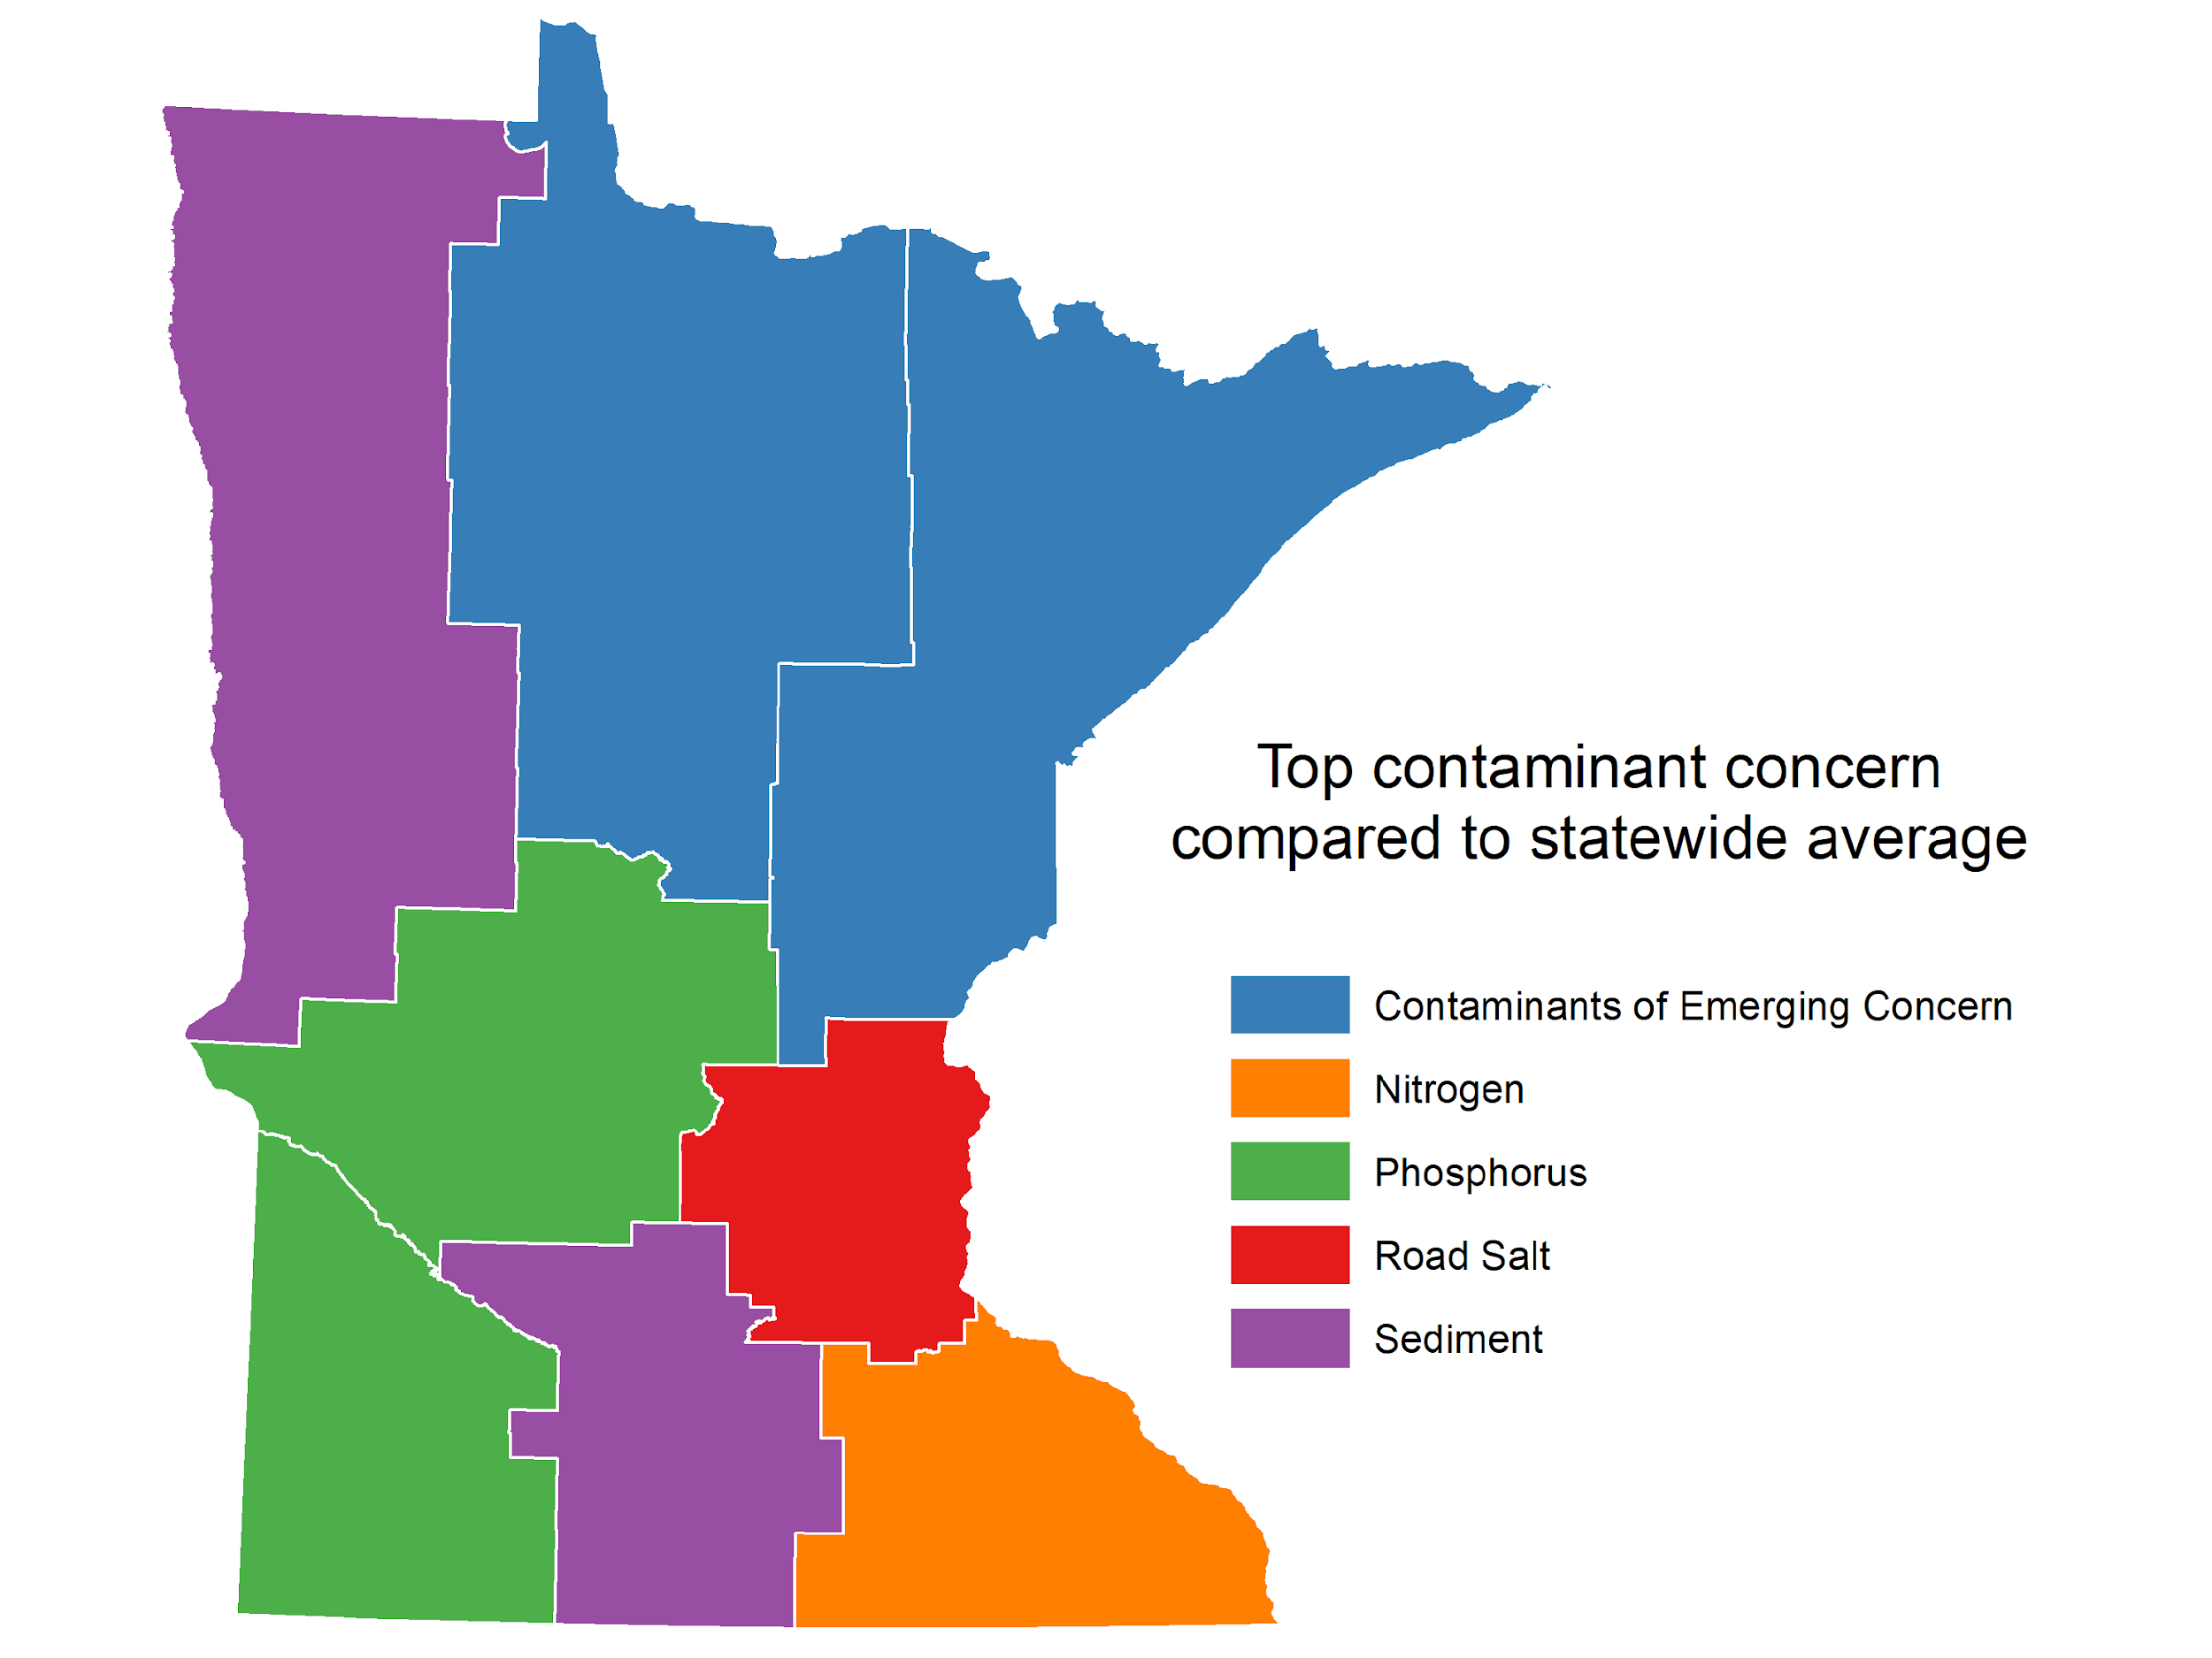
Chemicals and Microbes
What’s in the water?
  Pharmaceuticals, estrogens, pesticides (CECs)
  Nutrients
  Chloride
  Viruses
  Bacteria
Courtesy of Bonnie Keeler
Notes:
25 by 25 town halls
MN people know about chemical pollutants
Microbiological also important

Slide 5
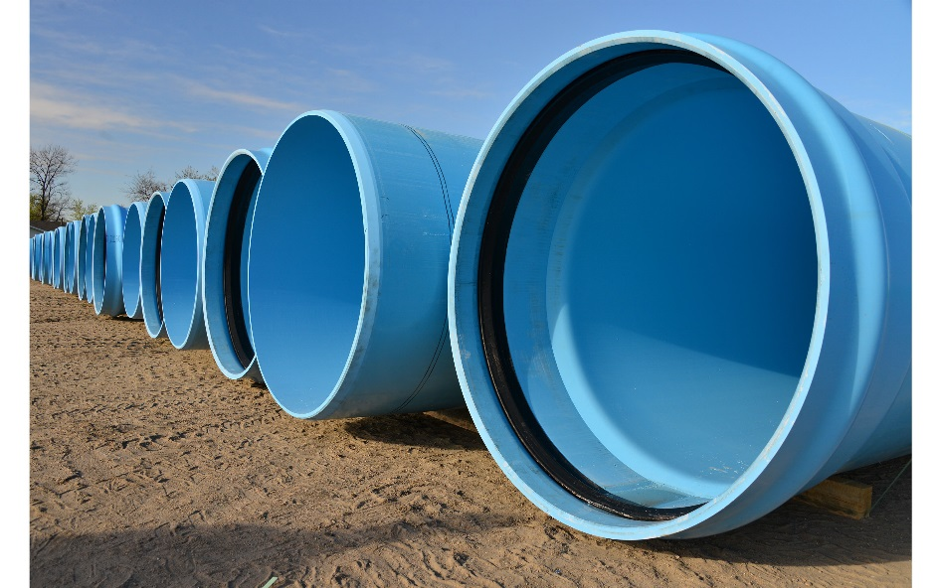
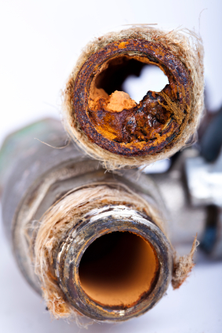
Drinking Water
Nitrosamines
Contaminants of Emerging Concern
  PFAS
  Pharmaceuticals
  neonicotinoids
Opportunistic pathogens
Release of monomers, curing agents
Upgrade treatment?
Infrastructure replacement?
Notes:
Nitrosamines are carcinogens formed during specific disinfection conditions if precursors present (wastewater often a source of precursors, so water
Talk more about PFAS later
Recent work from Iowa suggests neonics in drinking water

Slide 6
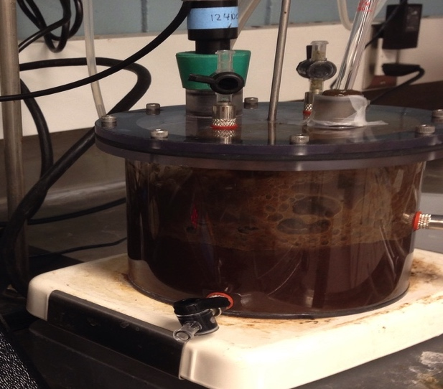
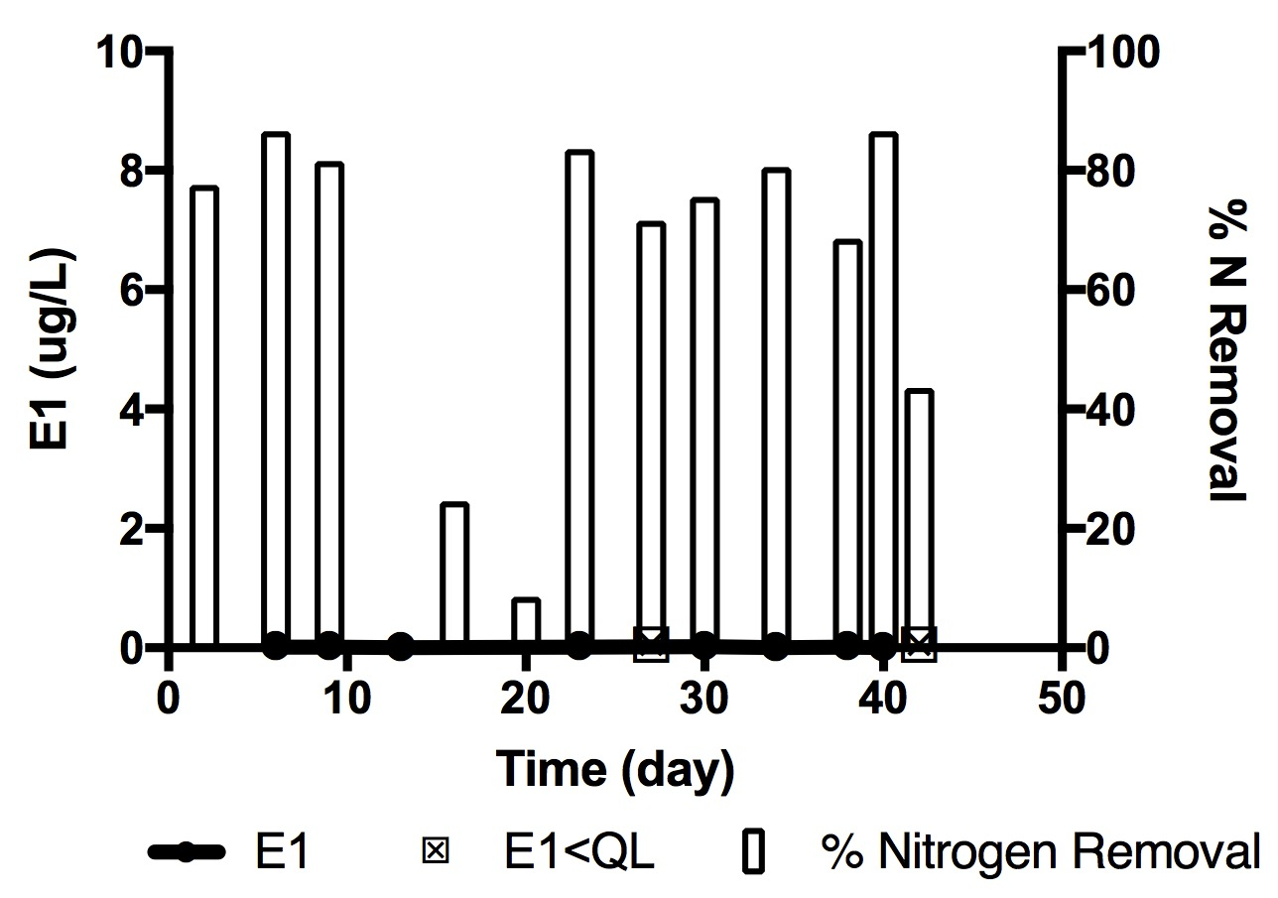
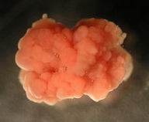
Wastewater
Low energy/energy positive treatment
How do we recover resources better?
Protect ecosystems from Contaminants of Emerging Concern
  Upgrade treatment?
Sewer detectives? (opioids?)
Infrastructure replacement?
Encourage innovation
Peterson, K. N., et al.. 2017Environmental Science: Water Research & Technology, 3:1051-1060.
Notes:
Innovation needed in this sector – lots of value in what we currently spent a lot of money and energy to treat.

Slide 7
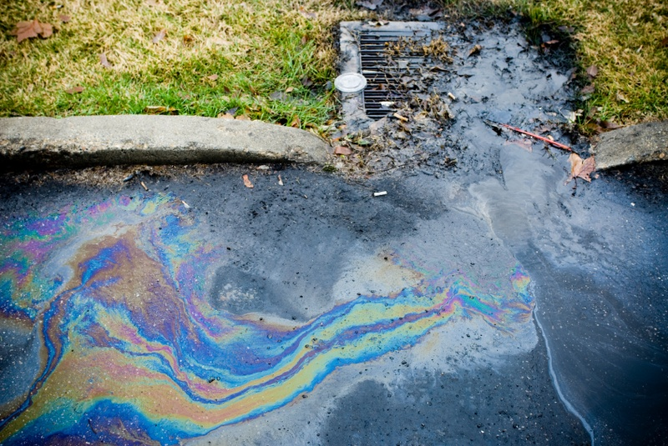
Stormwater
Collection and Reuse
  Wide variety of chemicals
  Microbial risks (aerosols)
  Tire wear particles/chemicals
Chloride
  Risks may outweigh benefits of deicing
  Water softeners
  Effective use, alternatives
  Removal?
Notes:
Regulations on re-use may need to be looked at.
Where do we use salt? Perhaps sand is good enough in parking lots….
No easy/cheap way to remove chloride

Slide 8
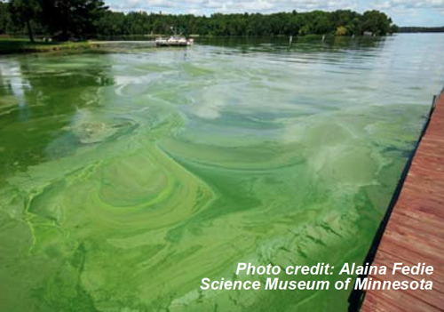
Old Pollutants, New problems
Nitrate
Phosphorus
  External
  Internal
Sediments
Nutrients + Climate (+ pesticides?) = Harmful Algal Blooms (HABs) = aesthetic and toxin issues

Slide 9
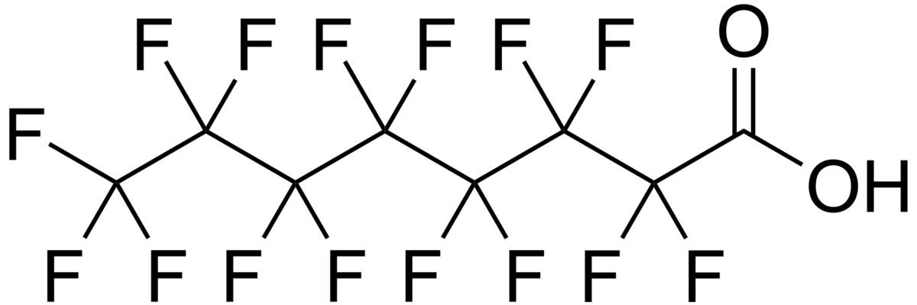
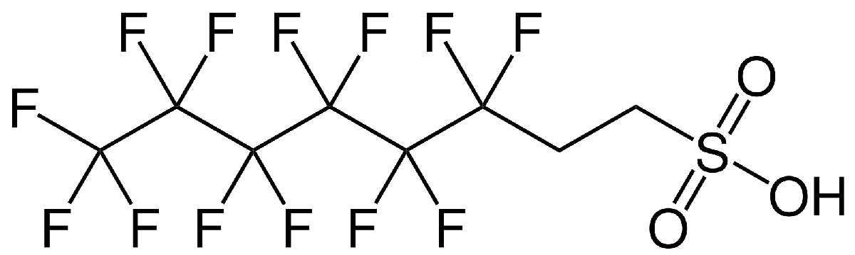
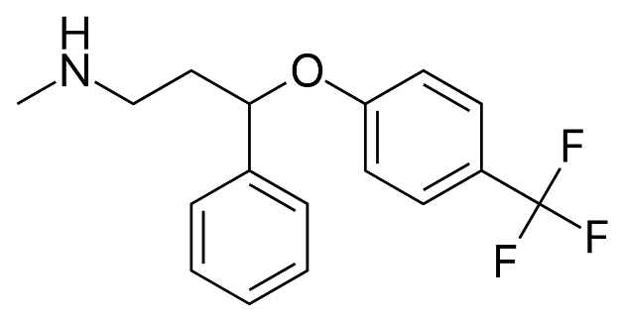
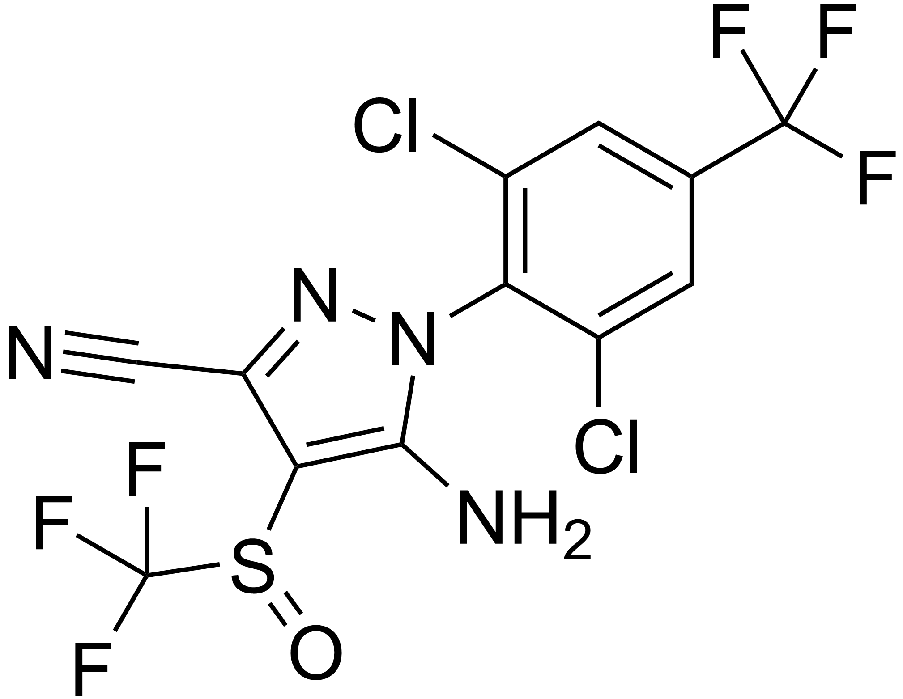
Fluorinated Chemicals
Per- vs. Poly- vs. pharms/pesticides
Manufacture
Use
Fire training activities
Groundwater, surface water, drinking water, wastewater, and storm water issue

Slide 10
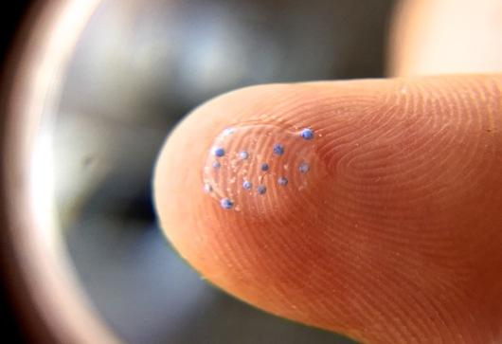
New Pollutants
New products introduced to market
  Pesticides
  Pharms
  Consumer products
Nanomaterials/metals impregnated in clothing
Plastics
  Wear particles
  Purposeful introduction
  Monomer, polymers, particles
Image credit: MPCA
Nanomaterials may also be solutions to pollution problems!!!
Notes:
Complete environmental assessment of new products expensive/time consuming.
Need a better way

Slide 11
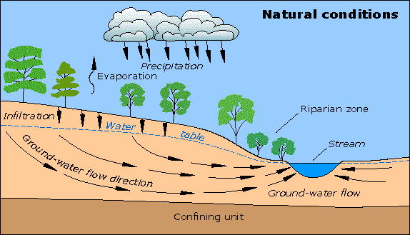
Groundwater
Source/well head protection
Nitrate
Viruses
Declining levels (overuse, climate, lack of recharge)
Notes:
We take groundwater, drink it/flush toilets with it, the send it to WWTP and the river == not sustainable.

Slide 12
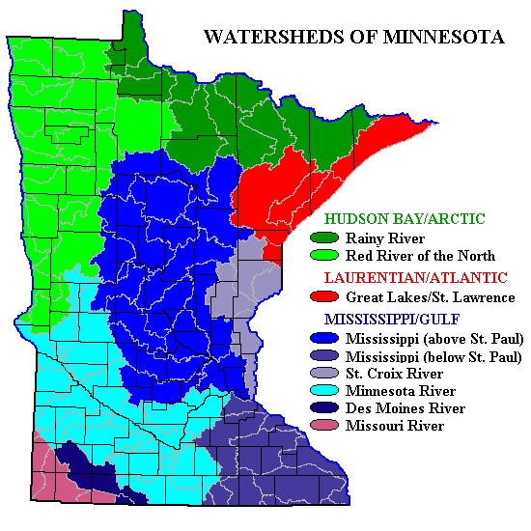
Watershed/Surface Waters
Manure management
  Bacteria
  CECs
Erosion
  Land use, climate
Mining
  Metals, sulfide
Effects of urbanization
Stormwater control
Climate change

Slide 13
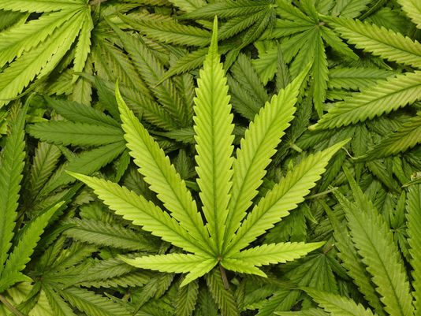
Other decisions may affect water….
How much water is needed?
What chemicals/nutrients are applied?
Do bioactive compounds leach from live plants?
Notes:
New policies, products, regulations (or removing regulations) may have unanticipated water impacts.

Slide 14
Change is coming Innovation is needed
Business as usual will stress
  Sustainable water quantity
  Sustainable water quality
  Human well being
  Environmental welfare
  Agriculture
  Industrial productivity/profits
  Impacts of climate change
Virus/bacterial monitoring & treatment
Chemical design, marketing, regulation
Treatment technologies
Water management (and treatment) strategies
  Recharge groundwater?
  reuse
Infrastructure rehabilitation and upgrades
Notes:
Management and reuse can lead to other issues
-NDMA, contamination of groundwater with CECs, aerosolization of microbes if storm/wastewater used for irrigation

