Slide 1
Housing Infrastructure Bonds and
GO Bonds for Public Housing
April 16, 2015

Slide 2
Our Mission:
Minnesota Housing finances affordable housing for low- and moderate-income households while fostering strong communities.
Notes:
Introduce Minnesota Housing by explaining what we do: Minnesota Housing provides access to safe, decent and affordable housing and builds stronger communities across the state. It has a national reputation as one of the finest housing finance agencies in the country and has built an enduring alliance among partners in the for-profit, non-profit and government sectors to achieve its mission.
Minnesota Housing offers products and services to help Minnesotans buy and fix up their homes and to stabilize neighborhoods, communities and families. It also supports the development and preservation of affordable rental housing through both financing and long term asset manage­ment. It has pioneered a successful model for supportive housing that helps stabilize the lives of some of the state’s most vulnerable citizens.

Slide 3
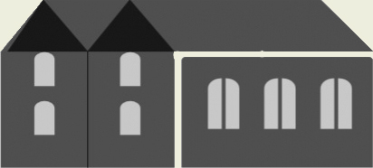
2014 Outcomes
59%
of all homebuyers assisted had an annual income under $50,000
Served 59,129 households
Assisted more than 12,014 homebuyers
24.4% were households of color
75% of renters assisted had an annual income under $20,000
Provided $754 million
in funding for housing

Slide 4
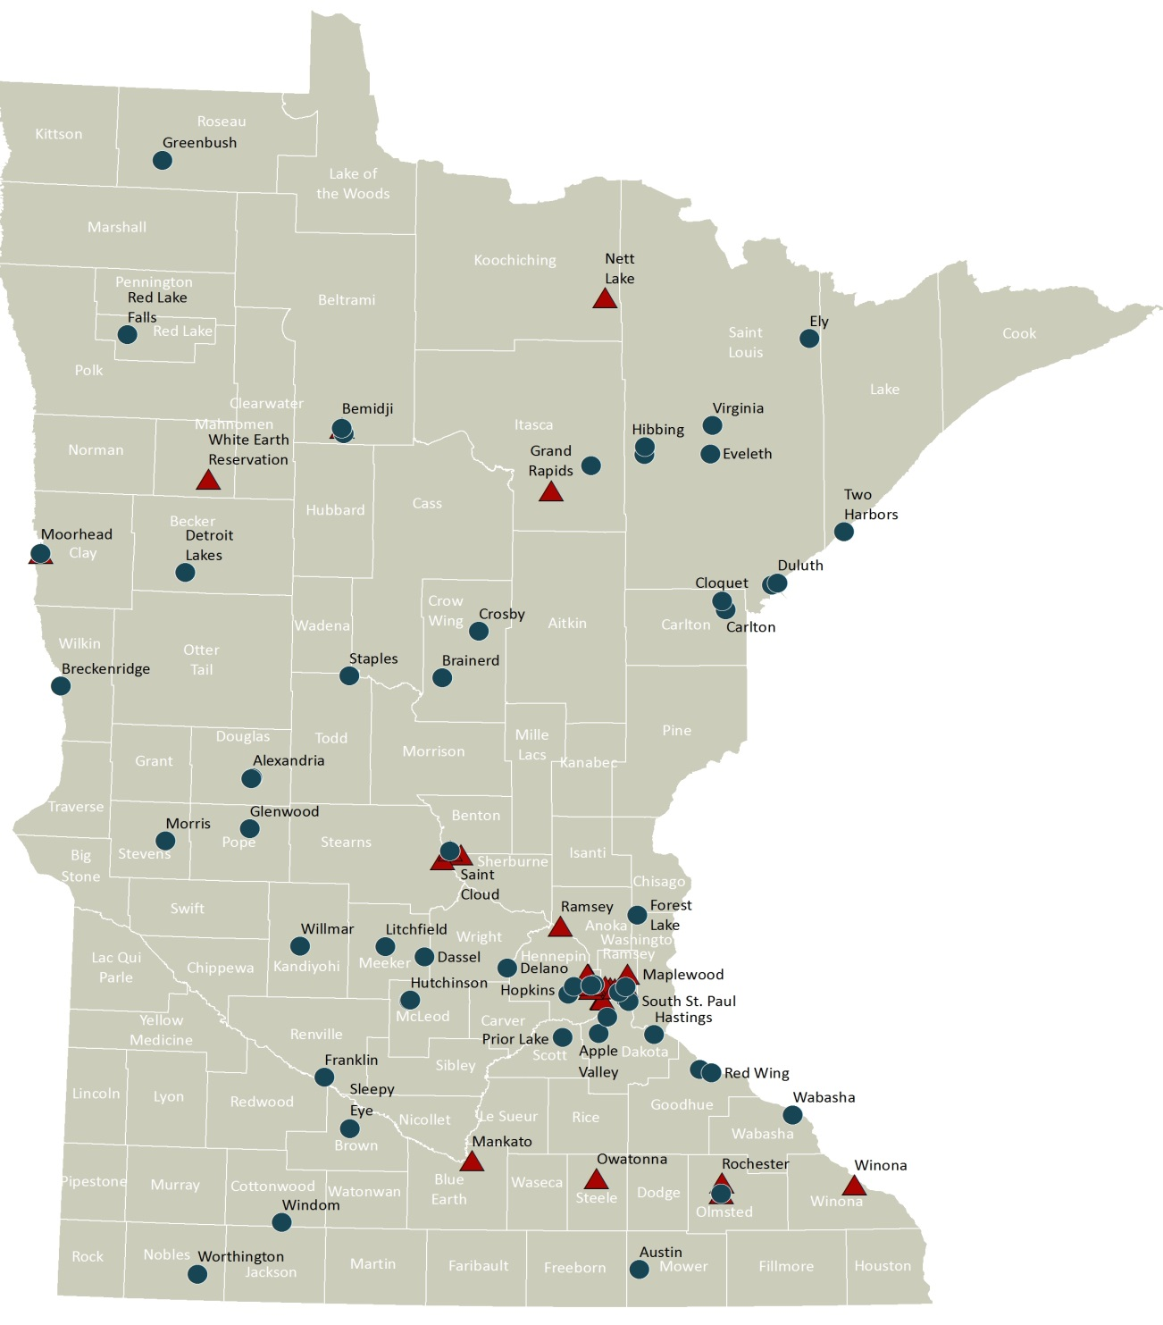
Capital Investments in Housing 2002-2012
Housing
Infrastructure Bonds
or nonprofit
Housing Bond
Proceeds
GO Bonds
Notes:
State investment: $216 million

Slide 5
2014 Bonding Bill
The Legislature approved $100 million in bonding for housing
$80 million in Housing Infrastructure Bonds (HIB)
$20 million in GO Bonds for Public Housing
All of the funding has been committed to projects across Minnesota
Projects breaking ground in 2015
Notes:
HIB proceeds awarded in October 2014
GO Bond proceeds awarded in January 2015

Slide 6
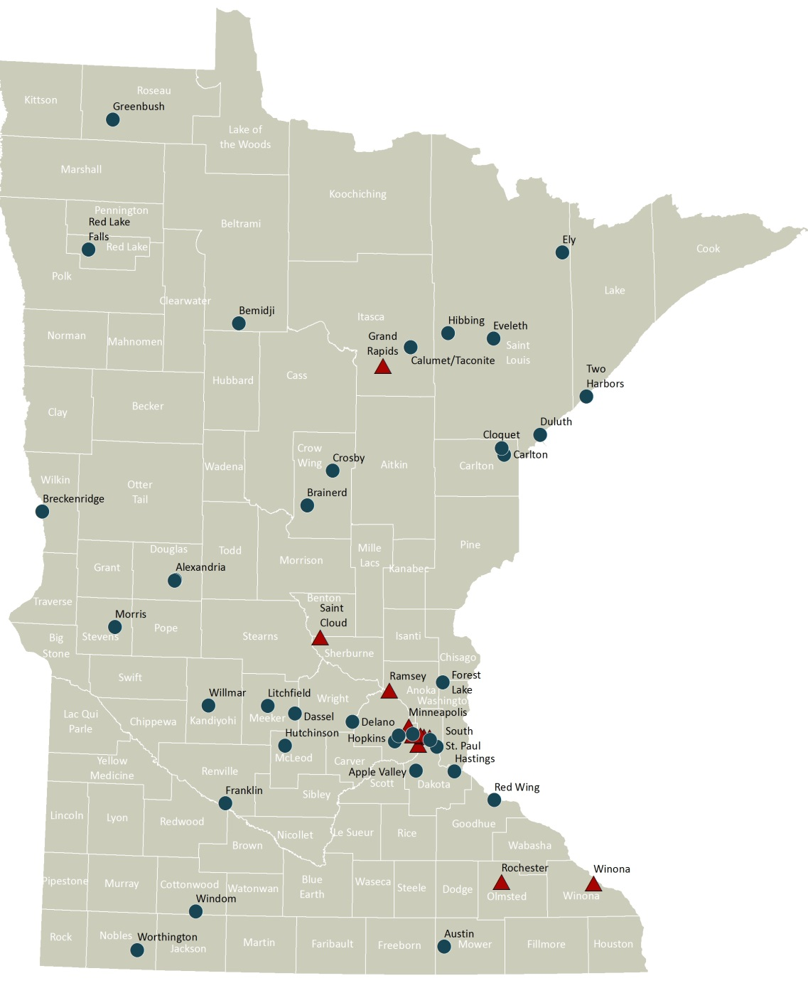
Capital Investments in Housing 2014-2015
Housing
Infrastructure Bonds
or non-profit
Housing Bond
Proceeds
GO Bonds
State investment: $100 million

Slide 7
Housing Infrastructure Bonds (HIB)

Slide 8
2014 Housing Infrastructure Bonds
Fully Committed – Bonding dollars were committed in October 2014
Proceeds will be used to fund 1,200 units of housing in 16 projects across the state

Slide 9
Eligible Uses
1. Preservation of Federally-Assisted
Housing
2. Supportive Housing
3. Foreclosure Recovery
4. Community Land Trusts
Notes:
AA: Again, it might be nice to have these come in on your click so you can discuss each one without people getting distracted. Your call though!

Slide 10
Why Housing Infrastructure Bonds?
Most of the housing in the state is privately owned
GO bonds limited to public ownership
Rents of low to moderate-income tenants limit privately-financed development
Cost effective solution to housing
The cost of rental assistance is 2-6 times less than the cost of emergency shelters
Notes:
Average cost to serve a Bridges household is about $500 a month. We know that the cost of emergency shelter is about $30-$90 a day (depending on household size), 2-6 times the cost, not even including additional increased costs of emergency room visits, police encounters, and other negative outcomes, which we know are a real cost of homelessness. Costs of Hennepin County Jail are about $120/day, the cost of detox is over $200/day, and the costs of psychiatric hospitalization are even greater.

Slide 11
Awarding Funds
Legislature authorizes Housing Infrastructure Bonds
Developers compete for funding through competitive RFP process
Owners maintain housing affordability for at least 20 years

Slide 12
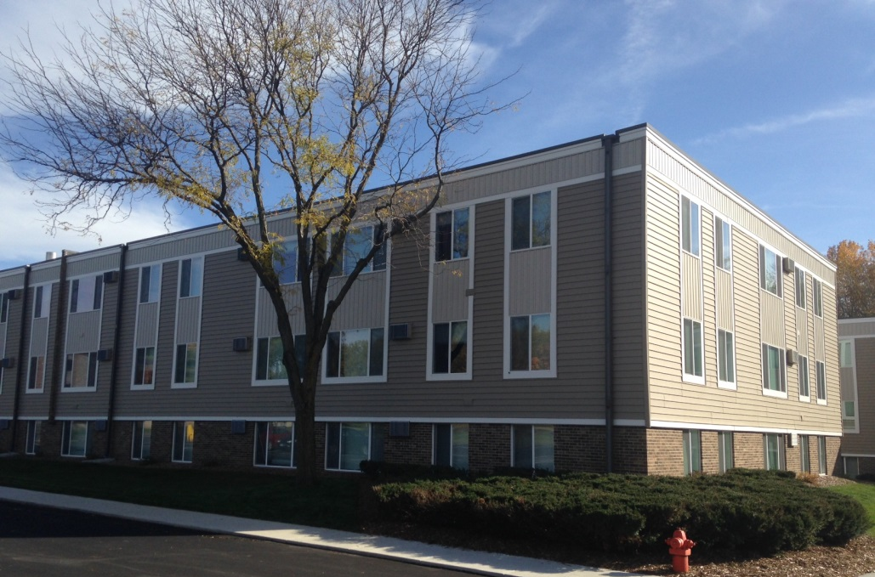
Preservation of Federally-Assisted Housing
Square on 31st, Rochester
Funded in 2012
Acquisition and Rehabilitation of 104 unit building
Includes 95 project-based Section 8 units

Slide 13
Leveraging Funds for Preservation
Every $1 in state funding for gap financing for preservation leverages approximately $3 in private capital funding.
Every $1 in state funding preserves $4 in federal assistance.

Slide 14
Supportive Housing
Beacon Hill, Grand Rapids
48 new construction units
Apartments for long-term homeless and persons with disabilities
2 and 3 bedroom family housing townhomes
Notes:
Units are 2, 3 and 4 bedrooms
6 Long-term homeless units
Tribe’s 2nd supportive housing project

Slide 15
Foreclosure Recovery
Sunwood Village, Ramsey
47 new construction units
Family housing
Located near Ramsey Northstar Station
Notes:
Includes funding from the Met Council, DEED, Federal Home Loan Bank and CPED.

Slide 16
Supportive Housing for Veterans
Veterans East
New construction of 100 units of supportive housing targeted for homeless veterans
Located adjacent to VA Medical Center

Slide 17
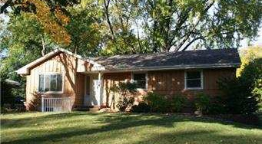
Community Land Trusts
Homes Within Reach, Suburban Hennepin County, Community Land Trust
10 Units
Average annual income of households served is $41,000
Notes:
158 zip codes out of 883 statewide are considered foreclosure recovery areas
The agency determines foreclosure recovery areas based on number of REO properties, the foreclosure rate and the delinquency rate.

Slide 18
GO Bonds for Public Housing Rehabilitation

Slide 19
Public Housing in Minnesota
Public housing serves 36,000 low-income Minnesotans
Includes 12,000 children
More than 65% have incomes less than $15,000 per year
More than 90% of public housing units are 20+ years old
Notes:
In 2012, $5.5 million in GO Bonds funded 14 projects and 950 units of public housing across the state.

Slide 20
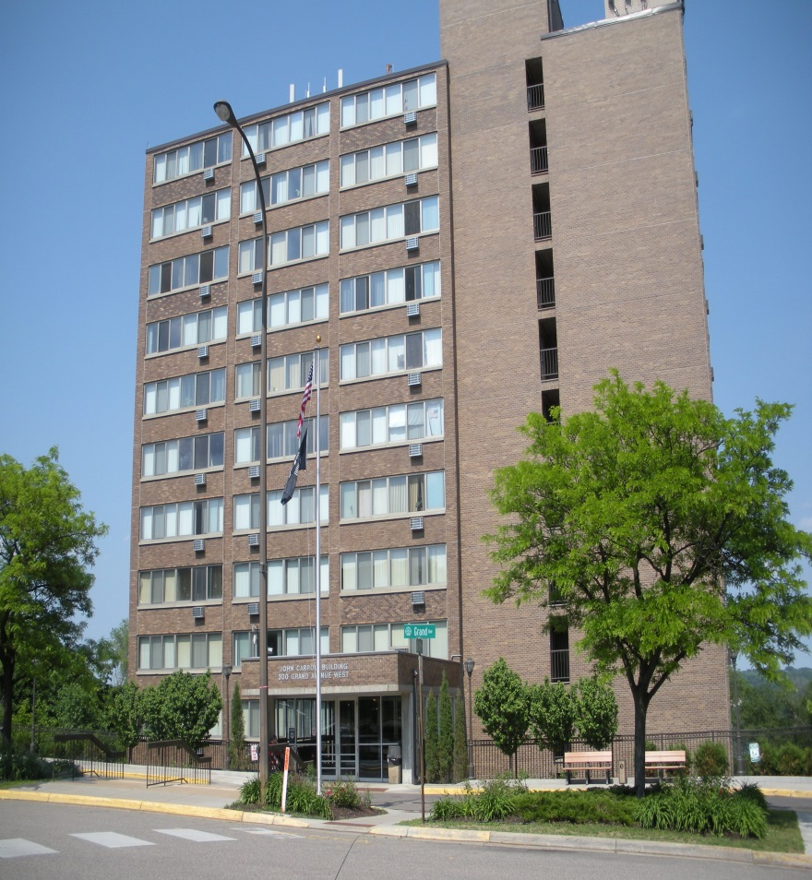
2014 Public Housing
In 2014, $20 million in GO Bond proceeds committed to rehab nearly 2,500 public housing units in 35 developments
Nearly 75% of funds went to Greater Minnesota
Notes:
In 2012, $5.5 million in GO Bonds funded 14 projects and 950 units of public housing across the state.

Slide 21
Governor’s Bonding Proposal
$50 million
$40 million in Housing Infrastructure Bonds (appropriation bonds)
$10 million in Public Housing Bonds (General Obligation or GO bonds)
Investment would build or rehab an estimated 1,900 housing units.

Slide 22
Program Need
Received 3 times as many requests as we were able to fund for both programs
$117 million in Unfunded Requests for Housing Infrastructure Bond Proceeds in 2014
26 developments remained completely unfunded
$31 million in unfunded requests for GO Bonds for public housing rehabilitation

Slide 23
The Need for Affordable Housing
More than 600,000 households in Minnesota pay more than 30% of their income for housing
More than 10,000 Minnesotans are homeless on a given day
Children with their parents make up 35% of the homeless population, a 9% increase since 2009
Communities still recovering from foreclosure crisis
State’s Section 8 portfolio is aging and in need of capital for rehabilitation to preserve affordability of properties

Slide 24
For More Information
Contact:
Commissioner Mary Tingerthal
mary.tingerthal@state.mn.us
651.296.5738
www.mnhousing.gov
Ryan Baumtrog
Ryan.baumtrog@state.mn.us
651.296.9820
Katie Topinka
katie.topinka@state.mn.us
651.296.3706

