Slide 1
World’s Best Workforce and the Every Student Succeeds Act
House Education Policy Committee
January 15, 2019

Slide 2
Overview
The Every Students Succeeds Act (ESSA) State Plan Development Process
Vision and Priorities from Stakeholders
World’s Best Workforce (WBWF)
North Star
Data Reporting
School Recognition
Accountability and Support

Slide 3
Timeline

Slide 4
Stakeholder Engagement
Working with students, families, educators, administrators, advocates, tribal leaders, community members and policy makers
Committees, regional meetings, community meetings, survey, Twitter Town Hall, focus groups and more
More than
300
statewide
meetings

Slide 5
Vision and Priorities from Stakeholders
Equity and a focus on every Minnesota student, pre-K through grade 12
Federal ESSA plan in support of state World’s Best Workforce
Well-rounded education
Support for schools and districts
Transparency in reporting

Slide 6
Ten Minnesota Commitments to Equity
Prioritize equity.
Start from within.
Measure what matters.
Go local.
Follow the money.
Start early.
Monitor implementation of standards.
Value people.
Improve conditions for learning.
Give students options.
Notes:
Greg

Slide 7
WBWF Requirements
Comprehensive, long-term strategic plan focused on:
School readiness.
Third grade literacy.
Achievement gaps.
Graduation.
Career and college readiness.
Annual report and annual public meeting
Annual report posted to website.
Meeting to review progress with stakeholders.
Summary of annual report - submitted to MDE
Submit between Oct 15 and Dec 15.
For Identified Districts
Identify improvement strategies and use of general education revenue to support the strategies

Slide 8
WBWF: Strategic Planning
School boards adopt a comprehensive, long-term strategic plan to support teaching and learning aligned to these five areas:
Meet school readiness goals;
Have all third-grade students achieve grade-level literacy;
Close the academic achievement gap;
Have all students attain career and college readiness;
Have all students graduate from high school.
The strategic plan also focuses on equitable access to experienced, effective, in-field, and diverse teachers.

Slide 9
WBWF: Stakeholder Engagement and Continuous Improvement
Convene a District Advisory Committee of representative stakeholders.
Publish an annual report each year reflecting on the prior school year.
Engage in dialogue with stakeholders at an annual public meeting.
Submit a summary of the annual report to MDE each year.
MDE reviews and provides feedback to districts.

Slide 10
WBWF: Accountability and Support
Commissioner must identify districts in any consecutive three-year period not making sufficient progress toward improving teaching and learning.
Commissioner, in collaboration with the identified districts, may require the district to use up to two percent of its basic general educational revenue per fiscal year for commissioner-specified strategies and practices.

Slide 11
Reporting. Recognition. Accountability and Support.
Notes:
Stephanie

Slide 12
Data Reporting
Transparent data reporting is a priority for stakeholders.
In addition to data on test results and graduation rates, ESSA’s new data reporting requirements include:
Equitable access to educators.
Discipline disparities.
Preschool enrollment.
Rigorous course-taking, college-going, and college credit accumulation.
Fiscal transparency.
Data for foster care students and students experiencing homelessness added in some areas.

Slide 13
Minnesota Report Card Updates
In December, navigation shifted to question-based, which was preferred by users during outreach.

Slide 14
Minnesota Report Card: My School Redesign
At a glance summary of a school.
Principal’s message.
Information about student perceptions, attendance, achievement, and graduation rates.

Slide 15
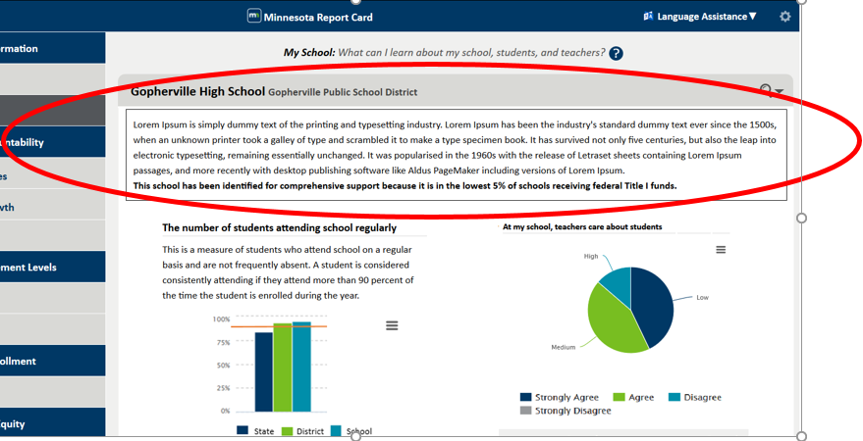
Minnesota Report Card: My School Redesign

Slide 16
Reporting. Recognition. Accountability and Support.
Notes:
Stephanie

Slide 17
Recognizing Schools
In August 2018, 526 schools were recognized using the accountability indicators.
We will continue expanding our recognition system to include other measures, such as school readiness, well-rounded education or career & college readiness.
Schools can be recognized in multiple areas (“Badging” approach).

Slide 18
Initial Six North Star Recognition Badges

Slide 19
Potential Upcoming School Recognition Options
High school student access to, and proportionate participation in, a well-rounded educational experience.
Arts, Career and Technical Education (CTE), Health and Physical Education, Social Studies, Science, Technology, Engineering and Mathematics (STEM), World Languages
High school career and college readiness:
9th grade credit completion rates, participation in rigorous high school courses, CTE concentrators, need for developmental education in college, college completion, graduates earning a livable wage

Slide 20
Other Recognition Ideas from Stakeholders
Improvement Over Time.
Ready for Kindergarten.
Safe, Happy, and Healthy.
Credit and Dropout Recovery.
Support Staff.

Slide 21
Reporting. Recognition. Accountability and Support.
Notes:
Stephanie

Slide 22
North Star – Accountability & Support
Identifies districts for support under the state’s World’s Best Workforce law.
Identifies schools for support under the federal Every Student Succeeds Act (ESSA).
Uses several indicators grouped into three stages to prioritize for different levels of support.
Keeps indicators separate and simple.
Maintains a focus on student groups.

Slide 23
Prioritizing for Support
All Schools
All districts and charters (~500)
Title I Schools
Schools ESSA Provides the Resources to Support
50 Districts and charters that are prioritized for support

Slide 24
The Indicators
Academic Achievement
The number of students at the “Meets Standards” or “Exceeds Standards” achievement levels divided by all students in tested grades. Calculated separately for math and reading.
Progress Toward English Language Proficiency
The average progress English learners made toward individual growth targets on the ACCESS for ELLs test.
Academic Progress
A score based on students’ achievement levels from one year to the next. Calculated separately for math and reading.
Graduation Rates
The percentage of students who graduated in four years and seven years.
Consistent Attendance
The percentage of students attending more than 90 percent of the days they are enrolled.
M
T
W
T
F

Slide 25
The Three Stage Decision Process
Stage 1
Math Achievement
Reading Achievement
Progress Toward English Language Proficiency
Stage 2
(Elementary/Middle)
Math Progress
Reading Progress
---
Stage 2
(High)
Four-Year Graduation
Seven-Year Graduation
Stage 3
Consistent Attendance

Slide 26
Categories of School Support
Comprehensive Support
Targeted Support
Ongoing onsite technical assistance from the Regional Centers of Excellence (RCEs).
Mostly district support, with professional development opportunities from the RCEs.
The lowest 5% of Title I schools based on Stages 1-3.
51 schools.
Title I schools with overall performance below thresholds in Stage 1 and Stage 2.
50 schools.
Schools where student groups perform below thresholds for at least one indicator in each stage.
109 schools.
All public high schools with a four-year graduation rate below 67% overall or for any student group.
147 high schools not in the lowest 5% of Title I schools.
Support from MDE
Title I schools with overall performance below thresholds in Stage 1.
133 schools.

Slide 27
Districts Identified Under WBWF
District Support
Support from cross-functional teams combining staff from MDE and the RCEs.
The lowest 10% of traditional districts using the three-stage process.
33 Districts
The lowest 10% of charter schools using the three-stage process.
17 Charters.

Slide 28
WBWF: A Focus on Accountability and Support
Commissioner must identify districts in any consecutive three-year period not making sufficient progress toward improving teaching and learning.
Commissioner, in collaboration with the identified districts, may require the district to use up to two percent of its basic general educational revenue per fiscal year for commissioner-specified strategies and practices.

Slide 29
WBWF Cross Functional Teams
Five cross-functional teams
Charters
Districts with high American Indian populations
Districts in the Achievement & Integration program
Other Rural Districts
Minneapolis and St. Paul
Each cross-functional team has 5-7 MDE staff members
Teams meet monthly as large group and monthly as a small team
(11 charters that are also CSI are only supported by RCEs, not cross functional teams)
Notes:
Review handout with MDE cross functional team member names

Slide 30
Role of cross functional team members
Understand local context and build relationships through initial conversations with district/charter leadership, reviews of WBWF plans, summaries, and data.
Provide support, coaching, and resources for districts to:
Establish leadership team of stakeholders
Conduct comprehensive needs assessments
Understand root causes and prioritize needs
Select strategies to address the needs
Allocate resources to support the strategies
Implement improvement strategies

Slide 31
WBWF Planning Year: 2018-2019 Timeline
September
October-November
December
January-February
Early Spring
Late Spring
-Initial plan implementation
-Introductory meetings continue
-Initial inquiries
-Support focus area: selecting strategies
-Submit needs, strategies, and general education budget recommendations to MDE
-Kick-off meetings
-Cross-functional team assignments
-Introductory meetings
-Support focus areas: stakeholders,
leadership teams,
needs assessments
Build MDE/district relationships. Engage stakeholders. Assess needs & set priorities. Select strategies; create plan. Implement.

Slide 32
Categories of School Support
Comprehensive Support
Targeted Support
Ongoing onsite technical assistance from the Regional Centers of Excellence (RCEs).
Mostly district support, with professional development opportunities from the RCEs.
The lowest 5% of Title I schools based on Stages 1-3.
51 schools.
Title I schools with overall performance below thresholds in Stage 1 and Stage 2.
50 schools.
Schools where student groups perform below thresholds for at least one indicator in each stage.
109 schools.
All public high schools with a four-year graduation rate below 67% overall or for any student group.
147 high schools not in the lowest 5% of Title I schools.
Support from MDE
Title I schools with overall performance below thresholds in Stage 1.
133 schools.

Slide 33
Support and Improvement: General Requirements for Schools under ESSA
Districts and charters with schools identified for comprehensive support and improvement or targeted support and improvement schools are responsible to provide oversite and leadership for identified schools in four broad areas.
Communicate and engage with stakeholders.
Conduct comprehensive needs assessments for the schools.
Review district- and school-level resources among and within schools.
In partnership with stakeholders, design and implement support and improvement plans.
Notes:
Talking point: While these are requirements, we prefer

Slide 34
Support and Improvement: Resources
Checklist for comprehensive support and improvement schools.
Checklist for targeted support and improvement schools.
Self-assessment for districts regarding their role in school improvement.
Guidance for assessing and addressing resource inequities.
Comprehensive Needs Assessment Summary Report.
School Improvement Plan.
Record of Continuous Improvement (under development).
Monitoring process (under development).

Slide 35
Support and Improvement: Regional Centers of Excellence
Provide on-site assistance for and partnership with local leadership teams to
Select evidence-based practices.
Create implementation capacity.
Create conditions that support change and continuous improvement.
Notes:
TONI
Partnership with six Minnesota Service Cooperatives
Metro area is served by the Center in Rochester and Sartell, primarily.

Slide 36
Support and Improvement: Updates
March 2018—High schools with graduation rates below 67% notified. Work begins with identified schools.
August 2018—Schools and districts identified for support and improvement publicly released.
September 2018—Schools and districts attend kick-off meetings.
September 2018—Advocates conduct introductory visits in districts.
October 2018—Centers facilitate data retreats for school teams.
October 2018—Advocates conduct initial inquiry in districts and schools.
October 2018-Present—Schools establish teams, conduct needs assessment, and identify strategies with support from the Centers.

Slide 38
Support and Improvement: Quick Wins
Provide momentum for the larger change.
Demonstrate a tangible commitment to improvement.
Support buy-in for the overall school improvement process.
Establish important foundations for strategies to be implemented in the longer-term school improvement plan developed in year 1.
Create points of celebration and evidence of quick improvement to share with stakeholders.
Areas for Quick Wins
District support
School culture and climate
Staffing and access to effective teachers
Academic standards
Instructional time

