Slide 1
Minnesota Association of County Veterans Service Officers
House Veterans and Military Affairs Finance and Policy 1/23/2023

Slide 2
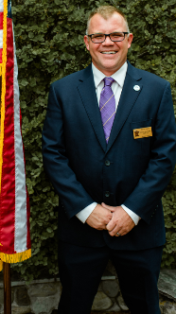
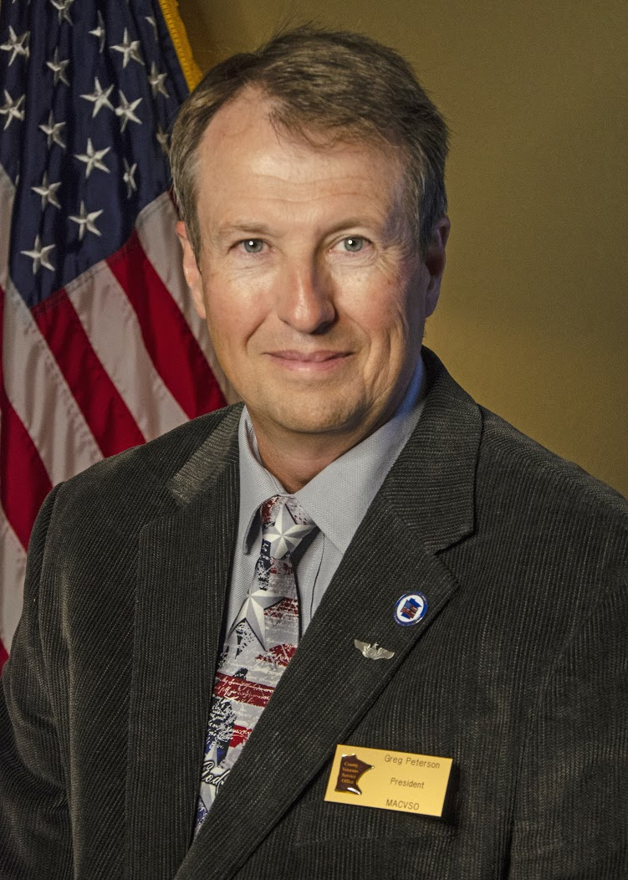
Today’s Presenters
Legislative Director Greg Peterson Air Force Veteran Brown County
President Martin Howes Army Veteran Roseau County

Slide 3
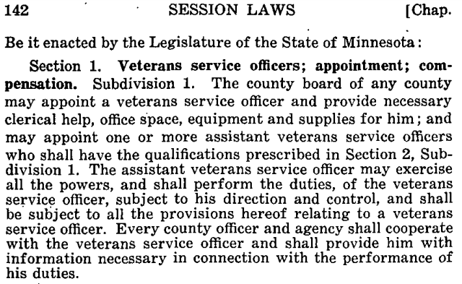
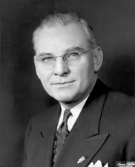
CVSOs Created by Legislature - 1945
Governor Edward Thye

Slide 4
Statutes Governing CVSOs
197.60: Appointed, Term, Compensation, Tax Levy, Oath of Office
197.601: Qualifications: Resident, US Citizen, Veteran 197.602: Joint Actions by Multiple Counties 197.603: Duties & Data Privacy 197.604: Unlawful to Pay Fee 197.605: MDVA Provides Resources 197.606: Classed as County Employees
197.608: Grant Program

Slide 5
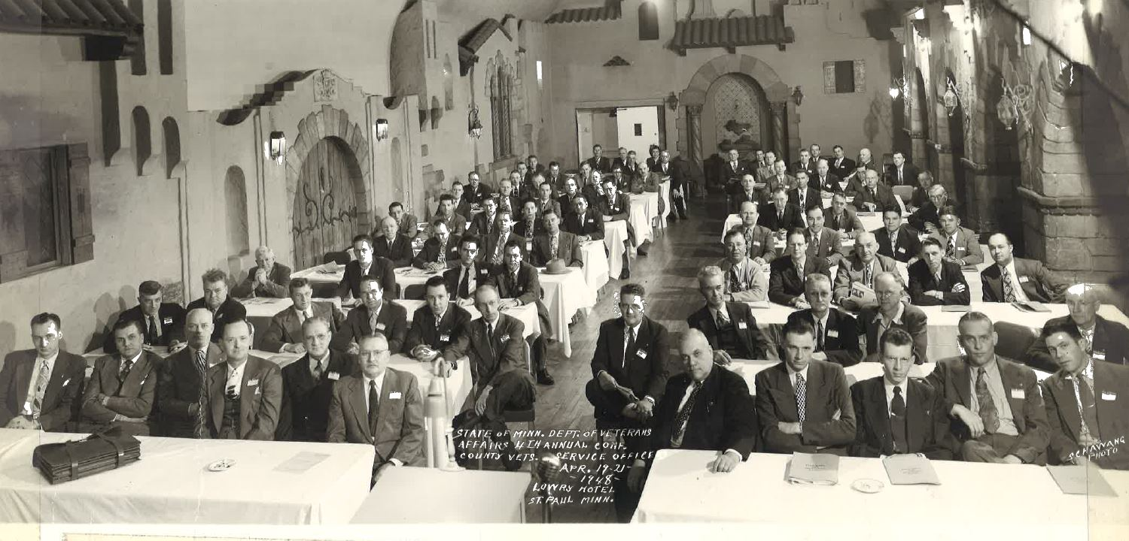
Early Partnership
Discuss with committee members

Slide 6
MACVSO Helps Form NACVSO
Formed in 1991 36 States Have CVSOs Provide Standardized Trg National Legislation

Slide 7
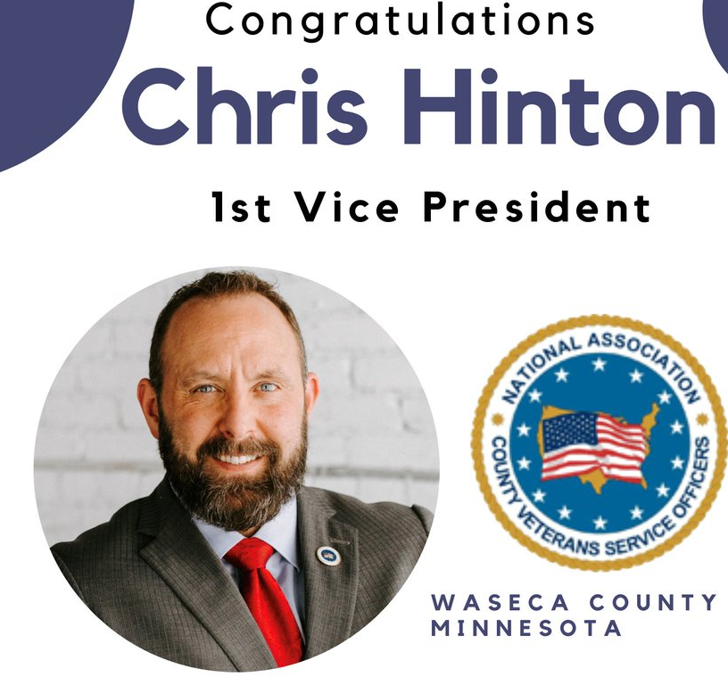
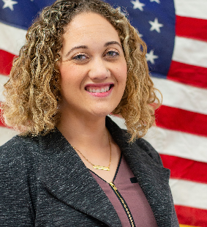
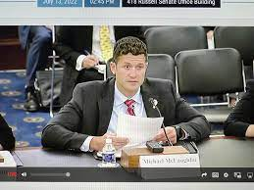
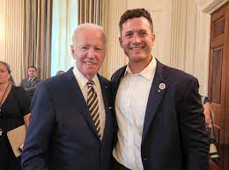
Minnesota CVSOs Leading National Org.
Mike McLaughlin – Blue Earth Co.
Ashely Laganiere Olmsted Co.

Slide 8
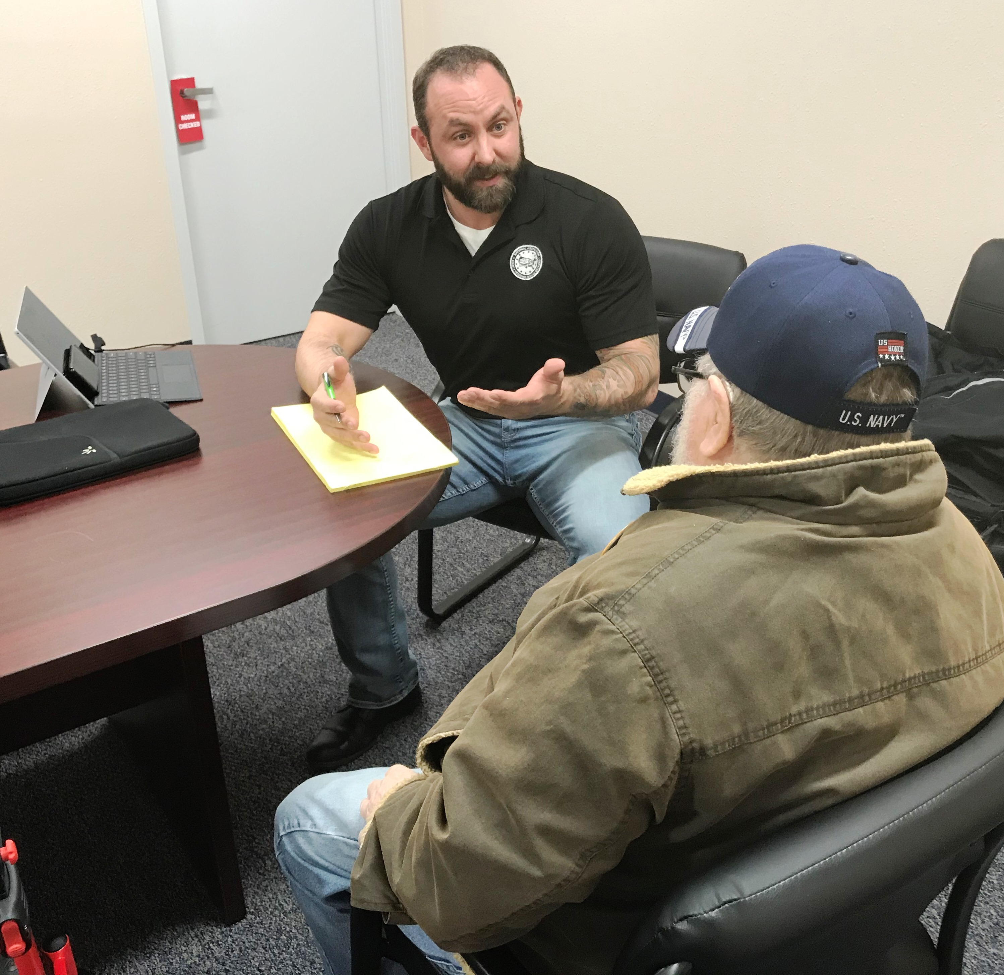
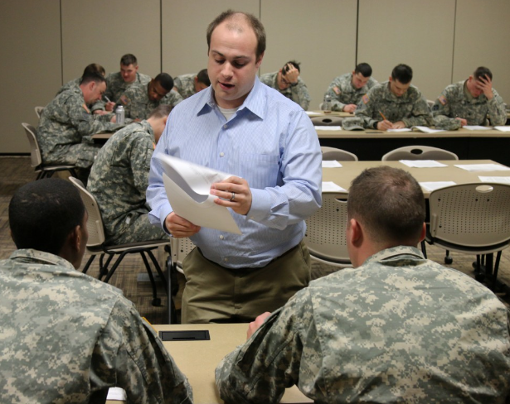
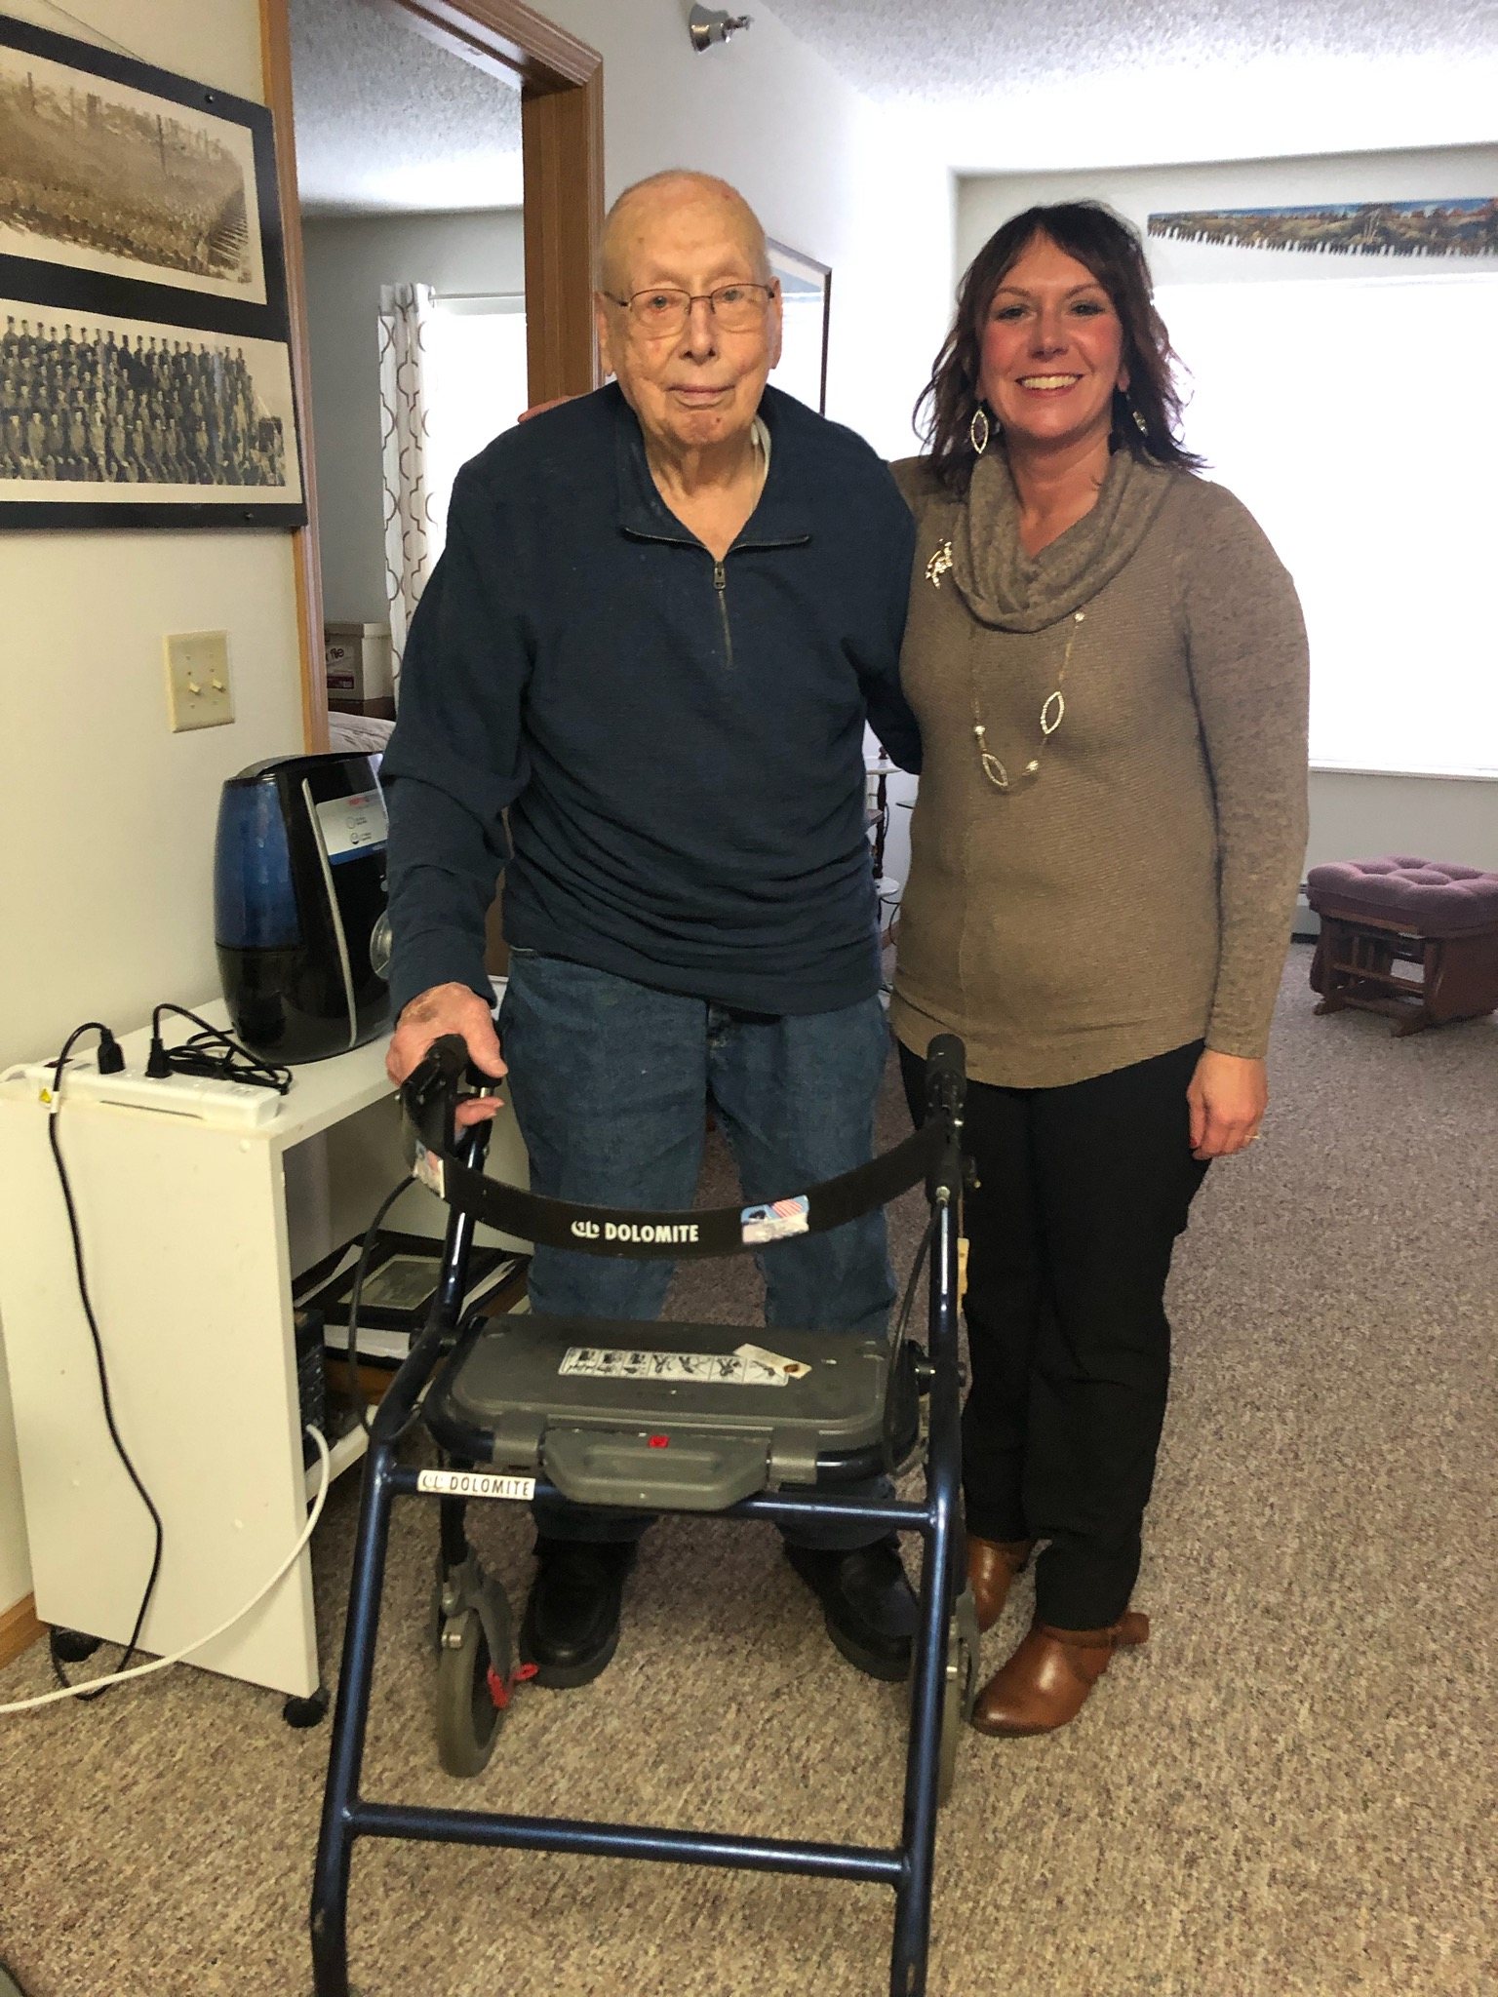
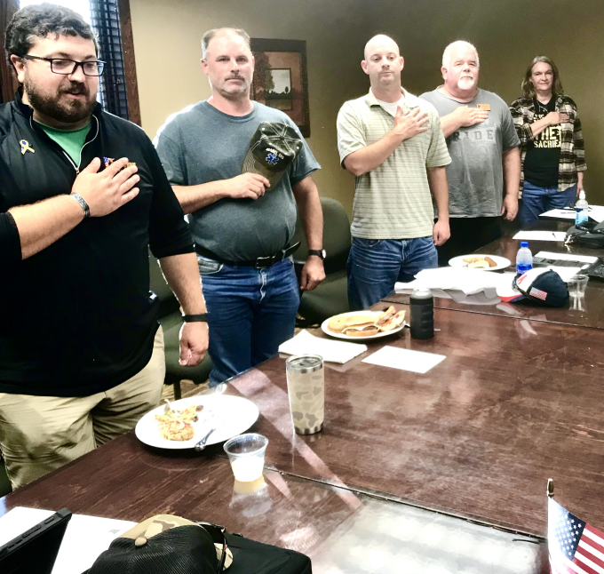
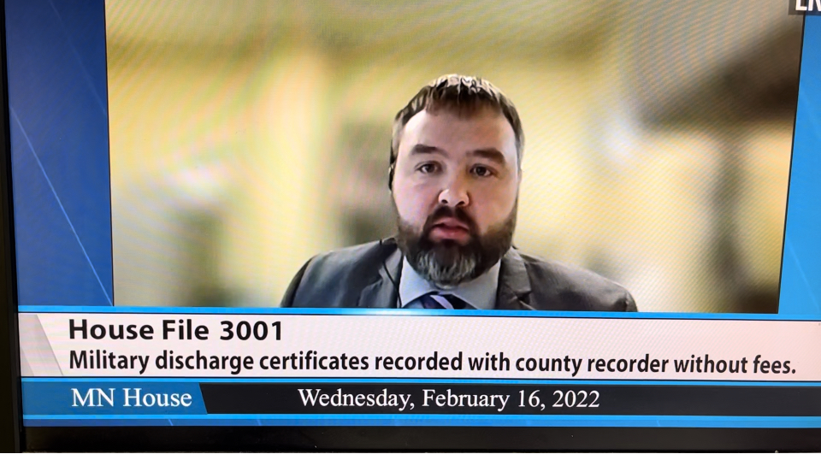
A Day in the Life…

Slide 9
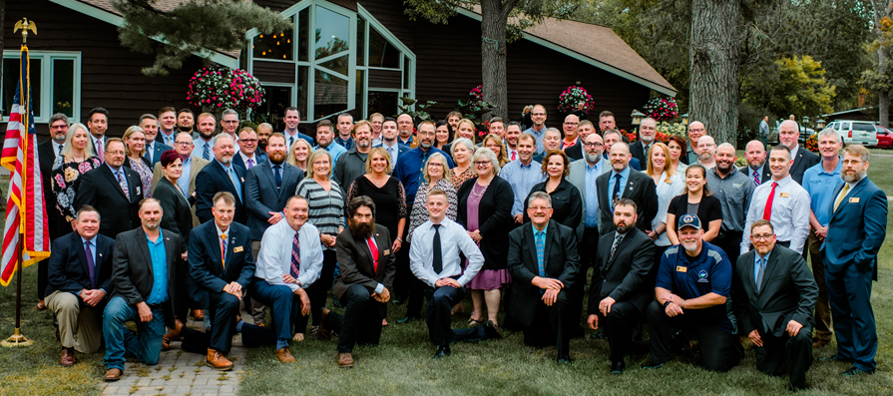
Our Team Serves Minnesota’s Veterans

