Slide 1


Reading Well by Third Grade
Presentation to the
MN House Education Innovation Policy Committee
January 31, 2017

Slide 2
Student Performance Trends
2012-2016

Slide 3
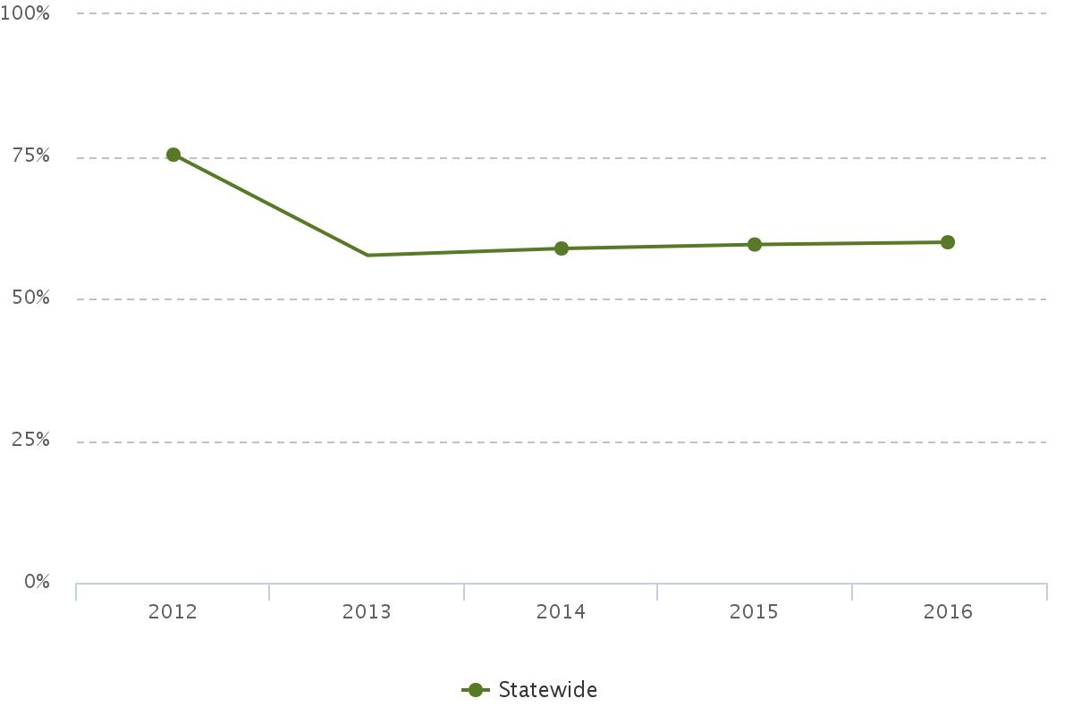
Statewide Reading MCA trends
All grades
Reading proficiency, all tested grades:
2013: 57.6%
2014: 58.8%
2015: 59.5%
2016: 59.9%
Minnesota Department of Education. (2016). 2012 – 2016 statewide reading proficiency, all grades. Minnesota Report Card. Retrieved from http://rc.education.state.mn.us/

Slide 4
All Grades Disaggregated Reading Data by Race/Ethnicity Student Groups
Data from the Minnesota Report Card. Retrieved from http://rc.education.state.mn.us/

Slide 5
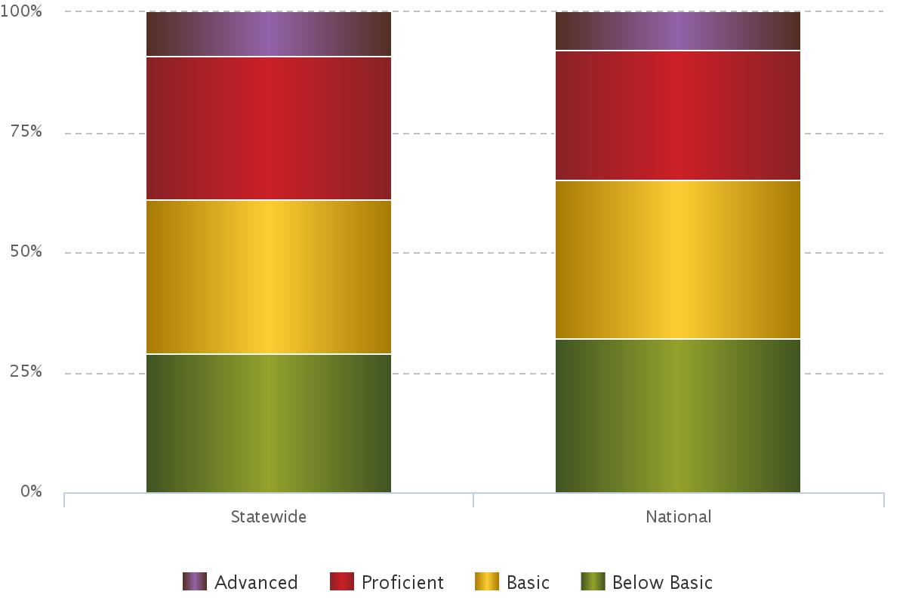
2015 NAEP Reading Achievement
Grade 4
Minn. / Nation
Advanced:
9% 8%
Proficient:
30% 27%
Basic:
32% 33%
Below Basic:
29% 32%
Minnesota Department of Education. (2016). 2015 NAEP achievement levels, reading. Minnesota Report Card. Retrieved from http://rc.education.state.mn.us/

Slide 6
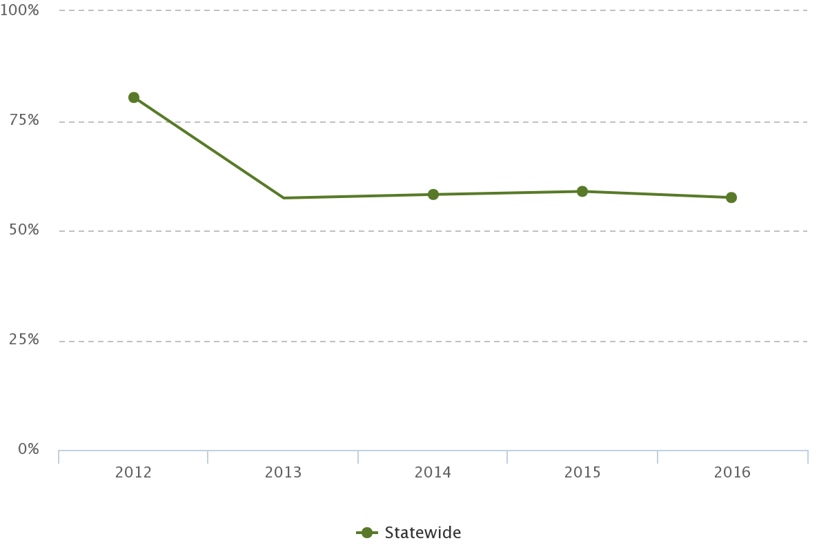
2013-2016 MCA Reading Achievement
Grade 3
All tested grades 3rd grade
2012*: 75.3% 80.3%
2013*: 57.6% 57.4%
2014: 58.8% 58.2%
2015: 59.5% 58.9%
2016: 59.9% 57.5%
*New standards in reading were implemented in 2013. Comparisons in reading from 2012 to 2013 should not be made.
Minnesota Department of Education. (2016). 2015 NAEP achievement levels, reading. Minnesota Report Card. Retrieved from http://rc.education.state.mn.us/

Slide 7
Disaggregated 3rd Grade Reading Data by Race/Ethnicity Student Groups
Data from the Minnesota Report Card. Retrieved from http://rc.education.state.mn.us/

Slide 8
Disaggregated 3rd Grade Reading Data by Other Student Groups
Data from the Minnesota Report Card. Retrieved from http://rc.education.state.mn.us/

Slide 9
Key Policies
2011-present

Slide 10
Read Well by Third Grade (RWBTG)
120B.12
2001: Passage of “Reading Intervention” law
It has been titled “Reading Proficiently No Later Than the End of Grade 3” since 2011, when the Local Literacy Plan was added.

Slide 11
Read Well Provisions
Assessment and Identification
Parent Notification and Engagement
Interventions
Staff Development
Reporting

Slide 12
Literacy Incentive Aid
124D.98 (2011)
A funding formula based on two measures:
  Proficiency Aid: Determined by the percentage of Grade 3 students meeting or exceeding the standards on the MCA-Reading
  Growth Aid: Determined by the percentage of Grade 4 students meeting their growth target from the 3rd grade MCA to the 4th grade MCA.
FY 17 state total Literacy Incentive Aid is $45.6M
Literacy Incentive Aid can be used for any purpose

Slide 13
Other Recent Literacy Initiatives
Minnesota Reading Corps
  Funding to ServeMinnesota (124D.42)
Singing-based Reading Program Pilot
  Funding to Rock ‘n’ Read
Statutory Definitions
  Comprehensive, scientifically based reading instruction (revised 2011)
  Dyslexia (added 2015)

Slide 14
Implementation
What do we know about implementation of standards and policies?

Slide 15
Data Sources
English Language Arts Standards (ELA) and Multi-Tiered System of Supports (MTSS) Implementation Survey
  Annually administered since 2014
Local Literacy Plan Analysis
  2016 Sample analysis by Hanover Research
Read Well Data and Plan Submission
  Online submission system in place since 2015
Several findings to share from this data.

Slide 16
2016 ELA/MTSS Implementation
Survey
Measures school-wide implementation of the core features of MTSS within the context of ELA
12 items embedded within the MTSS core features address standards work, specifically
Only 19% of elementary schools, 13% of middle schools, and 9% of high schools rate a majority of those items as being at full implementation; Of those schools taking the survey both of the last two years, only 17% are at full implementation.

Slide 17
What is “Full Implementation?”
Full implementation means that there is deep understanding and refined ongoing use of data and effective practices. Training and coaching are provided to prevent erosion and promote sustained implementation.

Slide 18
Challenges
Slow progress; implementation takes time
Back slide/sustainability
  Over 40% of key leaders changed between 2015 and 2016 (721 schools responded in 2016)
  Adoption of new standards, curriculum, or practices can impede implementation progress
  Districts and schools are often implementing multiple initiatives at once
  Continuous improvement processes often uncover the need to revisit work or false assumptions that need to be addressed

Slide 19
Full Implementation of Standards/MTSS Improves Reading Performance
2016 MDE data analysis shows a weak but positive correlation between MTSS responses and reading proficiency
  Schools that had an average “fully implemented” response on the MTSS survey had an average of 5% more students who scored proficient on reading than did the schools with an “installing” average response on the MTSS.

Slide 20
Local Literacy Plan Analysis
Over 84% of districts’ plans met 50% or more of the required components of Read Well.
However, only 24% of districts met 70% or more of the components.
Districts are struggling to keep up with the changes in the law; there is a lag in implementation as capacity is built at all levels of the state system.

Slide 21
Read Well Data Submissions
Reporting has revealed challenges with local assessment and data literacy.
  Assessments have been reported as measuring reading components that they do not assess.
  Multiple schools using the same assessment at the same grade report very different cut scores for “grade level proficiency.”
  Some assessments are being used for purposes that the publishers do not claim are valid (diagnostics or progress monitoring, for instance).
  Significant turn-over in staff reporting each year results in inconsistency and need for retraining.

Slide 22
Read Well Data Submissions (cont.)
Districts are largely reporting students’ “at-risk” status, not their proficiency
  At-risk identification is needed to drive intervention, which is a critical focus of the law.
  However, as of 2011, the law asks districts to identify if students are reading at grade level.
  Therefore, there is a question as to whether districts are assessing proficiency or only identifying students not “at-risk.”

Slide 23
MDE Efforts

Slide 24
Current MDE Efforts
Minnesota Standards Portal development
Tiered Fidelity Inventory pilot project
Regional Centers of Excellence reading specialists providing adaptive assistance
Standards-based Education Rubric development for Priority/Focus Schools
Learning Management System pilot
E-Learning module and course development

Slide 25
Current MDE Efforts (cont.)
Development of the Kindergarten Entry Profile (KEP), which includes a valid and reliable menu of comprehensive assessments that can be used for PreK-3rd Grade
Early Learning Assessment Tool Finder available on MDE website
Early Childhood Indicators of Progress revised and posted January 2017
Regional certified trainers available to provide support for KEP administration
Publication: Navigating the School System When a Child is Struggling with Reading or Dyslexia: Frequently Asked Questions

Slide 26
Current MDE Efforts (concluded)
Professional Development and Technical Assistance
  Age 3 to Grade 3 literacy and MTSS Communities of Practice
  Professional development collaborations with Minnesota organizations:
    Minnesota Writing Project, Minnesota Reading Association, Minnesota’s Reading and Writing Centers (U of M), Higher Education Literacy Partnership (dyslexia organizations), and Minnesota ASCD
ESSA Literacy Education for All – Results for the Nation (LEARN) Grant application

Slide 27
Presenter Contact Information
Beth Aune, Ph.D.
  Director, Division of Academic Standards and Instructional Effectiveness
  Beth.aune@state.mn.us
Cory Stai, M.Ed.
  Reading Specialist
  Cory.stai@state.mn.us

