Slide 1
Minnesota Department of Public Safety FY20-21 Budget

Slide 2
Department of Public Safety
Public Safety Policy and Finance Committee
Alcohol and Gambling Enforcement
Emergency Communication Networks
Fire Marshal Division
Homeland Security and Emergency Management
Office of Justice Programs
Bureau of Criminal Apprehension

Slide 3
Total DPS Budget Base FY18-19 Public Safety Division
Total all funds = $376,872
(in thousands)

Slide 4
FY18-19 Expenses By Category Public Safety Divisions
Total all funds = $376,872
(in thousands)

Slide 5
Emergency Communication Networks
Minnesota Department of Public Safety

Slide 6
Emergency Communication Networks Minnesota Department of Public Safety
ECN receives no funding from the General Fund, but collects a .95 cent monthly fee assessed upon all wired, wireless, prepaid wireless and packet-based telecommunications services capable of accessing 911 in MN.
ECN receives an annual appropriation of $77.2 million from the 911 Emergency Services Account of the Special Revenue Fund.

Slide 7
DPS Technology Needs
2019 Governor’s Budget Recommendation:
Increase DPS core technology services from the general fund, special revenue fund, and 911 emergency fund.
Purpose:
To support existing hardware, software, and MNIT staffing costs for DPS public safety divisions.
This funding is to address needs that are not currently accounted for in the department’s base technology budget, in addition to increased workstation replacement, support, and 24/7 help desk support costs.
$1.53M General Fund FY20/21 : Ongoing
$190,000 Special Revenue Fund FY20/21 : Ongoing
$395,000 911 Emergency Fund FY20/21 : Ongoing

Slide 8
Alcohol and Gambling Enforcement
Minnesota Department of Public Safety

Slide 9
Alcohol and Gambling Enforcement Minnesota Department of Public Safety
AGED receives an annual appropriation of $2.74 million
AGED collects $1.24 million per year in special revenue, of which $500,000 in receipts are transferred to the General Fund each year. The Gambling Control Board also transfers $70,000 to AGED each year.
2019 Budget Policy Request: Align microdistillery statute with all other alcohol licenses that AGED approve.
No fiscal impact.

Slide 10
State Fire Marshal
Minnesota Department of Public Safety

Slide 11
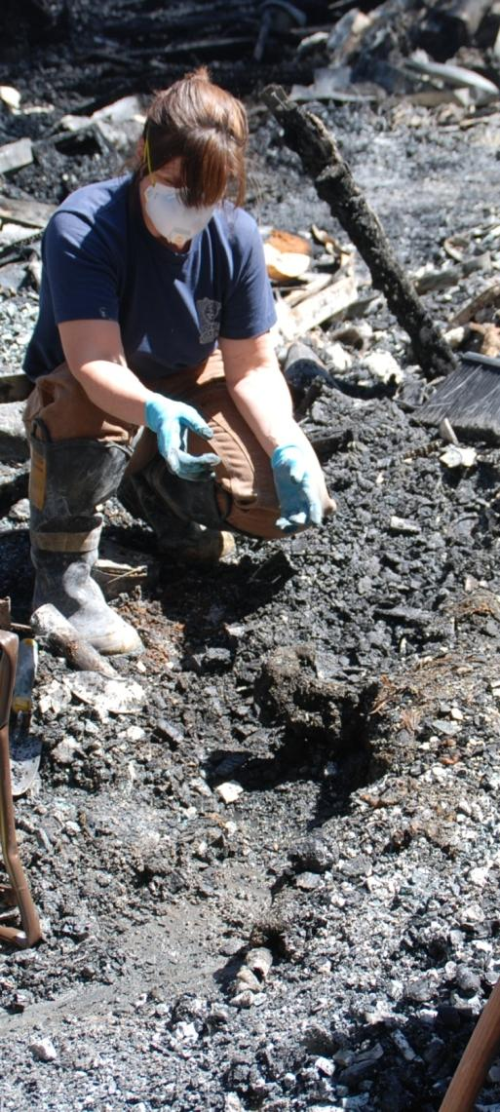
State Fire Marshal Minnesota Department of Public Safety
The State Fire Marshal Division receives an annual appropriation of $6.42 million in Special Revenue funds.
2019 Budget Policy Request: Reduced Cigarette Ignition Propensity Account expansion of approved uses.
No fiscal impact.

Slide 12
Office of Justice Programs
Minnesota Department of Public Safety

Slide 13
Office of Justice Programs Minnesota Department of Public Safety
OJP Services
Crime Victim Reparations
Crime Victim Justice Unit
Grants Management Unit
Crime Victims Services Grants
Abused Children
Battered Women/Domestic Violence
Sexual Assault
General Crime
Justice and Community Grants
Reduce crime
Delinquency
Drug abuse
Violence intervention/prevention
Statistical Analysis Center

Slide 14
Office of Justice Programs Minnesota Department of Public Safety
OJP receives an annual appropriation from the General Fund of $39.9 million.
OJP administers state and federal grants to over 750 non-profits and local units of government.

Slide 15
Murdered and Missing Indigenous Women Task Force
2019 Governor’s Budget Recommendation:
Murdered and Missing Indigenous Women Task Force
The Governor’s proposal would convene a task force, in consultation with the Minnesota Indian Affairs Council.
To advise the commissioner and report to the Legislature on the causes and extent of victimization of indigenous women and girls in Minnesota.
Outline strategies to reduce and end violence against indigenous women.
Includes the opportunity for members from all 11 tribal nations to participate.
$105,000 FY20 | $45,000 FY21

Slide 16
Homeland Security and Emergency Management
Minnesota Department of Public Safety

Slide 17
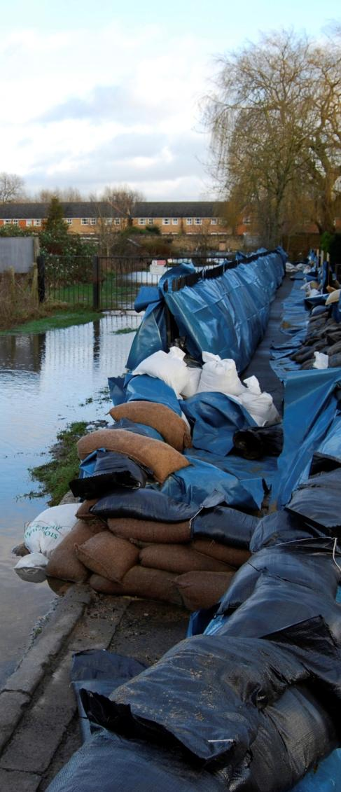
Homeland Security and Emergency Management Minnesota Department of Public Safety
HSEM receives an annual appropriation from the General Fund of $2.6 million (23% of operating budget).
HSEM administers federal homeland security, emergency management, and disaster recovery grants to local governments. For FY19, these grants are estimated at $44 million.
The 11 state hazmat response teams received an annual base appropriation of $850,000 from the Fire Safety Account.
HSEM manages the Disaster Assistance Contingency Account, which has provided more than $50 million of disaster relief since the account was created in 2014.
Deficient funding request of $10 million in FY19
$10 million FY20/FY21 requested to fund the account

Slide 18
Homeland Security and Emergency Management
2019 Governor’s Budget Recommendation:
Reinstatement of the railroad and pipeline safety assessment
To continue to ensure local preparedness and state support of hazardous materials incidents in communities along Minnesota’s railroads and pipelines.
$2.5 million FY20 |$2.5 million FY21 : Ongoing
School Safety Center (SSC) to meet increased demand
The SSC provides:
Facility security assessments
Emergency plan reviews
Active shooter/violent intruder response procedures
School Resource Officer (SRO) training
Threat assessments
Program information briefings to teachers, staff, principals, superintendents, school boards, and local law enforcement.
$250,000 FY20 |$250,000 FY21 : Ongoing

Slide 19
Bureau of Criminal Apprehension
Minnesota Department of Public Safety

Slide 20
Bureau of Criminal Apprehension Minnesota Department of Public Safety
Investigative Services
Complex Criminal
Violent Crime
Narcotics
Predatory Crimes
Digital Forensics
Financial Crimes
MN Fusion Center & Criminal
Information Analysis
Task Force Involvement
State Agency Partnerships
Forensic Science Services
Laboratories
DataMaster Breath Alcohol Calibration and Certification Program
Combined DNA Indexing System (CODIS)
Crime Scene Service
Training and Expert Testimony

Slide 21
Bureau of Criminal Apprehension Minnesota Department of Public Safety
The BCA received a direct appropriation of $59.9 million in FY19.
General Fund – $57.5 million in FY19.
Trunk Highway Funds - $2.4 million in FY19

Slide 22
BCA Technology Needs
2019 Governor’s Budget Recommendations:
Replace Automated Fingerprint Identification System (AFIS)
12 years old, no longer supported.
This proposal leases technology instead of buying a new system for $10M.
$1.5 million FY20 | $1.5 million FY21 : Ongoing
FBI Cyber security compliance
This funding will address cyber security vulnerabilities and other Federal Bureau of Investigation (FBI) compliance issues.
$1.5 million FY20 | $1.3 million FY21
$1.2 million : Ongoing

Slide 23
Gun Violence Prevention
2019 Governor’s Budget Recommendation:
Resources to implement two gun violence prevention proposals currently introduced in the legislature:
a proposal to create a new requirement for background checks when private parties transfer any firearm.
a proposal that creates an Extreme Risk Protection Order (ERPO) process in statute.
$188,000 FY20 | $38,000 FY21 : Ongoing

Slide 24
BCA Investigatory and Laboratory Needs
2019 Governor’s Budget Recommendations:
Investigators, a training coordinator and an analyst to provide statewide training and technical assistance related to sexual assault investigations.
BCA would also provide assistance to local partners and additional training.
$546,000 FY20 : Ongoing
Investigators to provide statewide leadership, case assistance and training for vulnerable adult investigations.
$258,000 FY20 | $246,000 FY21 : Ongoing
Investigators, an analyst and forensic scientists to address opioid abuse.
The is part of a package of proposals funded by new fees on opioid manufacturers, wholesalers, and entities that handle controlled substances.
$1.6M FY20 | $1.242 FY21 : Ongoing

Slide 25
BCA Budget Policy
Background Checks for Contractors at Noncriminal Justice Agencies:
Needed to meet FBI requirements and to secure criminal justice information used in noncriminal justice agencies to make decisions about licensing, housing, employment or other benefits.
Background checks have an associated fee that covers both the amount charged by the Federal Bureau of Investigation (FBI) as well as the costs incurred by the Bureau of Criminal Apprehension (BCA) to conduct the checks.
No fiscal impact.

Slide 26
Questions?
John Harrington, Commissioner
651-201-7174
John.M.Harrington@state.mn.us

