Slide 1
Chronic Wasting Disease: 2019
Trevor R. Ames, DVM, MS, DACVIM
Dean and Professor, College of Veterinary Medicine
January 23, 2019
Notes:
Thank you for the opportunity to provide a status report on the science of Chronic Wasting Disease or CWD. Over the last year the University has been contacted by a number of legislators requesting our involvement in finding a solution. CWD threatens our wild and farmed cervid populations.
I am here with several University of Minnesota faculty to discuss our work on CWD and what new technology may be used to deal with this problem.
While I am proud of the great faculty we have in the College of Veterinary Medicine. One of our competitive advantages is collaborating across a large comprehensive University that spans all disciplines like the UMN.
We have taken advantage of some of that expertise to propose what we will present to you today.

Slide 2
CWD - background
A fatal brain disease
Part of a family of diseases
No strong evidence for risk to humans, but concern exists
Transmitted by bodily fluids
Notes:
CWD is a progressive, fatal disease that affects the brain, spinal cord, and many other tissues of farmed and free-ranging deer, elk, and moose.
CWD belongs to a family of diseases called prion diseases or transmissible spongiform encephalopathies (TSEs). Other TSEs include mad cow disease, scrapie in sheep and goats, and Creutzfeldt-Jacob disease in humans, variant Creutzfeldt-Jacob disease or the human form of “mad cow disease” in people is also a TSE
To date, there is no strong evidence for the occurrence of CWD in people, and it is not known if people can get infected with CWD prions. Some experimental studies have shown transmission of CWD prions to primates raising concern and since 1997, the World Health Organization has recommended that it is important to keep the agents of all known prion diseases from entering the human food chain.
Scientists believe CWD proteins (prions) likely spread between animals through body fluids like feces, saliva, blood, or urine, either through direct contact or indirectly through environmental contamination of soil, food or water. Just to be clear, CWD does not appear to naturally infect cattle or other domesticated animals.

Slide 3
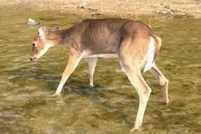
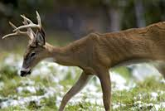
CWD - what does it look like
CWD may have an incubation period of over a year
Obvious neurological signs may develop slowly
Deer, elk, reindeer, and moose with CWD may not show any signs of the disease for years after they become infected.
Clinical signs may include:
  drastic weight loss (wasting)
  stumbling
  lack of coordination
  listlessness
  drooling
  other neurologic symptoms
Notes:
excessive thirst or urination
drooping ears
lack of fear of people
aggression

Slide 4
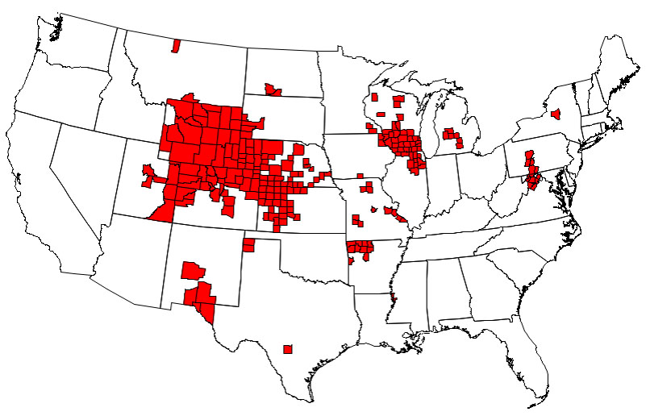
Centers for Disease Control and Prevention
Notes:
As of August 1, 2018, there were 226 counties in 23 states with reported CWD in free-ranging cervids. This map is based on information from multiple sources, including state wildlife agencies and the United States Geological Survey. Obviously, this map is now somewhat out-dated, but these maps will be brought up to date when all the data from the fall surveillance programs are added. In the last 3 years the MN DNR has identified 35 wild deer that were positive for CWD. The infected counties in WI have all developed since the early 2000s.
The MN DNR and BAH work jointly to monitor and control CWD in farmed and wild cervidae
The faculty that are with us today will give you more information on the research that has been done at the CVM on CWD….The surveillance programs the CVM is involved with within the sate….And a new tool that could help in the control of this disease.
SO IF THERE ARE NO QUESTIONS FOR ME, I’ll turn the mic over to Doctors Jerry Torrison and Jeremy Scheffers from our Veterinary Diagnostic Laboratory.
----------------------------------------------
Background stuff.
The U.S. Department of Agriculture’s Animal and Plant Health Inspection Service regulates commercially farmed deer and elk. The agency operates a national CWD herd certification programExternal. As part of the voluntary program, states and individual herd owners agree to meet requirements meant to decrease the risk of CWD in their herds.
A negative test result does not guarantee that an individual animal is not infected with CWD, but it does make it considerably less likely and may reduce your risk of exposure to CWD.

Slide 5
Chronic Wasting Disease (CWD)
Sampling, Research & Testing
Jerry Torrison, DVM, PhD, Director
Jeremy Schefers, DVM, PhD, Pathologist
University of Minnesota
Veterinary Diagnostic Laboratory

Slide 6
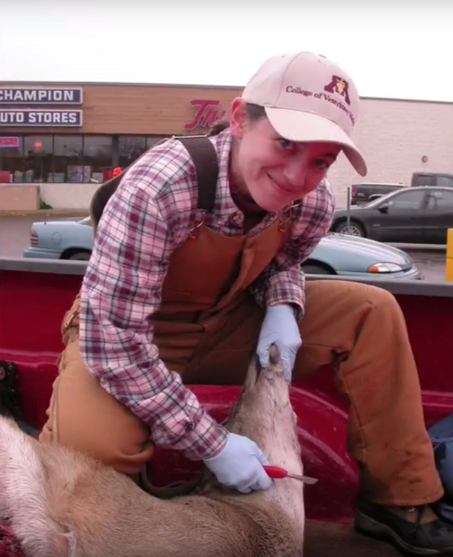
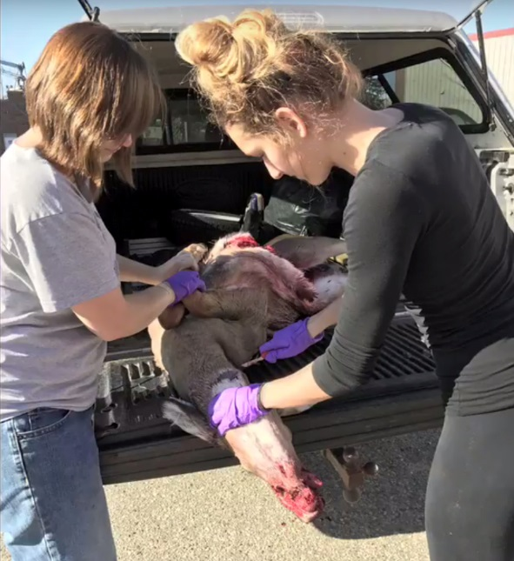
Sample collection by DVM students

Slide 7
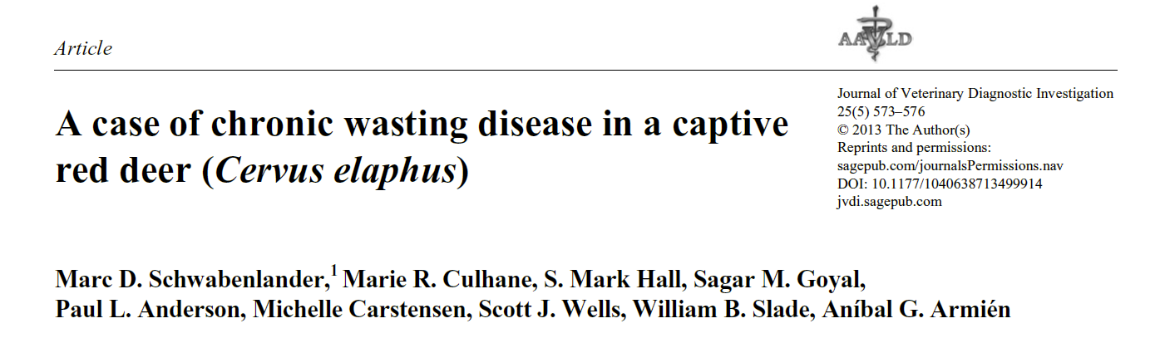
Collaborative research with the
Department of Natural Resources,
Board of Animal Health and producers

Slide 8
VDL/CVM CWD Diagnostic Services
Immunohistochemistry (IHC) testing for farmed cervids for the Board of Animal Health
IHC testing for hunter harvested deer for voluntary testing
Diagnostic confirmation of results from enzyme linked immunosorbent assays (ELISA)

Slide 9
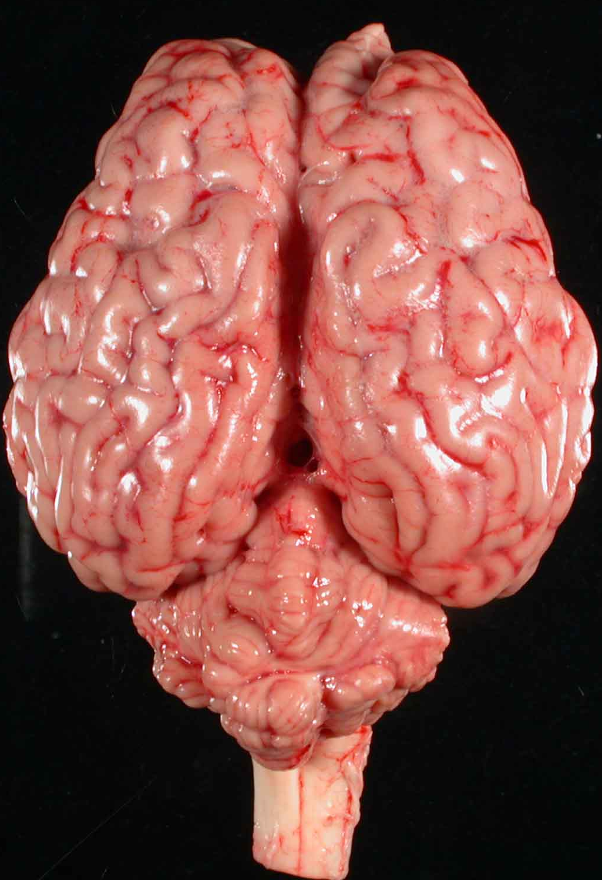
IHC Testing
Immunohistochemistry (IHC)

Slide 10
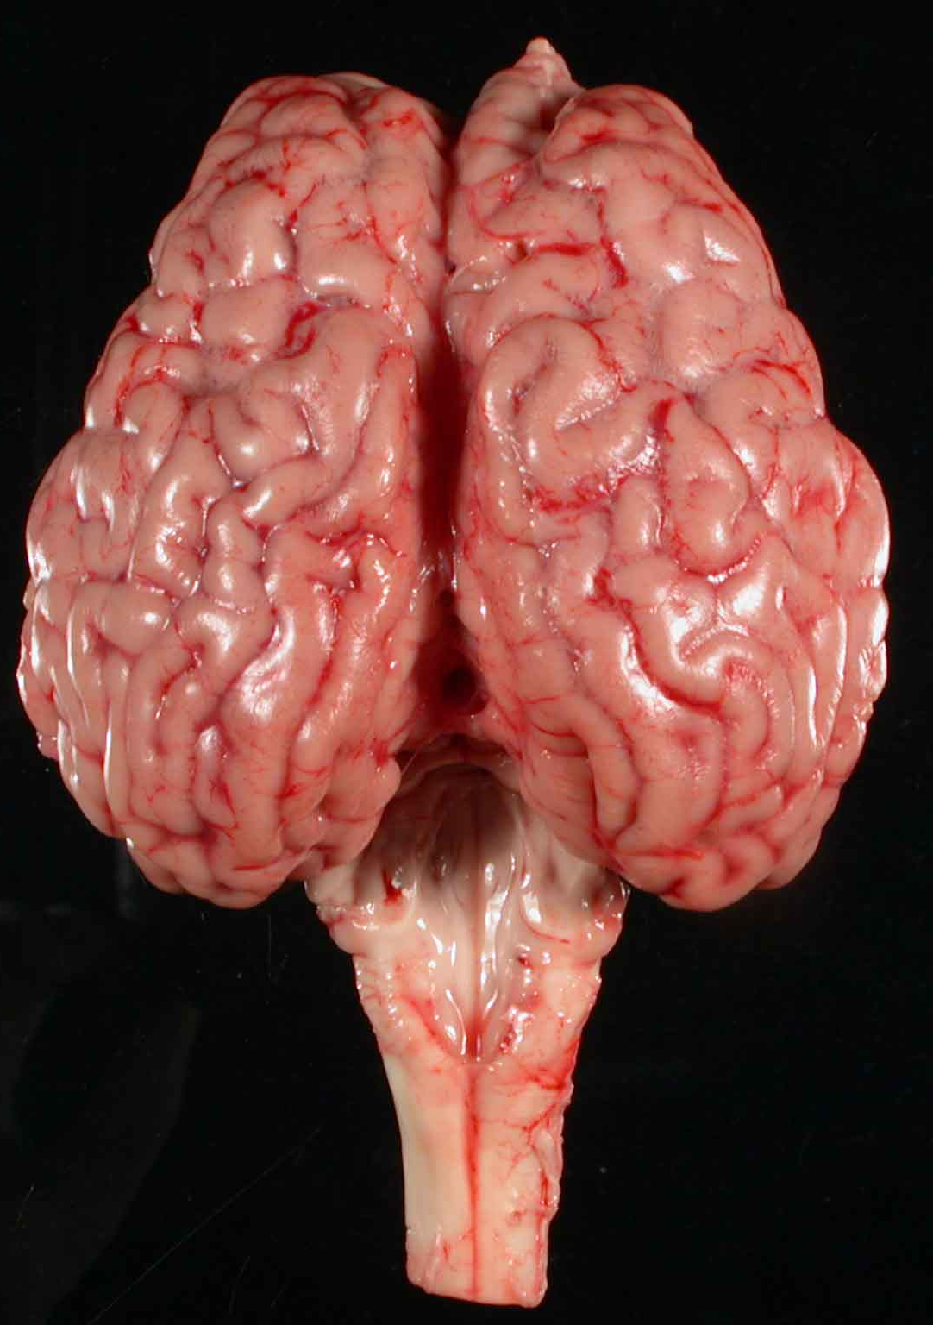
Bovine Brain
Cerebellum removed
Immunohistochemistry (IHC)
OBEX: V–shaped area in brain stem

Slide 11
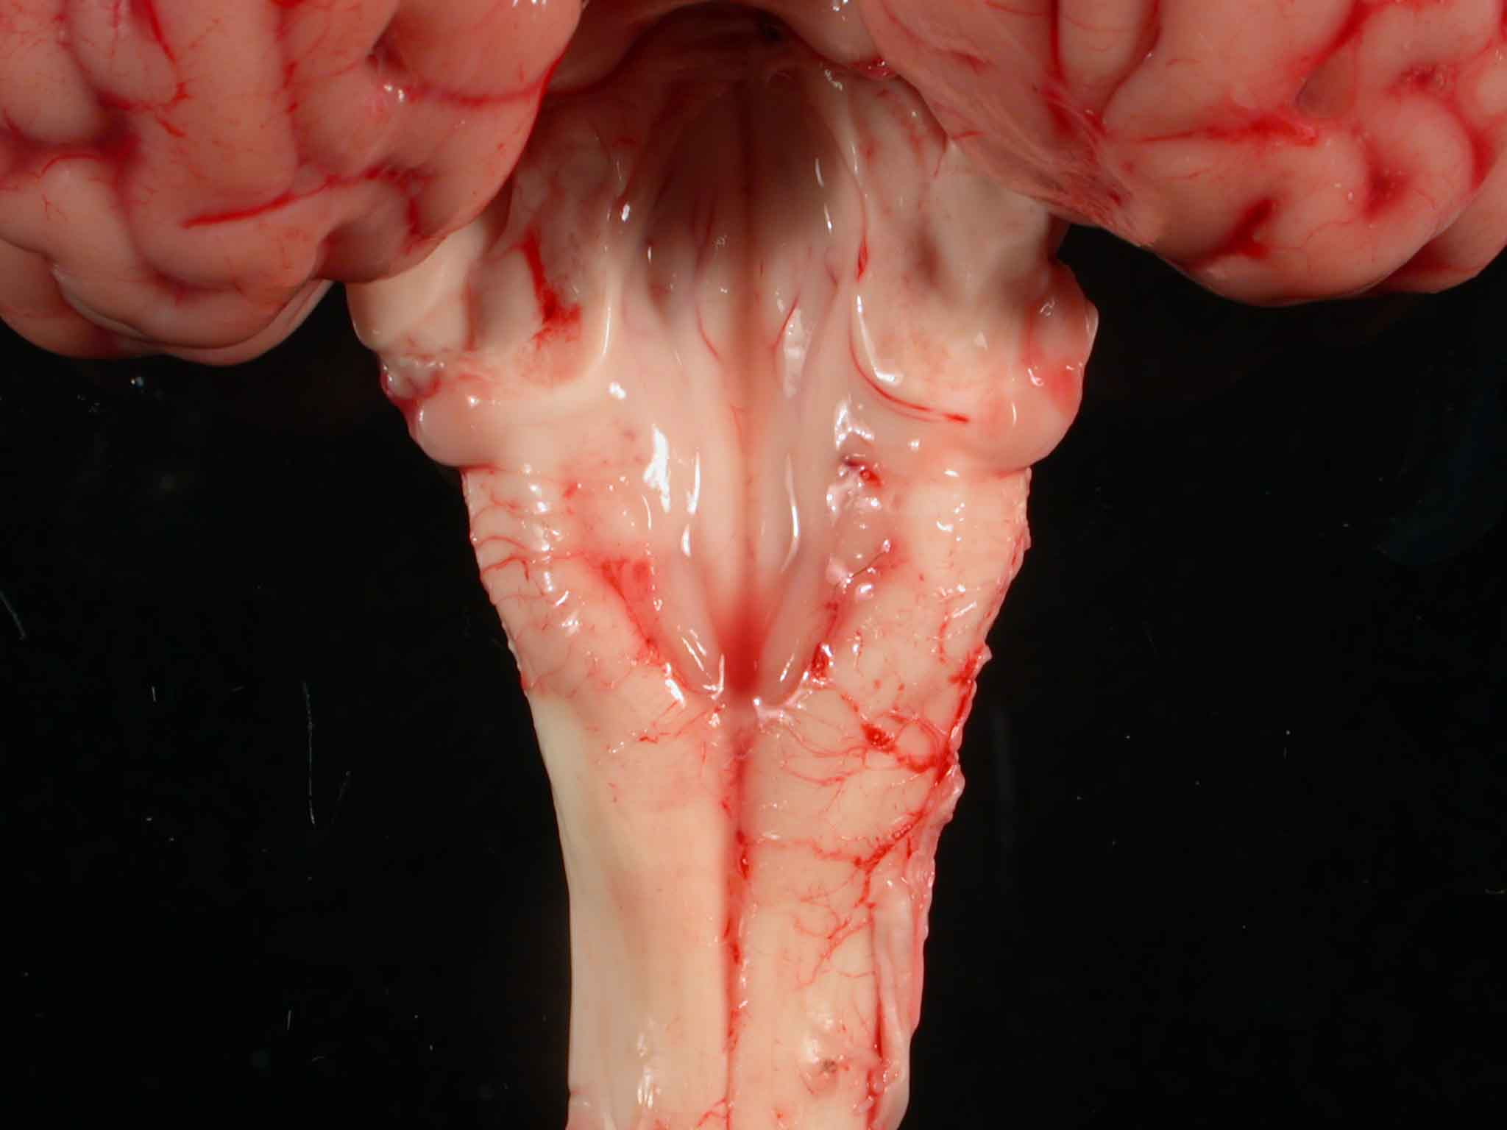
Close up of OBEX
Immunohistochemistry (IHC)
Blue lines outline “V”
Submit all tissue within the white box

Slide 12
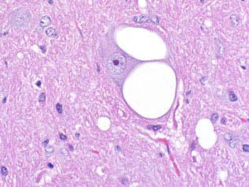
Spongiform encephalopathy – BSE, CWD, Scrapie
AFIP June 2004
AFIP June 2004

Slide 13
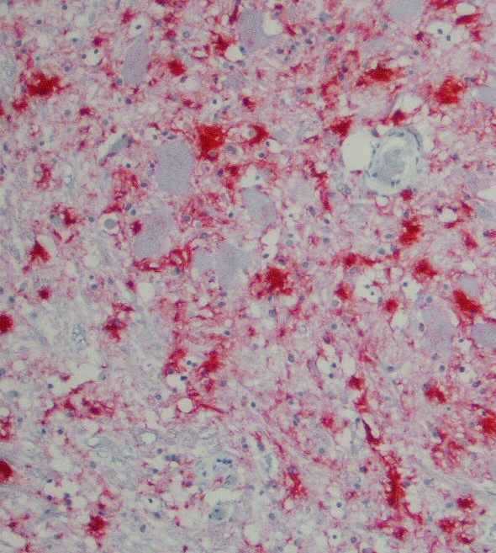
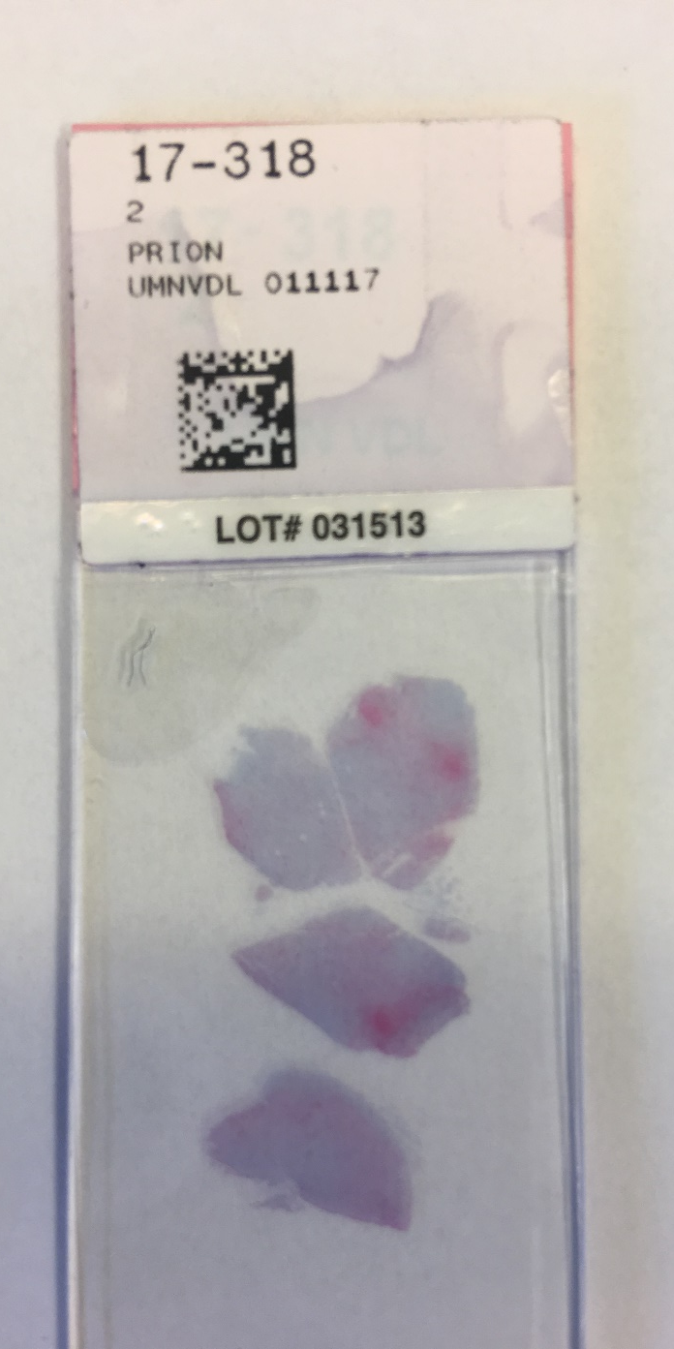
Immunohistochemistry (IHC)
Testing process
Formalin fixation
IHC staining
Initial reading
Confirmation by USDA

Slide 14
CWD Testing Challenges
IHC & ELISA
Future needs
Expensive ($30 - $80)
Slow (4 - 14 days)
Invasive (brain & lymph nodes)
Postmortem (dead)
Laboratory based (ship to test)
Highly technical
Accurate “Gold Standard” (IHC)
Affordable
Fast (1-2 days)
Non-invasive (swabs, envir.)
Antemortem (live)
Field based
Simple & user-friendly
Accurate
Confirmation

Slide 15
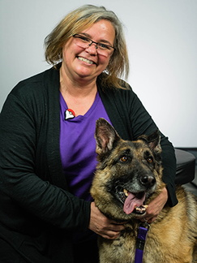
Pamela Skinner, PhD
Dept. of Veterinary and Biomedical Sciences
College of Veterinary Medicine

Slide 16
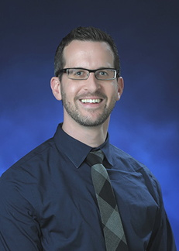
Davis Seelig, DVM, PhD, ACVP
Dept. of Veterinary Clinical Sciences
College of Veterinary Medicine

Slide 17
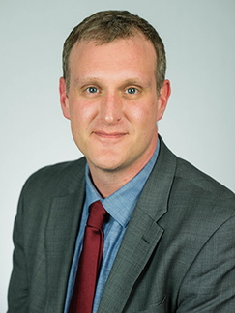
Peter Larsen*, PhD
Dept. of Veterinary and Biomedical Sciences
College of Veterinary Medicine
*AgREETT funded faculty

Slide 18
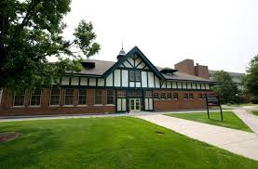
College of Veterinary Medicine
Notes:
Transition to Ames closing

Slide 19
CVM – history of finding solutions
First PCR test for Porcine Epidemic Diarrhea to help swine producers control disease. (2014)
First to map domestic turkey genome, helping breeders produce healthier turkeys. (2003)
First vaccine to help stop spread of a severe respiratory disease caused by Avian metapneumovirus. (2003)
Led the team that developed the first vaccine for Porcine Reproductive and Respiratory Syndrome. (1991)
Created a new diagnostic test for brucellosis (Bang’s disease) in dairy cows (1949), this test was instrumental in the elimination of brucellosis from US cattle and is still used today.
Notes:
We look forward to working with our partners in the state agencies to address this emerging problem

Slide 20


