Slide 1
MPCA overview
Greta Gauthier | Assistant Commissioner
Joshua Bunker | Chief Financial Officer
February 14, 2019

Slide 2
Our mission
Protect and improve the environment and enhance human health.

Slide 3

Core products and services
Monitor air, land, and water for contaminants
Issue permits and enforce regulations
Educate to prevent pollution
Find and clean up contamination
Respond to emergencies and spills
Set environmental rules and policies

Slide 4
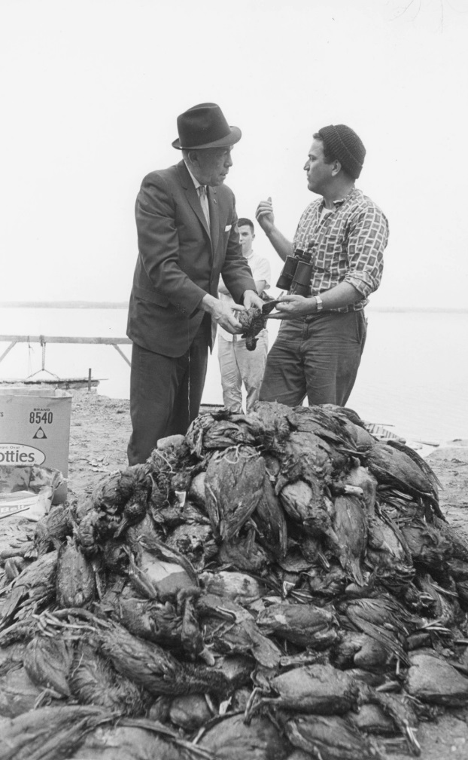
Statutory authority
State Laws | 229 state laws (not including appropriations) apply to the MPCA and direct program operations.
EPA delegations | Air programs: Outdoor air monitoring, permitting, air toxics, compliance & enforcement, regional haze, rules, etc. Water programs: Monitoring, permitting, TMDL, C&E, stormwater, feedlot, etc. Land programs: Solid waste, hazardous waste monitoring & enforcement, Resource Conservation and Recovery Act (RCRA), etc.
Notes:
Two major oil spills happened in the early 1960s – both the result of industrial accidents -the end result was that the Mississippi coated in oil from St. Paul to Lake Pepin.
The first spill was at the Richards Oil Plant in Savage in December 1962, when a ruptured oil pipe put 1 million gallons of petroleum into the Minnesota River.
The second spill was at Honeymead Products Company in Mankato in January 1963, when a storage tank collapsed and 2.5 million gallons of soybean oil went into the Minnesota River.
This picture shows George Serbesku, a Pine Bend resident who worked at a St. Paul stockyard, and Governor Karl Rolvaag. Mr. Serbesku brought two bushel baskets of dead oily ducks – and dumped them in the Caapitol Rotunda – urging for funds to help rescue and clean waterfowl.
Governor Rolvaag issued a state of emergency.
The only agency regulating water pollution at the time was the Water Pollution Control Commission (WPCC). The WPCC was part of Public Health Services and could only act if a health emergency was created.
In the end, two units of the MN National Guard were activated.
Today there are 229 state laws governing MPCA and our work
The MPCA is delegated by the Federal Government to implement 3 major federal laws in Minnesota:
The Clean Water Act
The Clean Air Act
The Resource Conservation and Recovery Act
The Resource Conservation and Recovery Act (RCRA) is the public law that creates the framework for the proper management of hazardous and non-hazardous solid waste. The law describes the waste management program mandated by Congress that gave EPA authority to develop the RCRA program.
For new members, a Key Point about environmental agencies: The complexity of your work Legislating over these agencies depends on whether or not the agencies have federal delegations.
BWSR and DNR are governed mostly by state laws. And state laws can be changed by the state legislature.
MPCA, and the Health and Agriculture Departments, are governed by state laws but also have federal laws they most follow. These agencies are delegated – via formal agreements with federal agencies - to enforce and implement federal law, with oversight from federal agencies.
THUS many of the things MPCA and these other ‘federal delegated” agencies do cannot be changed by state lawmakers.
AND some bills proposed by state legislators are problematic for MPCA if those bills conflict with federal law.

Slide 5

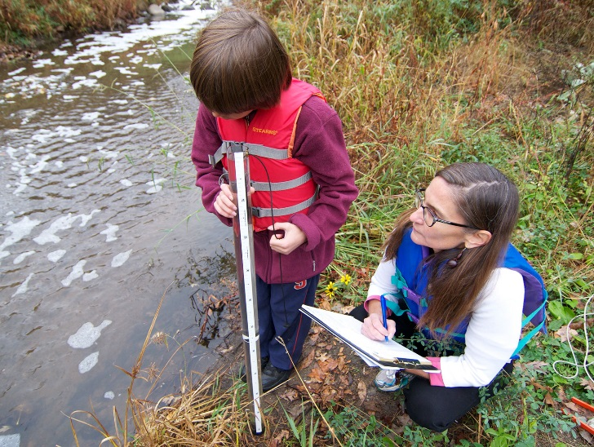
Our partners
Business large and small
All levels of government (international, federal, state, county, municipal)
Tribal Nations
Non-governmental organizations
Citizen water monitors
Minnesota residents
Notes:
Photo: Sappi North America's paper mill in Cloquet, Minn., received the Minnesota Governor's Award for Excellence in Waste and Pollution Prevention in 2009
MPCA has a network of 1200 citizens who voluntarily monitor water quality around the state.

Slide 6
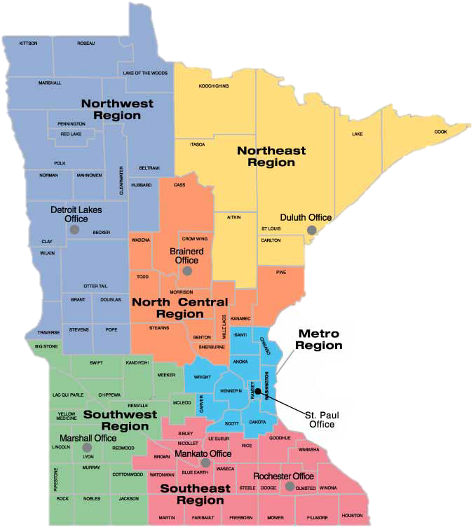
MPCA Organizational Structure
Six Regional Offices:
Duluth
Detroit Lakes Brainerd
Marshall
Mankato
Rochester
Notes:
% staff in St. Paul and % staff located in Regional offices

Slide 7
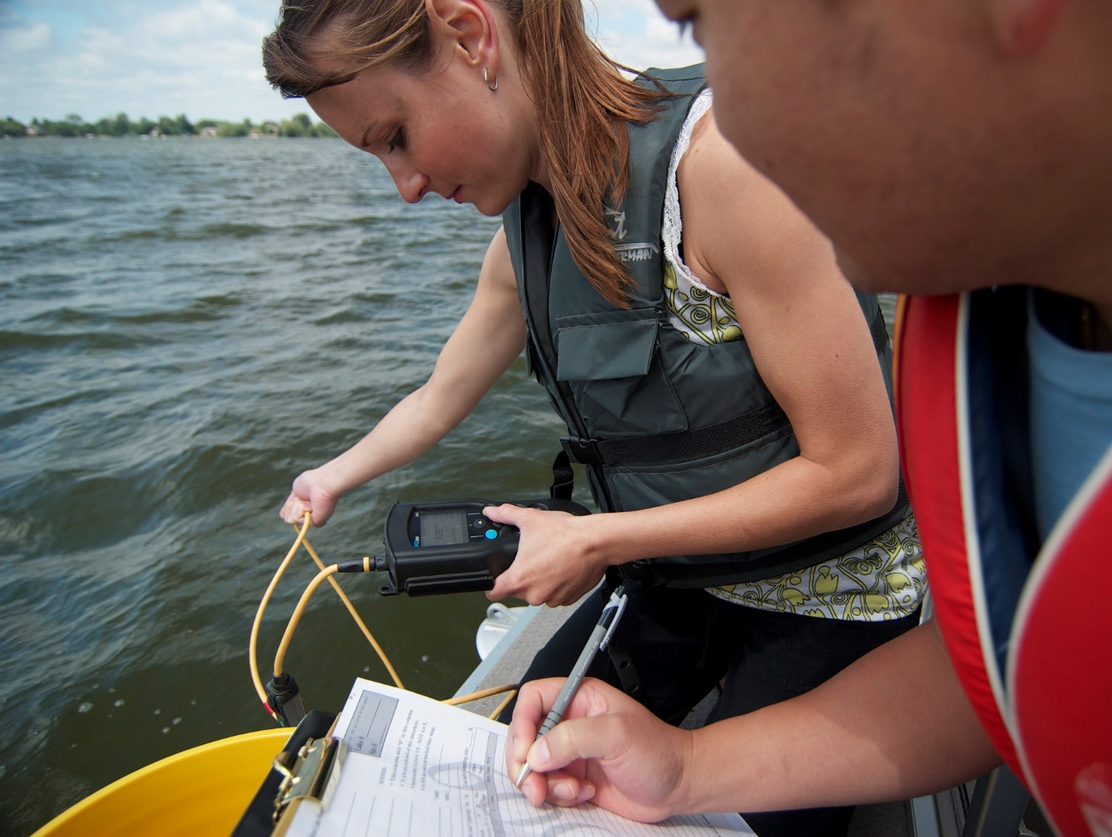
Mostly Scientists
Established in 1967
Medium-sized agency (about 900 FTE)
Low turnover rate (2.5%)
48% women
70% of staff are scientists
Engineers
Hydrologists
Soil Scientists
Chemists
Biologists
Environmental Specialists

Slide 8







MPCA Organizational Structure
Commissioner’s Office
Remediation
Watershed
Operations
Environmental Analysis & Outcomes
Resource Management & Assistance
Industrial
Municipal

Slide 9
Where the money comes from

Slide 10
Where the money goes

Slide 11
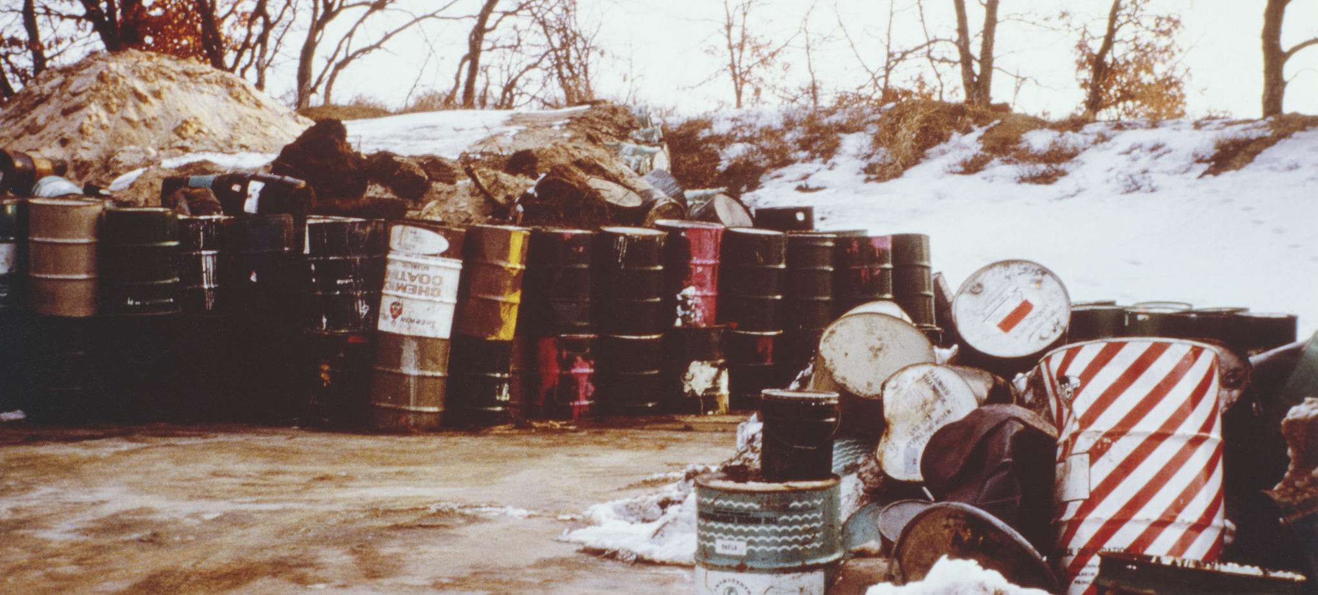
Remediation Division

Slide 12
Remediation Division
Key work:
Clean up contaminated properties, including landfills
Manage long-term projects to remediate past pollution, such as PFC contamination in the east Metro and industrial pollution in the St. Louis River
Superfund, Closed Landfill programs

Slide 13
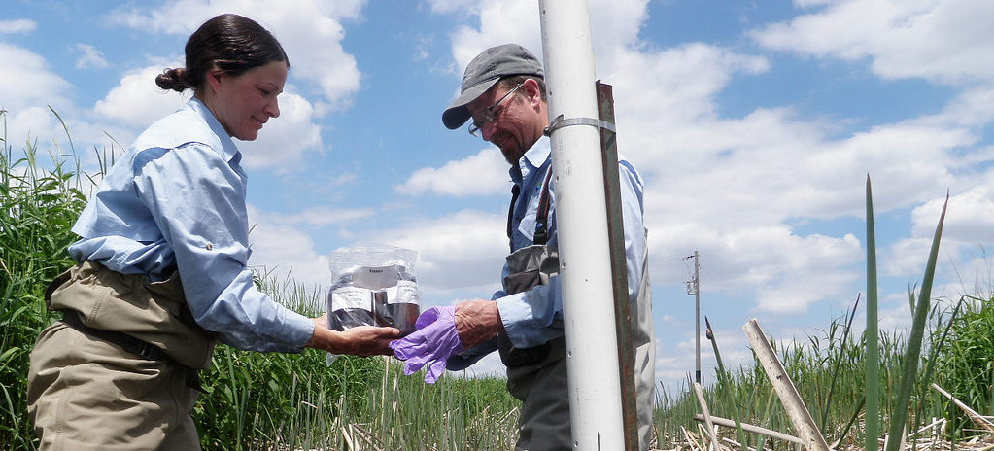
Watershed Division

Slide 14
Watershed Division
Key work:
Investigate causes, sources, and potential solutions for water pollution problems
Issue permits for animal feedlots
Manage several grant programs that benefit local partners

Slide 15

Operations Division

Slide 16
Operations Division
Key work:
Provide services that benefit all agency programs:
Fiscal & contracting
Human resources
Legal services
Communication
Data management
Emergency management
Facilities & fleet

Slide 17
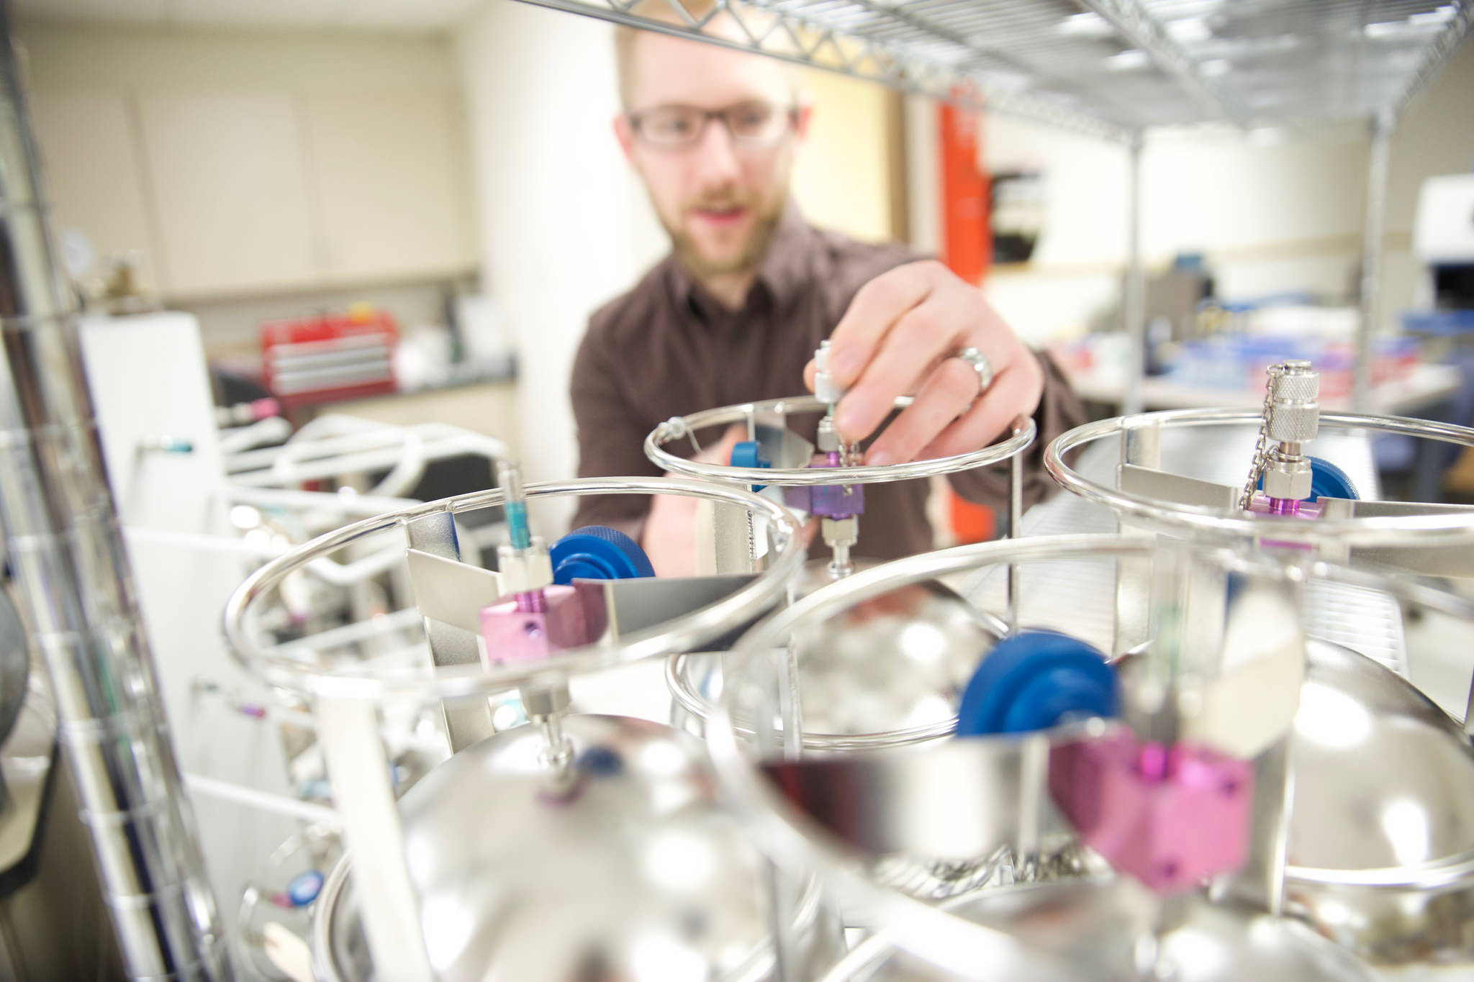
Environmental Analysis and Outcomes Division

Slide 18
Environmental Analysis and Outcomes Division
Key work:
Monitor and evaluate environmental conditions
Develop environmental standards
Make environmental data broadly accessible to stakeholders & the public

Slide 19

Resource Management & Assistance Division

Slide 20
Resource Management & Assistance Division
Key work:
Address pollution through nonregulatory approaches (prevention, technical & financial assistance, education)
Manage solid waste, hazardous waste, rulemaking, and tanks

Slide 21
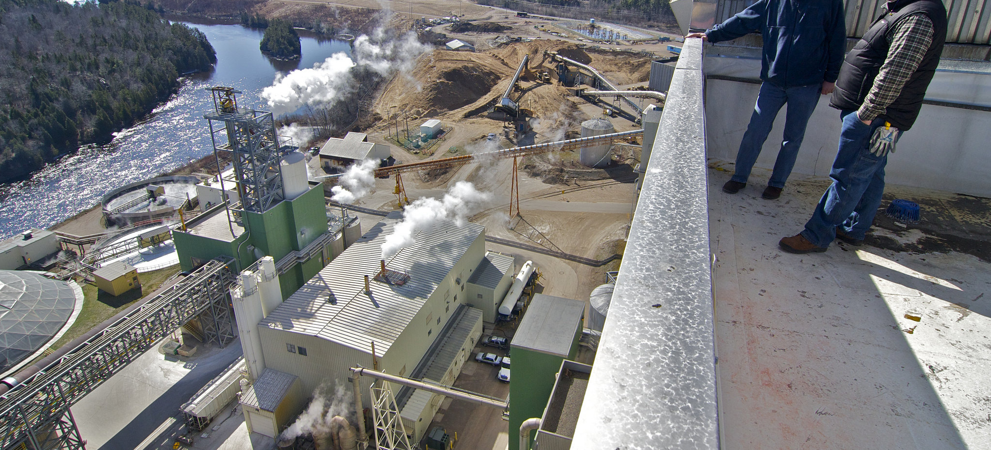
Industrial Division

Slide 22
Industrial Division
Key work:
Work with larger private industrial facilities on permitting, compliance, and enforcement
This work encompasses regulations on air quality, water quality, hazardous waste, and underground storage tanks.

Slide 23
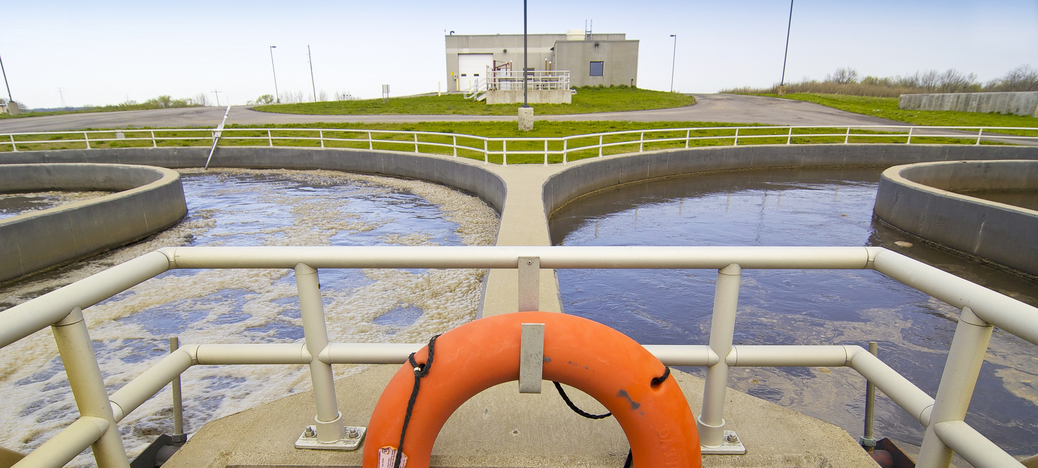
Municipal Division

Slide 24
Municipal Division
Key work:
Work with cities and towns to ensure proper management of wastewater, stormwater, and septic systems
This work includes technical assistance, permitting, compliance & enforcement, and development of policy

Slide 25



MPCA Organizational Structure
Commissioner’s Office
Air
Water
Land
Operations
Remediation
Watershed
Operations
Environmental Analysis & Outcomes
Resource Management & Assistance
Industrial
Municipal
Continuous Improvement Management Team
Emergency Preparedness Management Team
Environmental Results Management Team
External Engagement Management Team
Fiscal Systems Management Team
Human Resources Management Team
Information Systems Management Team
Enforcement Lateral Team
Permit Managers Team
Regulatory Action Team

Slide 26
Trade-offs and Tandems
Timeliness
Due Diligence
Environment
Economy
Engagement
Efficiency
Risk
Uncertainty

Slide 27
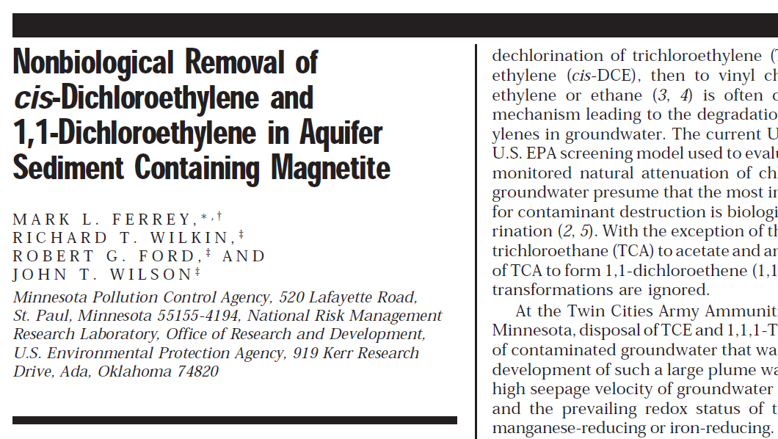
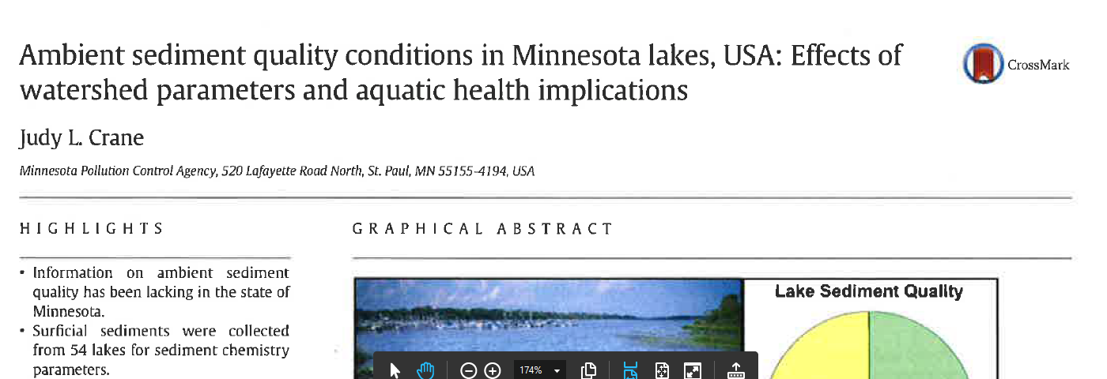
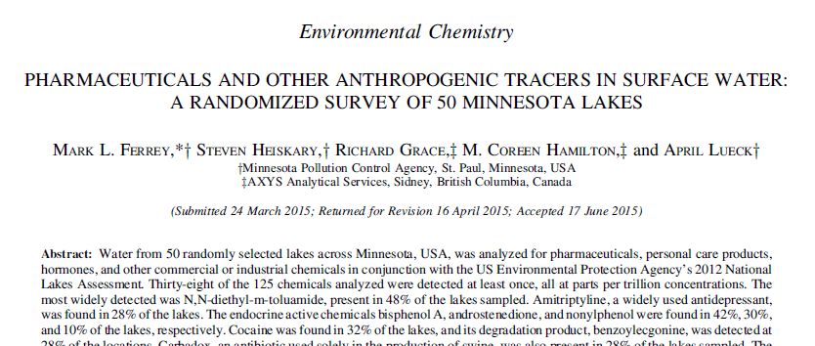
21st Century Tradeoffs
Environmental and Human Health Science is constantly evolving
Detection technology has accelerated much faster than cleanup technology
What we can measure versus what we can manage
Notes:
Economy vs. Environment – It’s a false choice. We need both, and they are inextricable. This can be tricky for specific projects, though, because often the economic question is more immediate (getting a new project off the ground) while the environmental question is longer-term (cumulative or long-term impacts of a new emission or discharge). It’s also important to note that an element of environmental regulations is preserving capacity for future economic development (i.e. if we allow one project to use up all the space between the current conditions and the standard, that project will prevent future projects/growth).
Timeliness vs. Due Diligence – We know we need to make expeditious decisions; we also have a responsibility to ensure the relevant information is reviewed and confirmed.
Risk and Uncertainty – Our science can quantify risk and uncertainty, but it can’t make it go away. Best practices and regulations can minimize risk, but to what level? Everyone has a different comfort level with risk and uncertainty, and often that comfort level is project-dependent. Our laws are set up for deliberative processes (public notice and comment, hearings, etc.) to ensure Minnesotans have a voice in these risk decisions.
Transparency vs. Expediency – It is important that Minnesotans have a say in the decisions that affect our environment. Engagement processes take time, though, and at the end of the day there is often still controversy because of differing values.
What We Can Measure vs. What We Know How to Manage – Science is advancing faster in the measurement arena than the management (treatment of prevention) arena. That means we can now measure a lot more chemicals in the environment at a lot lower concentrations, but we either don’t have the scientific data yet to know the impacts (or not) of those chemicals, or we know the impacts but we don’t have a cost-effective means of treating for them.
Environmental and Human Health Science is Constantly Evolving – The fact that science is always advancing is a great thing for Minnesota overall – scientific innovation regularly leads to improved quality of life. It also means that things we once thought were safe are found to be unsafe – and vice versa. Which means that we regularly find ourselves revisiting closed remediation sites or revision permit requirements to incorporate new information. Doing so is critical to our mission of protecting human health and the environment, but it also frustrating to Minnesotans when the “goalposts change,” or the conclusions about a site are revised due to new information.
What is true in general may not be true in particular:
Yes, we complete 97% of our priority permits within the established 90- 150- and 210-day goals. But that doesn’t matter to a business or city in the 3% that is anxiously awaiting their permit issuance.
Yes, air quality is generally good across Minnesota and we don’t have significant non-attainment areas. But that isn’t good enough for the family that lives next to an interstate highway and therefore experiences poor air quality, and has a child suffering from asthma.

Slide 28
Thank you!
Greta Gauthier
Greta.Gauthier@state.mn.us

