Slide 1
Budget Overview for House HHS Finance Committee
Jan Malcolm, Commissioner of Health
January 23, 2019

Slide 2

The Role of Public Health in Minnesota

Slide 3
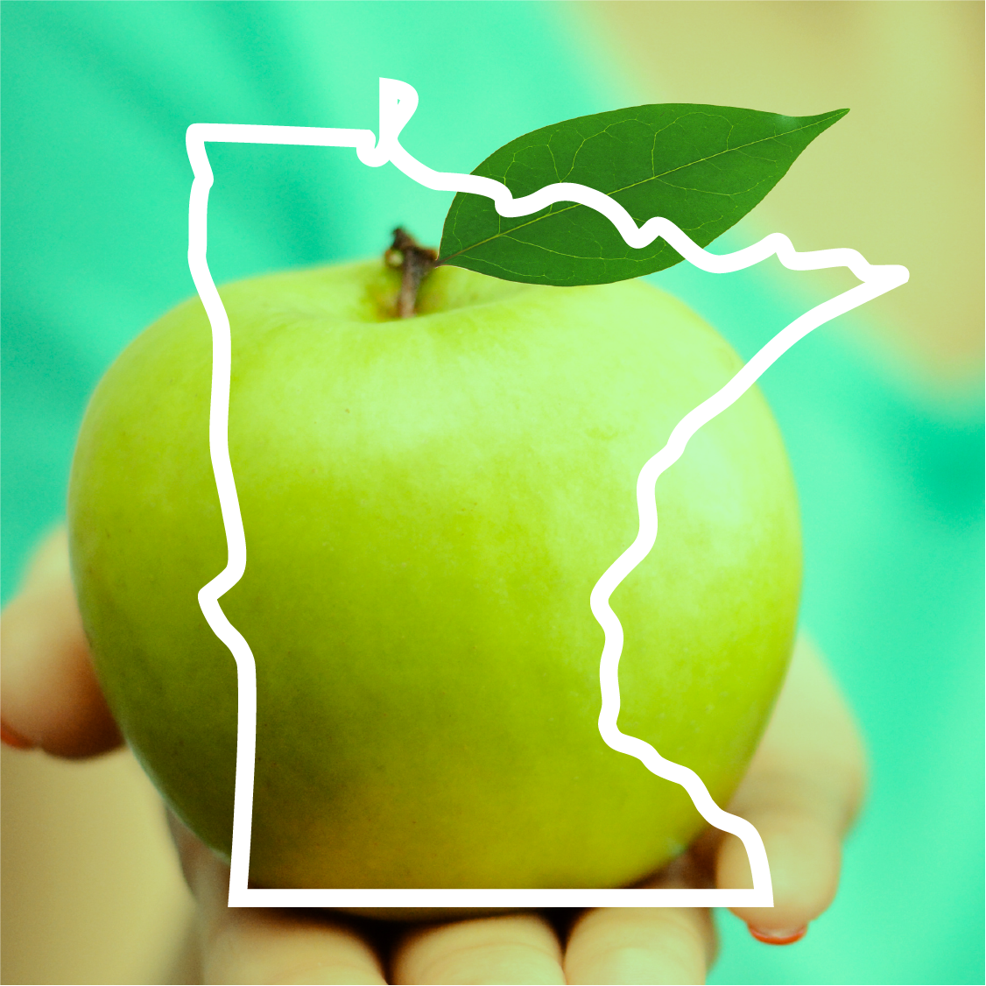
Public Health in Minnesota
Minnesota Rankings: The Good News
  1st Fewest cardiovascular deaths per 100,000
  1st Fewest premature deaths per 100,000
  1st Lowest rates of physical & mental distress
  3rd Developmental screening
  4th Lowest uninsured rate
  4th Lowest rate of diabetes
  4th Senior health
  5th Lowest rate of low birthweight infants
  6th Prenatal care
  10th Preventable hospitalizations
SOURCE: United Health Foundation
Notes:
Minnesota has dropped from 1st in overall rankings as recently as 2006, to 6th in 2017 to 7th this year.

Slide 4
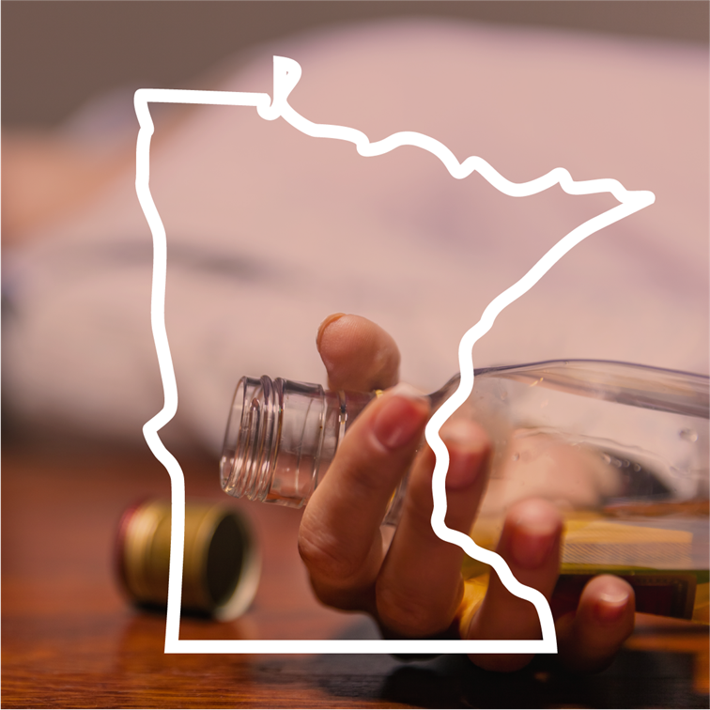
Public Health in Minnesota
Minnesota Rankings: The Bad News
  33rd HPV immunizations for females
  34th Tdap immunizations
  35th High school graduation rate
  42nd Homeless family households
  46th Excessive drinking
  48th Immunizations for children
  49th Percentage of children with adequate health insurance
SOURCE: United Health Foundation
Notes:
We’ve fallen in overall rankings and we have some of the worst health disparities among states.

Slide 5

Public Health in Minnesota
Minnesota Rankings: The Ugly News
Minnesota has some of the worst health disparities in the nation
Compared to whites, Minnesota’s populations of color and American Indians experience:
  Shorter life spans
  Higher rates of infant mortality
  Higher incidences of diabetes, heart disease, and cancer; and
  Poorer general health
Notes:
We’ve fallen in overall rankings and we have some of the worst health disparities among states.
These disparities negatively affect quality of life, cost of healthcare, and overall health of all Minnesotans.

Slide 6
What Determines Our Health?
Notes:
This chart shows how many factors influence our health, and the relatively small role played by clinical health care.
And yet when we discuss the big health issues of the day, we focus far more attention and resources on that small sliver of the pie.

Slide 7
Public Health in Minnesota
Health Care/Human Services (DHS)
Providing medical treatment to a child with measles
Enrolling people in health insurance to ensure chronic disease treatment
Treating people with addiction or overdose in hospital or program
Public Health (MDH)
Teaching parents about the value of immunizations
Working with local governments to reduce prevalence of chronic disease
Addressing root causes of diseases of despair (alcohol abuse, suicide, etc)

Slide 8
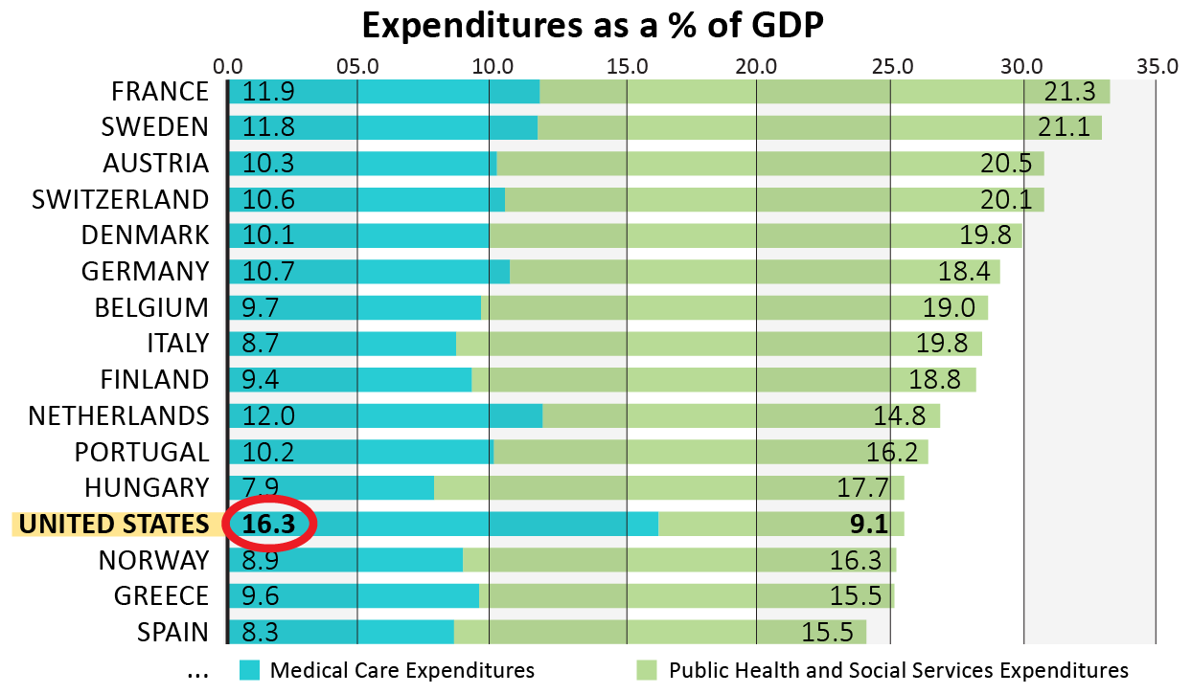
Total Investment in Health and Human Services
In OECD, for every $1 spent on health care, about $2 is spent on prevention and other social services
In the U.S., for every $1 spent on health care, about 55 cents is spent on prevention and other social services
Source: Bradley et al., 2011

Slide 9
Total Investment in Health and Human Services
Notes:
Add label for green section of bar chart in bottom.

Slide 10

Public Health in Minnesota
Why the poor performance? Consider chronic disease
1 million people (25%) age 10 to 64 in Minnesota were moderately or severely obese in 2017 – with direct spending costs of $476 million per year
Nearly 900,000 adults age 60 or older had at least 1 diagnosed chronic disease – representing costs of $9.4 billion per year
37% of adults were exposed to smoking in 2014 (current smoker; 2nd hand smoke or quit smoking), down from 40% in 2009 but still costing $250 million per year
Notes:
Why are we doing so poorly relative to other countries? One clue from Minnesota: obesity and chronic disease.

Slide 11

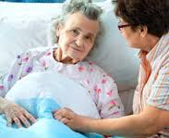
Public Health in Minnesota
We can’t afford to treat our way out
Spending related to chronic conditions is projected to soar by 2023
Chronic conditions (among age 60+) spending will more than double - up to $15 billion/yr
Dementia-related (age 18+) spending will double - up to $397 million/yr
Hypertension-related spending will increase 92% to $7.8 billion/yr
Notes:
SHIP and other prevention investments that drive down the incidence and costs of chronic disease are a bargain.
THIS SLIDE IS UPDATED FROM THE VERSION USED FOR HHS POLICY ON 1/22. NEW NUMBERS COURTESY OF STEFAN G.

Slide 12

The Impact of Public Health in Minnesota

Slide 13

MDH Mission:
“To protect, maintain and improve the health of all Minnesotans.”

Slide 14
Public Health in Minnesota
MDH District Offices

Slide 15
Public Health in Minnesota
State and Local Partnership
MINNESOTA
COMMUNITY
HEALTH BOARDS
Notes:
We rely on other state agencies and Minnesota’s local public health organizations to carry out the work of public health.

Slide 16

The MDH Budget

Slide 17
Expenditure History FY 2013-18 (in millions)
Notes:
No growth and slow growth environment. Overall expenditure at the department were $503 million in FY 2013 compared to $582 by FY 2018. Overall expenditures declined in FY 2016. Growth from FY 2017 to 2018 was 1%.
LINE SHOWS PERCENTAGE CHANGE FROM EACH YEAR
OTHER (Light blue) INCLUDES HCAF, FEES…

Slide 18
Sources and Uses of All Funds
Notes:
Sources graph: The majority of “All Other” is MERC (Medical Education and Research Costs). MERC’s slice of the entire pie is 14%

Slide 19
Staff by Funding Source
1,485 full-time equivalent (FTE) staff
Scientific and programmatic experts
Epidemiologists
Nurses
Economists
Data analysts
Community health specialists
Engineers
Laboratorians
Notes:
Our budget supports a workforce of highly skilled staff.

Slide 20
Federal Sponsors in FY 2019
Agency | # of Awards | Amount in millions | % of Total
U.S. Dept. of Agriculture (USDA – mostly WIC) | 9 | $125.9 | 47%
Centers for Disease Control & Prevention (CDC) | 104 | 76.7 | 28%
Health Resources & Services Administration (HRSA) | 19 | 24.8 | 9%
Centers for Medicare & Medicaid Services (CMS) | 16 | 17 | 6%
U.S. Dept. of Health & Human Services (HHS) | 19 | 13.4 | 5%
Environmental Protection Agency (EPA) | 11 | 8.1 | 3%
All Other | 10 | 3.3 | 1%
Total | 188 | $269.2 | 100%

Slide 21
Health Care Access Funds
Prevent
disease
Improve cost
and quality
Build infrastructure
and access
Statewide Health Improvement Partnership (SHIP) $17.5M
Health Economics $6.6M
Health Care Homes $1.8M
MN eHealth Initiative
$328,000
Loan forgiveness for health care providers $3.3M
Support for rural and underserved areas $2.1M
Grants to expand the health care workforce $2.2M
Grants to support hospitals and clinics $1.8M

Slide 22
Community and Family Health
• The Federal Women, Infants and Children (WIC) program provides healthy food and nutrition services to over 181,000 pregnant women, infants, and young children.
• Home visiting services provided to more than 12,200 at-risk families.
• Almost 35,000 children with special health needs and their families connected to supports and services.
• Prenatal, parenting, child safety, and other support services provided to more than 15,500 pregnant or parenting women.
• Family planning counseling services provided to more than 41,000 low-income or high-risk individuals.
• Teen pregnancy prevention efforts reached more than 29,500 teens.
Notes:
ADD CHARTS FOR EACH DIVISION SHOWING FUNDING BY SOURCE

Slide 23
Health Promotion and Chronic Disease
• Screened 11,692 low-income women for breast and/or cervical cancer in 2017 and detected 116 new cases of cancer.
• Trained 101 people statewide to provide diabetes prevention classes to those at heightened risk.
• Funded 8 community opioid prevention projects that helped participants reduce use by 600,000 pills in 2018
• Trained more than 16,000 people on evidence-based suicide prevention curricula.
• Our statewide registry of newly-diagnosed cancer cases registered 29,847 cases in 2015.
• 25,162 Minnesotans with a traumatic brain or spinal cord injury received services in 2017 through MDH grant-funded programs.

Slide 24
Health Partnerships and Equity
• Support 51 community health boards (local public health).
• Distribute $81 million per biennium to local governments, hospitals, and community-based organizations to support local public health activities, emergency preparedness activities, and to eliminate health disparities.
• Provide support and guidance on reducing health disparities to more than 150 community-based organizations from populations of color and American Indian communities.
• Coordinate emergency preparedness and response activities between state (MDH), community health boards, and 8 regional health care preparedness coalitions.
• Collect, analyze, and communicate health-related data.

Slide 25
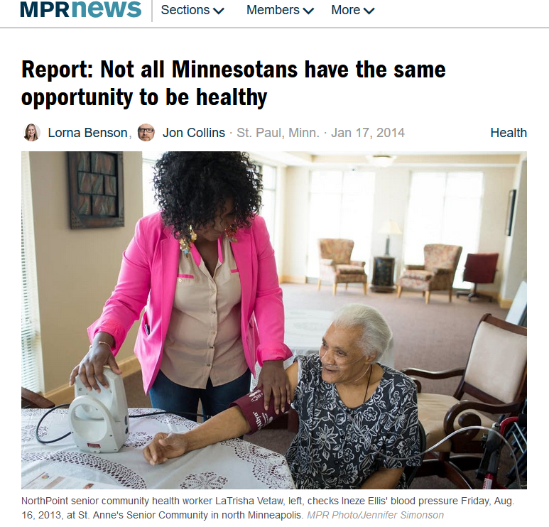
Public Health in Minnesota
Public health at work in Minnesota:
Advancing health equity

Slide 26
Statewide Health Improvement
• Partners with local public health, tribal governments and community-based organizations to ensure all Minnesotans lead healthier lives by preventing chronic disease before it starts.
• Provides $17.5 million per year in funding and support to Minnesota’s 87 counties and 10 tribal nations across the state to improve policies and create environments that support healthy eating, physical activity, and decrease commercial tobacco use and exposure to secondhand smoke.
• Tobacco-Free Communities grants provide $3.2 million per year to reduce tobacco use among youth in Minnesota and promote tobacco prevention activities.

Slide 27

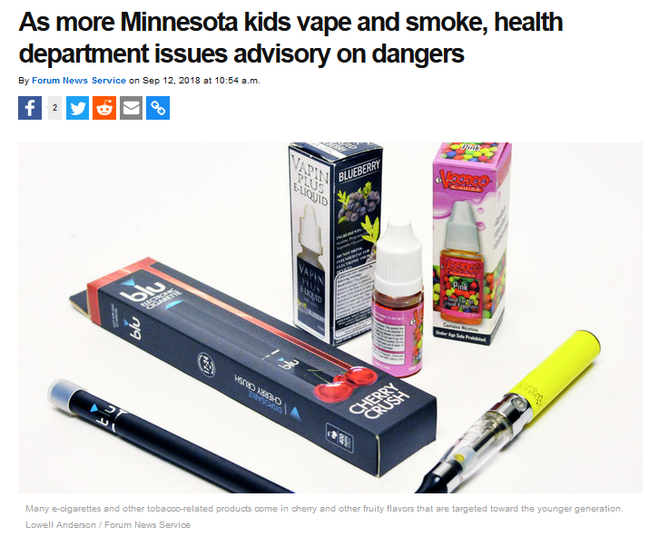
Public Health in Minnesota
Public health at work in Minnesota:
Sounding the alarm on e-cigarettes
Notes:
Alternative to the previous slide. We will use one or the other, not both.

Slide 28
Health Policy
• Minnesota Health Access Surveys measure changing percentage of uninsured Minnesotans each year, demonstrating the impact certain health care policies can have on health insurance coverage.
• Minnesota All Payer Claims Database supports evidence-based research on health policy impacts.
• Nearly $20 million in grants and loan forgiveness awards distributed statewide, supporting recruitment of health professionals in rural and underserved communities and a stronger health care infrastructure.
• Office of Vital Records issues more than 600,000 birth and death certificates annually and facilitates certification of over 99% of death records online, making them available to families more quickly.

Slide 29
Medical Cannabis
• Approved the enrollment of 15,794 patients and authorized 1,250 healthcare practitioners to certify patients as of mid-2018.
• Oversee 2 manufacturers and 8 cannabis patient centers in Minnesota.
• Added post-traumatic stress disorder as a qualifying medical condition on December 1, 2016, Obstructive Sleep Apnea and Autism Spectrum disorder on December 1, 2017, and Alzheimer’s on December 1, 2018.

Slide 30
Environmental Health
• Test drinking water at more than 7,000 public water systems.
• Ensure safe food, drinking water, lodging, and swimming pools in 23,000 establishments statewide.
• Promote healthy indoor environments and the reduction of unnecessary radiation exposure for over 11,000 facilities and individual contractors.
• Certify 12,000 food managers each year and support 35,300 active food managers.
• Regulate annually the installation of 6,000 new wells and the sealing of 7,000 wells no longer in use.

Slide 31
Infectious Disease
• Coordinated programs to immunize the 70,000 infants born each year.
• Investigated largest multi-drug resistant TB outbreak in the U.S., within Ramsey County.
• Investigated 1,408 cases of Lyme disease, 638 cases of anaplasmosis, and 59 cases of babesiosis in 2017. Worked with partners to identify several new tick-borne disease causing agents.
• Investigated 601 cases of syphilis in 2017.
• Developed a toolbox that provides the components all hospitals should have in place to identify, isolate, and inform authorities regarding a patient with a high consequence infectious disease.

Slide 32
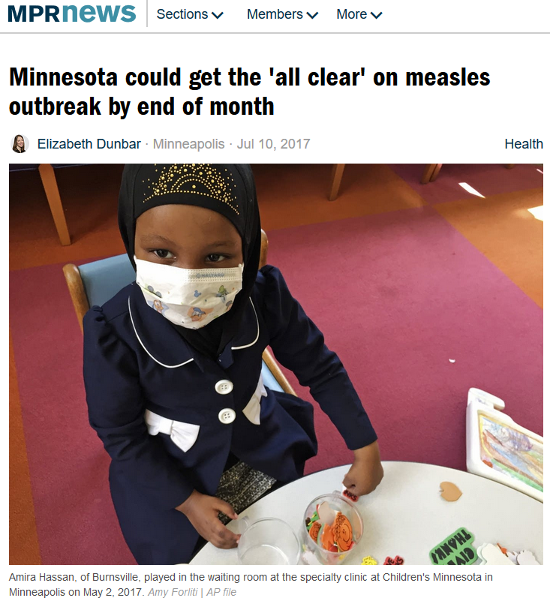
Public Health in Minnesota
Public health at work in Minnesota:
2017 Measles Outbreak Response

Slide 33
Public Health Laboratory
• Screen for rare disorders in newborn babies, including hearing loss and critical congenital heart disease. In FY2018 the lab screened 67,127 newborns for 61 rare treatable disorders.
• Provide testing for contaminants in the environment and to evaluate exposures to contaminants in people. In FY 2018, the lab received 40,507 samples and performed 116,304 analyses.
• Provide testing for viruses and other microbes that make people sick, as well as look for outbreaks related to food and water. In FY 2018, the lab performed 84,091 tests on 44,907 samples.

Slide 34
Health Regulation
• Monitor 4,200 health care facilities and providers for safety and quality.
• Review qualifications and regulate more than 6,700 health professionals.
• Monitor nine health maintenance organizations and three county-based purchasing organizations that provide health care to 1.1 million Minnesotans.
• Maintain a registry of more than 60,000 nursing assistants.
• Inspect 560 funeral establishments and license 1,300 morticians.
• Register more than 3,400 spoken language health interpreters.

Slide 35
Health Operations Bureau
• Oversee and guide nearly $325 million in outgoing grants to 500 unique grantees.
• Review and release 45 separate legislatively-mandated reports.
• Provide human resource services to over 1,500 MDH employees in 10 locations across Minnesota.
• Process more than 25,500 payment transactions and execute 1,700 contracts and grant agreements for MDH programs each year.
• Provide information technology services support for 250 software applications, 256 servers, and 2,070 personal computers.

Slide 36

The Public Health Quandary: Prevention Often Invisible
Notes:
Our greatest successes are often invisible because they prevent problems

Slide 37
For more budget information
See “Health” on MMB’s website: https://mn.gov/mmb/budget/current-budget/governors-budget-recommendations/base-budget-books.jsp
Contacts:
Jan Malcolm, Commissioner of Health, 651-201-5810
Melissa Finnegan, Legislative Director, 651-201-5805

