Slide 1
Department of Human Services
FY2016/17 Governor’s Budget Overview
January 2015

Slide 2
2014 – 2015 direct appropriations for DHS
We spend 77% on basic & long-term health care
77%
Source: Minnesota Management & Budget BPAS data

Slide 3
What creates health?

Slide 4
We have invested in health care expansion to cover more Minnesotans
Source: 2013 Minnesota Health Access Survey, Minnesota Department of Health and University of Minnesota, School of Public Health’s State Health Access Data Assistance Center

Slide 5
Now, we are turning our attention to the other factors that create health
We need to make new investments in areas of our budget where it makes the biggest difference.
Children and Families
Mental Health
This will help address the challenges we face.

Slide 6
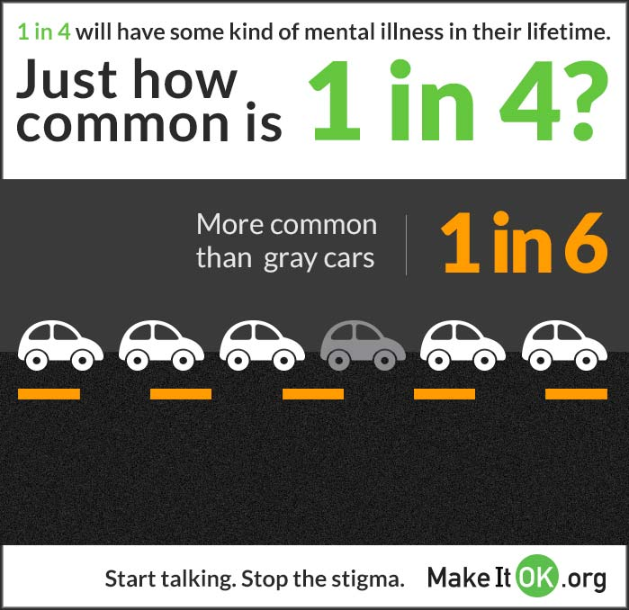
Challenges: Mental health capacity

Slide 7
Challenges: Gaps in substance use treatment
1 in 18 Minnesotans with substance disorders receive treatment
Source: 2010 Minnesota Survey on Adult Substance Use

Slide 8
Challenges: Access to care

Slide 9
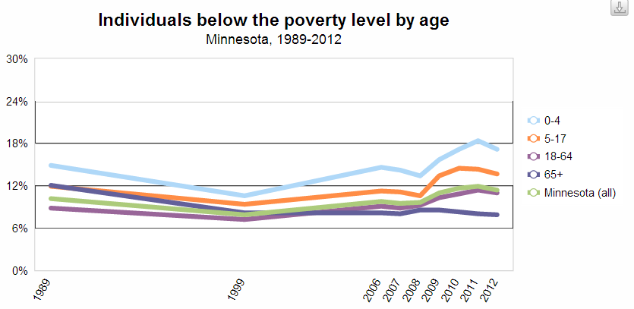
Challenges: Increased child poverty
78,000 children in Minnesota are in deep poverty – living at half or less of the poverty line

Slide 10
Challenge: Children and housing
Current issues: The number of homeless children and their families has almost quadrupled per one-night shelter counts

Slide 11
Challenges: Age wave

Slide 12
Challenges: Pressure on the system

Slide 13
Our budget priorities start to address these challenges
Children and Families
Mental Health
Direct Care and Treatment
Infrastructure and Requirements
Health Care
Continuing Care

Slide 14
Children and Families
Problem: 78,000 children in Minnesota are in deep poverty – living at half or less of the poverty line

Slide 15


What investments have we made?
Created Northstar Care for Children
Expanded support for parents
Improved child care quality through Parent Aware
Increased funding for sex trafficked and homeless youth
Established Housing Assistance grant for some MFIP families
Visits to 4-star Parent Aware child care centers
Top: Y Early Learning in St. Paul
Bottom: Panda’s Playhouse in Sartell

Slide 16

Challenges that still exist
In Minnesota:
5 in 10 Black children
4 in 10 American Indian children
3 in 10 Hispanic children
2 in 10 Asian children and
1 in 10 White children …
LIVED IN POVERTY IN 2012
Source: U.S Census Bureau, 2012 American Community Survey

Slide 17

Children and Families: Our 2015 proposals
Invest in Quality Child Care
  Simplify child care assistance requirements to reduce complexity for participants and counties ($1.6M in FY16/17)
  Revise Basic Sliding Fee child care allocation formula and reduce the waitlist - currently at 6,939 ($12.5M in FY16/17)
  Sustain the Parent Aware Quality Rating System
  ($3.5M in FY16/17)
Address disparities and work with our tribal partners
  Support expanded tribal administration of human services programs for WEN ($2.8M in FY16/17) and Red Lake TANF ($284K in FY16/17)
  Establish an American Indian Family Early Intervention Program to families who are at risk for possible child maltreatment ($2M in FY16/17)
  Change how funds will be allocated and distributed to tribes related to the Tribal Customary Adoption Grants (Budget Neutral)
  Invest in targeted, coordinated, culturally-specific care for pregnant mothers at high risk of poor birth outcomes from drug use ($272K in FY16/17)

Slide 18
Children and Families: Our 2015 proposals continued
  Oral Health ($9.9M in FY16/17)
  Reform the way Oral Health services are provided in Medical Assistance and MinnesotaCare.
Child protection ($2.5M in FY16/17)
  Support best practices
  Increase accountability for county and tribal child welfare agencies
Support Families in Minnesota
  Eliminate the application fee for Child Support Services ($34K in FY16/17)
  Make necessary changes to Northstar Care for Children (Budget Neutral)
  Increase funding for food support in the Minnesota Food Assistance Program (MFAP) ($1.1M in FY16/17)

Slide 19
Community supports administration
Problem: The mental health infrastructure is insufficient with too many gaps, structurally and financially fragile, limited service availability, and inconsistent measurement

Slide 20

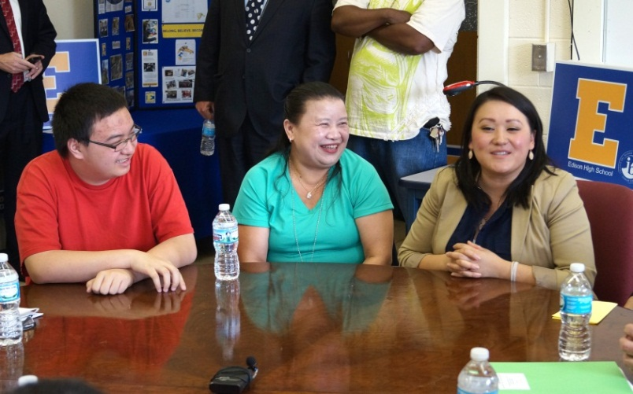
What investments have we made?
School-linked mental health
Crisis response for children and adults
Increased some payment rates
Established new benefits
School-linked mental health grant announcement, Edison High School, Minneapolis

Slide 21
Challenges that still exist
Existing community capacity does not meet needs - Anoka Metro Regional Treatment Center has a waiting list of 77
Some children’s services are not available in Minnesota - We have between 300-400 children each year who would be best served in Psychiatric Residential Treatment Facilities
Rates are often insufficient to cover the cost of services - Riverwood Centers, which served some 3,000 clients, closed suddenly in 2014
Lack of treatment services for the most acute children and adults - The system does not have adequate resources for the most aggressive clients
We have work force issues - Most of Minnesota is designated as a Mental Health Professional Shortage Area
Focus has been on treatment and interventions, leaving prevention and early interventions behind

Slide 22
Why is mental health a top priority for 2015?
Nearly 30 years after passage of the state’s Comprehensive Mental Health Act, the vision of a state-wide system of adult mental health services is far from complete.

Slide 23
Why is mental health a top priority for 2015?
25 years after passage of the state’s Comprehensive Mental Health Act, the vision of a state-wide system of children’s mental health services is even less developed.

Slide 24
We need to expand services in the continuum of care
Prevention
Early intervention
Treatment
Recovery
ACES Trauma-informed Multigenerational Primary care access | Screening Appropriate assessments School-linked mental health Crisis response | Benefits in MHCPs Evidence-based practices Standardized measures | Peer specialists Housing programs to reduce homelessness Respite grants Supported employment
Implement Behavioral Health Homes Mental health consultation School-based diversion First episode psychosis intervention | Expand Crisis services Certify Behavioral Health Clinics Reduce ACEs Expand Respite Care | Create Psychiatric Residential Treatment facilities; Close CABHS Stabilize and reform MH payment structures Psychiatric Residency Program Increase capacity for people with complex needs MSH funding | Expand supported housing ACT quality and expansion Flexibility in our Transitions Initiatives
What’s been done
What needs to be done

Slide 25
Mental Health: Our 2015 proposals
Prevention
  Incorporate primary care and support for wellness in Behavioral Health Homes ($6.9M in FY16/17)
  Mental health consultation for early childhood providers ($922K in FY16/17)
  School-based diversion pilot for students with co-occurring disorders ($65K in FY16/17)
  Intervene in first episode psychosis ($260K in FY16/17)
Early Intervention
  Expansion of crisis services ($4.7M in FY16/17) and respite care ($847K in FY16/17) to keep people in the community and out of hospitals
  Certify Behavioral Health Clinics ($398K in FY16/17)
  Reduce the incidence of Adverse Childhood Experiences (ACEs) ($796K in FY18/19)

Slide 26
Mental Health: Our 2015 proposals
Treatment
  Begin to establish Psychiatric Residential Treatment capacity in the state ($6.6M in FY16/17) and close Child and Adolescent Behavioral Health Services (CABHS) ($1.3 M investment in FY16/17; savings thereafter)
  Stabilize and reform mental health services payment structure ($5.5M in FY16/17)
  Create Public Psychiatric Residency Program ($354K in FY16/17)
  Increase residential services within DCT for individuals with complex conditions ($4.8M in FY16/17)
  Minnesota Security Hospital ongoing funding to continue improvements needed from conditional licensure ($11.2M in FY16/17)
Recovery
  Increase access to housing with supports for adults with mental illness ($4.7M in FY16/17)
  Improve and expand the Assertive Community Treatment (ACT) program ($1.3M in FY16/17)
  Create more flexibility for our Transitions Initiative (Budget Neutral)
  Create initial licensure standards for withdrawal management
  (Budget Neutral)

Slide 27
Housing and Olmstead: Our 2015 proposals
Invest in a new way to provide housing in Minnesota for people with disabilities – Olmstead Goal ($3.1M in FY16/17)
Data collection support for Plan to Prevent and End Homelessness ($1.2M in FY16/17)
Additional proposals in the spirit of Olmstead:
Expansion of Mental Health Crisis Services
Quality improvement and expansion of Assertive Community Treatment
Housing with Supports - expands housing options for Adults w/ MI
Jensen Settlement Administrative Costs - improves access to community based living options
Psychiatric Residential Treatment Facility
Increased Capacity for Individuals with Complex Conditions
Transitions Initiative Flexibility

Slide 28
Direct Care and Treatment
Problem: The current mental health and substance abuse systems do not have the proper incentives to keep people in community-based settings and maintain DCT as the provider of last resort

Slide 29

What investments have we made?
Focused on greater community integration
Clarified our role as a safety net provider
Increased transparency and outside scrutiny
Reduced staff injuries
Reduced use of seclusion and restraints
Received bonding funds for St. Peter campus
Minnesota State Operated Community Services staff and the individuals they support clean up a roadside near Hayfield as part of the Adopt-A-Highway program

Slide 30
Direct Care and Treatment: Our 2015 proposals
Expand services to those clients with the most needs; Reduce capacity where people can be served in the community
  Increase county share of cost for Anoka clients who do not need hospital level of care ($1.8M savings in FY16/17)
  Reduce capacity in the C.A.R.E. program and create a rate system that incentivizes private providers to serve the most complex clients ($18M investment in FY16/17)
Address Jensen Requirements
  Funding on-going costs of complying with the court ordered requirements of the Jensen settlement ($3.9M in FY16/17)
DCT Operating Adjustments (SOS and MSOP)
  SOS ($6.5 M in FY16/17)
  MSOP ($7.8M in FY16/17)

Slide 31
MSOP Reform
Minnesota Sex Offender Program (MSOP)
  Equalize county share of cost for clients on provisional discharge ($281K savings in FY16/17)
  Move MSOP forward by increasing frequency of client evaluations and risk assessments, investing in less restrictive alternatives and increasing capacity for the judicial branch ($6.8M in FY16/17)

Slide 32
MUST HAVEs and Infrastructure
Problem: New legal, federal or other requirements obligate DHS to seek resources to fulfill new mandates
Problem: In recent years, DHS has had to absorb many cost increases

Slide 33
Must Haves and Infrastructure: Our 2015 proposals
Meeting requirements and mandates
  Updating state law and state computer systems so counties and DHS can comply with new requirements
    Child Support Conformity ($92K in FY16/17)
    Adult Foster Care Liability Insurance ($666K in FY16/17)
    Federal Compliance on Homeless Youth ($223K in FY16/17)
  Aligning state and federal policy in publicly funded health care programs
    Medical Assistance cost-sharing requirements ($222K in FY16/17)
    Compliance with ruling on treatment of assets in long term care ($5.2M in FY16/17)
    Basic Health Program regulations ($732K in FY16/17)
  Providing increased funding for MNsure IT development and operating costs related to Medical Assistance and MinnesotaCare enrollees ($11.7M in FY16/17)
Investments to efficiently run DHS programs
  Fund Central Office and DHS MN.IT personnel cost increases of 1.8% annually based on the historic average ($5.7M in FY16/17)

Slide 34
OIG Proposals
OIG proposal to Strengthen Recovery Act Contract (RAC) effectiveness ($70K savings in FY16/17)
OIG proposal for Background Studies for Special Circumstances (Fee-supported and Budget Neutral in FY16/17)

Slide 35
Health Care
Problem: While Minnesota has lowered its uninsured rate to 4.9 percent, it has not adequately addressed health inequities between public programs and the commercial market

Slide 36
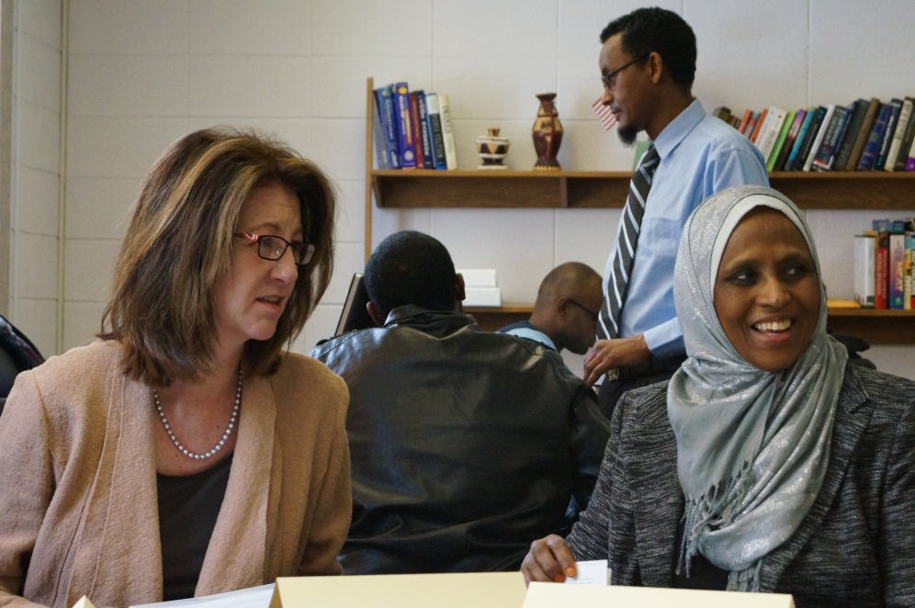
What investments have we made?
Leveraged opportunities under the ACA
  Medicaid expansion
  Exchange
  Improved MinnesotaCare
Visit to navigator organization, Somali Health Solutions, Minneapolis

Slide 37
Health Care: Our 2015 proposals
Ensure Better Health Outcomes
  Expand the Medication Therapy Management Program to individuals with one prescription for a complicated disease ($41K savings in FY16/17)
  Improve opioid related prescribing practices in Emergency Departments ($33K in FY16/17)
  Expand Minnesota Restricted Recipient Program ($519K savings in FY16/17)
Preserve access to hospital care for low-income Minnesotans
  Ensure that Minnesota hospitals can continue to maximize federal Disproportionate Share Hospital (DSH) funding ($5.2M in FY16/17)
Improve Third Party Liability Recoveries ($2M savings in FY16/17)
Change the Medical Assistance Lien Processes to alleviate administrative burdens ($101K savings in FY16/17)

Slide 38
Sustainable MinnesotaCare
This proposal reduces expenditures through changes to the enrollee cost sharing and premium structures
  Premium changes for enrollees with income above 150% of FPG
  Cost sharing equivalent to a platinum plan
These changes preserve a vital program while maintaining relatively low out of pocket costs
  Premiums for a single adult remain lower than those offered in MNsure
  Low out of pocket costs relative to silver level plans

Slide 39
Continuing care for older adults
Problem: More people with disabilities and older adults should be able to choose to live and work safely in the community

Slide 40

What investments have we made?
Launched Own Your Future
Implementing Reform 2020
Increased Nursing facility and HCBS rates

Slide 41
Continuing Care: Our 2015 proposals
Expand the smarter purchaser approach to LTC while creating focused incentives
  Expand the Own Your Future campaign by implementing a smarter purchaser approach and creating a new HCBS Innovation Pool ($3.3M in FY16/17)
Self Directed Workforce Negotiations
  Increases the rate for Personal Care Attendants (PCA) based on investments the state has agreed on through negotiations with Self Directed Work Force representatives in SEIU ($16M in FY16/17)

Slide 42
Total Investment
Total GF investments in FY16/17 of $175M
Total GF investments in FY18/19 of $288M
Net HCAF reductions in FY16/17 of $63M
Net HCAF reductions in FY18/19 of $61M

Slide 43


Investment for the purpose of…
Healthy People
Stable Families
Strong Communities

