Slide 1
Minnesota’s Municipal Transportation System
House Transportation Finance Committee
February 16, 2017
Anne Finn, LMC Transportation Lobbyist

Slide 2
About the League of MN Cities
The League serves 833 of Minnesota’s 853 cities through advocacy, education and training, policy development, risk management, and other services
The League also operates an insurance trust for cities

Slide 3
Affiliates
Coalition of Greater Minnesota Cities
Metro Cities
Minnesota Association of Small Cities

Slide 4
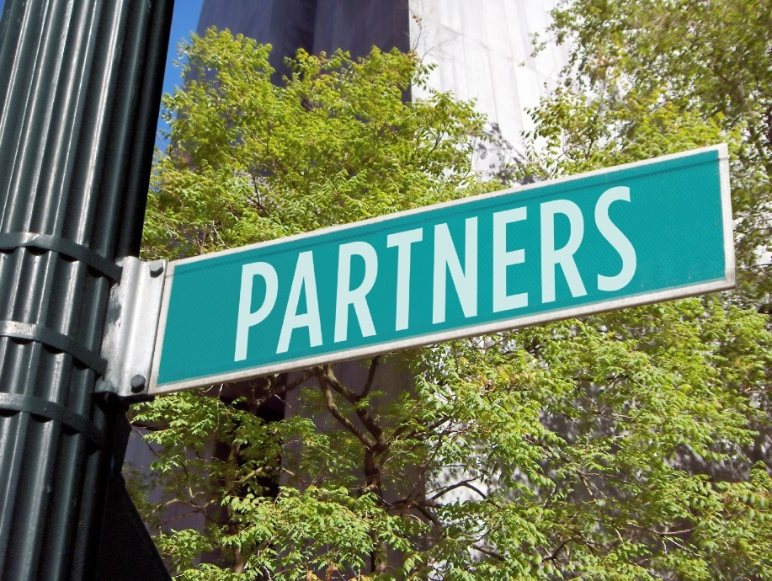
Transportation Partners
YOU!
USDOT
MnDOT
Metropolitan Council
Counties
Economic development authorities
Businesses

Slide 5
About Minnesota’s 853 Cities
139 are in the seven-county metropolitan area
Of the 714 cities in greater MN, only 36 have a population > 10,000
361 cities have a population < 500
495 cities have a population < 1,000

Slide 6
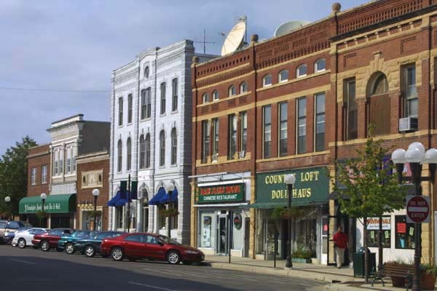
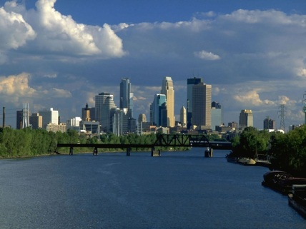
Bottom line: Minnesota’s cities are diverse

Slide 7
For the Record
Minnesota cities--large and small, rural, urban and suburban--support passage of an omnibus transportation funding bill that is comprehensive, multimodal and sustainable.

Slide 8

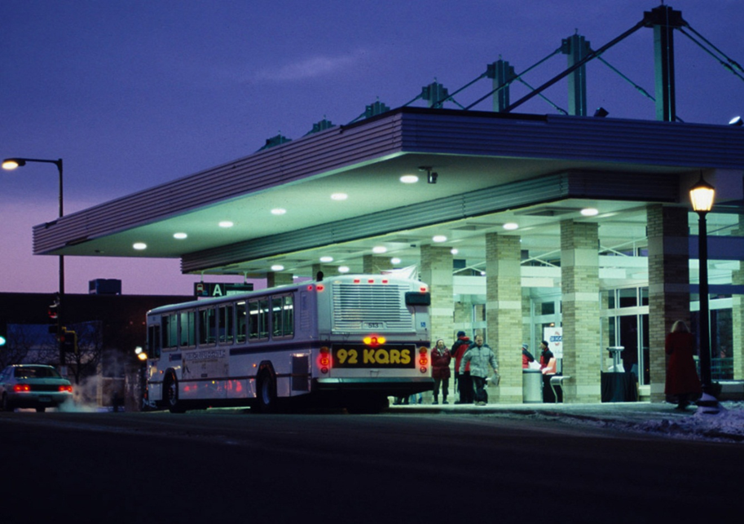
Big picture: Planes, trains and automobiles (and buses)

Slide 9
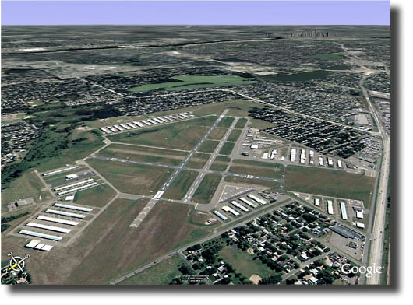
Airports

Slide 10
Airports
135 publicly owned airports in MN
Metropolitan area has MSP + 6 reliever airports
Remaining 129 are in greater MN
In greater MN, airports are typically owned by a city

Slide 11
Muncipal Airports: Funding
State Airports Fund (SAF) is the primary state funding source for aeronautics
SAF comes from dedicated taxes on aviation fuel, aircraft registration, and airline flight property
Money in the fund is appropriated biennially to MnDOT as part of the transportation budget
Notes:
State Airports Fund is the primary source of funding for municipal airports
Some federal funding is also available, depending on eligibility and action by feds

Slide 12
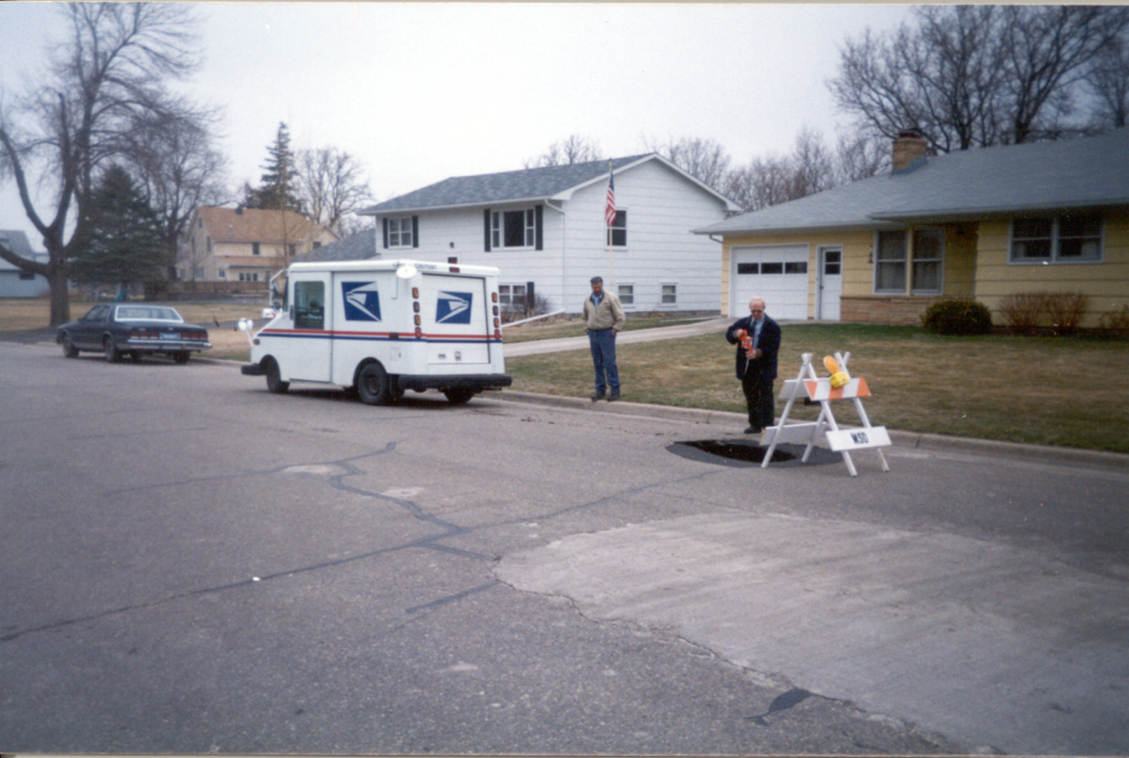
City Streets

Slide 13
City Streets: The System
Municipal streets make up over 22,500 miles (about 16 percent) of roadways in MN
Made up of collectors and residential streets
The design and quality of city streets is significant to all users and is critical to local economies

Slide 14
City Streets: Maintenance
Maintenance of this system is essential if cities are to maximize investments
Every $1 spent on maintenance saves $7 in repairs/reconstruction (Source: USDOT)
Best time to do maintenance? When pavement condition is good

Slide 15
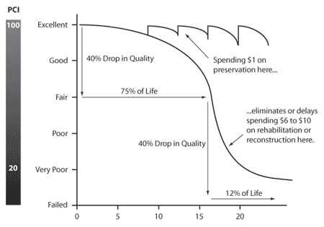
City Streets: Maintenance

Slide 16
City Streets: New Construction
New construction is sometimes necessary
To accommodate growth
To attract economic investments
Cost of new
$2.5 to $3.5 million per mile (Source: MnDOT)
Includes engineering, all underground work, C&G, sidewalk, landscaping, etc.
ROW acquisition, utilities extra

Slide 17
City Streets: MSA/Non-MSA
City street system is divided into two systems:
Municipal State Aid (MSA)
City street system

Slide 18
MSA: Where does it come from?

Slide 19
MSA: Eligibility
MSA funds up to 20% of streets in cities over 5,000 population
Currently, 148 (of 853) cities receive MSA
MSA roads make up less than 16 percent of total city mileage
Additionally, MSA streets have design requirements

Slide 20
MSA: Shortcomings
Most cities are ineligible for MSA
In MSA cities, MSA funds are often exhausted by cost participation in state/county projects
Property taxes supplement MSA on MSA streets

Slide 21
Non-MSA City Streets: The 84%
The city street system (city-owned streets not receiving MSA) makes up the remaining 84% of city streets
Non-MSA city streets are funded with property taxes, local government aid and special assessments
Less common: assistance from county, developer fees

Slide 22
City Street Funding Challenges
City budgets are strained
Special assessments are unpopular, difficult to administer
Maintenance is affordable, but not always a priority
Tax exempt property does not pay

Slide 23
City Street Funding by the Numbers
According to Office of the State Auditor
In 2015 cities collectively budgeted $541 million (9% of total expenditures) for street maintenance and repair
In 2015 cities collectively budgeted $887 million (14.7% of total expenditures) for street construction and improvement
Notes:
Source: OSA
Streets and Highways. These budgeted expenditures reflect the costs associated with the
maintenance and repair of local highways, streets, bridges, and street equipment.
Common expenditures include patching, seal coating, street lighting, street cleaning, and
snow removal. Expenditures for road construction are not included in current
expenditures but are accounted for as capital outlay.
Streets and Highways Capital Outlay. This category includes budgeted expenditures for
road and bridge construction projects, including major rehabilitation and improvement
projects for existing roads and bridges.

Slide 24
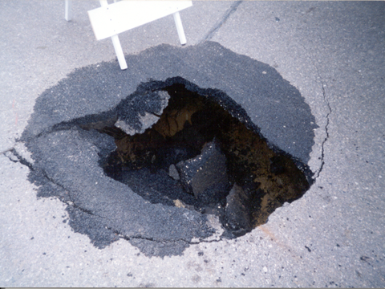
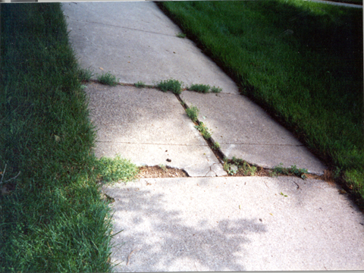
Municipal Street System is Aging

Slide 25
Existing Funding is Flat to Declining
Unlikely
Eligibility for MSA by more cities, more streets
Special assessments, property taxes suddenly becoming popular

Slide 26
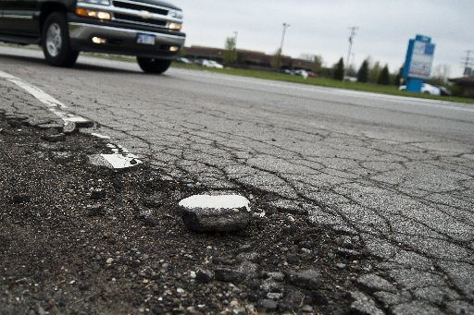
The Cost of Doing Nothing
What if revenues remain flat?
Deterioration of city streets will accelerate
Cities will struggle to attract and retain businesses
Property taxpayers will shoulder burden

Slide 27
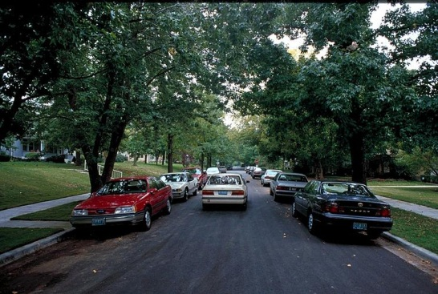
TFAC: $400 Million Annual Need

Slide 28
Priority: Revenue for Non-MSA City Streets
Dedicated revenue for non-MSA city streets
Needed in cities of all sizes
Small Cities Assistance Account
Large Cities Assistance Account

Slide 29
Priority: Cost Participation Assistance
Assistance shouldering cost participation in state and county projects
Would prevent delayed maintenance on city-owned systems
Idea: New account in Local Road Improvement Program

Slide 30
Priority: Street Improvement District Authority
Would allow cities to collect fees for:
Maintenance
Construction
Reconstruction
Fixed transit infrastructure
Trails and pathways

Slide 31
Priority: Bonding for Transportation
Corridors of Commerce
Transportation Economic Development
Local Road Improvement Program
Local Bridge Account
Rail Safety Improvements

Slide 32
Thank you!
Anne Finn
651-281-1263
afinn@lmc.org

