Slide 1

County-Based Purchasing:
A Local, Integrated, Transparent, Publicly-Accountable, and Proven Minnesota Health Care Programs model
Minnesota House HHS Finance Division
January 31, 2019
Presenters: Jim Przybilla, Leota Lind, Brad Anderson
© 2019 Minnesota Association of County Health Plans

Slide 2

Models for Delivering Minnesota Health Care Programs (MHCP)
DHS Fee-for-Service (FFS) – administered by the Department of Human Services
Traditional MHCP Managed Care – administered by HMOs
County-Based Purchasing (CBP) – administered by counties
Integrated Health Partnership (IHP) – embedded by DHS in models 1-3 above
Next Gen IHP – administered by DHS, delivered through health systems – not yet implemented
© 2019 Minnesota Association of County Health Plans

Slide 3
Of the MHCP delivery models, CBP is the only model:
Locally owned and governed by the counties it serves*
Specifically designed for rural communities and to address the unique challenges of delivering MHCP in Greater Minnesota
Organizationally integrated with county health and human services resources, which are substantial in rural counties, including most resources relevant to addressing social determinants of health*
*Exception – Hennepin Health has these attributes but is not CBP
© 2019 Minnesota Association of County Health Plans

Slide 4
Models for Delivering MHCP
MACHP believes that:
All models are worthwhile
No one model fits all counties
All the models can be improved upon
The State and counties should jointly and equally decide what model will best deliver MHCP locally
© 2019 Minnesota Association of County Health Plans

Slide 5
CBP is not for every county
Risk-Reward tradeoff with reward based on what the community values and believes will work best for its vulnerable residents
© 2019 Minnesota Association of County Health Plans

Slide 6
Counties doing CBP today
Itasca Medical Care (www.imcare.org), headquartered in Grand Rapids, owned and governed by Itasca County, with an average 2018 enrollment of approx. 8,300 members.
PrimeWest Health (www.primewest.org) headquartered in Alexandria, owned and governed by 13 counties, with an average 2018 enrollment of approx. 42,000 members. Possible expansion to additional 11 rural counties.
South Country Health Alliance (https://mnscha.org), headquartered in Owatonna, owned and governed by 11 counties, with an average 2018 enrollment of approx. 41,000 members.
© 2019 Minnesota Association of County Health Plans

Slide 7
The CBP-DHS MHCP Contracting Overview
State (DHS) contracts with counties to:
Manage and pay for MHCP-covered services to counties’ residents enrolled in MHCP
Accept 100% financial risk (up/down) for the total cost of MHCP participants’ health care
Carry out all regulatory reporting and compliance requirements
© 2019 Minnesota Association of County Health Plans

Slide 8
What the State gets from CBP (and what makes CBP unique and effective)
Public transparency – CBP complies with all government sunshine laws and regulations, an attribute embraced and advantageous to integration
Public accountability – CBPs are governed by locally elected public officials; few people are more sensitive to local needs, concerns, and change
Social and civic responsibilities – Neighbor caring for neighbor and local government commitment to the well-being of residents
Economy of scale – Ability to make the State $ go farther – integrate county resources with State MHCP resources to achieve the State’s MHCP goals
Public-Private partnerships – Integrate public and private health care and human services resources. No one sector can do it alone.
© 2019 Minnesota Association of County Health Plans

Slide 9
What the State Gets from CBP (and what makes CBP unique and effective)
Integration – MHCP payer integrated with significant county health and human services resource to more readily leverage integrated service delivery across the entire health care continuum
Local Convener – As a local MHCP administrator, CBP has a broad spectrum of local stakeholders who can be readily organized to address needs
Value-Added – Reinvestment of financial surpluses above capital reserve requirements to improve access, quality, and cost-effectiveness of care
Innovation – Unique local needs drive unique but replicable local solutions
Results – Continually improving Triple Aim measures most relevant to the local community and State – population health, quality, and cost
© 2019 Minnesota Association of County Health Plans

Slide 10
Example: Strengthening Dental Access
© 2019 Minnesota Association of County Health Plans

Slide 11
Example: Reducing Neonatal Abstinence Syndrome (NAS)
. . . Using a $1.7 million grant from PrimeWest Health, Sanford hospital leaders teamed up with child welfare and social service specialists in Beltrami County and the Red Lake Reservation. Crucially, they not only screen for opioid addiction and treat it in expectant mothers, but also identify underlying problems such as a lack of stable housing or mental health care that helped fuel those addictions.
Minneapolis StarTribune, April 23, 2017
© 2019 Minnesota Association of County Health Plans

Slide 12
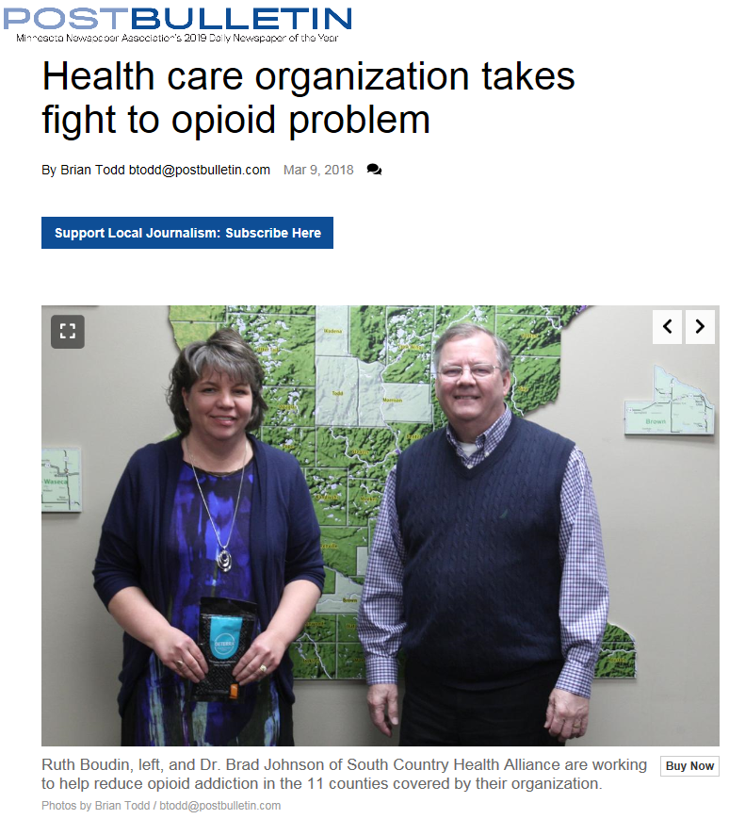
Example: Leading the fight against opioid abuse
South Country is the only health plan to add a case management program to address the opioid epidemic.
This person centered case management program is aimed at decreasing the incidence of chronic opioid use.
Opioid case management adds to the shared decision making process providing education and outreach support to providers and enrollees on safe and effective pain management with prescription opioids, non-opioid pharmaceutical therapies, and other alternative treatment options.
© 2019 Minnesota Association of County Health Plans

Slide 13
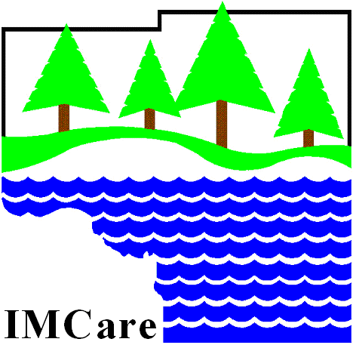
Example: Consistent Excellent
Provider Satisfaction
“We are very satisfied with IMCare” – Local Optometrist
“IMCare program is great!” – Local Chiropractor
“I appreciate prompt claims processing” – Local Behavioral Health Provider
“I’m very thankful for IMCare for us as providers, but more so for our patients because it has virtually eliminated access issues.” – Local Dentist
Network Provider Satisfaction Survey: Overall, how satisfied are you with IMCare services? | 2015 98% | 2016 95% | 2017 99% | 2018 100%
© 2019 Minnesota Association of County Health Plans

Slide 14
Challenges
Quality and Outcome Measure alignment – HMOs, CBPs, and Providers have multiple unaligned population health, quality, and outcome measures from multiple measurement entities; this creates significant “measurement fatigue” and lack of a unified, coordinated focus on an agreed-upon set of highest priority measures
FFS to Value Based Payment (VBP) Transition – Slow transition has providers caught in the crossroads making it difficult for them to make the culture shift and capital commitment to MHCP VBP
MHCP Reimbursement Rate Setting – Steady introduction of new high cost drugs and technology, and of new provider types and programs, requires a dynamic MHCP rate-setting methodology to ensure MHCP capitation rates are neither excessive nor inadequate; this will ensure fair reimbursement to providers which is necessary to preserving and increasing access to care for MHCP participants
© 2019 Minnesota Association of County Health Plans

Slide 15
Preserving the CBP model
Establish a statutory “home” for CBP – CBP plans, with the support and guidance of legislative counsel, have proposed updating language and consolidating CBP language in its own section of law: 62W. Currently, CBP is regulated as if it is a private HMO.
This has prevented both the State and counties from optimizing the model
Regulations specifically intended for HMOs have harmed CBPs
Is inconsistent with traditional partnerships between the State and counties
Amend HF3 – Revise “direct contracting” language that would otherwise eliminate CBP from MinnesotaCare to the detriment of local enrollees and CBPs
© 2019 Minnesota Association of County Health Plans

Slide 16
Thank you!
QUESTIONS
© 2019 Minnesota Association of County Health Plans

Slide 17
Contact:
Steve Gottwalt Executive Director 952-923-5265
steve@machp.org
© 2019 Minnesota Association of County Health Plans

