Slide 1
House HHS Finance HF576
February 25, 2015

Slide 2
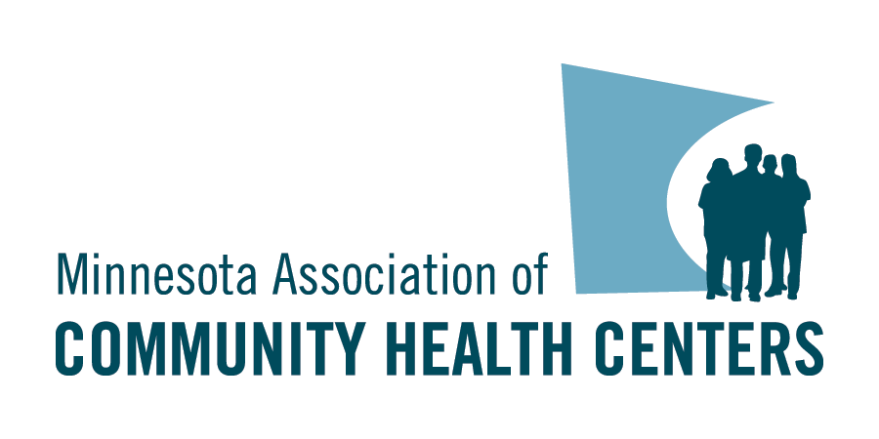
Community Health Centers The Basics
17 organizations at 70+ service sites in state serving 180,000 Minnesotans.
Also known as “Federally Qualified Health Centers – FQHCs”
Not-for profit corporations.
51% of Board are patients.
Serve a Medically Underserved Area.
Comprehensive primary care – medical, dental and mental health.
Enabling services key to model.
Serve all regardless of ability to pay.
Sliding fee schedule for the uninsured.
ROI – 9% of non-disabled MHCP with 1.2% of budget

Slide 3
Community Health Centers Locations
Greater MN
Twin Cities
Open Door Health Center –Mankato
Lake Superior Community Health Center – Duluth
Sawtooth Mountain Clinic – Grand Marais, Grand Portage, Tofte
Scenic Rivers Health Services – Cook, Bigfork, Big Falls, Floodwood, Northome, Tower
Community Health Service– Moorhead, Rochester, Wilmar, Olivia (*Seasonal), Owatonna*, Breckenridge*, Northern Mobile Unit, Southern Mobile Unit
Minneapolis
Axis Medical Center
Community-University Health Care Center
Health Care for the Homeless
Indian Health Board
Native American Community Clinic
Neighborhood HealthSource
North Point Health & Wellness
People’s Center
Southside Community Health Services
St. Paul
Open Cities Health Center
United Family Medicine
West Side Community Health Services

Slide 4
CHC Patient Demographics
Source: HRSA Uniform Data System, 2013
Source: Kaiser State Health Facts, 2013

Slide 5
CHC Patient Demographics
Source: HRSA Uniform Data System, 2013
Source: US Census Bureau, 2013

Slide 6
CHC Patient Demographics
Source: HRSA Uniform Data System, 2013
Source: Kaiser State Health Facts, 2013

Slide 7
CHC Patient Quality Indicators
SELECTED QUALITY INDICATORS
88% of CHCs are recognized as federal Patient Centered Medical Homes (PCMH)
78% of pregnant women entered prenatal care during first trimester
90% of patients screened for tobacco-use
86% asthma patients age 5 through 40 have a treatment plan
71% of diabetic patients have A1c under control (<=9.0%)
Lower LBW rates compared to state averages – by every race/ethnicity

Slide 8
Balancing History and Innovation
FFS
Pay for SERVICES
TCOC
Pay for VALUE
Serving the Underserved
Participating in Health Care Reform
MN DHS – “ACO Demonstrations”
Moving away from fee-for-service to Total Cost of Care (TCOC) arrangement – while meeting Financial & Quality Benchmarks

Slide 9
FQHC Innovation: Federally Qualified Health Center Urban Health Network (FUHN)
Only FQHC led Medicaid focused Accountable Care Organization in the nation.
1st “virtual” ACO in MN – non affiliated providers
Attributed 25,000 patients
Met all patient satisfaction goals and quality benchmarks
8.6% reduction in ED Visits in Year One, and currently at 16.2% in Year Two
$2.6 million in savings
Trending toward 20% reduction in ED Visits in Year Two
“Line of sight” into clinical care picture.

Slide 10
Success – ED Visits Reduced

Slide 11
FQHC Innovation – Hennepin Health
9% reduction in ED Visits
3% reduction in Inpatient Admissions
2.5% increase in Primary Care Visits
10.8% increase in patients meeting Optimal Diabetes Care
23.5% increase in patients meeting Optimal Vascular Care
7.6% increase in patients meeting Optimal Asthma Care

Slide 12
What We’ve Learned From the Demonstrations
Care coordination is at the core of the model.
Ensuring patients with multiple chronic diseases are managed
Data analytics for population health management is critical (and expensive).
Patient Outreach and Education necessary to engage patients in their care.
Value of “connecting” with social services our patients use/need to address the social determinants of health.
20% of outcomes influenced by services “provided within the 4 walls of the clinic”

Slide 13
FQHC Priority Areas
Care Coordination
Access
Data Analytics
Oral Health
Reduce health disparities
Reduce avoidable ER & Hospitalizations
Integrate Care
Engage Consumers
OUTCOMES

Slide 14
HF576
$2 million increase to CHC appropriation operated under Minn. Stat. 145.9269
“to continue, expand, and improve federally qualified health center services to low-income populations”
Currently at $2.5 million per year and scheduled to decrease by $125,000 in each year of FY16-17 biennium
Minnesota Department of Health (MDH) – Office of Rural Health and Primary Care (ORPHC)
Established in 2007

Slide 15
$2 million increase for FQHCs
Care Coordination
23,300 patients
40.00 FTE
Data Analytics
25,100 patients
5.50 FTE
Expanded Access
24,673 patients
6.50 FTE
Oral Health
12,577 patients
6.25 FTE
44 Investments
Nearly 60.00 FTE
Impacting 85,000 FQHC Patients

