Slide 1
Connected and Automated Vehicles
Jay Hietpas, P.E.
MnDOT State Traffic Engineer

Slide 2
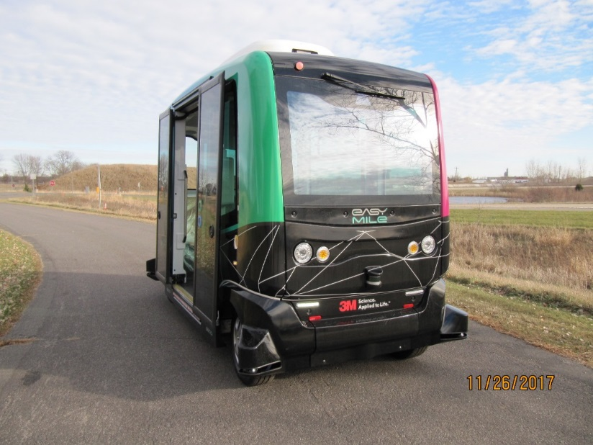
Presentation Overview
Connected and Automated (CAV) Background
CAV Activities to Date
Executive Order Overview

Slide 3
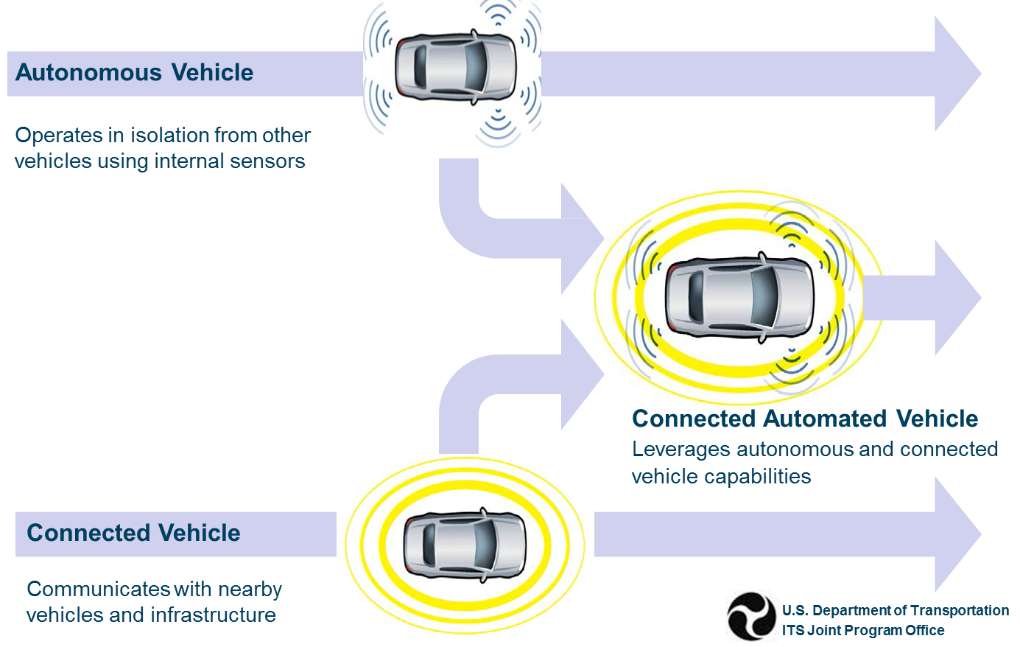
Connected Automation
Autonomous Vehicles
Operates in isolation from other vehicles using sensors
Uses connected and automated technologies
Connected Vehicles
Communicates with vehicles and infrastructure

Slide 4
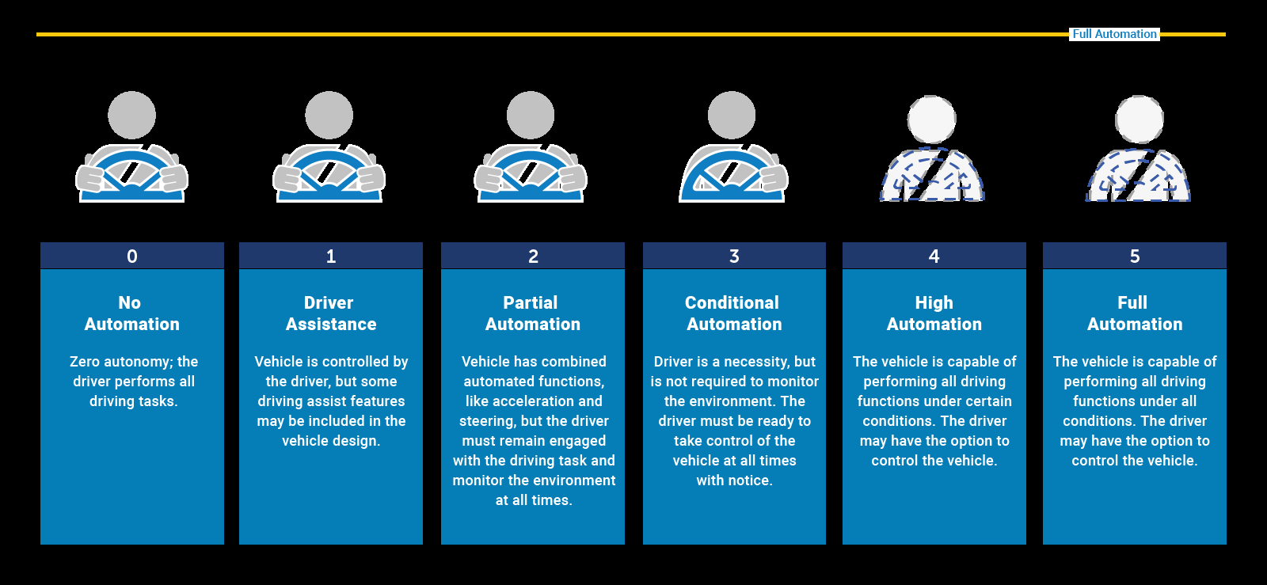
Society of Automotive Engineers (SAE) Levels of Automation
0
1
2
3
4
5
No
Automation
Driver
Assist
Partial
Automation
Conditional
Automation
High
Automation
Full
Automation

Slide 5
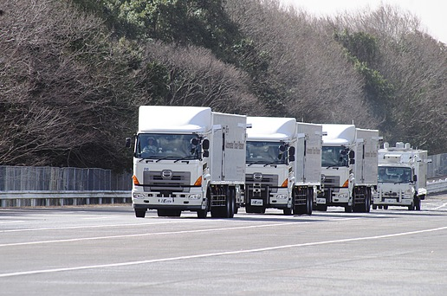
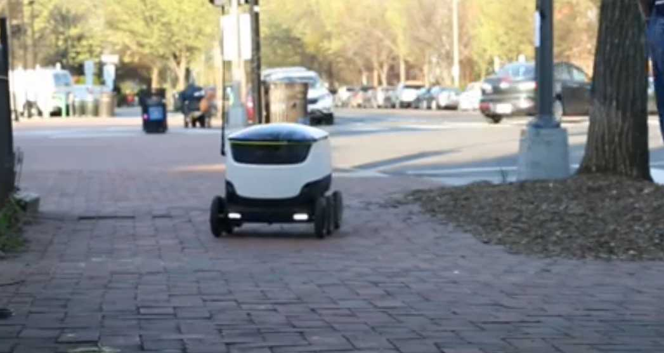
Items Being Considered
Automated & Connected Vehicles
Truck Platooning
Automated Delivery Services
Mobility as a Service
(MAAS)
Electric Vehicles

Slide 6
How Real is It?
Source: theverge.com
Source: engadget.com
Source: The Washington Post

Slide 7
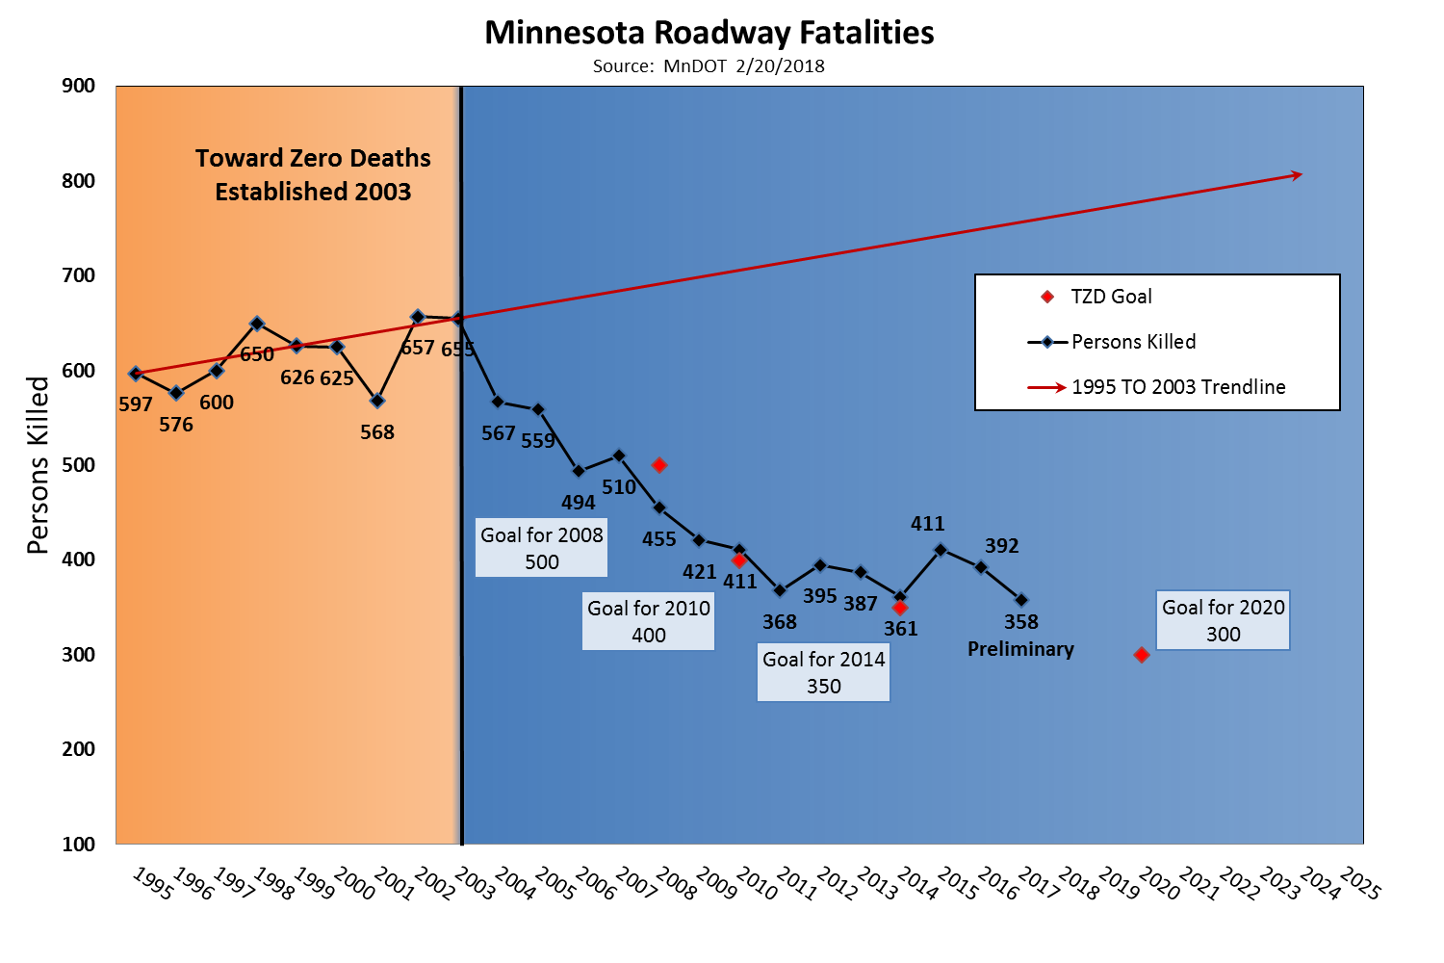
What is the Impact to Minnesota?
Safety
Changes in operations
Infrastructure Changes
Regulation
Mobility Opportunities
Business Opportunities
Notes:
Minnesota Crash Facts 2015

Slide 8
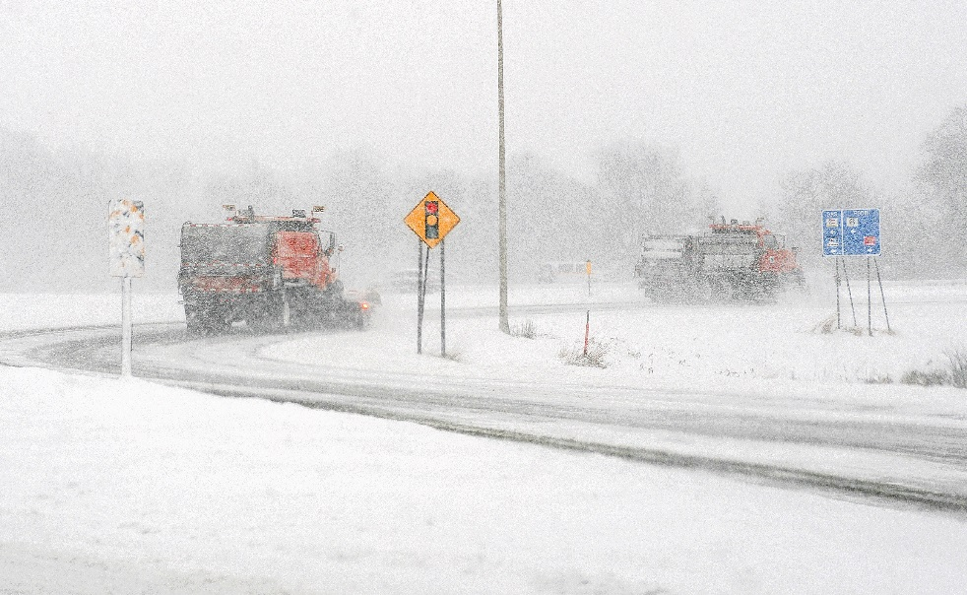
What are the Challenges?
Snow / Ice
Salt

Slide 9
National Highway Traffic Safety Administration Automated Driving Systems Recommendations
Automated Driving System 2.0: A Vision for Safety – Sept 2017
Best Practices for State Agencies
Form a Jurisdictional Committee for deliberation of automated driving system testing
Examine laws and regulations to address barriers to operation on public roadways
Best Practices for Legislatures
Do not place unnecessary burdens on competition or innovation
Support efforts to allow the testing and deployment of automated vehicles on public roads

Slide 10
National Highway Traffic Safety Administration Recommendations
Notes:
MnDOT Examining Statutes/Rules
ID Statutes/Rules Limiting AVs
ID Possibilities within Current Statutes/Rules
Currently Not Promoting Legislation

Slide 11
Safe Automated Vehicle Testing Demonstration
Project Goals
Snow and Ice Testing
Identify Infrastructure
Identify Operations Impacts
Improve Future Mobility Options
Increase Minnesota’s Influence
Develop Partnerships
Public Feedback

Slide 12
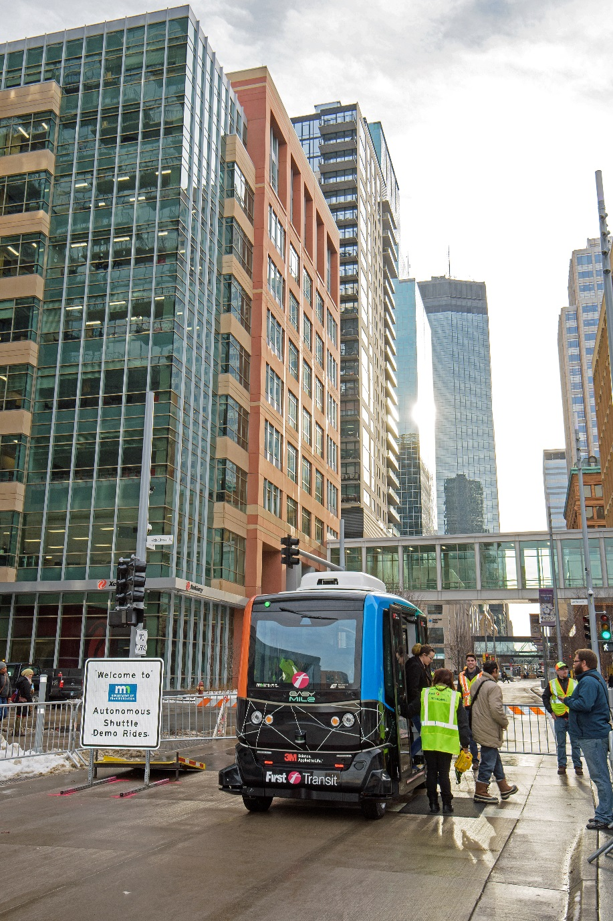
Downtown Minneapolis - Nicollet Mall Demo
TOTAL riders for the 3 day demo: 1279

Slide 13
Survey Responses
Q: Are you looking forward to having driverless vehicles operate on all roadways in the future?

Slide 14
States with Legislation and Executive Orders

Slide 15
Executive Order - Basis
Business and research
Transformational to transportation, commerce, mobility; workforce, land-use, and public safety
Positively impact public health
Support economic growth
Reduce transportation barriers for the disabled, elderly, and low-income

Slide 16
Executive Order – Expected Outcomes
Advisory Council
Study, assess, and prepare for the transformation and opportunities associated CAVs
Develop recommendations for changes in state law
Submit Report to Legislature by December 1, 2018.

Slide 17
Executive Order – Expected Outcomes
Report Contents
Transportation infrastructure and network;
Cyber security and data privacy standards;
Vehicle registration, training, licensing, insurance, and traffic regulations;
Economic development, business opportunities, and workforce preparation; and
Accessibility and equity for all Minnesotans.

Slide 18
Chairs
Commissioner Zelle (MnDOT)
Christopher Clark (Xcel Energy)
Advisory Council
Finance Public Safety
Transit Local Government
Higher Education Labor
Workforce Training Freight
Insurance Advocacy
Automotive Industry
Ex-Officio
8 State Agencies
Metropolitan Council
MN Council on Disability
Senate
House

Slide 19
Preparing for CAV
MnDOT, DPS and Other Agency Roles
Establish programs for development, testing, and deployment;
Support safe and effective testing and use of Connected and Automated Vehicles (CAV); and
Protect data as classified under the Minnesota Government Data Practices Act.

Slide 20
Interagency CAV Team
Led by MnDOT
Goal – To Implement Executive Order
Staff from ex-officio agencies
Ensure interagency coordination and collaboration in developing cross agency policies and programs; and
Provide operational support to the Advisory Committee.

Slide 21
Questions
Jay Hietpas, PE
State Traffic Engineer
Jay.hietpas@state.mn.us

