Slide 1


Legislative Working Group on Economic Disparities in Minnesota
SUSAN BROWER, MINNESOTA STATE DEMOGRAPHER
January 2016

Slide 2
Presentation Topics
Growth of diverse populations in Minnesota
Recent focus on data for Black Minnesotans
Economic disparities in detail (by Minnesota’s “cultural groups”)

Slide 3
1. Growth of DIVERSE POPULATIONS IN MINNESOTA
Notes:
Do I need projections

Slide 4
Populations of Color Now Jointly Total
1 million in MN; 19% of the Population
Source: U.S. Census Bureau

Slide 5
Minnesota’s Populations of Color by Major Race Groups, 2014
Source: U.S. Census Bureau

Slide 6
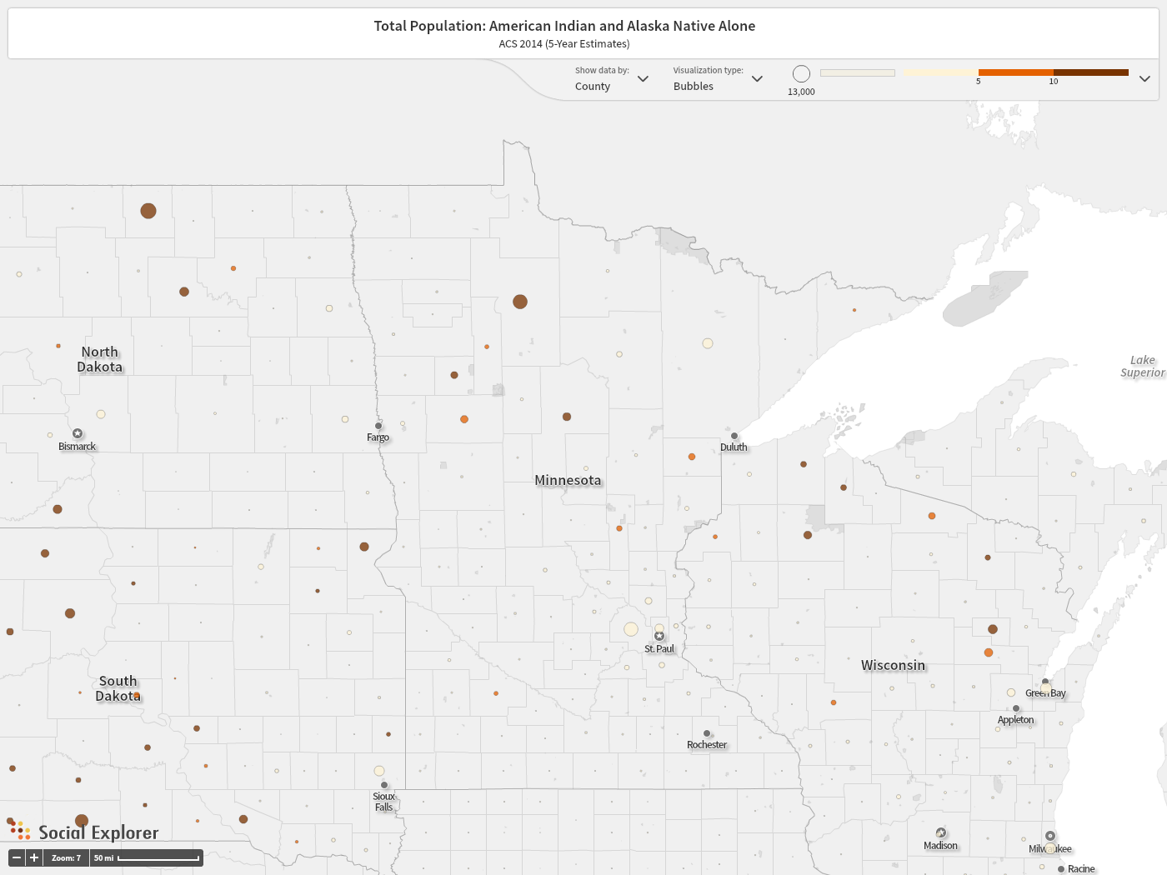
American Indian Population By County
(Note: Color shows percent, size of dot shows number)

Slide 7
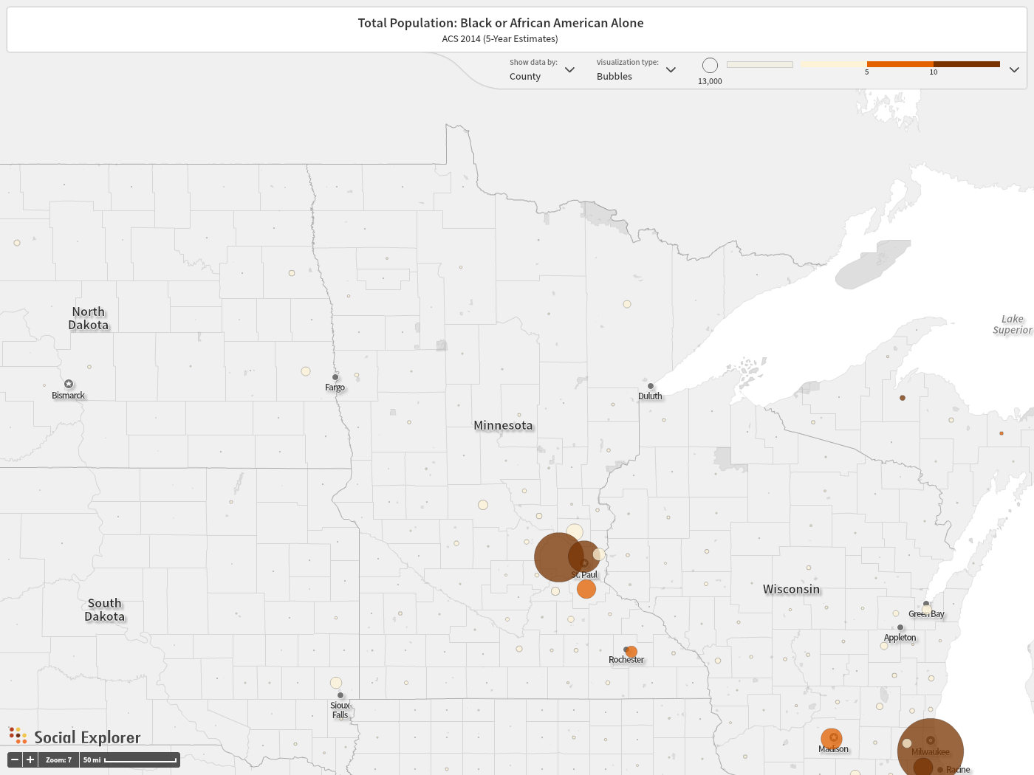
Black Population By County
(Note: Color shows percent, size of dot shows number)

Slide 8
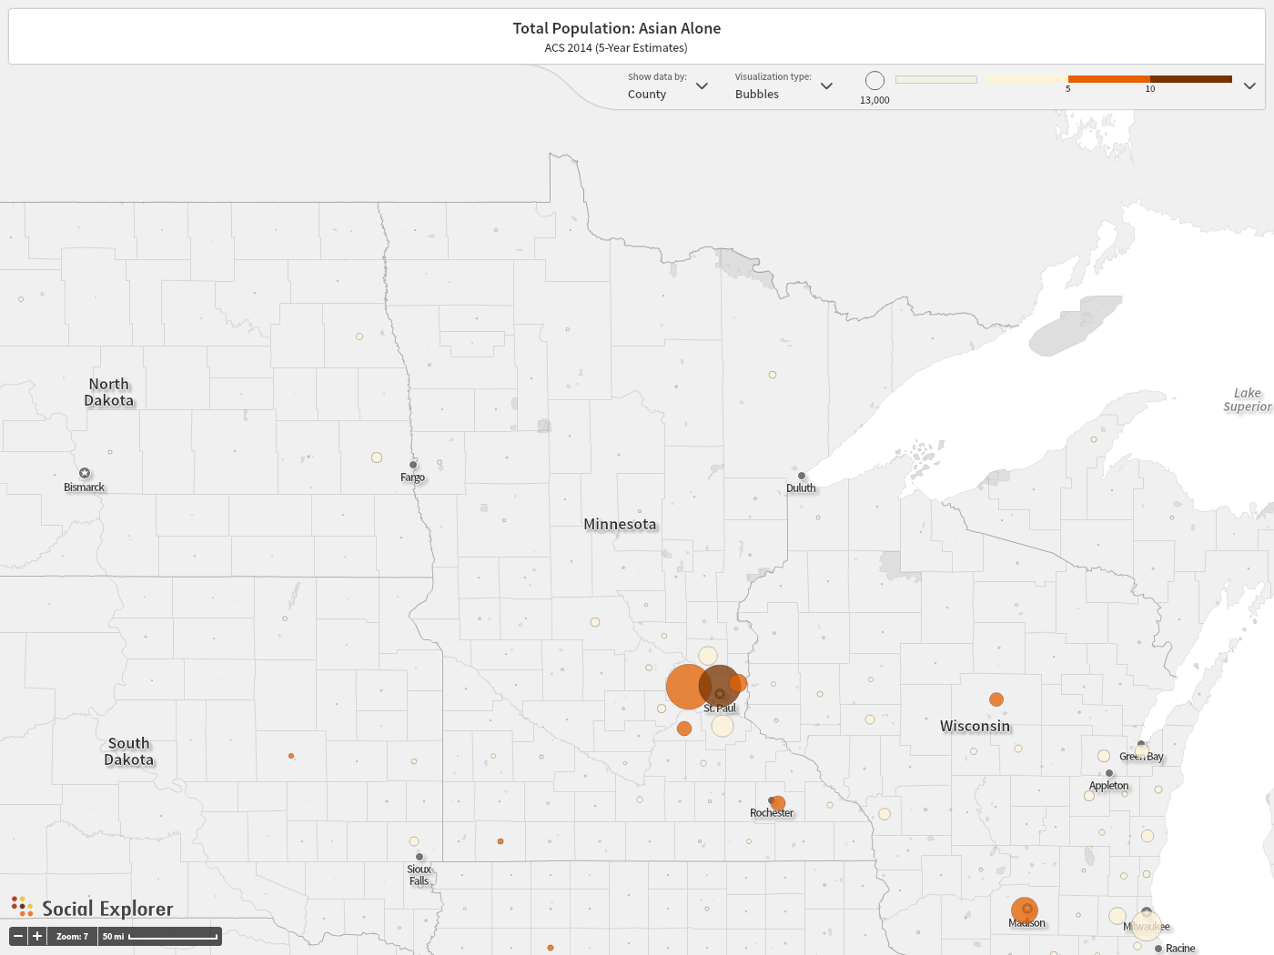
Asian Population By County
(Note: Color shows percent, size of dot shows number)

Slide 9
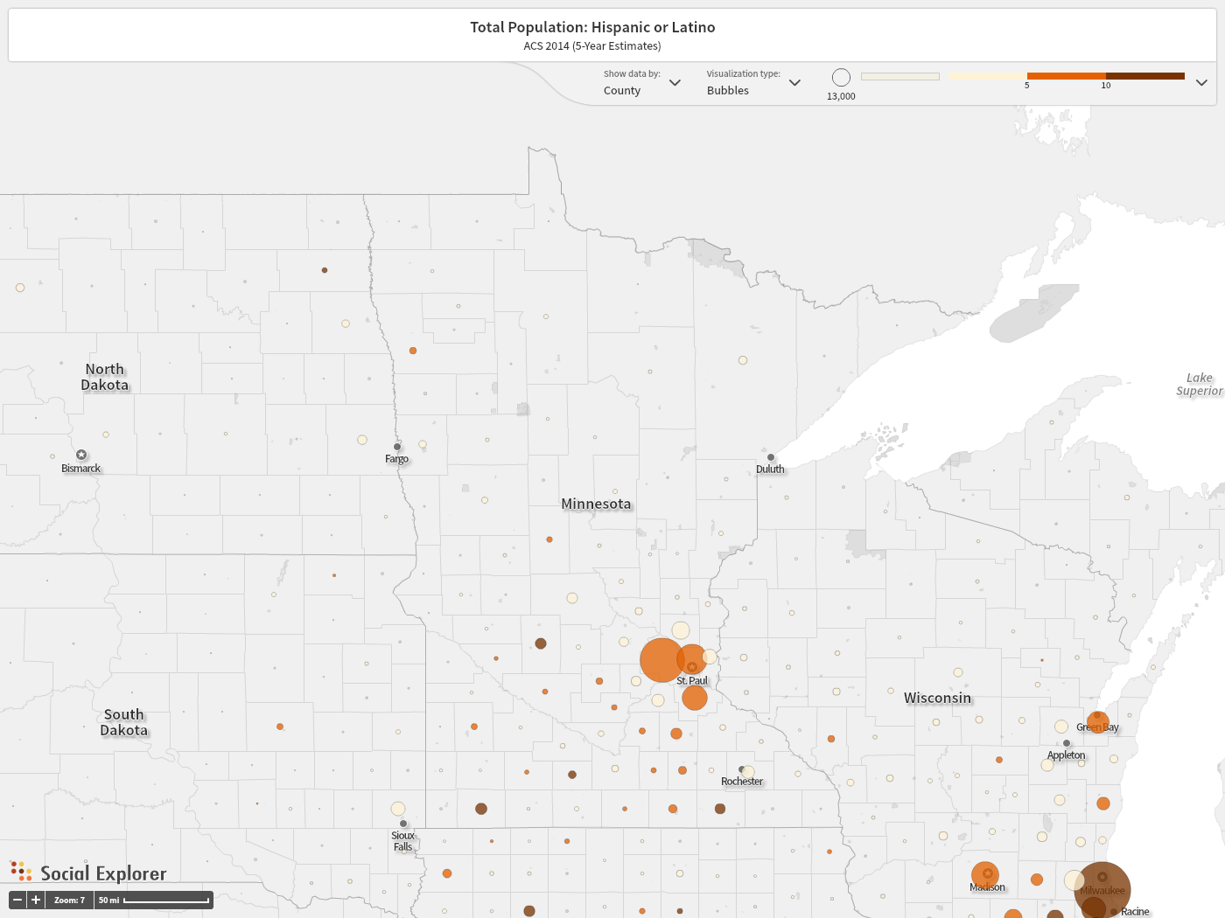
Hispanic/Latino Population By County
(Note: Color shows percent, size of dot shows number)

Slide 10
Racially Diverse Populations Bolstering Growth Across State, 2000 to 2010
Growth (%), Pop. of color
Growth (%), White pop.
Source: U.S. Census Bureau

Slide 11
Past & Projected Growth in Labor Force
Annual average, ages 16+
Source: U.S. Census Bureau, Minnesota State Demographic Center Projections

Slide 12
White Working-age Pop. Declining; Robust Growth For Most Populations of Color
Source: U.S. Census Bureau

Slide 13
2. RECENT FOCUS ON DATA FOR bLACK MINNESOTANS

Slide 14
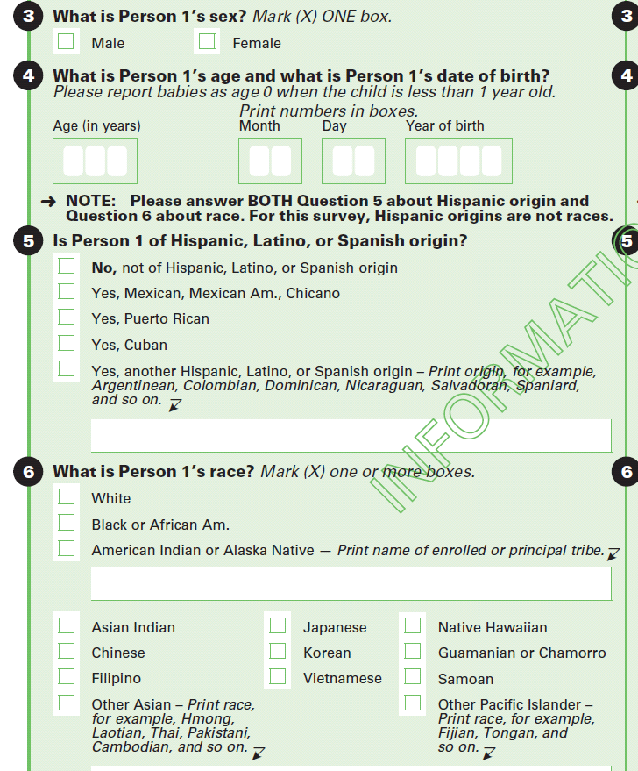
Data Source:
U.S. Census Bureau’s American Community Survey
77,000 Minnesota households surveyed every year

Slide 15
Recent Media Focus on Household Income Decline between 2013 and 2014
Source: U.S. Census Bureau, American Community Survey. Note: Confidence intervals are reported at the 95% level.

Slide 16
MN’s Median Household income is More Than Twice the Median for Black households
Source: U.S. Census Bureau, American Community Survey. Note: Confidence intervals are reported at the 95% level.

Slide 17
Rate of Poverty for Black Minnesotans:
3 Times the Rate for All Residents
Source: U.S. Census Bureau, American Community Survey. Note: Confidence intervals are reported at the 95% level.

Slide 18
Black Unemployment Lower Now Than Just After The Recession
Source: U.S. Census Bureau, American Community Survey

Slide 19
More People Employed, Particularly in Part-time Work with Lower Earnings
Source: U.S. Census Bureau, American Community Survey

Slide 20
Black Population Has Increased Rapidly Since 2000
Notes:
Increase of about 135,000 since 2000

Slide 21
Black Minnesotans Come from across the U.S., the globe; ~40% are immigrants and their children
In this graph, “immigrants” are people who are either:
born outside the U.S., or
born in the U.S. and live with at least one parent who is foreign-born.
Source: U.S. Census Bureau, American Community Survey. Note: Error margins exist around estimates but are not shown.

Slide 22
Poverty Highest Among Somalis;
Lowest Among Other Black immigrants
Source: U.S. Census Bureau, American Community Survey. Note: Range shows the 90% confidence interval. Percentage given is the midpoint of the range.

Slide 23
3. Economic disparities in detail (by Minnesota’s “cultural groups”)

Slide 24
All data in the report refer to the annual average during years 2010 to 2014.
Report is available at mn.gov/demography

Slide 25
order | Cultural Group | Broad Racial or Ethnic Group
1 | Dakota | American Indian
2 | Ojibwe | American Indian
3 | Asian Indian | Asian
4 | Chinese | Asian
5 | Filipino | Asian
6 | Hmong | Asian
7 | Korean | Asian
8 | Lao | Asian
9 | Vietnamese | Asian
10 | African-American | Black
11 | Ethiopian | Black
12 | Liberian | Black
13 | Somali | Black
14 | Mexican | Hispanic
15 | Puerto Rican | Hispanic
16 | Russian | White
17 | White | White
Minnesota’s
17 Cultural Groups

Slide 26
Cultural Group | Percent | People
White | 82.1% | 4,417,700
African-American | 4.0% | 216,700
Mexican | 3.4% | 184,100
Hmong | 1.2% | 66,600
Somali | 0.9% | 46,300
Asian Indian | 0.8% | 42,800
Ojibwe | 0.6% | 33,500
Vietnamese | 0.6% | 29,800
Chinese | 0.5% | 29,400
Korean | 0.4% | 22,500
Ethiopian | 0.3% | 17,000
Filipino | 0.3% | 14,100
Liberian | 0.3% | 14,000
Puerto Rican | 0.2% | 12,500
Lao | 0.2% | 12,100
Russian | 0.2% | 9,900
Dakota | 0.1% | 6,100
Not in any above group | 3.9% | 207,200
All Minnesotans | 100% | 5,382,400
Cultural Groups, by Size
Notes:
7 largest groups make up 93% of the population

Slide 27
People in Poverty
 | Poverty (<100%) | Near Poverty (100-199%)
Ojibwe | 12,200 | 8,400
Asian Indian | 2,700 | 4,000
Hmong | 17,700 | 22,300
African-American | 72,800 | 51,500
Somali | 26,400 | 11,700
Mexican | 47,100 | 57,200
White | 346,800 | 578,300
All Minnesotans | 594,400 | 809,000

Slide 28
Children Under Age 18 in Poverty
 | Children in Poverty (<100%)
Ojibwe | 4,900
Asian Indian | 800
Hmong | 8,900
African-American | 31,900
Somali | 13,200
Mexican | 23,500
White | 74,100
All Minnesotans | 183,300

Slide 29
Work Status, Ages 16-64
 | Unemployed OR Not in Labor Force (Ages 16-64)
Ojibwe | 10,300
Asian Indian | 7,600
Hmong | 15,500
African-American | 59,700
Somali | 9,700
Mexican | 33,300
White | 635,700
All Minnesotans | 847,700

Slide 30
Labor Force Participation and Employment, Ages 16-64
 | Not in labor force | Un-employed
Ojibwe | 7,800 | 2,500
Asian Indian | 6,200 | 1,500
Hmong | 12,200 | 3,300
African-American | 42,300 | 17,400
Somali | 6,300 | 3,300
Mexican | 25,100 | 8,200
White | 502,700 | 133,000
All Minnesotans | 661,000 | 186,700

Slide 31
Labor Force Participation of Women, Mothers
 | Mothers Living With Children <13, Not in the LF | All women (16-64) Not in the LF
Ojibwe | 1,000 | 3,800
Asian Indian | S | 5,000
Hmong | 2,000 | 6,200
African-American | 4,700 | 19,700
Somali | S | 3,900
Mexican | 7,400 | 16,700
White | 65,800 | 286,600
All Minnesotans | 94,000 | 374,800

Slide 32
Labor Force Participation of Men, Fathers
 | Fathers Living With Children <13, Not in the LF | All men (16-64) Not in the LF
Ojibwe | S | 4,000
Asian Indian | 100 | 1,100
Hmong | 900 | 6,000
African-American | 1,000 | 22,600
Somali | S | 2,400
Mexican | 900 | 8,400
White | 10,600 | 216,100
All Minnesotans | 16,500 | 286,200

Slide 33
Earners Per Household,
For Householders Under Age 65
 | No Earners in Household
Ojibwe | 2,100
Asian Indian | 500
Hmong | 900
African-American | 12,400
Somali | 1,800
Mexican | 1,200
White | 80,000
All Minnesotans | 106,400

Slide 34
Median Earnings of Full-time, Year-Round Workers, Ages 16-64
 | Earnings for Full-Time, Year-Round Workers
Ojibwe | $35,800
Asian Indian | $80,400
Hmong | $32,800
African-American | $38,300
Somali | S
Mexican | $28,900
White | $50,000
All Minnesotans | $48,000

Slide 35
Usual Hours Worked, All Workers Ages 16-64
 | <35 Hours Per Week | 35+ Hours Per Week
Ojibwe | 2,800 | 8,300
Asian Indian | 2,400 | 19,600
Hmong | 6,200 | 19,500
African-American | 21,000 | 52,200
Somali | 5,600 | 8,600
Mexican | 20,200 | 57,000
White | 533,900 | 1,744,100
All Minnesotans | 636,000 | 2,033,100
Notes:
Workers 16-64

Slide 36
Homeownership
 | Renter HHs | Owner HHs
Ojibwe | 6,600 | 6,000
Asian Indian | 7,900 | 7,000
Hmong | 7,200 | 6,500
African-American | 50,000 | 16,200
Somali | 12,400 | 1,100
Mexican | 25,400 | 18,500
White | 422,800 | 1,416,800
All Minnesotans | 584,100 | 1,525,600
Notes:
Workers 16-64

Slide 37
Other Factors Associated with Economic Insecurity That Appear in our Report
    Educational Attainment
    Language Limitations
    Disability
    Geographic Mobility
    Transportation barriers
Many other factors are also important, but not captured by census surveys

Slide 38
Educational Attainment, Ages 25-64
 | No H.S. Diploma/ GED | H.S. Diploma/ GED
Ojibwe | 3,200 | 6,200
Asian Indian | 1,100 | 1,100
Hmong | 7,400 | 5,900
African-American | 15,300 | 25,500
Somali | 6,000 | 4,500
Mexican | 32,200 | 23,400
White | 81,700 | 573,800
All Minnesotans | 179,600 | 677,500
Notes:
Workers 16-64

Slide 39
Language Limitations, Ages 5+
 | People Who Do Not Speak English Well or At All
Ojibwe | 0
Asian Indian | 1,600
Hmong | 11,000
African-American | 0
Somali | 7,300
Mexican | 30,400
White | 10,700
All Minnesotans | 102,000

Slide 40
Disability
 | Ages 18-44 With A Disability | Ages 45-64 With A Disability
Ojibwe | 1,400 | 2,200
Asian Indian | 400 | 500
Hmong | 1,500 | 2,200
African-American | 11,900 | 12,200
Somali | 1,300 | S
Mexican | 4,300 | 2,800
White | 81,400 | 146,100
All Minnesotans | 110,300 | 177,000
Notes:
Workers 16-64

Slide 41
Geographic Mobility, Ages 1+
 | Moved in past year
Ojibwe | 5,300
Asian Indian | 11,200
Hmong | 13,800
African-American | 61,800
Somali | 10,600
Mexican | 38,000
White | 539,400
All Minnesotans | 755,500

Slide 42
Households Without a Vehicle
 | Households without a vehicle
Ojibwe | 2,200
Asian Indian | 1,400
Hmong | 1,100
African-American | 20,700
Somali | 3,700
Mexican | 5,000
White | 106,200
All Minnesotans | 153,100

Slide 43
Hmong, Af. American, Somali and Mexican Groups Are Young;
Future Growth Potential High
Notes:
Poverty and near poverty

Slide 44
Summary
Diverse populations are driving growth. This pattern will continue into the future.
Recent census data underscore disparate outcomes for Black Minnesotans. These disparities have been present for a long time.
Complex situations, multiple factors associated with “gaps” and economic instability.

Slide 45
Susan Brower susan.brower@state.mn.us mn.gov/demography
Twitter: @MN_StateData

