Slide 1
MMA Presentation to the
House Health & Human Services
Reform Committee
Doug Wood, MD, MMA Board Chair
January 28, 2015

Slide 2
Overview
About the MMA
Few physician facts – numbers, distribution, training
MMA legislative priorities
  Patient access to care
    Workforce capacity
    Supporting new ways of delivering care
  Patient access to treatment
    Barriers to medication
  Patient opportunities for health
    Health protection/promotion

Slide 3
The MMA
Professional association – 162 years old
10,000 members – physicians and physicians-in-training.
Dedicated to advancing the practice of medicine, the medical profession, and patient health.

Slide 4
MMA Strategic Goals
Helping Minnesotans become the healthiest in the nation
Making Minnesota the best place to practice medicine
Advancing professionalism in medicine
Notes:
MMA’s legislative priorities align with the

Slide 5
Minnesota Physicians
22,000 licensed physicians
16,800 are located in Minnesota
14,000 (est.) actively practicing
Distribution of Practicing Physicians by Medical Group Size
Sources: Minnesota Board of Medical Practice, Licensure Statistics as of November 8, 2014. Actively practicing count and group distribution size from MMA Physician Database, 2014.

Slide 6
Physician Training
College degree
Medical School – 4 years (MD or DO)
Residency – 3 to 7 years
  Specialty dependent
Board certification – renewed every 6 to 10 years
  ~145 specialties/subspecialties
Lifetime learning
  Continuing medical education (CME)
    State licensure requires minimum of 75 credit hours every 3 years
State licensure = degree, exams + 1 year of residency
Notes:
Medical school includes 2 years of science/classroom study, followed by 2 years of clinical rotations.
Board certification – although voluntary, it is becoming increasingly common due to things such as health plan credentialing and hospital privileging

Slide 7
MMA Legislative Priorities
Access to care
Access to treatment
Access to best chance for health

Slide 8
1. Patient Access to Care:
Physician Services
Insurance card does not = access to care
Physician shortages projected nationally
  45,000 2015
  65,000 by 2025
Pressures on physician workforce capacity
  Long training timeline
  Aging – about 43% of active MN physicians age 55+
  Federal cap on residency slots (funded by Medicare) – since 1997
Sources: Association of American Medical Colleges; Minnesota Department of Health, Office of Rural Health and Primary Care; Robert Graham Center, “Minnesota: Projecting Primary Care Physician Workforce,” September 2013; available at: http://www.graham-center.org/online/etc/medialib/graham/documents/tools-resources/minnesotapdf.Par.0001.File.dat/Minnesota_final.pdf

Slide 9
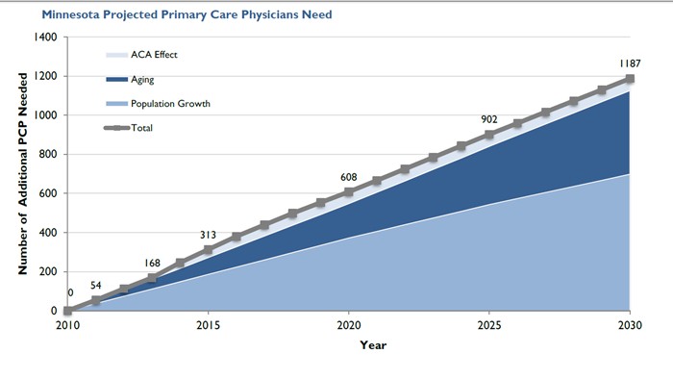
MN Primary Care Physician Gap – Urgent
Source: Petterson, Stephen M; Cai, Angela; Moore, Miranda; Bazemore, Andrew. State-level projections of primary care workforce, 2010-2030. September 2013, Robert Graham Center, Washington, D.C.
Notes:
The primary care physician shortage is particularly worrisome.
Recent analysis indicates that to maintain current rates of utilization, Minnesota will need an additional 1,187 primary care physicians by 2030, a 28% increase compared to the state’s current levels.
This slide shows the effect of the various forces on primary care capacity – with ACA responsible for about 5% of the increased need, aging accounting for 36% and 58% due to general population growth

Slide 10
Recommendations: Patient Access to Care
Address student debt
  Loan forgiveness
    Proven strategy to direct physician supply to needed areas
Support exposure to and promotion of primary care
  More preceptor sites for medical student clinical rotations
Invest in access
  Clear evidence: low payment rates hurt access
  ACA: bumped Medicaid rates for primary care services to Medicare levels, 2013-2014

Slide 11
MN Medicaid to Medicare
Rate Comparison (2014)
Source: 2014 published conversions factors
Notes:
78% of Medicare for E&M/OB services, 91% of Medicare for mental health services, and 70% of Medicare for all other services. 2009 – MN Medicaid was approximately 64% of Medicare (pre-RBRVS conversion)

Slide 12
Patient Access to Care:
New Models of Care
Increasing use of telehealth
  Extending physician specialties to other geographies
  Innovative models for care delivery (video, remote ICU monitoring, etc.)
Challenges of readily obtaining licensure in multiple states

Slide 13
Recommendations:
Patient Access to Care – New Models
Expedite licensure process for those seeking multi-state licenses
  Support passage of Interstate Licensure Compact
  Developed by Federation of State Medical Boards
  Not a push for national licensure
  Licensure (and regulation/discipline) remains state-based

Slide 14
2. Patient Access to Treatment
Pharmaceutical therapy is critical to avoid ED use, hospitalizations, disease complications.
20%-30% of prescriptions are never filled
Medication not continued as prescribed in about 50% of cases
Prior authorization of medications a contributing factor
Extraordinarily intrusive into physician-patient relationship
  Inconsistent, inefficient, expensive
Sources: http://scriptyourfuture.org/wp-content/themes/cons/m/release.pdf ; Osterberg 2005, NEJM; Ho 2009, Circulation

Slide 15
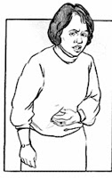










Prior Authorization Experience
Why?
Which form?
Different and changing rules
Notes:
A patient sees his/her physician.
Based on patient’s condition, physician prescribes a medication. Whether a particular drug is covered by a health plan, the cost of the drug, or any conditions about coverage – are rarely available to the prescriber at the time of the appointment.
The physician’s prescription is sent electronically to a pharmacy. The patient goes to the pharmacy to get her prescription.
Before the patient gets it, the pharmacy submits a claim to the insurance company or pharmacy benefit manager. If not approved, the pharmacy can’t give prescription to patient. Often, the patient leaves at this point and waits for medicine.
When an insurer denies a pharmacy claim, it is not always clear WHY it was denied. Regardless, the physician is notified and has to try again. If it is a drug that must be prior authorized, the physician clinic often needs to figure out which form needs to be used to ask for permission. Often information from a patient’s medical record needs to be gathered and included with the request. That request is then sent to the insurer or pharmacy manager. It can take several days to get a response, but if it is approved, the physician then needs to write the prescription, send it to the pharmacy and then the patient is told to pick it up.
If it is denied again, there is usually an opportunity for appeal, but again more documentation and details need to be provided.
The main point of this slide is the complexity of the current process, the lack of consistency, the primary assumption that the insurer knows more than the prescribing physician, and the fact that patients are caught in the middle of this waiting for access to their medications.

Slide 16
Recommendations:
Patient Access to Treatment
Transform medication prior authorization to a quality improvement function
  Already high approval rates
  Focus on outliers
  Eliminate disruptions in treatment/more expensive complications
Simplify process
Improve transparency

Slide 17
3. Patient Opportunities for
Better Health
Drivers of health are largely outside clinics and hospitals
  Personal, social, and environmental factors
Your policy changes are working!
  Minnesota’s smoking rate of 14.4% is lowest ever recorded
    35% drop in smoking since 1999
    Rate is lower than national average Invest in public health (clean air, water, prevention)
NO health benefits from tobacco use
Source: ClearWay Minnesota and Minnesota Department of Health. Tobacco Use in Minnesota, Minnesota Adult Tobacco Survey 2014. Released 2015.

Slide 18
Recommendations:
Patient Opportunities for Health
E-cigarettes
    Safety and health risks suggest need for caution
    Continue progress: extend e-cigarette clean air protections to bars and restaurants

Slide 19
Conclusion
Common goal: better health for all Minnesotans
Progress on goal includes:
  Improve physician workforce and care delivery
    Increased support for loan forgiveness
    Medicaid rates on par with Medicare – primary care services
    Expedited mechanism for multi-state licensure
  Reduce barriers to needed treatment
    Reform and simplify prior authorization
  Equal chance for health
    E-cigarettes out of bars and restaurants
Notes:
The MMA and the Legislature have the same goals – to improve the health of all Minnesotans. For that to occur, we need to work together. The MMA is here as a resource to you and to help identify the barriers to achieving that goal.
We urge your support of helping to address some of those barriers this year:

Slide 20
Questions

