Slide 1
The Business of Child Care
January 18, 2017

Slide 2
At a Glance – First Children’s Finance
Celebrating Over 26 years supporting the
business needs of child care providers
Founded in 1991 as a Community Development Financial Institution (CDFI) and neighborhood-based developer of child care centers in Minneapolis
Became a national nonprofit organization in 2006, with new branch offices in Michigan and Iowa in 2008
Launched Greater Than MN in 2013 with focused support to rural center-based and family child care providers
Loan Fund Exceeds $11 Million in loans granted – exceeding over 8,500 slots created or preserved
Notes:
First Children’s Finance helps children, families and communities thrive by increasing the availability of quality child care and early education.
We focus on “the business side” of child care:
Providing loans and business development assistance to high-quality child care businesses serving low- and moderate-income families, and
Building partnerships that connect these vital businesses with the resources of the public and private sectors.

Slide 3
Greater Than MN
What's Greater Than Minnesota?
Greater Minnesota is greater than its challenges. Together, we are greater than our size in numbers. We have dreams for our children that are greater than the status quo.
Visit www.greaterthanMN.org for more information!
Community Solution Action Plan
Business Leadership Cohort
Child Care Work Group
Notes:
Add link to overview or embed

Slide 4
The Business Case for Child Care
It’s more than providing care for children

Slide 5
Why It Matters…
Community Vitality
Tomorrow’s workforce
Return on investment
Working parents
Access to quality child care and early education is vital to individual productivity and regional economic growth.
Notes:
Working parents cannot access and maintain productive employment today without affordable, quality care and education for their children. More than 381,300 children depend on paid child care every week in Minnesota.
Tomorrow’s workforce will not be prepared to succeed in the global economy unless all children receive quality care and education today.
The return on investment in quality care and education today reduces long-term costs to the public and private sectors.

Slide 6
Women in the Workforce
In 2014, 84% of Minnesotans ages 25-64 participated in the labor force, including 77% of Minnesota women with a child(ren) under age 6.
(Source: 2014 American Community Survey)

Slide 7
Child Care’s Economic Contribution in MN
The Minnesota child care industry revenue of $883.2 million led to another $900 million in spillover impact on local economies.
(Source:“Child Care in State Economies” ced.org/childcareimpact)
Notes:
The MN child care industry employs about 32,292 individuals who support an additional 14,100 jobs in local economies.
The $523.2 million in MN employee and proprietors’ earnings within the child care industry generates $460 million in additional earnings throughout MN.

Slide 8
Effects of Child Care on Business
(Source: F I R S T 5 Santa Barbara County – Employee Child Care Study)
Notes:
The Downtown Employee Child Care Survey was distributed to 9,041 employees (in English and Spanish,
electronically and in print) through 23 participating employers representing diverse industries. Three parent
focus groups were also held.
The study was conducted by Summa Associates, aWork-life Effectiveness Frm with extensive experience in
employee child care needs assessment, corporate child care and elder care referrals. Additional data was layered
over the survey results, including Census, federal salary information, and the results of a local child care center
capacity study.
The Survey Respondents
• 2,015 work in downtown Santa Barbara
• 51%of respondents both live and work in downtown Santa Barbara
• Over half of the respondents work in zip code area 93101
• 697 respondents are parents who have a total of 1,202 children (626 children are age 5 or
younger and 576 children are age 6 to 12)
• 363 respondents are either currently pregnant or adopting, or expect to have children in
the next 5 years.
• 38%of respondents have employment positions in either office and administrative support
ormanagement
• 149 respondents have elder/adult care responsibilities and an additional 443 expect to have
these responsibilities in the next 5 years

Slide 9
Effects of Child Care on Business
When child care is unstable for
employees, businesses lose out…
45% of parents are absent from work at least once due to child care issues, missing an average of 4.3 days
65% of parents’ work schedules are affected by child care challenges an average of 7.5 times
(Source: “Economic Impact of Child Care” Lets Grow Kids)
Notes:
These stats refer to a six month period

Slide 10
Understanding the Financial Model

Slide 11
Center Child Care Organization Overview
Child Care Centers
Organized under Rule 3
Regulates areas such as square footage, outdoor play space, toilets and sinks.
Multiple regulating agencies
Notes:
Regulatory agencies include DHS, Fire, Local Zoning/Building Inspection

Slide 12
99 Seat Center - Performance Model
Assumes a Child Care Center in Fillmore County using the 2014 Market Rate Survey Rates
Start-up range from $400k - $600k plus property acquisition
Wages range from $9 -$13/hour with $200 monthly health insurance stipend
Age Group | Capacity | 85% Capacity
Infant | 16 | 13.6
Toddler | 28 | 23.8
Preschool | 40 | 34.0
School Age | 15 | 12.7
Loses $74,000 a year
Needs 94% occupancy to break-even

Slide 13
52 Seat Center – Performance Model
Assumes a Child Care Center in Fillmore County using the 2014 Market Rate Survey Rates
Start-up range from $200k - $450k plus property acquisition
Wages range from $9 - $13/hour with $200 monthly health insurance stipend
Age Group | Capacity | 85% Capacity
Infant | 8 | 6.8
Toddler | 14 | 11.9
Preschool | 20 | 17.0
School Age | 10 | 8.5
Loses $62,000 a year
Needs 101% occupancy to break-even

Slide 14
Center Expenses Summary
Staffing 70%
Facilities 20%
Food 5%
Everything Else…..Including Profit

Slide 15
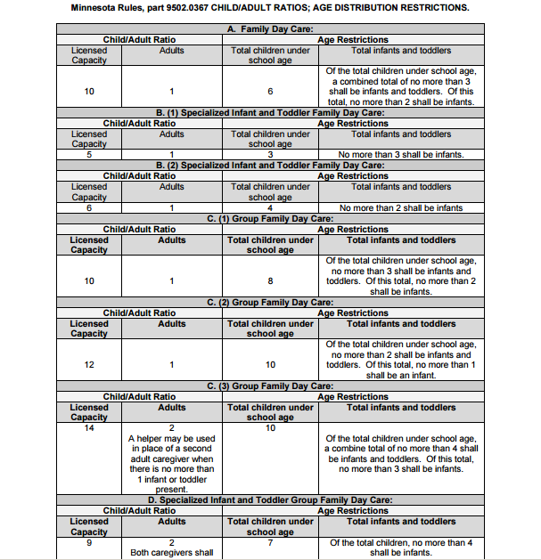
Family Child Care Organization Overview
Family Child Care
Organized under Rule 2
Licensing of homes for family child care and group family child care

Slide 16
The Family Child Care Business Analysis Tool
Profit & Loss Statement
Cash Flow Analysis
Business Analysis Review
How the Business Operates
View of Monthly Cash-In & Monthly Cash-Out
How Much Money the Business Makes or Loses
Notes:
Very little research has been done on FCC business practices and which factors most impact their profitability
Understanding the drivers of success is important for FCC providers and the policymakers
The FCC Business Analysis tool was designed for multiple uses

Slide 17
FCC Providers in Sample
28% of providers were located in Twin Cities Metro Area, remaining were located in 15 counties in Greater Minnesota
On average, providers have been in business 12 years
Most FCC providers worked alone; only 9% employed an assistant or substitute
On average, they served 10 children

Slide 18
FCC Revenue
On average, providers reported annual revenue of $50,938 (median of $47,775)
90% of income is from tuition
93% of providers in sample received income from the Child and Adult Care Food Program; CACFP makes up, on average, 10% of program income
30% of providers received CCAP; of those receiving CCAP, the payments accounted for 23% of tuition received
5% of providers received income from a Early Learning Scholarship

Slide 19
FCC Preschool Revenue
Every provider in the sample served preschool children.
Preschool tuition made up, on average, 54% of tuition income.
The importance of preschool tuition for the financial viability of family child care needs to be recognized, especially as Minnesota considers Universal Preschool. Mixed delivery systems for preschool that include – or perhaps target– family child care partnerships is critical to maintaining the supply of child care across the state.

Slide 20
FCC Expenses
On average, providers reported annual expenses of $26,372.
Two-thirds of program expenses are associated with occupancy.
The “other” category includes many things (none of which make up more than 2% of program expenses).
Expenditure | Amount | Percent
Occupancy Expenses | $ 10,833.71 | 41%
Food Expenses | $ 6,857.71 | 26%
Transportation | $ 1,568.77 | 6%
Activities/Supplies | $ 1,355.85 | 5%
Phone/Internet | $ 1,014.09 | 4%
Cleaning/Supplies | $ 768.00 | 3%
Other | $ 3,973.83 | 15%

Slide 21
FCC Profit and Pay
Annual revenue $50,938
Annual expenses -$26,372
$24,566 Average annual profit (salary)
Providers report operating an average of 53 hours/week
Operating 53 hours/week + 12 hours/week to clean, manage and prepare
When converted to an hourly wage, 49% of providers are making less than $8/hour before taxes

Slide 22
FCC Profit and Pay

Slide 23
Comparing Metro to Greater MN

Slide 24
Comparing Metro to Greater MN
Metro programs make over $9,000 more annually than programs in Greater MN; the difference in program expenses is just $1,200 (nonsignificant)
Differences in profit are driven almost entirely by differences in tuition rates
Greater MN providers reporting serving more children, on average, than providers in the Metro
This finding lends viability to the idea that CCAP rates should be based on operating expenses rather than on the tuition rates charged by other providers in the region.

Slide 25
Impact of Quality
Providers with a Parent Aware rating are spending more than 4 times as much as non-participating providers on quality practices
A 450% difference seems dramatic, but quality practices make up just 2% of program expenses
Preliminary results indicate that implementing quality practices cost providers an additional $1.32 per child per week ($688 per year)

Slide 26
Impact of Quality – Sample Limitations
All the Metro providers in the sample were participating in Parent Aware
In Greater MN, Parent Aware participation was associated with $3,344 more income for programs annually, attributable to higher tuition rates
The overall sample of programs is small, so it is too early to say with certainty whether differences in tuition rates will be seen in the larger population
It is not yet known whether higher tuition rates make a program more likely to join Parent Aware or whether programs can charge higher rates because of their Parent Aware ratings

Slide 27
Innovative Solutions in Greater MN
Community partnerships
Private sector partnerships
Employer sponsored care
Fully utilizing licensing options: A, B and C licenses
Attracting millennials to replace an aging workforce
Policies

Slide 28
FCF Recommendations to Communities
Communities need a right sized solution – don’t get fixated on a particular property or building.
The private sector cannot be 100% of solution – there needs to be good policy and incentives.
Licensors need to be knowledgeable about all FCC licensing options.
Involve existing providers in your community – they are part of the solution.
Always run financials before committing to a project – look for a broad base of support.

Slide 29
No one has yet realized the wealth of sympathy, the kindness and generosity hidden in
the soul of a child. The effort of every true education should be to unlock that treasure.
– Emma Goldman

