Slide 1
Minnesota Correctional Facilities Capital Investment
Proposals
MCF – St. Cloud 2016

Slide 2
St. Cloud – Intake, Health Services & Loading Dock
Remodel existing space for intake unit, construct new health services unit and loading dock
Agency Request: $19 million
Goals
Complete phase two
Improve safety for staff and offenders through improved layout and safety features
Reduce crowded areas in intake and health services
2
Notes:
Our third project is at the St. Cloud facility – our intake facility for adult male offenders. This project has several components and costs $33.045 million. It includes construction of a new health services unit, remodeling existing space for intake and construction of a loading dock and warehouse outside of the secure perimeter.
This project is about improving safety for staff by improving the layout and adding safety and security features to the areas.
Due to space constraints we have an inadequate# of holding cells, processing areas, and cannot separate offender movement in & out of the facility or in various areas. Additionally, existing spaces aren’t in compliance with building or accessibility codes to meet needs of disabled offenders.

Slide 3
St. Cloud – Intake
Renovate existing space for new intake unit
Approximately 700 offenders processed in and out each month in an over-crowded space
Location, size and layout are inadequate, poorly designed and unsafe for staff
St. Cloud intake area
3
Notes:
The second component of this project is to, after the health services area is constructed, to renovate space for a new intake unit. Again, the existing space was designed to serve many less offenders than are processed in and out of this facility. As I said earlier, the St. Cloud facility is our adult male intake facility – so all new commitments to the department come first to SCL for processing.
We process about 700 offenders in and out of this facility every month. The space was poorly designed and doesn’t adequately or safely meet our needs.
We need to be able to physically and visually separate those incoming and outgoing offenders. The existing hallways are way too narrow. When disturbances occur in this area, the space is very tight/close for the staff to manage in as they remove offenders to another location when they are fighting.
In addition to tight quarters, there is not adequate space for all the functions that need to occur in the intake area. Staff use storage closets as an interview/screening room for offenders when numerous offenders are being processed simultaneously. This creates significant security and staff safety concerns. Additionally, there is a lack of useable showers for offenders, inadequate space for property transfer/search/distribution. These deficiencies would be addressed

Slide 4
St. Cloud – Intake
Numbers in intake cells can vary from 3 to 30 offenders at any one time
4

Slide 5
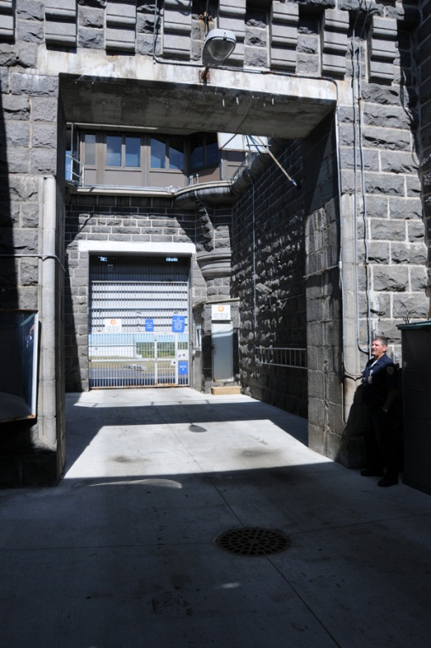
St. Cloud – Loading Dock
Currently:
Some trucks too large to fit in truck sally port, creating security risk
Currently, all trucks must enter the secure perimeter
Construction of a secure receiving center would:
Eliminate need for public delivery trucks to enter secure perimeter
Allow staff to search product before it enters facility
5
Notes:
~$1.3m additional cost to split into two phases.

Slide 6
Our Mission:
Reduce recidivism by promoting offender change through proven strategies during safe and secure incarceration and effective community supervision.
Notes:
In closing – these requests are our most critical needs for this agency. Shakopee fence to enhance public safety; AP money that will be used throughout the state at all facilities; the the St. Cloud project to address unsafe, inefficient conditions and spaces that no longer meet our basic needs for intake and health services.
Last year we received 5 million AP and money for a well and water treatment project at the Stillwater facility (ADP 1600) (4th project on our priority list). We received $3.391 million for this project. STW operates two wells. Well #1 was installed in 1914 and does not comply with Dept. of Health regulations because it is too close to a sanitary sewer line. This is the current back-up well for the facility. Well #2 was installed in 1961 and serves as the main water source for the facility. The project includes installing a new well that would become the main water source for the facility, capping and sealing the 1914 well, installing a new system to remove high iron content and efficiently soften the water; replacing piping that is close to failure due to rust and corrosion, and constructing a new building for the water treatment equipment.

