Slide 1
Public Health Response Fund Update
Minnesota Department of Health
March 8, 2018

Slide 2
MDR TB

Slide 3
Multi-drug Resistant TB (MDR TB)
Multi-drug resistant tuberculosis (MDR TB) is caused by TB bacteria that have developed resistance to at least isoniazid & rifampin, 2 of the first-line TB medications.
Treatment time 2-3x longer.
Pan-sensitive (regular) TB costs about $17,000 per case to treat. MDR-TB costs $134,000 per case to treat. That is $117,000 increase per case!

Slide 4
Update as of 3/7/18: Multidrug-Resistant TB (MDR TB) Cases in MN*
Since 2016….
19 total MDR cases
14 in Hmong community
10 in outbreak
* Includes burden cases: patients treated for MDR TB but not included in official CDC statistics (e.g. clinical case with exposure to MDR TB, non-countable case, and patient for which initial susceptibilities could not be done)
Notes:
Since 2016, we’ve had 19 MDR TB cases in Minnesota.
14 of them were in the Hmong community, accounting for >80% of the total MDR cases.
Among the non-Hmong cases in the past few years, they’ve been from Mongolia, India, Somalia, Ethiopia, Iran
All of the MDR cases so far this year have been in the Hmong community.
10 of these Hmong patients are considered part of the outbreak.

Slide 5
Public Health Response Fund for Infectious Disease: MDR TB
$224,635 received for MDR TB:
$ 81,885 for temporary staff at MDH
$82,000 for St. Paul-Ramsey County Local Public Health staff
$5,000 for educational materials
$2,000 for translation services
$3,750 for miscellaneous supplies
Notes:
~

Slide 6
Outreach Activities
Met with the 18 Clans leadership to provide updates and seek guidance
Engaged elected officials from Hmong community
Partnered with the Hmong Health Care Professionals Coalition
Interviews on Hmong radio; Preparing program for Hmong TV
Outreach at various events (e.g. Hmongtown market, Hmong resource fair)

Slide 7
Adult Day Care Centers
Training held at 16 of 17 Hmong Senior Centers for staff and attendees
All adult day centers required to “develop and maintain a written record for each participant…a report on a physical examination, updated annually…and documentation that the participant is free of communicable disease or infestations.”
Working with DHS to reach adult day care

Slide 8
Provider Education
Potential for additional elders to have TB
Alerting providers to have a high index of suspicion for TB in Hmong patients
Staff have conducted over a dozen trainings at clinics, grand rounds, and conferences

Slide 9
Contact investigations
Each case of TB is interviewed to identify their contacts: household, work, school, social
Contacts are then screened for TB, starting with those with the greatest exposure.
Screening involves assessment for medical risk factors, symptom screen, a blood (or skin test) to measure a person’s immune activity to TB, and for many contacts in this outbreak, an x-ray

Slide 10
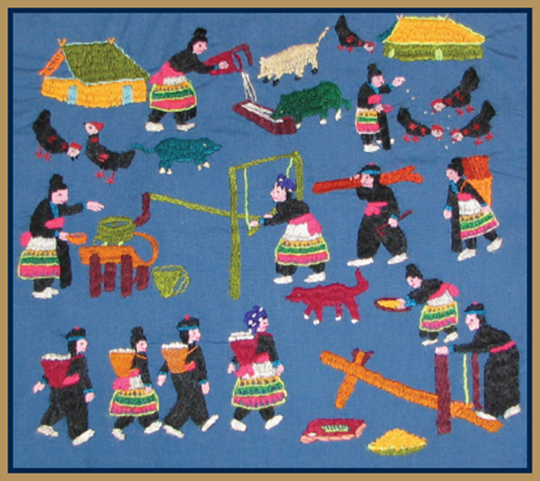
Update as of 3/8/18: Contact Investigations Summary – preliminary numbers
Total contacts identified: 598
Fully screened: 328 (54%)
Diagnosed with new LTBI: 75 (23%)
In process: 46 (8%)
Not fully evaluated: 83 (14%)
141 lost to follow-up (24%)

Slide 11
Syphilis

Slide 12
Syphilis
Syphilis is an STD that can be treated with antibiotics
Untreated syphilis can be passed from mother to unborn child and result in congenital syphilis
Babies, who survive pregnancy, may be born with congenital syphilis can have bone deformities, enlarged liver and spleen, jaundice, blindness or deafness, and may be developmentally delayed
IMAGE: http://www.wales.nhs.uk/sitesplus/gallery/888/syphilisbacaterias.jpg

Slide 13
Syphilis in Minnesota

Slide 14
Syphilis Cluster Status 3/5/18
Total number of outbreak related syphilis cases reached 84.
Males accounted for 30 cases (41%) and females 44 cases (59%).
Ten (23%) of the female cases were pregnant at the time of report; all pregnant females have been treated with antibiotics.
The outbreak is disproportionately affecting communities of color, with sixty-nine (93%) cases among people of color and five cases (7%) being White non-Hispanic people.
Fifty-seven (77%) of the cases have admitted or known history of drug use; 18 (24%) cases are hepatitis C positive.

Slide 15
Public Health Response Fund for Infectious Disease: Syphilis
$288,503 received for syphilis:
$88,253 for temporary staff at MDH
$150,000 grants to tribes for harm reduction and syringe services
$10,000 for educational materials
$5,000 for outreach events
$3,750 for miscellaneous supplies

Slide 16
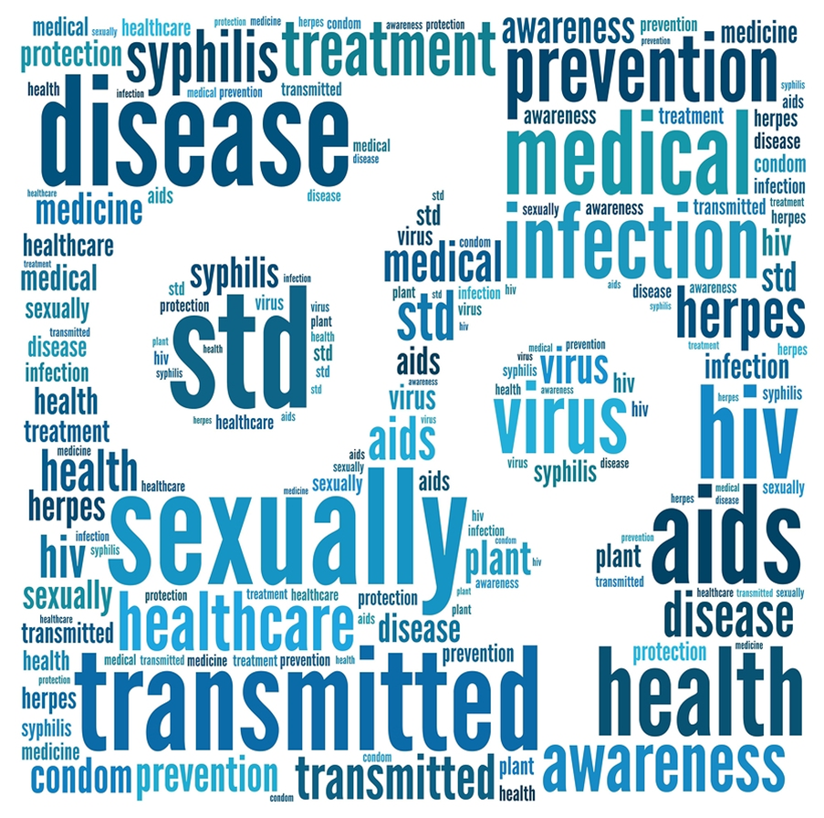
Goals of Outreach
To get cases tested and treated
To identify contacts and have them treated
Treatment cures disease, eliminates infectiousness and can prevent congenital syphilis

Slide 17
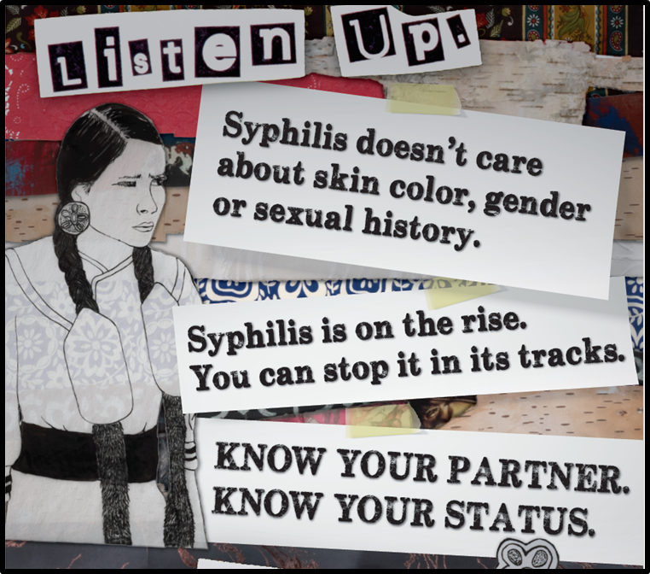
Outreach Activities
We have conducted 11 clinical trainings for tribal health staff
We are working with KAT Communications and their American Indian-focused media outlet, GoodHealthTV, to create and distribute culturally-centered educational materials
Testing events held in collaboration with tribal health
Testing for syphilis in 3 jails began in February 2018

Slide 18
Tribal Grants
$150,000 were designated for two tribal grants for syphilis prevention.
Includes purchase of syphilis testing supplies, clinician time to increase testing, surveillance, and follow up on positive cases of syphilis.
Providing harm reduction services to injection drug users

Slide 19
Measles

Slide 20
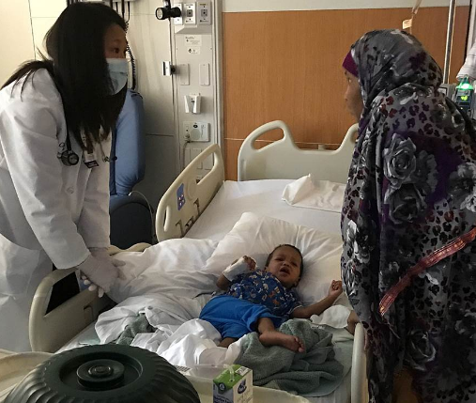
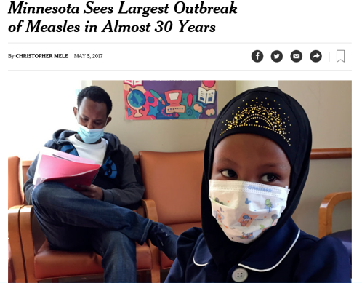
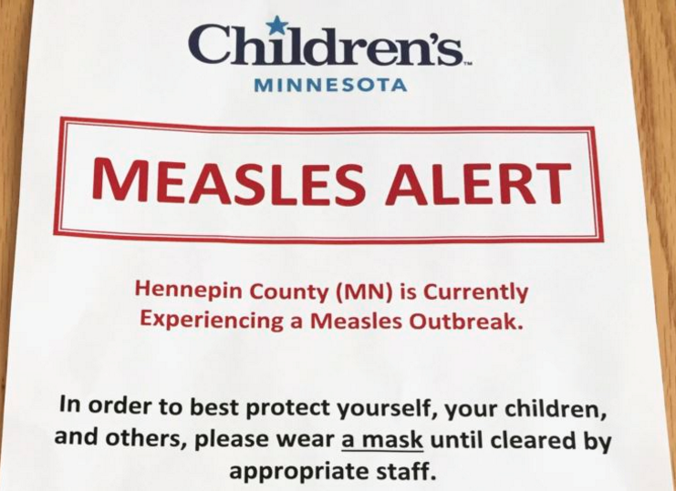
Measles hits Minnesota March, 2017

Slide 21
Measles Epidemiologic Summary
79 cases of measles
64 (81 %) Somali descent
Ages 3 months to 57 years of age
71 (91 %) Unvaccinated
22 (28 %) hospitalized
Source—not identified, no travel history

Slide 22
The Costs of Not Vaccinating
Known costs $2.3 million (MDH, Hennepin, Children’s Hospital)
Health care response: staff time for responding to exposures, costs for providing IG
Schools and child care: staff time for identifying at risk children and enforcing exclusions, costs of homebound care
Medical costs: clinic visits, ER visits, laboratory testing, IVIG, hospitalizations
Direct cost for families of lost work staying home with excluded children

Slide 23
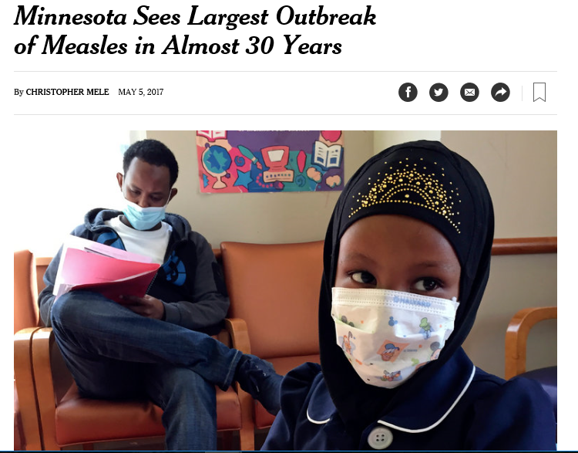
Impact of Misinformation on Somali Minnesotan Community
Notes:
Figure: 1+ MMR vaccination rates by 24 months, presented by birth year. Data from MIIC and Vital Records, birth years 2004-2013.

Slide 24
Public Health Response Fund for Infectious Disease: Measles
$100,445 received for measles:
$8,900 for the PHL to purchase laboratory testing kits and materials
$28,398 for a temporary, part-time virology, bacteriology, and laboratory analyst
$58,028 to extend a temporary Somali outreach worker position
$5,119 communication materials and supplies

Slide 25
Outbreak 2017: Laboratory Testing Results, April 11-July 15
Number of specimens
MMWR week
Notes:
Ov

Slide 26
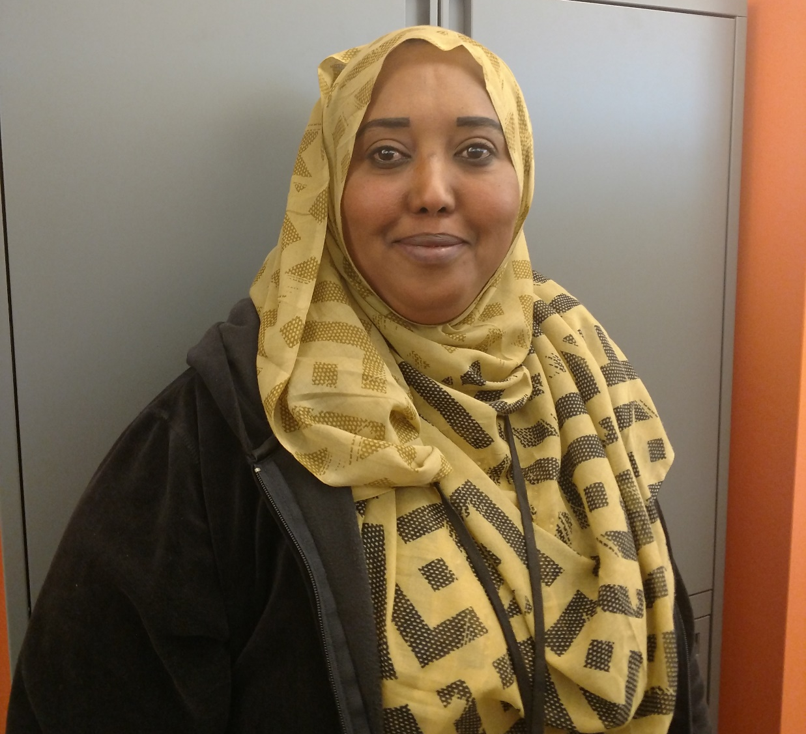
Outreach Worker Activities
Phone calls to families during the outbreak to explain the rationale and requirements of exclusion.
Follow up with excluded families and affected child care facilities to hear their stories and document challenges with complying with 21-day exclusion.
Phone interviews with parents to assess and evaluate their experience with MMR vaccination and clinic interactions. We expect to reach 300 families by June 2018.

Slide 27
Measles cases and MMR doses administered, 2017
MDH Health Alert 3
MDH first learns of a suspect measles case with no travel. MDH Health Alerts 1 & 2
MDH Health Alert 4

Slide 28
MMR Vaccination Status
91.6
58.5
41.7

Slide 29
Thank you!
Kristen Ehresmann
Kristen.Ehresmann@state.mn.us

