Slide 1
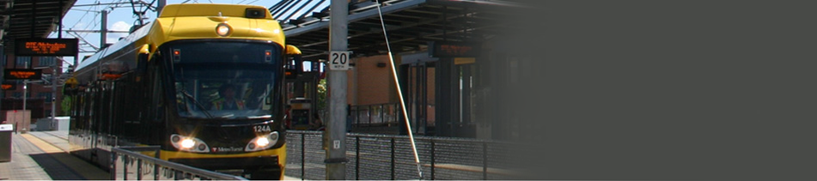
Joint Meeting of the House and Senate Transportation Committees
January 17, 2017
Notes:
1
WW

Slide 2
Presentation Overview
Brief History: Pre-CTIB
A Shared Regional Vision for Transit
How CTIB Makes Decisions
Roles and Responsibilities
Funding The Regional Vision
Funding Priorities and Commitments
Current Funding ChallengesChallenges
Notes:
RRA will take of this slide

Slide 3
Brief History: Pre-CTIB

Slide 4
Brief History: Pre-CTIB
County Regional Railroad Authorities
  Authorized in 1980 to preserve and improve local rail service:
      Preserve rail corridors
      Plan, develop, construct, establish rail and BRT
      Contributions capped at 10% of capital costs of rail if imposed metro sales tax
Revenue Source: property tax
Collaborated in advocating for transit projects – since 1992
  LRT Joint Powers Board (statutory responsibilities) – seven member counties
  Metro Transitways Development Board – seven member counties

Slide 5
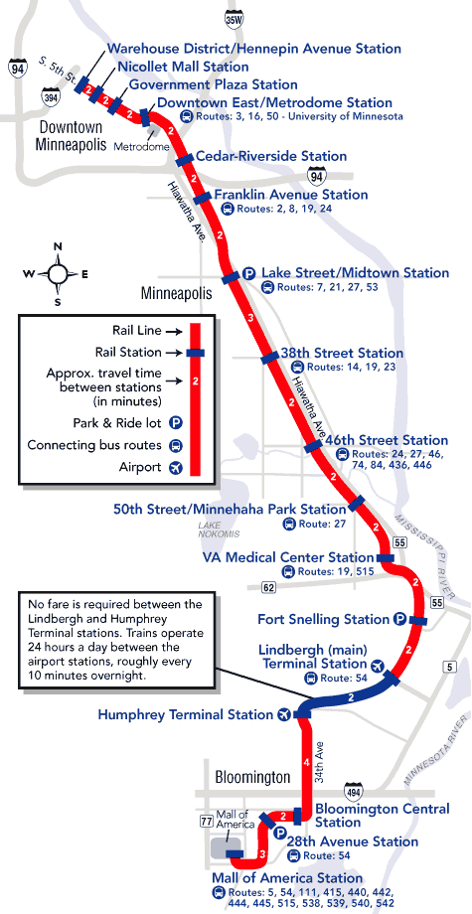
Brief History (cont’d)
Based on plans and EIS developed for Highway 55 (Hiawatha Ave.) Corridor
  1985 agreement between MnDOT and Community
HCRRA assumed responsibility for LRT planning
Hiawatha LRT advances with state funding in 1998 and 1999
MnDOT and Met Council responsible for construction
Opened in 2004
Ridership far exceeded projections
Notes:
20 years

Slide 6
2008 Transportation Legislation
Authorization of County Tax
For Transit Expansion
Imposed by 5 of 7
Metro Counties
Leased Motor Vehicle Tax
¼-percent sales tax (0.25%)
$20 motor vehicle excise tax
Anoka, Dakota, Hennepin,
Ramsey, & Washington
Anoka, Dakota, Ramsey, Washington & Scott
Notes:
Metropolitan Transportation Area Sales Tax

Slide 7
CTIB’s Authorizing Legislation
(297A.992)
Authorized: Metro counties to impose sales tax by resolution
Required: Formation of Joint Powers Board (JPB)
Required: Pooling of sales tax resources
Required: JPB to use revenue for grants
Required: Consistency with Met Council’s Transportation Policy Plan (TPP)

Slide 8
A Shared regional vision for transit

Slide 9
CTIB’s Vision
A network of connected transitways that acts as a catalyst for economic development, increased ridership and further transit expansion
Move users efficiently & safely
Mitigate congestion
Enhance development & competitiveness
Improve sustainability & livability

Slide 10
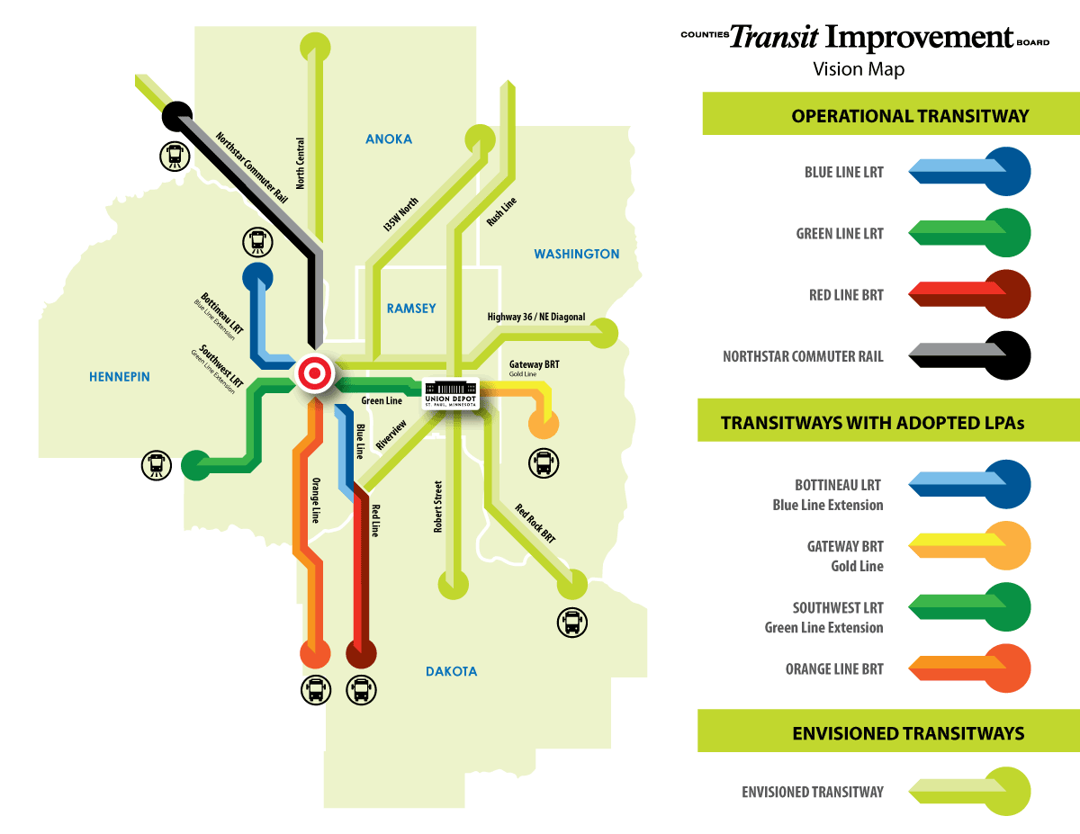
CTIB’s Regional Vision for Transitways
Network of connected transitways
Catalyst for economic development
Increased system-wide ridership
Further transit expansion
Notes:
Vision developed 2009

Slide 11
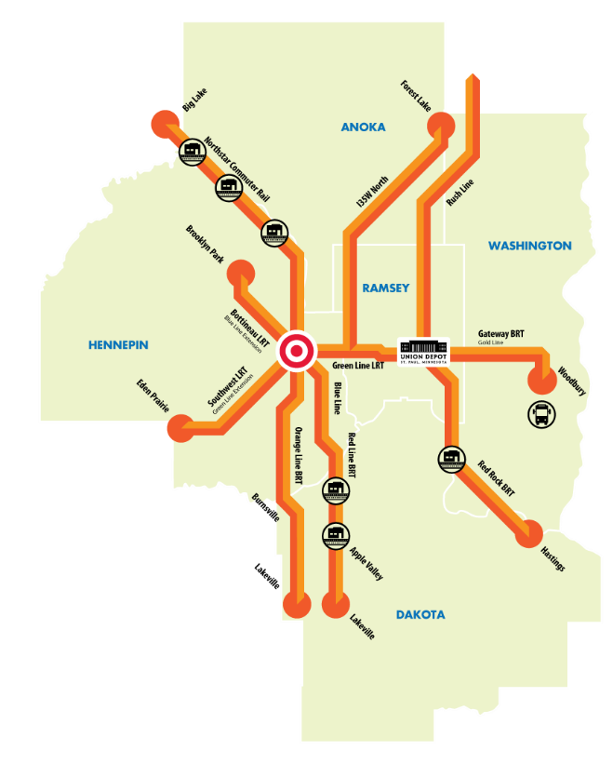
CTIB Achievements to Date
Green Line &
Red Line Opened
Property tax relief
$169 million
Investment in all
5 Counties
Accelerated Development
Southwest – PD
Bottineau – PD
Orange Line – PD
Gold Line – ready for PD
$982 million Invested
$768 million
Capital
$215 million
Operating
$11.77 million
Washington County
Guarantee

Slide 12
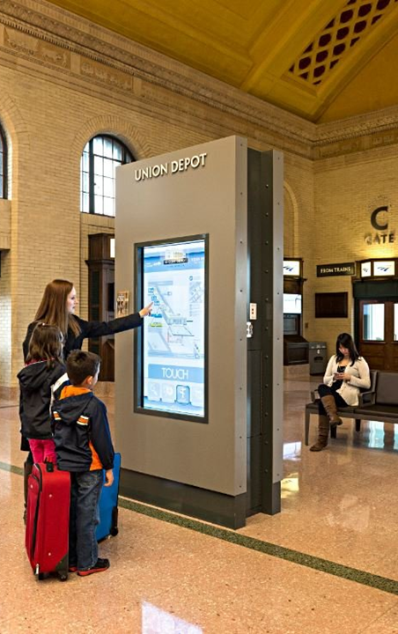
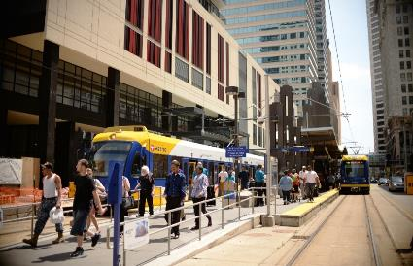
Transitways Propelling Growth
Investment*
Blue/Green Line = $4.6 billion
SWLRT = $430 million
Bottineau = $358 million
* Does not include cost of stadiums
Source: Metropolitan Council, 2016

Slide 13
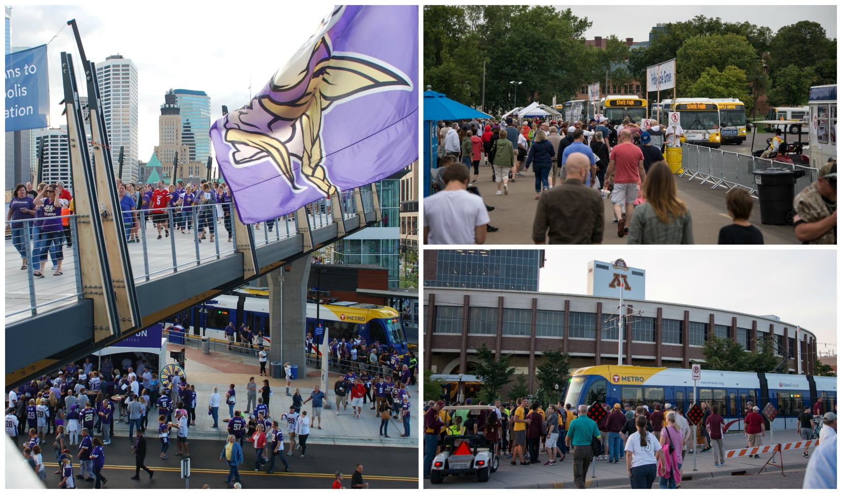
Light Rail Carries 28% of all Metro Transit Riders
Source: Metropolitan Council, 2016
Notes:
The top right photo was taken on the day the system had its highest ridership day – photo was taken at the State Fair

Slide 14
LRT Ridership: HUGE Success
2015 – highest Metro Transit Ridership since 1981
27.8% of all rides in Metro Transit System were on LRT (2016)
Average daily ridership
  Green Line – 39,386
  Blue Line – 30,337

Slide 15
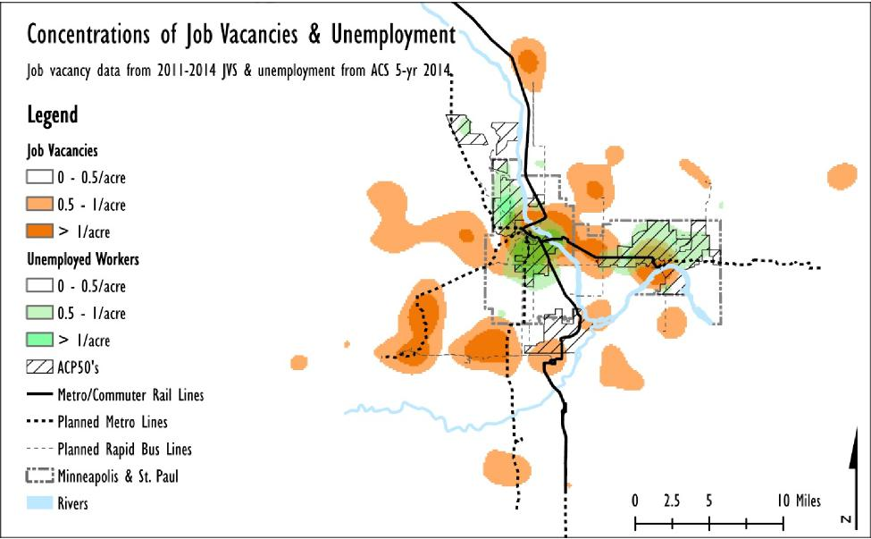
Transitways Connect
Workers to Jobs
Source: CTS, Linking the Unemployed to Jobs, Figure 3-4, 2016
Notes:
Orange = job openings
Green = unemployed
Hashed areas = areas of concentrated poverty
Greatest concentration of job openings is along the Southwest light rail line

Slide 16
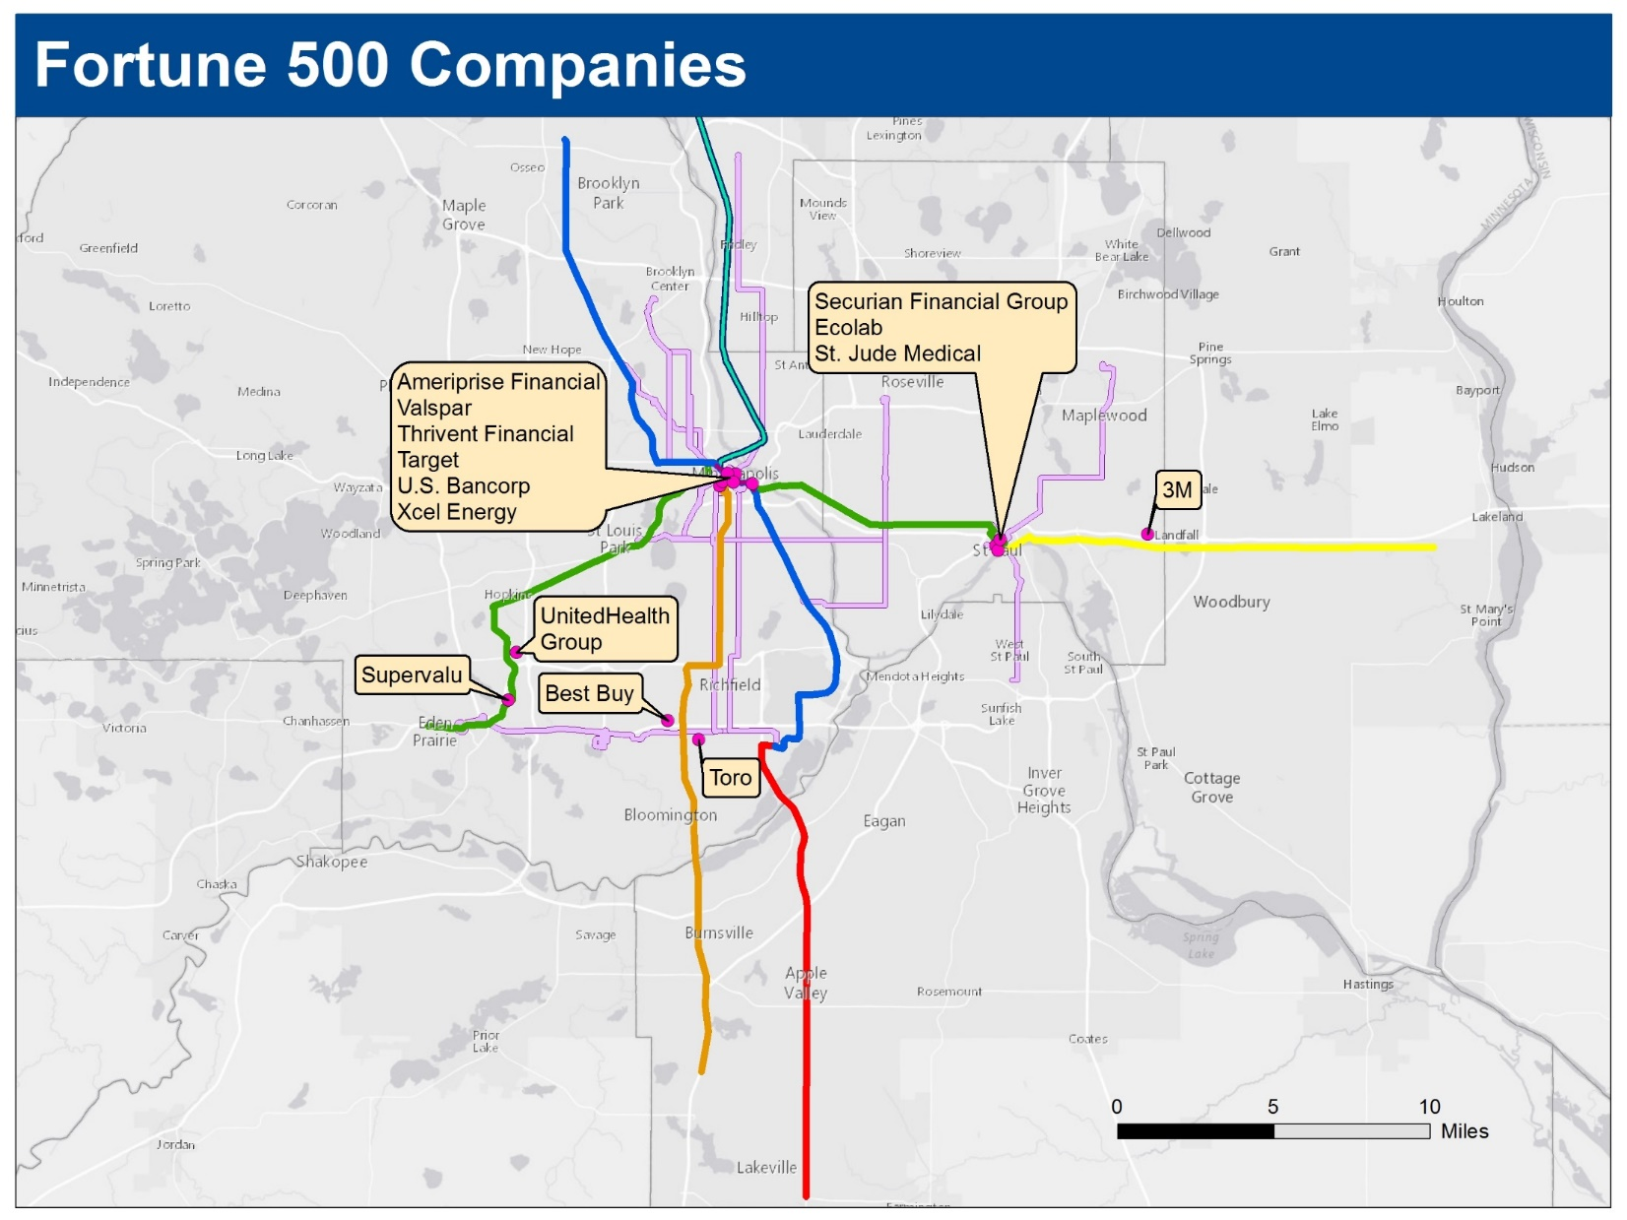
Source: Metropolitan Council, 2016

Slide 17
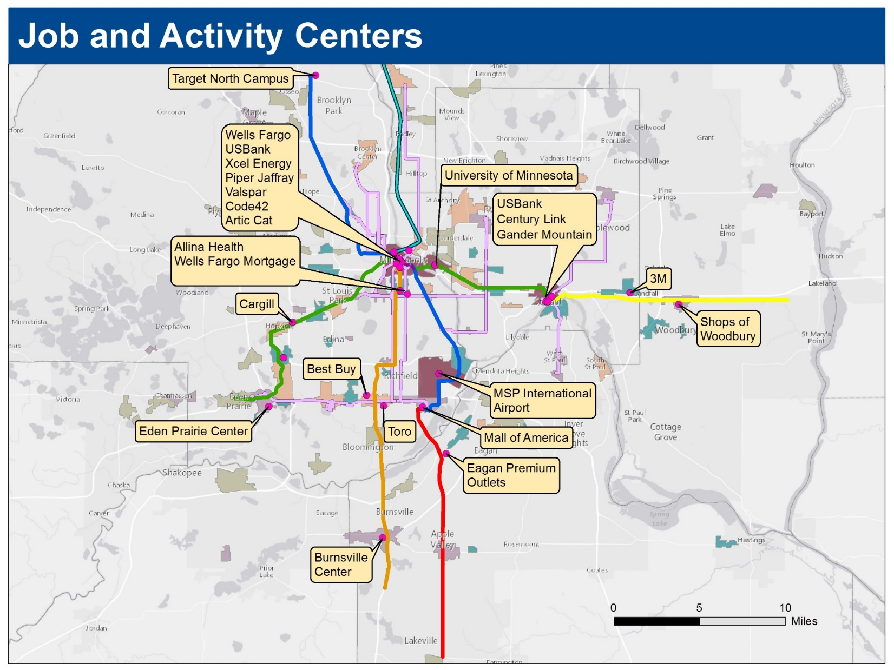
Source: Metropolitan Council, 2016

Slide 18
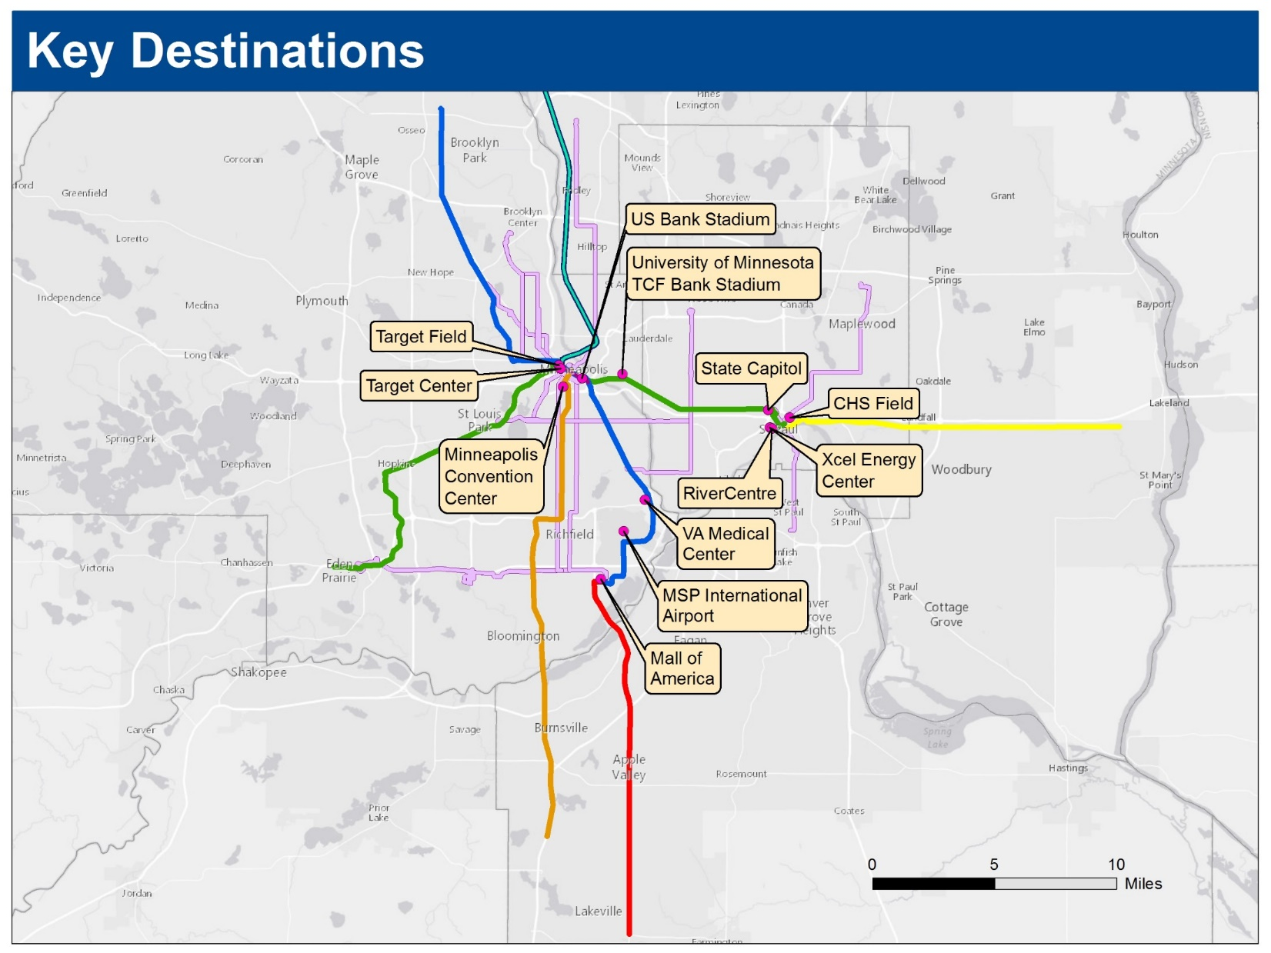
Source: Metropolitan Council, 2016

Slide 19
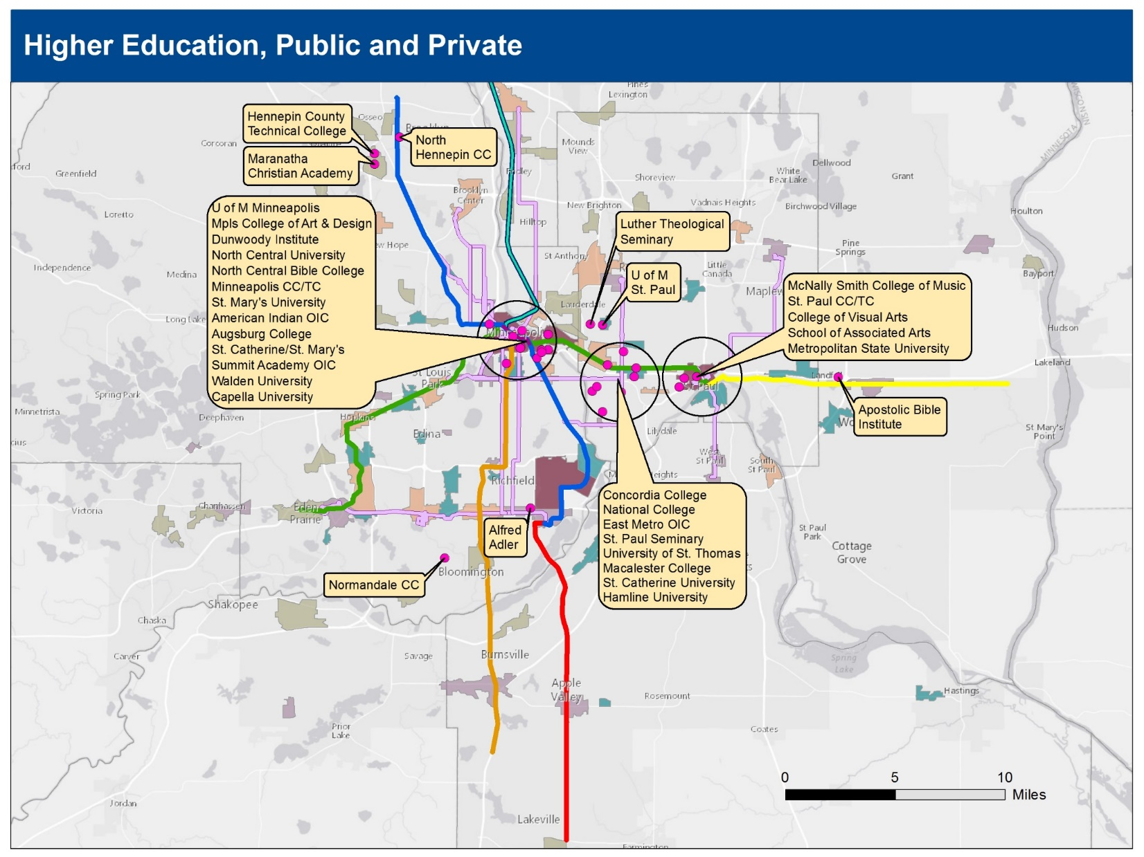
Source: Metropolitan Council, 2016

Slide 20
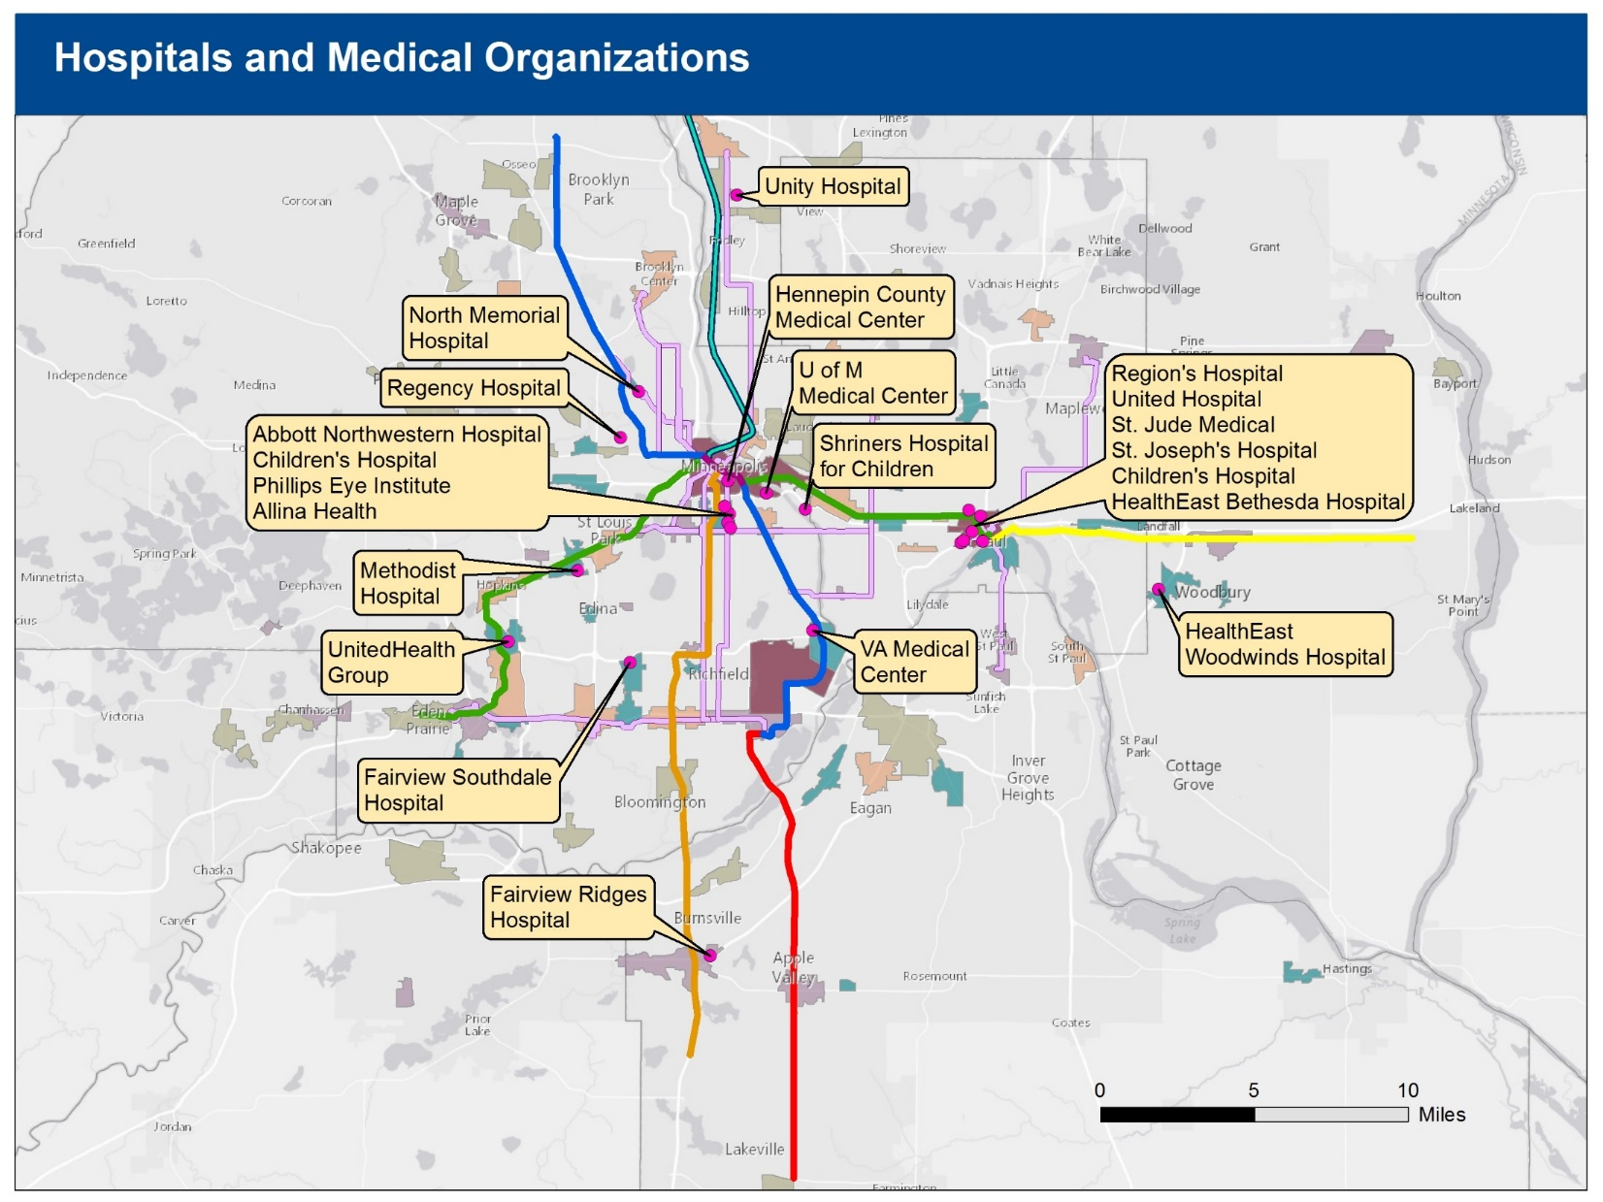
Source: Metropolitan Council, 2016

Slide 21
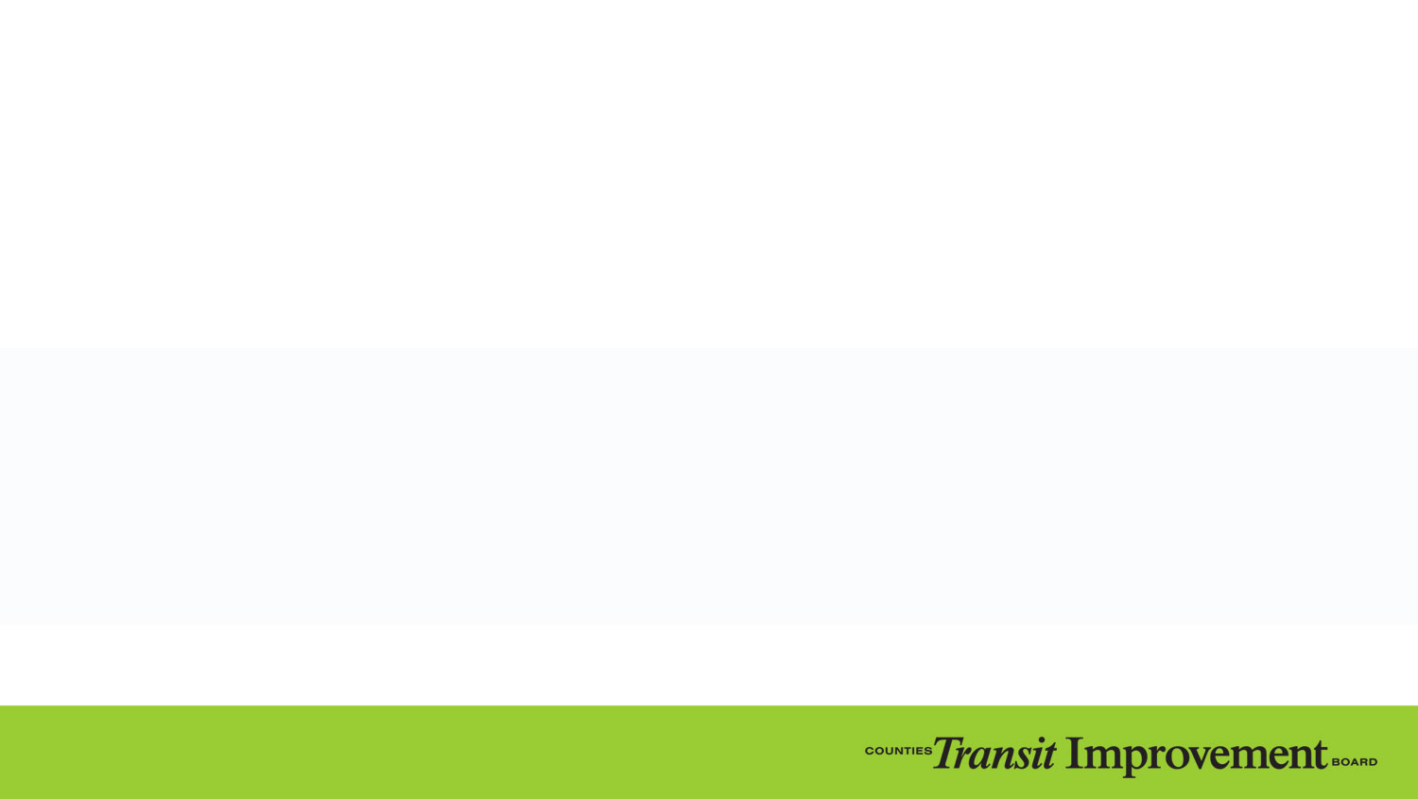
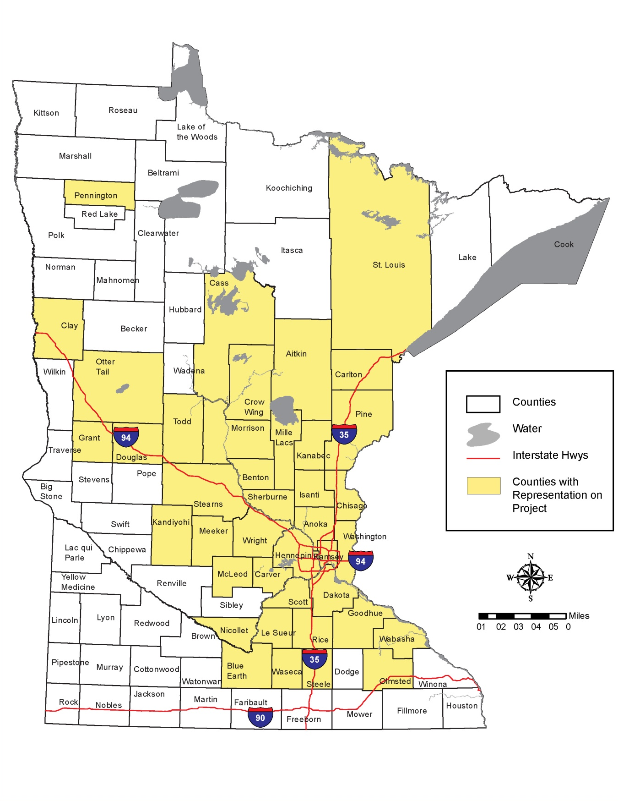
Central Corridor Light Rail Transit Providing Jobs Across MN
Home Zip code for CCLRT Construction Workers by county in 2012
Notes:
Central Corridor Light Rail Transit Providing Jobs Across MN
Home Zip code for CCLRT Construction Workers by county in 2012

Slide 22
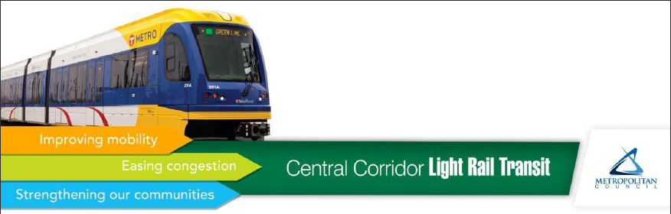
Rail Means Business -
Central Corridor Contracts
Primary Contractors:
Carl Bolander & Sons Co., St. Paul
Graham Construction Services
Walsh Construction, Chicago
Ames Construction Inc., Burnsville
C.S. McCrossan, Maple Grove
Siemens Mobility, Sacramento, CA
Aldridge Electric, Libertyville, IL
ColliSys, New Hope
PCL Construction Services Inc., Burnsville
Sub-contractors include:
AirFresh Industries, Stillwater
Goliath Hydro-Vac Inc., Lakeville
Povolny Specialties, Inc., Inver Grove Heights
All Agape Construction Co.
Gunnar Electric Inc., Eden Prairie
Precision Testing , Burnsville & Virginia, MN
All Star Rolloff Inc., Inver Grove Heights
Hansen Thorpe Pellinen Olson Inc.
Princess Trucking Inc., Elk River
Am-Tec Designs Inc. , Scandia
High Five Erectors Inc., Shakopee
Professional Engineering Services
C.P. Office Products, Circle Pines
MC Supply
Terron Trucking, Bloomington
Crystal Welding, Maple Grove
Meyer Contracting Inc., Maple Grove
Transignal, Elk River
Highway Solutions Inc., Stillwater
Public Solutions Inc.
B & B Diversified Materials
Icon Services Corp., St. Paul
Rani Engineering Inc., Minneapolis
B & L Supply Inc., St. Paul
J & L Steel Erectors, Hudson, WI
Ray Trucking
Bald Eagle Erectors Inc., Eagan
J.D. Donovan Inc., Rockville
Rock On Trucks Inc., Waite Park
Big G Tech Support, Brooklyn Center
Joans’ Minority Owned Supplier, Mpls.
Safety Signs
Big Jay’s Cleaning Services
Kang Contracting Corp., St. Paul
Sanders Steel Erectors, Hastings
Borgert Products Inc., St. Joseph
Lanier Steel Products Inc.
CI Utilities, Blaine
Shaw Trucking Inc., Ham Lake
Carlo Lachmansingh Sales Inc., Minneapolis
Lema Trucking
Simplex Construction Supplies, Blaine
MBE Trucking Inc., Delano
Standard Contracting Inc.
COHO Enterprises, Brooklyn Park
MC Electric
Stonebrook Fence Inc., Prior Lake
Astro Engineering and Manufacturing Inc., Plymouth
Dispatch Trucking
MFRA Inc., Plymouth
Two Buffalo Construction Supplies Inc., Minneapolis
E & J Rebar Inc., Oak Grove
Midwest Lighting Products, Maple Grove
Utility Sales & Supply Inc., Loretto
Eagle Land Surveying Inc., Rockford
MTECH Electric Inc.
Wissota Supply Co., Hastings
E-Con Placer
Nexpro Personnel Services, Inc., St. Louis Park
Woody’s Rebar Co. Inc., St. Paul
Eden Resources, Eden Prairie
Northstar Imaging Services, Inc., Eagan
Yaw Construction Group Inc., Minneapolis
Elliott Contracting Corp., Minneapolis
O’Malley Construction Inc., Le Center
Z Companies Inc. (dba ZAN)
Environmental Enhancements
EVS Inc., Eden Prairie
Source: Minneapolis/St. Paul Business Journal, February 25, 2011 from data provided by the Metropolitan Council. Cities were not available for all contractors.

Slide 23
How CTIB Makes Decisions

Slide 24
Governance Structure
Joint Powers Board of 5 Member Counties
  2 commissioners from each county
  Chair of Metropolitan Council
  Commissioners from 2 ex officio counties
GEARS Committee of Cities and Counties
  Elected officials (8 city, 6 county)
  Develops recommendations on grant applications

Slide 25
13 Colonies Population (1780)

Slide 26
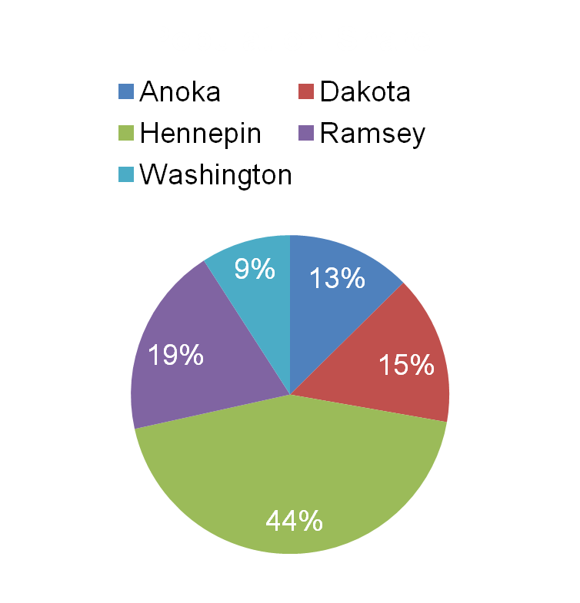
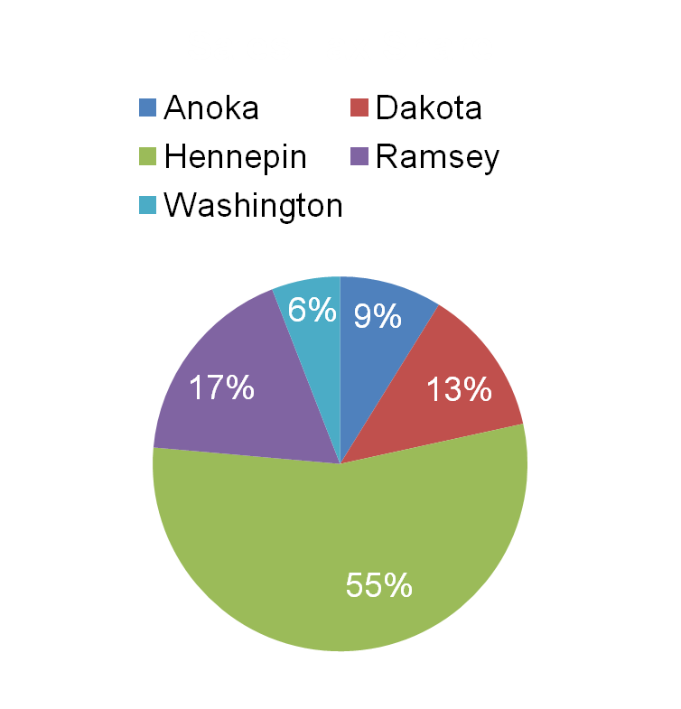
Regional Differences
Sales Tax
Population
Notes:
Together, these five counties generate more than half of the sales tax revenue in Minnesota
Collectively export $125 m per year to other counties thru CSAH formula

Slide 27
Weighted Voting Structure
100 total votes
Super Majority –
63 votes, from at least 3 counties, required to pass anything
Super Super Majority - 75 votes, from at least 3 counties, required to approve issuance of debt
Notes:
Beats a bicameral legislative body
Show me the money: $100m / year jump start for system expansion

Slide 28
A Lean Organization
¾ of 1% for administrative expenses (MN Statute Section 297A.992 subd. 4)
No buildings, property or land
No employees
Use county legal, financial staff
Contract for services as needed
Hennepin County acts as
financial manager
Hennepin County issued bonds for CTIB in 2010
Notes:
Statutorily limited to ¾ of 1% of sales tax revenue.

Slide 29
Roles and Responsibilities

Slide 30
CTIB Focus: Transitway Expansion
Invest in:
Engineering, construction and operations
BRT, commuter rail and LRT
“Supplement, not supplant” (297A.992, subd. 12)
Do not invest in:
Studies*
Intercity passenger rail, regular bus service, or arterial BRT
*Exception: Washington County Guaranteed Grants
Notes:
We promised expansion and that’s what we’ve invested in.
Really focused on expanding transit service along major high volume corridors.

Slide 31
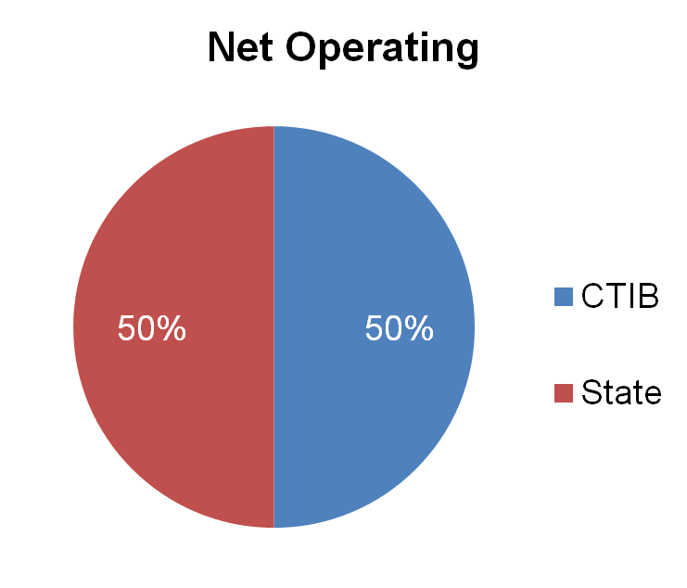
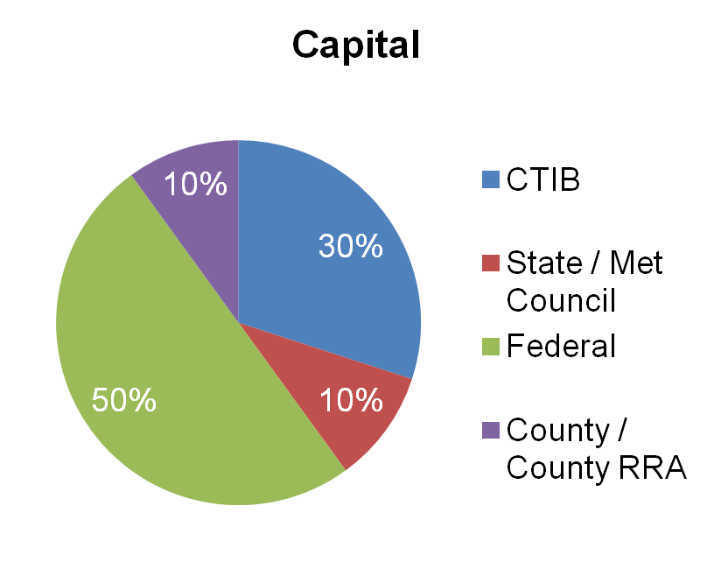
CTIB’s Role:
Largest Non-Federal Funding Source
County organization provides 80% of non-federal funding
Notes:
Highlight the other funding partners involved, to give a sense of who else we are working with to fund transitway expansion

Slide 32
CTIB’s Role as a Funding Partner
30% of total transitway capital cost
60% of funding for Project Development and Engineering
  Significant upfront risk, cash flow needs
50% of the net operating subsidy
Funding commitments to maximize federal funding
Consistency with TPP
Does not own, operate or construct transitways

Slide 33
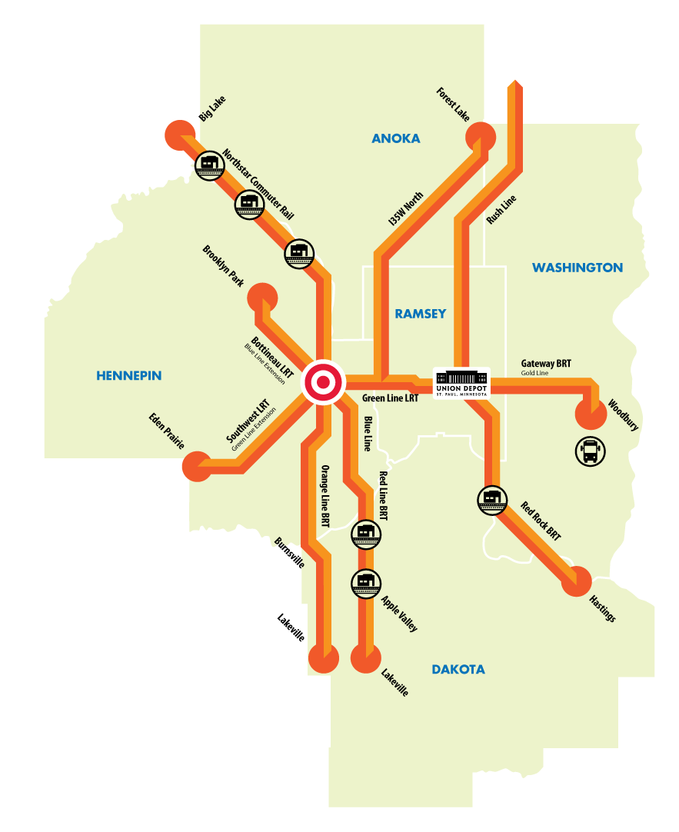
$982.2M: CTIB Investments to Date
Notes:
CTIB has had an impact across the region
I need a list in case I get questions

Slide 34
$1.5B: Federal Funding Leveraged
Project | Federal Funding Through September 2015
Bottineau Corridor | $9,520,830
Cedar Avenue BRT | $45,004,899
Central Corridor LRT | $544,300,450
Hiawatha LRT | $412,500,000
Gateway Corridor | $250,000
The Interchange | $17,441,500
Northstar Corridor | $178,701,661
Northstar Corridor Phase 2 | $3,000,000
Northstar Corridor Phase 2 Bus Demonstration | $97,400
Red Rock Corridor | $6,135,000
Robert Street Corridor | $1,180,000
Rush Line Corridor | $2,654,000
Southwest LRT | $534,275
Union Depot | $124,000,000
I-35W South BRT | $133,500,000
TIGER for Anoka County | $10,000,000
Gateway Corridor | $1,000,000
Total | $1,489,820,015
Notes:
Also need asterist next to projects CTIB did not fund: Union Depot, Interchange (which shold be labelled Target Field Station (Interchange)
What is Anoka Co Tiger for? I think we’ve received three TIGERs. May want to group them together as TIGER: Union Depot*, Tiger: Target Field Station* (Interchange), TIGER: Hanson??? Blvd Safety Improvement over Northstar & Highway 10

Slide 35
Funding THE Regional Vision
Notes:
I think it should read RUNDNG THE REGIONAL VISION, not “OUR” Regional VISION

Slide 36
CTIB’s Policy Framework
Authorizing legislation (Minn. Stat. 297A.992)
Joint Powers Agreement
Transit Investment Framework
Program of Projects Investment Strategy
Resolution Authorizing Annual Grant Solicitation
Grant Awards
Grant Agreements

Slide 37
CTIB Key Fiscal Policies*
Regional balance & connectivity
Maximized federal funding
Fiscal discipline & good stewardship of tax dollars
Responsible planning & execution of financial commitments
Reliable funding partner
*Transit Investment Framework

Slide 38
Program of Projects
Investment Strategy
Financial planning tool to inform Board decisions
Monitor of sales tax resources, need for bonding, affordability of projects
Identification of means to meet funding commitments
Specification of projects eligible for funding
Amount available for grants
Phase 1: plan to deliver a specific group of projects

Slide 39
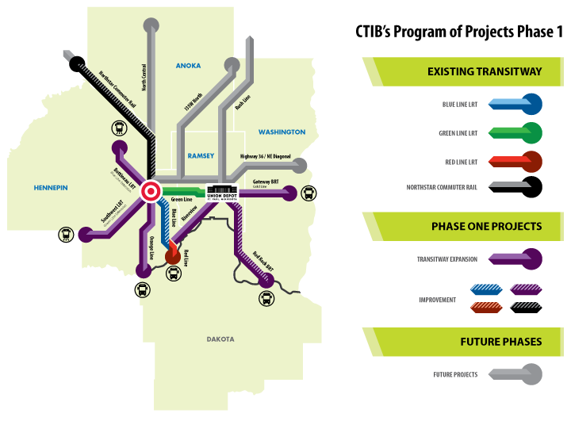
Program of Projects: Phase 1
Notes:
Looking ahead to the next 20 years, CTIB has a financial plan for how it can invest existing sales tax resources, balancing geographic equity with technical readiness of planned transitways

Slide 40

Adopted 2016 PoP Phase 1
CTIB Transitways
Transitway Improvements
Southwest LRT
Bottineau LRT
Orange Line BRT
Gateway BRT
Riverview as LRT
Blue Line vehicles
Cedar Grove Station
Mall of America Station
Northstar safety –
Armstrong & Hanson
Red Rock BRT
50% Net operating subsidy grants for designated transitways and transitway improvements
Notes:
[[[[Who voted for this]]]]]

Slide 41
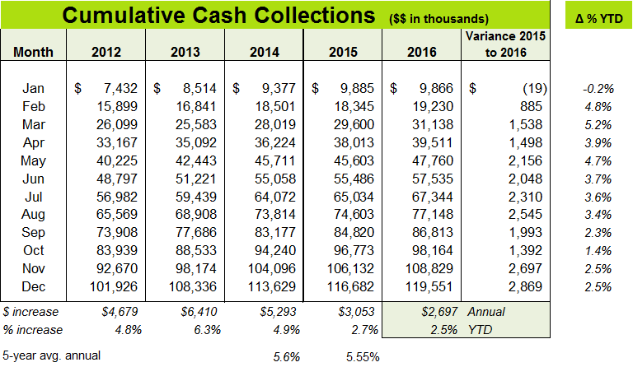
Sales Tax Receipts
Notes:
cAdd color to December line all the way accross

Slide 42
Funding Priorities and Commitments

Slide 43
Funding Priorities
Debt Service
Funding commitments: capital & operating
Completion of PoP Phase 1
  Transitway Capital
  Operating Subsidies
  Transitway Improvement Projects

Slide 44
Debt Status
Senior Sales Tax Revenue Note, Series 2010A
Original amount: $102,810,000
Yield: ~$110,000,000
Currently outstanding: $83,605,000
Annual debt service: ~$8,300,000
Final maturity: December 2030
Earliest call date: December 2019
Notes:
[[[[I added a few lines: Yield and Earliest Call date

Slide 45
CTIB Capital Commitments
(in $millions)
Corridor | PD | Eng. | Full | CTIB Funding Committed | Grants Awarded or Paid to Date | Remaining
METRO Green Line | -- | -- | $300,000 | $283,950 | $283,950 | $0
METRO Red Line BRT | -- | -- | $17,700 | $17,700 | $17,700 | $0
Southwest LRT | $88,600 | $152,786 | $516,500 | $516,500 | $271,356 | $245,144
Bottineau LRT | $27,600 | TBD* | $463,760 | $463,760 | $102,060 | $361,700
Orange Line BRT | $6,000 | n/a | $37,500 | $37,500 | $10,921 | $26,579
TOTAL |  |  |  | $1,319,410 | $685,987 | $633,423
Notes:
Change color

Slide 46
Planned Funding Shares
Transitway % $
Southwest LRT 27.80% $516.5 M
Bottineau LRT 30.19% 463.9 M
Orange Line BRT 24.90% 37.5 M
Gateway BRT 35.00% 147.0 M
Riverview LRT 31.00% 420.0 M

Slide 47
50% Net Operating Costs
Hiawatha LRT (Blue Line)
Northstar Commuter Rail (metro share)
Cedar Avenue BRT (Red Line)
I-35W South BRT (Orange Line)
Central Corridor LRT (Green Line)
Southwest LRT (funding commitment)
Bottineau LRT (funding commitment)
Notes:
$34. million

Slide 48
Current Funding Challenges

Slide 49
Transitway Project Readiness &
2017 Funding Needs
Project | Current Status | Next Steps | 2017 Needs
SWLRT | Eng. | FFGA app Construction | FFGA
Bottineau | PD | Engineering FFGA app | Full state share*
Orange Line | PD | SSGA app Construction | Full state share, other local funding*
Gold Line | Pre-PD | PD | State share for PD
Riverview | Pre-PD | Environ. review | State funding for environmental review
Rush Line (Phase 2, unfunded) | Pre-PD | Environ. review | State funding for environmental review
*Full funding required to secure FFGA or SSGA
Notes:
SSGA – Small Starts Grant Agreement

Slide 50
2017 Project Funding Obstacles
Federal process requires identification of full non-federal share
State funding has either been missing or unreliable

Slide 51
Dakota County Withdrawal
Withdrawal notice provided June 2016
CTIB receipt of Dakota County portion of sales tax stops March 2019
Loss is ~13%, or ~ $18M in 2020

Slide 52
Lack of State Share for SWLRT
Resulting delay increased project costs ($19M)
Necessitated bridge financing for Southwest
  $20.5M increase in HCRRA share
  $20.5M increase in CTIB share
  $103.5M Met Council commitment to issue COP’s
  $11.75M CTIB share of Met Council COP’s

Slide 53
Looking Ahead
How do we move forward
to meet counties, region and state’s
evolving needs?
→ Possible dissolution of CTIB

Slide 54
Existing Local Option Authority
Use existing statutory authority
available to all counties not in CTIB
to impose up to ½-percent sales tax for roads, bridges or transit

Slide 55
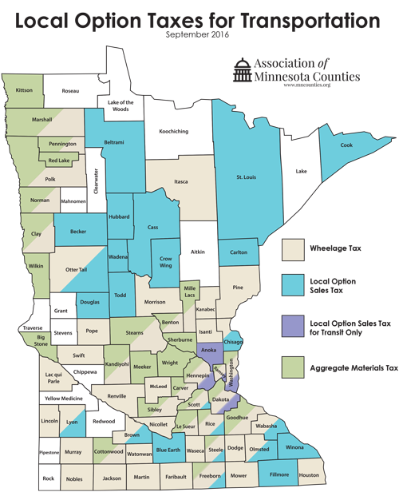
48
24
5
29
Notes:
Have the numbers changed since September 2016
Wheelage tax = 48 (tan)
Local Option Sales Tax = 24 (blue)
CTIB tax = 5 (purple)
Aggregate materials tax = 29 (green)

Slide 56
Comparison of CTIB Transit Tax and General Transportation Tax
CTIB Transit Tax (297A.992)
  ¼ percent
  Transit purposes only
  Joint powers board required
County Transportation Tax (297A.993)
  Up to ½ percent
  Road, Bridge or Transit purposes
  Joint powers board permitted

Slide 57
Capital Funding Evolution 1

Slide 58
Capital Funding Evolution 2
With CTIB Sales Tax
(297A.992)
Post-CTIB, with County Sales Tax (297A.993)
Notes:
[[[[This is not right.. The 40% slice shold be County Sales Tax and be a totally different color. And I’d take out the dotted line on the second pie; also, use the fist pie as the second pie on the previous slide]]]]]

Slide 59
Transitway Operations Evolution 1
Pre-2008, with County RRA Property Taxes
Post-2008, with CTIB Sales Tax (297A.992)

Slide 60
Transitway Operations Evolution 2
CTIB (297A.992)
County Sales Tax (297A.993))
Notes:
Don’t change the colors. It’s confusing. Keep the State one color throughout all the slides. Keep everyone the same color throughout. Also, make sure the position of the key is consistent with the position of the slices in the pies, i.e., reverse CTIB and Sate in first one and State and County in second]]]

Slide 61
Starting Point
To access up to ½-percent general county transportation sales tax under 297A.993, a county may not be a member of CTIB

Slide 62
Key Assumptions
Purpose of Dissolution: to utilize available revenue sources
Implementation: consistent with existing statutory authority
Dissolution: must work for all CTIB Counties
Lack of State Funding: will cause costly project delays

Slide 63
Key Assumptions
Statutory Requirement: Current CTIB sales tax resources must pay all debts and obligations
Commitments: Fund all grants made prior to dissolution
CTIB’s remaining funding commitments and obligations: must be assumed by one or more counties
Shifts in Organizational Structure: must be seamless to avoid disruptions

Slide 64
Key Implementation Steps
All 5 counties must agree on path forward
Counties agree to a full allocation of all CTIB responsibilities to counties
CTIB assigns, and one or more counties assume, remaining funding commitments
Necessary agreements among affected counties are approved
CTIB uses current resources to pay off debt and obligations

Slide 65
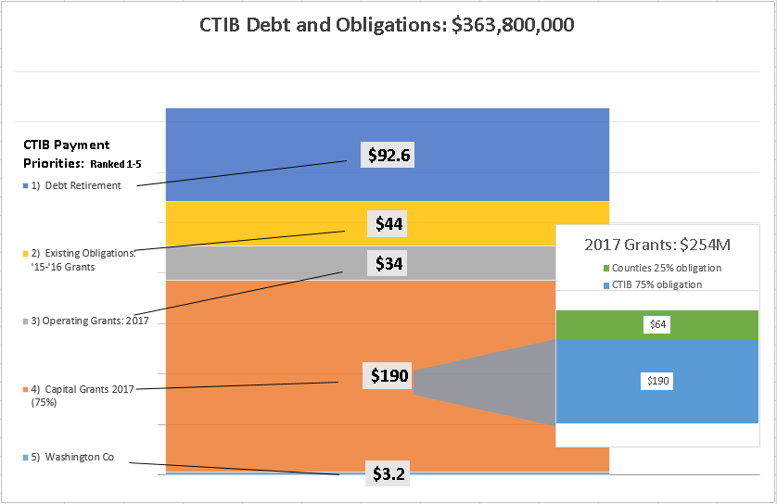
Notes:
[[[Why not make the Blue block of $190m the same orange as the big block so people know it’s the same money

Slide 66
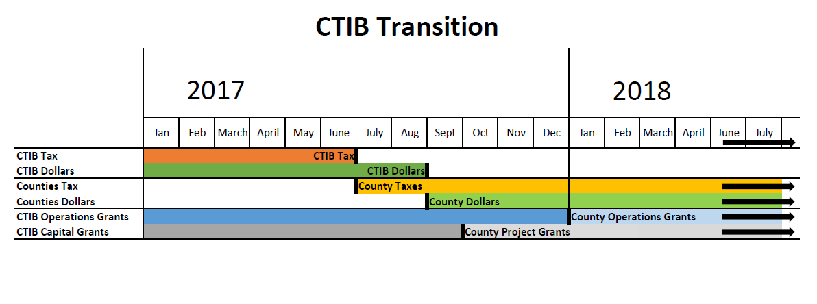
Notes:
[[[[Can these colors be coordinated with the colors on the previous chart fo continuity sake?]]]]

Slide 67
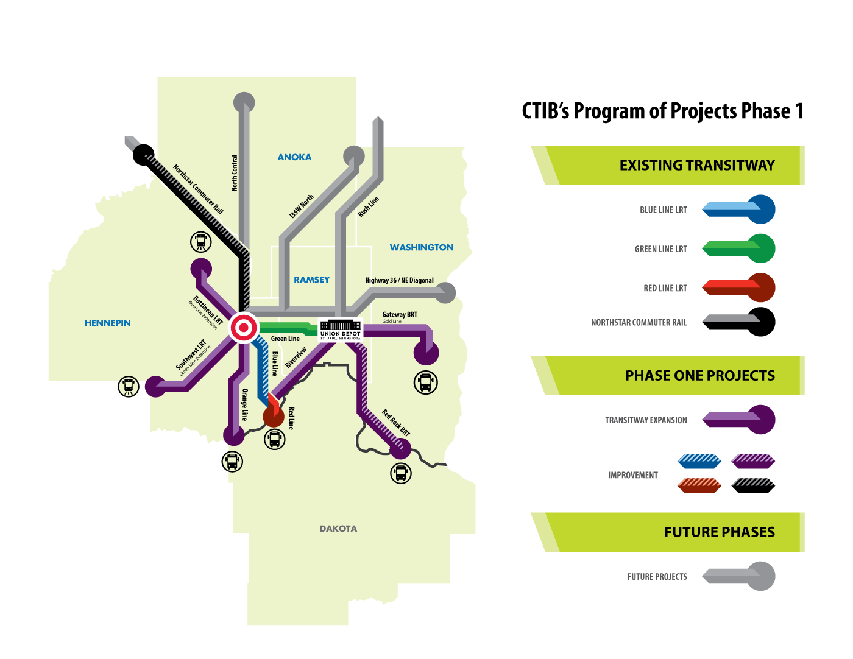
What would be built?
Southwest LRT (Green Line Extension)
Bottineau LRT (Blue Line Extension)
I-35W South BRT (Orange Line)
Gateway BRT (Gold Line)
Riverview Corridor
Red Rock Corridor BRT

Slide 68
Benefits
Corridors provide enhanced transit service throughout the region
Elimination of state capital share
No COP’s issued by Metropolitan Council for SWLRT
Additional federal funds invested in MN
Costly delays avoided
PoP delivered

Slide 69
Questions?
Commissioner Peter McLaughlin
Counties Transit Improvement Board Chair
Peter.mclaughlin@Hennepin.us
Mary Richardson
CTIB Administrator
Mrichardson@rranow.com
Notes:
69
[[[[Keep as last slide]]]]

