Slide 1
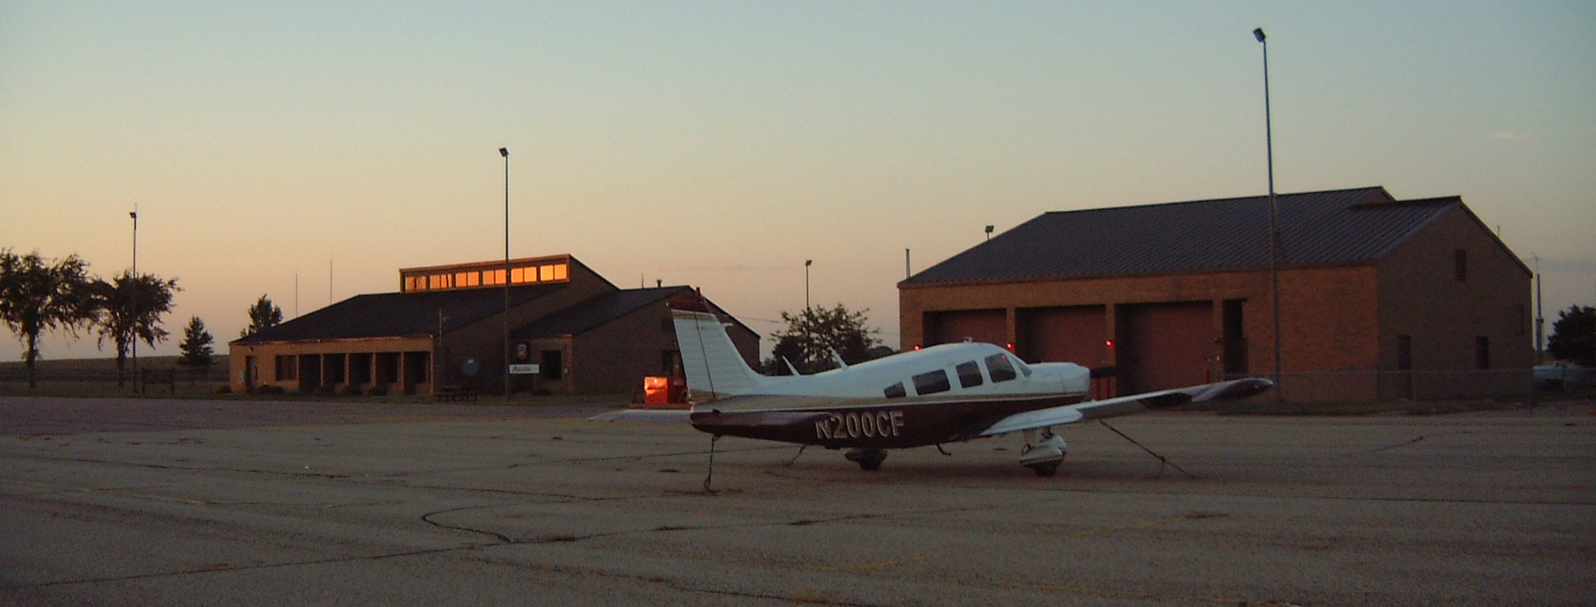
State Airports Fund
Cassandra Isackson | Aeronautics Director
March 6, 2018

Slide 2


How users fund the system
Aviation Fuel Tax
Airline Flight Property Tax
Aircraft Registration
State Airports Fund
Other: inspection, licensing, etc.
Aircraft Sales Tax

Slide 3
Revenue Sources
Aircraft Registration
Computed on the manufactured list price of the aircraft when new.
Effective July 1, 2014 the fee changed from a graduated percentage (1% on manufacture retail base list price) to a rate established in statute.
Range (16 tiers)
  Manufacture List Price ≤$500k = $100 (min)
  Manufacture List Price >$40m = $75k (max)
Notes:
Collected on a fiscal year basis from July 1 through June 30 of the following year.
This law does not impact registration tax for antique/classic aircraft, recreational aircraft, civil air patrol, government aircraft, hot air balloons, agricultural aircraft, air ambulance, and other aircraft defined under State Statute 360.55 & 360.653.
Aircraft Registration – What changed?
After the first year of aircraft life the tax was reduced (10% first year and 15% each after)
Range
Minimum = $50
Max example: Manufacture List Price $40m = $400k

Slide 4
Revenue Sources
Aviation Gasoline/Fuel Tax
Effective July 1, 2014 the rates are:
    Gasoline Tax = 5 cents/gallon
    Jet/Special Fuel Tax = 15 cents/gallon
    High volume users get a refund
Notes:
What changed?
Jet/Special Fuel Tax increased by 10 cents per gallon
Had been 5 cents/gallon

Slide 5
Revenue Sources
Aircraft Sales Tax
Current sales tax rate = 6.5%
Effective June 30, 2013:
    Sales/use tax revenues now deposited into State Airports Fund, includes leased aircraft; previously went to general fund
    Sales tax on aircraft parts and labor eliminated
Notes:
2013, state law changed, provided tax exemption
Sale, purchase, installation of equipment and parts
For repair and maintenance of aircraft
Includes upgrades/improvements; FAA Parts 91, 135
Purpose; encourage growth, aviation services industry

Slide 6
Revenue Sources
Airline Flight Property Tax
Paid by the airlines in lieu of other property taxes on “flight property”
The property tax portion of the state airport fund appropriation is calculated each year by MnDOT as the difference between the total fund appropriation and the estimated total fund revenues for the state fiscal year in which the tax is payable
Notes:
270.071 Subd. 7.Flight property.
"Flight property" means all aircraft and flight equipment used in connection therewith, including spare flight equipment. Flight property also includes computers and computer software used in operating, controlling, or regulating aircraft and flight equipment.
270.075 TAX LEVY.
§Subdivision 1.Rate of tax.
The commissioner shall determine the rate of tax to be levied and collected against the net tax capacity as determined pursuant to section 270.074, subdivision 3, to generate revenues sufficient to fund the air flight property tax portion of each year's state airport fund appropriation, as certified to the commissioner by the commissioner of transportation. The certification shall be presented to the commissioner prior to December 31 of each year. The property tax portion of the state airport fund appropriation is the difference between the total fund appropriation and the estimated total fund revenues from other sources for the state fiscal year in which the tax is payable and may include a portion of the balance in the state airports fund as determined to be available by the commissioner of transportation. The certification by the commissioner of transportation to the commissioner shall state the total fund appropriation and shall list individually the estimated fund revenues including the account carryover balance in the airport fund. The difference of these amounts shall be shown as the property tax portion of the state airport fund appropriation.
If a levy amount has not been certified by December 31 of a levy year, the commissioner shall use the last previous certified amount to determine the rate of tax, and shall notify the chairs and the ranking minority members of the committees of the house of representatives and senate having jurisdiction over the Department of Transportation that a certification was not made under this subdivision.

Slide 7
Revenues
Revenues (in millions $)
 | Actual | Actual | Actual | Actual | Actual | Budget | Budget | Planning Est | Planning Est
 | FY 2013 | FY 2014 | FY 2015 | FY 2016 | FY 2017 | FY 2018 | FY 2019 | FY 2020 | FY 2021
Sales Tax on Aircraft | - | 3.3 | 8.1 | 4.9 | 6.5 | 5.7 | 5.0 | 5.0 | 5.0
Airline Flight Property Tax | 12.0 | 9.2 | 8.1 | 7.0 | 7.0 | 8.0 | 7.0 | 6.5 | 6.0
Aircraft Registration Tax | 8.7 | 3.4 | 3.6 | 2.5 | 4.2 | 3.0 | 3.0 | 3.0 | 3.0
Gasoline & Special Fuel Tax | 2.5 | 3.3 | 6.2 | 6.1 | 5.8 | 5.0 | 5.0 | 5.1 | 5.2
Other* | 0.1 | 0.1 | 0.2 | 0.2 | 0.3 | 0.4 | 0.7 | 0.9 | 1.0
Total | 23.3 | 19.3 | 26.3 | 20.8 | 23.9 | 22.1 | 20.7 | 20.5 | 20.1
* Departmental Earnings, Investment Income, Other Income

Slide 8
Revenues
* Departmental Earnings, Investment Income, Other Income

Slide 9
Appropriations
Current Biennium
Estimate

Slide 10
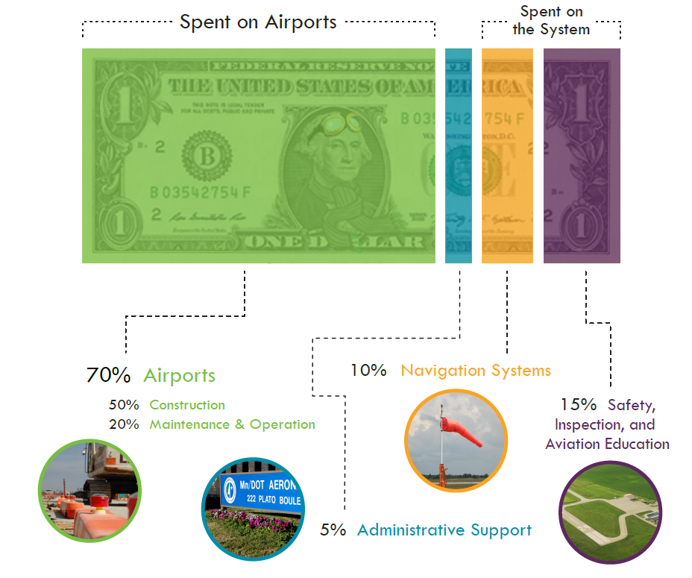
Expenditures

Slide 11
5-year Capitol Improvement Program
5-year list of requested projects
State Funds | Local Funds | FAA Funds | Total
$91,342,034 | $134,472,183 | $331,886,962 | $576,335,181
5-year estimated available funds
State Funds | Local Funds | FAA Funds | Total
$46,110,000 | $68,000,000 (est) | $168,000,000 | $282,110,000 (est)

