Slide 1


2025 Capital Budget Requests
Karin Berkholtz | Deputy Director
House Capital Investment Committee
February 20, 2025

Slide 2
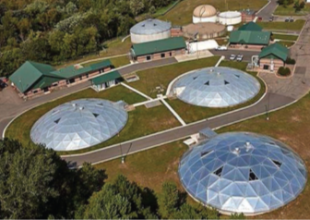
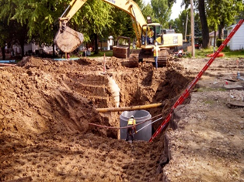
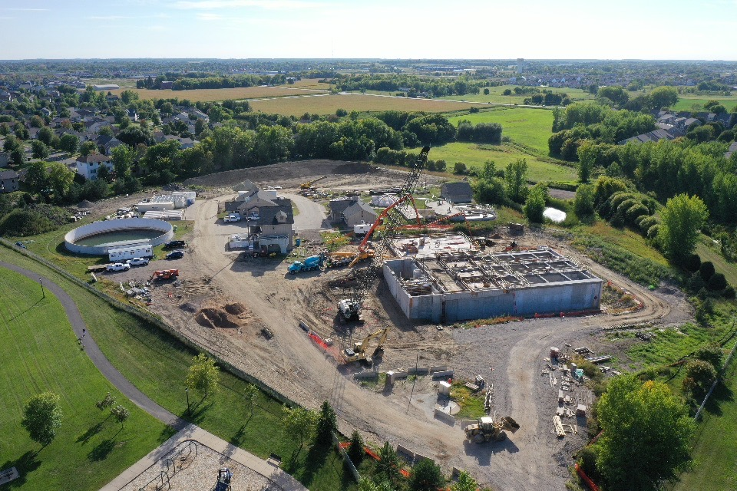
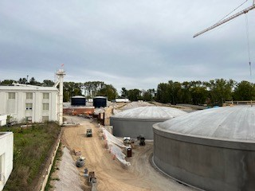
Governor’s 2025 Funding Recommendations
Proposed 2025 Capital Budget Requests: $99,012,000
CW and DW revolving fund state match | $39,000,000
Water Infrastructure Funding (WIF) Program | $23,485,000
Point Source Implementation Grant (PSIG) Program | $18,527,000
Emerging Contaminants Grants Program (new) | $18,000,000
Fund Source: General Obligation Bonds

Slide 3
State Match to Federal Capitalization Grants
$39M in state match will unlock $215M in federal funds.
Projects currently not fundable due to lack of state match
2025 Clean Water IUP |  | 2025 Drinking Water IUP
51 projects | $465M | 81 projects | $319M
Required 20% state match for 2025 & 2026 federal capitalization grants.
Repayments revolve back to pay PFA revenue bond debt service and make new loans.
FY23 appropriation of $41M for state match fully allocated.

Slide 4
Funding Program Requests
Water Infrastructure Funding (WIF) Program $23,485,000
Estimated WIF Needs:
Clean Water 27 unfunded projects, $41M | Drinking Water 56 unfunded projects, $48M
Point Source Implementation Grant (PSIG) Program $18,527,000
Estimated PSIG Needs: 28 unfunded projects, $128M
Emerging Contaminants (EC) Grant Program $18,000,000
New program to supplement federal funds to treat for manganese and PFAS in municipal drinking water systems. Estimated EC Needs: 2025 IUP: 19 unfunded projects, $194M

Slide 5
Policy Recommendations
Program | Policy Recommendations
CW and DW Revolving Funds | Authorize CW PF grants for projects to address emerging contaminants in wastewater. Authorize DW PF grants for projects to comply with a maximum contaminant level (MCL) requirement.
WIF program | Increase maximum grant to $10 million (currently $5 million).
PSIG program | Increase maximum grant to $12 million (currently $7 million).
Emerging Contaminants Grant Program | Establish new program to assist cities with construction projects to meet state drinking water standards for manganese and pending federal and state standards for PFAS substances. Program administered in conjunction with MDH utilizing the DWRF process. State funds will be combined with approximately $120M in federal funds available through the federal IIJA.

Slide 6

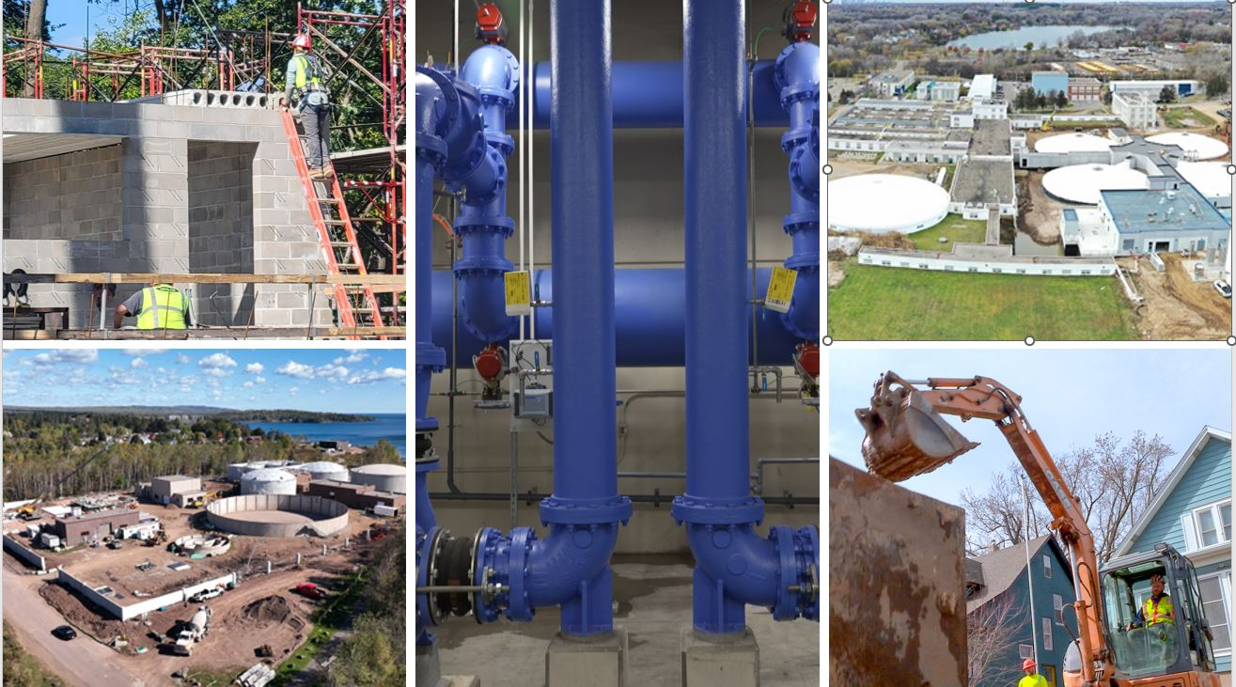
Questions?
Presenter
Email
Phone

