Slide 1
Trucking 101
John Hausladen
Minnesota Trucking Association
Notes:
Plus two bonus items!

Slide 2
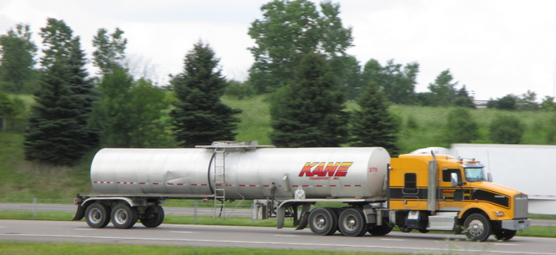
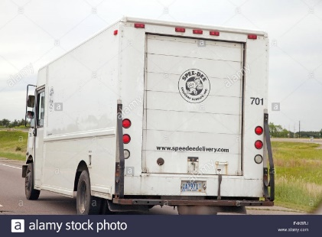
Trucking IS Minnesota
Goods
Raw materials
Manufactured
High Tech
Equipment
Vans
Flatbeds
Refrigerated
Tank
Dump
Parcel

Slide 3
If You Got It A Truck Brought It
17,680 MN-based trucking companies
68% of communities served exclusively
78% of all MN manufactured tons

Slide 4
Small Business on Wheels
2017 Tractor costs $150,000
2017 reefer trailer with skirts costs $60,000
5-axle tractor trailer pays $15,239 in combined state and federal taxes

Slide 5
Good Paying MN Jobs
1of 18 private sector jobs
34,500 truck drivers
$42,490 average salary

Slide 6
Highly Regulated
Daily work limits
Physicals
CDL
D&A testing
Background checks
Continuing education

Slide 7
Technology Explosion
E Logs
Satellite tracking
In-cab cameras
Lane departure
Crash avoidance
Rollover
Autonomous trucks

Slide 8
Crash Rate Dropping
National fatal crash rate has dropped 73% since 1975
Partnerships
Driver’s education
Share the Road
State Patrol
MNDOT

Slide 9
Cleaner Burning Engines
Nitrogen oxide and particulate matter at near zero levels
Dropped 98% since 1975
Smartway Transport Partnership
New engine technology

Slide 10
Challenges
Sluggish economy
Over regulation
Driver shortage
Congestion
Truck parking shortage

Slide 11
Truckers Need …
Good roads and bridges
Consistent regulations
Fair taxes
Qualified workforce

