Slide 1
Minnesota House of Representatives Aging and Long-Term Care committee
Susan Brower, Minnesota State Demographer
January 14, 2015

Slide 2
Topics for today
Aging Trends in Minnesota
Factors Impacting the Need for Long-Term Care (LTC)
Costs of LTC and income of older adults in MN
Labor force needed to care for aging residents

Slide 3
Number of MN’s older adults will increase substantially over the next 20 years
Sources: U.S. Census Bureau and Minnesota State Demographic Center
Notes:
3
3

Slide 4
Number of MN’s older adults will increase substantially over the next 20 years
Sources: U.S. Census Bureau and Minnesota State Demographic Center
Notes:
4
4

Slide 5
For the first time in MN history: More 65+ than school-age by 2020
Source: U.S. Census Bureau & Minnesota State Demographic Center
Notes:
5
5
Three main budget drivers at the state level school age kids, college age kids, and the older population. Education and Health Care are the largest expenditures in the state budget. By 2020 there will be more older adults in MN than school-age children. This will certainly have an effect on where and how we spend our state money.

Slide 6
Demographic shifts will change demand for public services
General Fund Expenditures
2014-2015
Within Health & Human Services
Medical Assistance Expenditures: 25% of GF spending (8.5 billion)
Medical Assistance Expenditures for the Elderly and Disabled: 16% of GF spending (5.5 billion)
MA expenditures include basic care, long-term care waivers and long-term institutional care
Sources: Minnesota Management and Budget, February 2013. House Research, Long-Term Care Services for the Elderly, November 2012

Slide 7
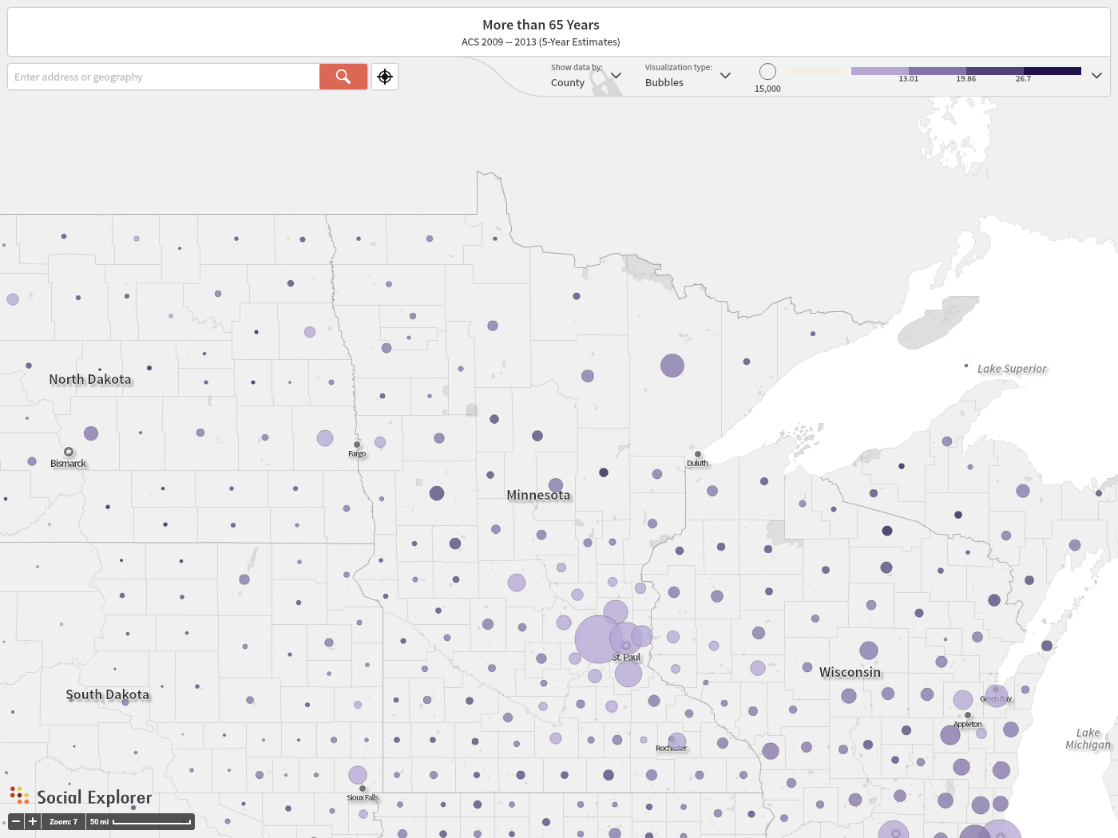

Slide 8
WHAT factors impact the Need for long-term care (LTC)?
Demographic: Age & Gender
Health status
Disability
Living arrangements
Notes:
http://longtermcare.gov/the-basics/who-needs-care/
Age
The older you are, the more likely you will need long-term care
Gender
Women outlive men by about five years on average, so they are more likely to live at home alone when they are older
Disability
Having an accident or chronic illness that causes a disability is another reason for needing long-term care
Between ages 40 and 50, on average, eight percent of people have a disability that could require long-term care services
69 percent of people age 90 or more have a disability
Health Status
Chronic conditions such as diabetes and high blood pressure make you more likely to need care
Your family history such as whether your parents or grandparents had chronic conditions, may increase your likelihood
Poor diet and exercise habits increase your chances of needing long-term care
Living Arrangements
If you live alone, you’re more likely to need paid care than if you’re married, or single, and living with a partner

Slide 9
Need for long-term care is substantial after age 85
Source: Stone, 2000

Slide 10
70% of older adults need long-term care
Source: Kemper, Komisar and Alecxih, 2006.

Slide 11
Older adults living in institutions Minnesota 2010
Source: Tabulated by the MN State Demographic Center from the Integrated Public Use Microdata Series.

Slide 12
MN Has reduced the number of residents living in nursing homes
Population in Nursing Homes
1980: 40,000
1990: 43,000
2000: 38,000
2010: 30,000
Source: U.S. Census Bureau

Slide 13
Healthy life expectancy at 65, 2007-2009
At age 65, the average Minnesotan will live an additional 20 years.
15 of those years will be disability-free, on average.
Source: Centers for Disease Control, 2013
Notes:
Minnesota’s older adults are healthy
A 65-year-old in MN today can expect to live another 20.1 years, with 15.6 of those years being in good health
However, variations in health and disability across racial groups
Range from 10.8 years in Missippi, 16.8 in Hawaii

Slide 14
2/3 of adults receiving long-term care are in “fair” or “poor” health
Source: Health Policy Institute, George Washington University. 2000 National Health Interview Survey.

Slide 15
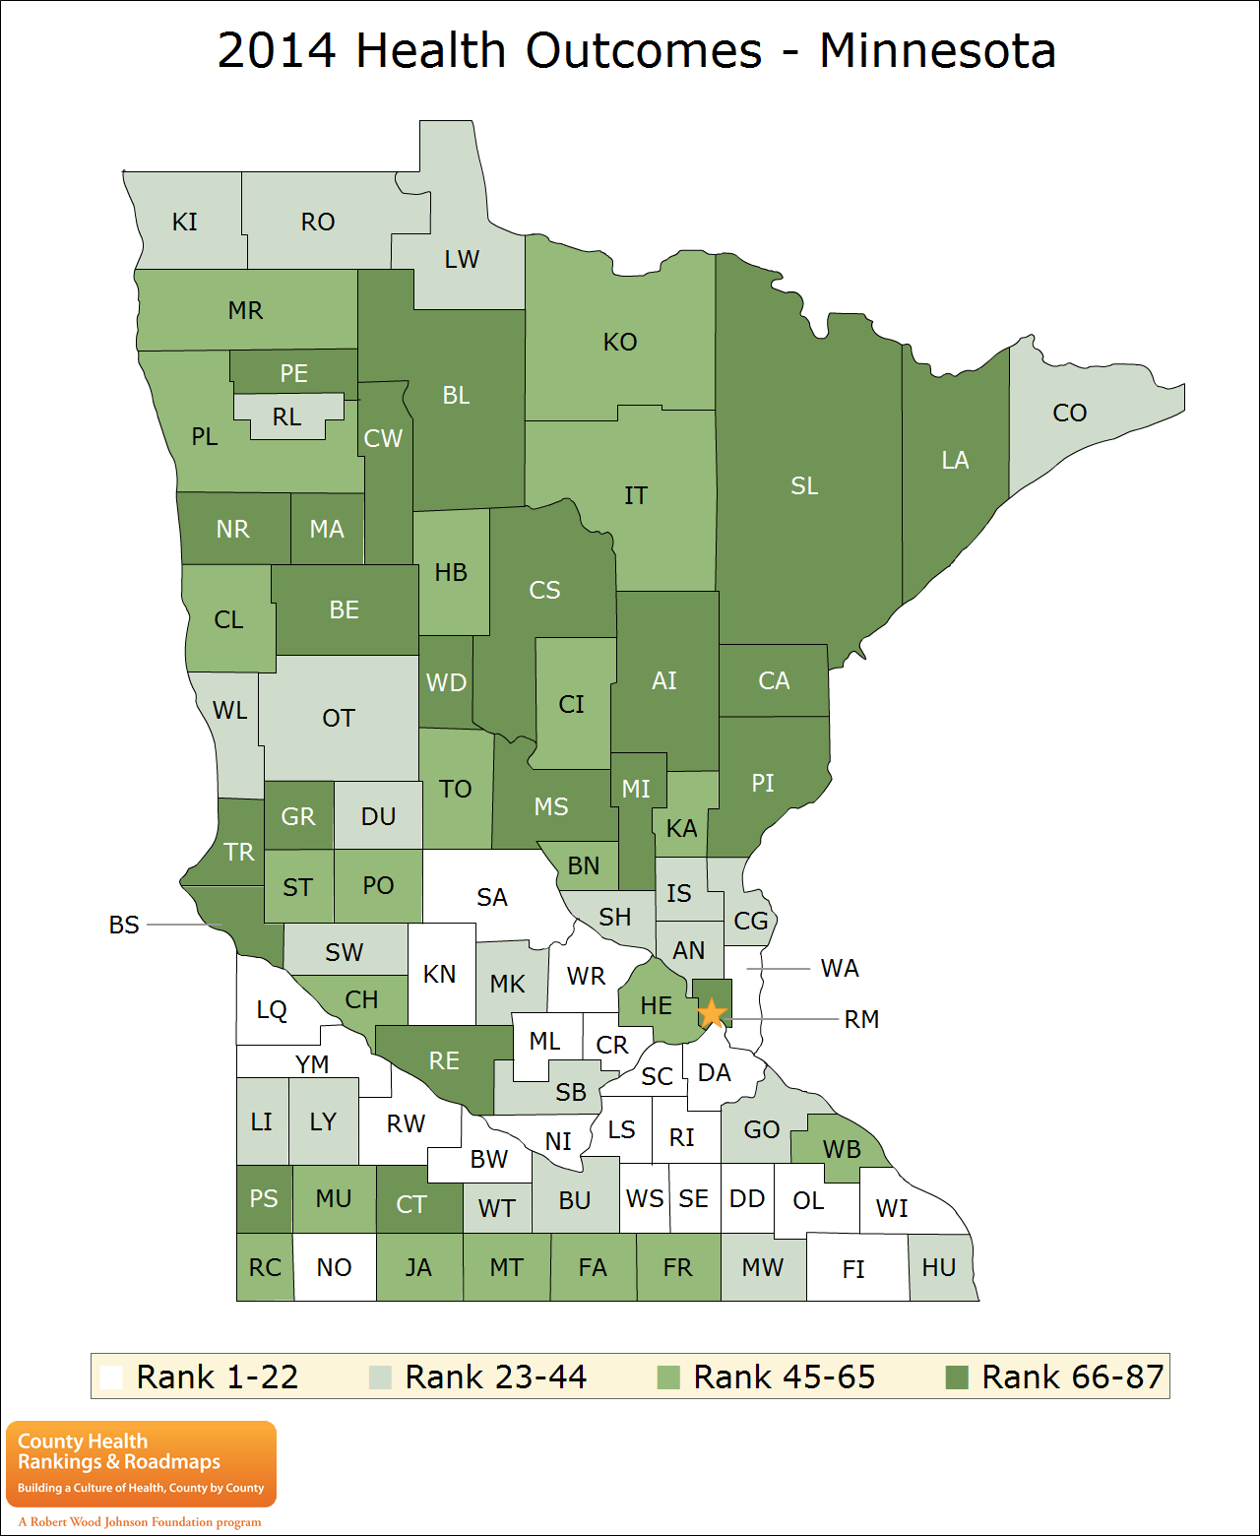
Health outcomes 2014
A index of self-rated health and life expectancy
MN’s healthiest counties are concentrated in the south
Notes:
http://www.countyhealthrankings.org/app/minnesota/2014/overview
The overall rankings in health outcomes represent how healthy counties are within the state. The healthiest county in the state is ranked #1. The ranks are based on two types of measures: how long people live and how healthy people feel while alive.

Slide 16
Aging brings higher rates of disability
Source: Tabulated by the MN State Demographic Center from the Integrated Public Use Microdata Series. Includes only the civilian, non-institutionalized population

Slide 17
Prevalence of disability declining slowly, age pattern remains
Disability limiting independent living
Disability limiting
self-care
Source: Crimmons, et al 2009. Estimates are for the U.S.
Notes:
Inability to perform one of the five activities of daily living (ADLs) is inability to perform self-care: bathing, dressing, eating, getting in/out of a bed or chair, and toileting. Inability to do one of the five instrumental activities of daily living (IADLs: preparing meals, shopping for groceries, managing money, using the telephone, and doing light housework) is inability to live independently.

Slide 18
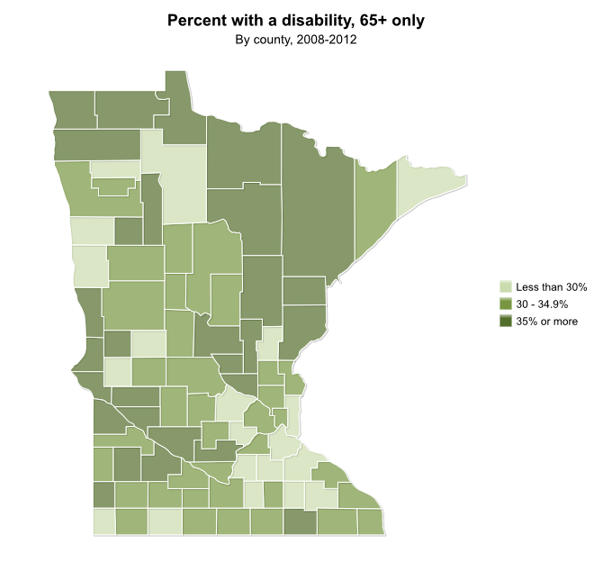
Rates of Disability among older adults
Source: mncompass.org

Slide 19
29% of older adults (AGE 65+) live alone; 200,000 in MN
Source: 2008-2012 American Community Survey, U.S. Census Bureau

Slide 20
Long-Term Care Costs In Minnesota
Average Daily Nursing Home Rate Private Room | Average Daily Nursing Home Rate Semi-private Room | Average Monthly Cost in Assisted Living Facility | Adult Day Care Daily Rate | Home Health Aide Average Hourly Rate | Homemaker Services Average Hourly Rate
$234 $85,775/ annual | $210 $76,650/ annual | $3,316* $39,792/ annual | $75 $27,375/ annual | $25 $20,000/ annual Est. | $22 $20,000/ annual Est.
*Not all-inclusive; additional charges for home care services. Source: Genworth 2012 Cost of Care Survey, Genworth Financial
Notes:
Long-Term Care Costs in Minnesota³
* This amount is not all-inclusive, there are additional charges for home care services
³Genworth 2012 Cost of Care Survey, Genworth Financial
•Home care costs are personalized to the care one needs, e.g. one may only need 2 hours of care a day or only 3 days a week for bathing assistance or meal assistance or medication reminders.
•Long-Term Care costs will continue to rise. For example, the $85,775 average cost for one year in nursing home is expected to be as high as $286,000 annually in 30 years, based on the expected increase in the cost of care (based on the 9-year average annual increase drawn from a comparison of data gathered from providers across the country for John Hancocks’ 2002, 2005, 2008 and 2011 Cost of Care surveys).
•Paying for care may have a significant impact on your own finances as well as your family members

Slide 21
Who Pays for Long Term Care in Minnesota ? (2010)
Source: MN Department of Human Services, 2010
Notes:
•26% is paid through private pay or out of your pocket. Or family members may feel obligated or need to help you financially. Or they may take on some of the services that one would pay for which could mean they need to take time from their job or family obligations or even quit their job which could impact them financially as well as place a strain on everyone involved.
•What about Medicaid? 34% is paid through Medicaid. Medicaid is a federal program but administered by each individual state with the intention to pay medical costs for those with limited income and assets. In MN it’s referred to as Medical Assistance or MA. Other government funded programs are Elderly Waiver, MN Senior Health Options (MSHO), Community Alternative Care (CAD), Community Alternatives for Disabled Individuals (CADI).
You must meet functional eligibility criteria and have very limited financial resources or deplete or “spend down” assets to the state-required level. The amount of coverage and the service providers are limited, e.g. only certain nursing homes, senior housing and home care agencies have their services covered by Medicaid which can limit choices and control one has over where they want to live or who is providing their care.
The state has the right to be repaid for services provided when a home is sold, e.g. if one is receiving services paid through Medical Assistance either for a spouse or for themselves with home care, a notice of potential lien is put on the home and when the home is sold, the state may recover costs they have paid out.
•32% is paid by Medicare? Medicare is a Federal program intended to pay medical costs for individuals over 65. It primarily pays for acute care for an injury or illness you can recover from. Medicare only pays for skilled care for a limited period of time and only after a hospital stay. Care is covered up to 100 days. The proportion is large because many individuals need long-term care briefly after a hospital stay and Medicare pays for that type of care. But it does NOT pay for custodial care, which is what most long-term care is.
•Only 7% is paid by private health insurance? This category includes long term care insurance, Vets insurance, other types of insurance that individuals may have. Health insurance rarely pays for long term care. If it does it follows the same rules as Medicare. Disability Insurance is meant to replace your income when you are unable to work, but does not provide additional benefits for nursing home confinement.
•Because of reduced financing, these programs will be limited, fund less services, or take longer to qualify for.

Slide 22
Of U.S. adults needing ltc, only 22% receive formal (paid) care

Slide 23
Plans to pay for Long-term care MN Baby Boomers, 2010
Source: Transform 2010 Survey, Minnesota Department of Human Services
Notes:
32 percent don’t know
18 percent gov’t program

Slide 24
What is middle income?
Difficult to come up with a meaningful number for “middle class” or “middle income”
The middle 20% of all MN households with a householder age 40+ has income between $44,000 and $68,000
But there is wide variation, especially when household size is considered
Source: MN State Demographic Center analysis of ipums data, 2007-2011 American Community Survey

Slide 25
Median household income declines with age
Source: MN State Demographic Center analysis of ipums data, 2007-2011 American Community Survey

Slide 26
Median household income by age of householder and household size
Source: MN State Demographic Center analysis of ipums data, 2007-2011 American Community Survey

Slide 27
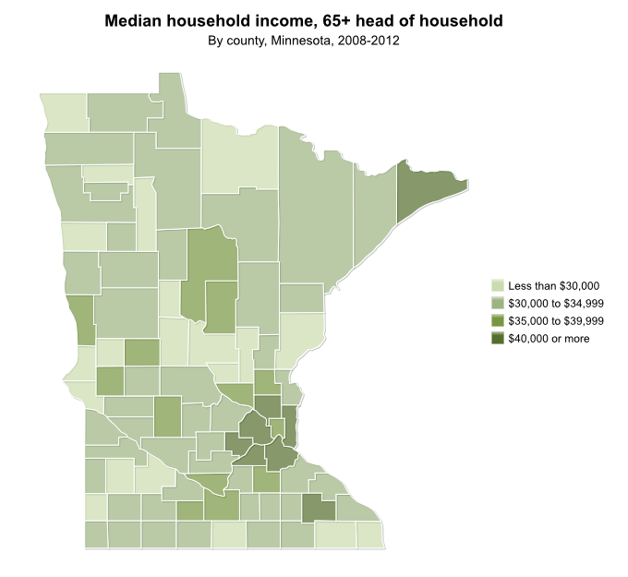
twin cities, rochester older adults: relatively high median incomes

Slide 28
NationallY, ½ of people buying long-term care insuraNce have incomes of $75,000+

Slide 29
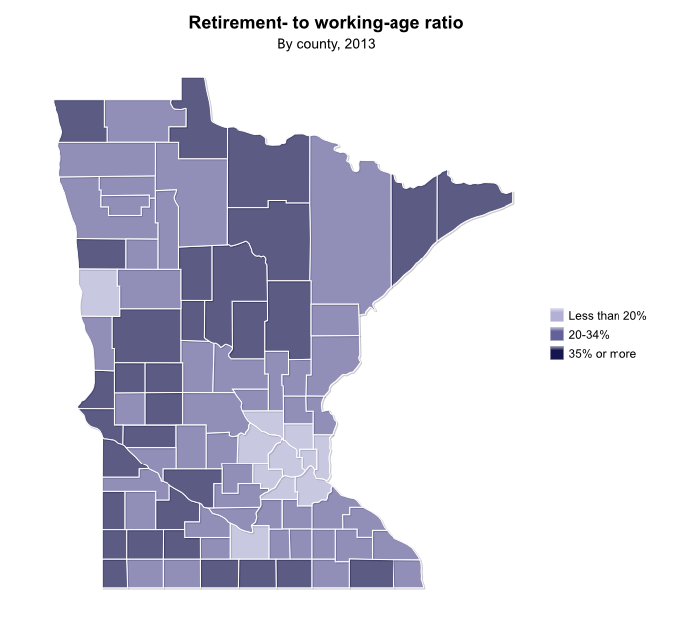
Availability of workers to care for aging population: Darker Areas will struggle more
20% = 5 working-age adult for every older adult
33%=3 working-age adults for every older adult

Slide 30
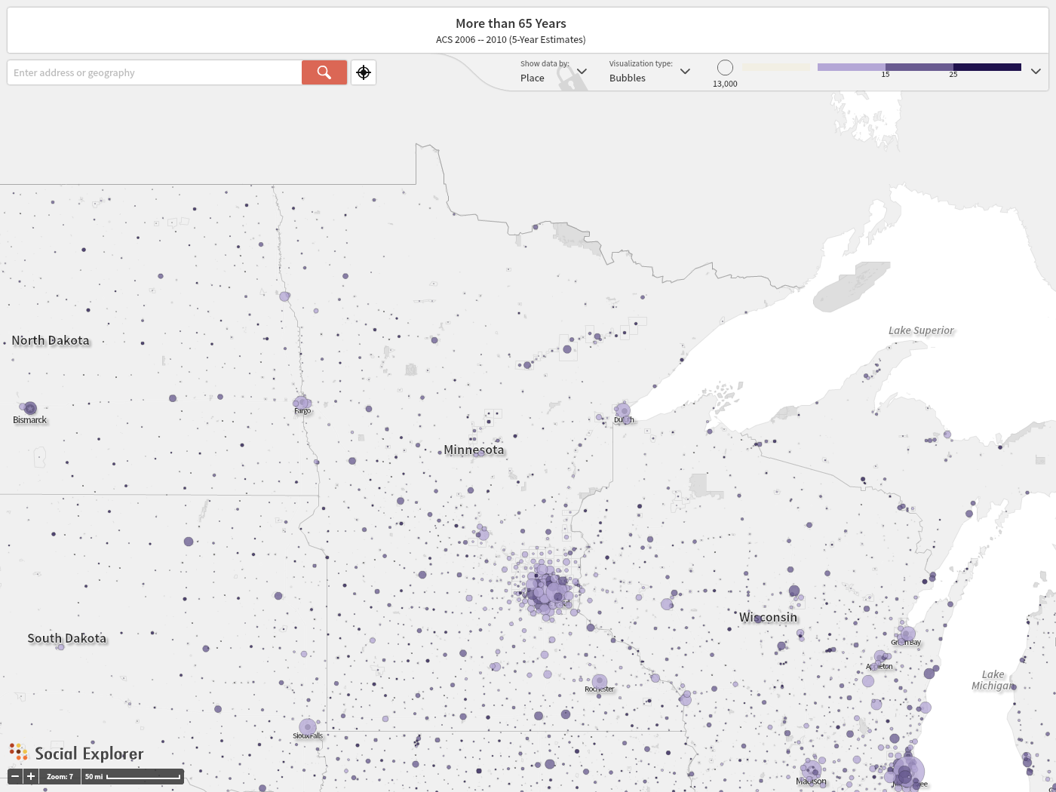

Slide 31
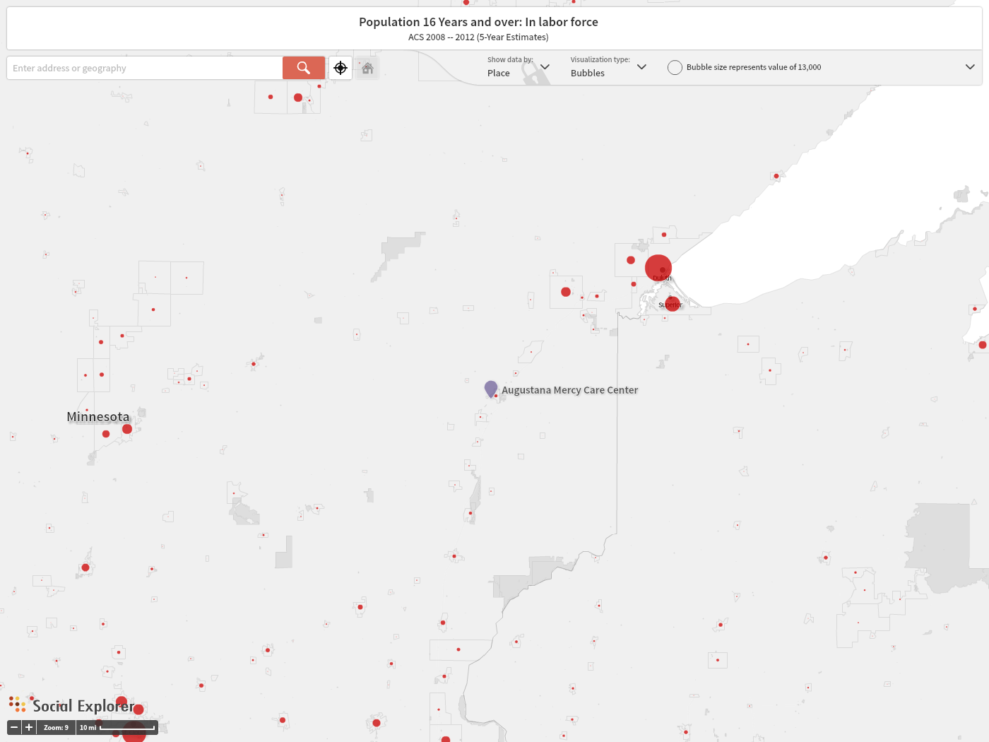

Slide 32
For the first time in MN history: More 65+ than school-age by 2020
Source: U.S. Census Bureau & Minnesota State Demographic Center
Notes:
32
32
Three main budget drivers at the state level school age kids, college age kids, and the older population. Education and Health Care are the largest expenditures in the state budget. By 2020 there will be more older adults in MN than school-age children. This will certainly have an effect on where and how we spend our state money.

Slide 33
mn.gov/demography
Twitter: @MN_StateData

