Slide 1
Medical Assistance in Minnesota
Heather Petermann, Karen Giusto and Diogo Reis| Health Care Administration

Slide 2
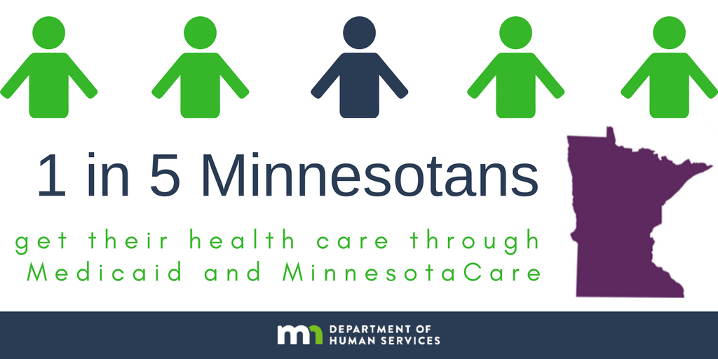
Notes:
Heather

Slide 3
What is Medical Assistance?
Medical Assistance is Minnesota’s Medicaid program, a state and federal program that fully covers a broad array of health care services for children, seniors, people with disabilities and people with low incomes
Established in 1965 along with Medicare
Third largest insurer in Minnesota after self-insured employer-based coverage and Medicare
Covers ...
More than half of all nursing home costs in the state
Nearly half of treatments for substance use disorder
Notes:
Heather

Slide 4
Medical Assistance enrollment
People with disabilities or blindness
Notes:
Heather; Medical Assistance provides health care coverage to more than 1.1 million Minnesotans, including many of our state’s most vulnerable residents. Parents and children are the largest population covered.

Slide 5
Parents and children: a closer look
2017 average monthly enrollment:
486,223 children
164,448 parents
21,270 pregnant women
2017 total spending on services:
Children: $1.7 billion ($289 per member per month)
Parents: $903 million ($458 per member per month)
Pregnant women: $224 million ($877 per member per month)
Notes:
Heather: Here’s a closer look at who makes up the parents and children category

Slide 6
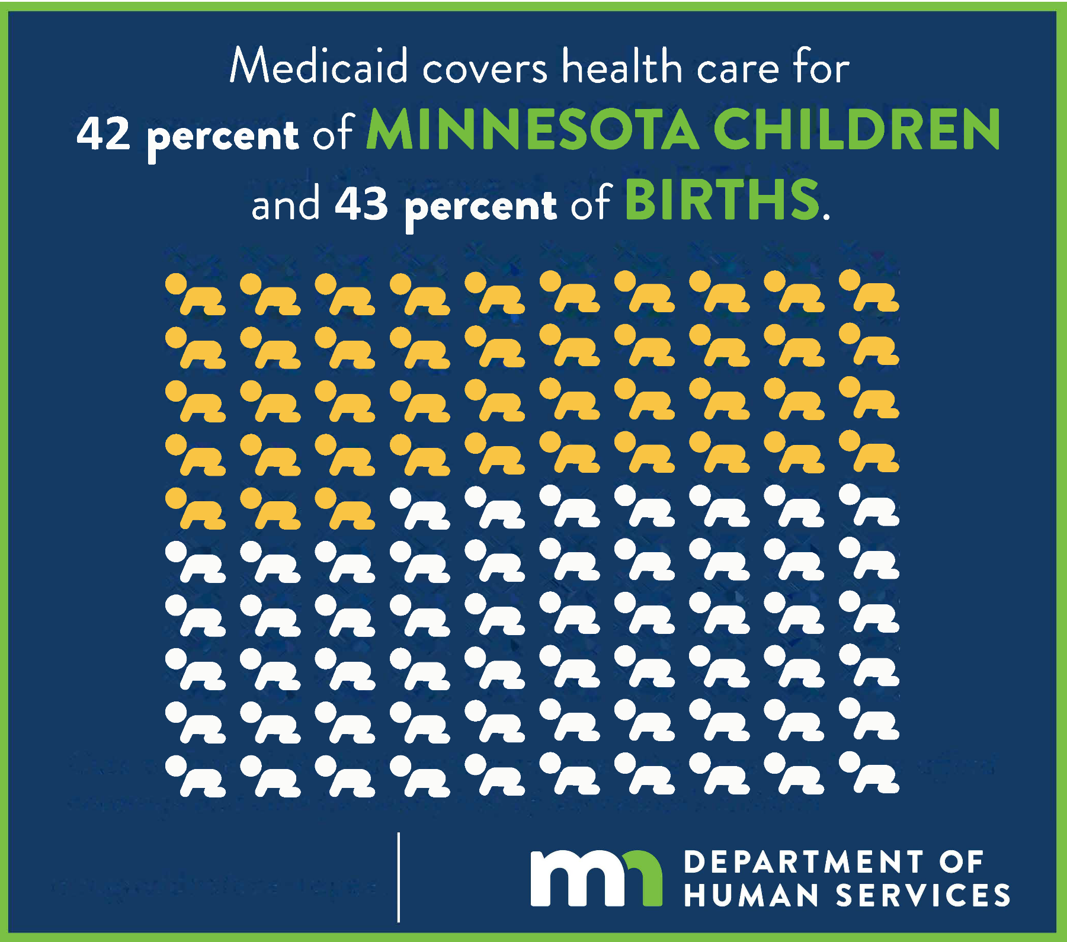
Notes:
Heather:
Children ages 0 to 18 are the single largest group in Minnesota’s Medicaid program making up 45 percent of total enrollment
42 percent of all Minnesotan children are covered by Medicaid on average annually
43 percent of all births are paid for by Medicaid on average annually

Slide 7

Medical Assistance spending in calendar year 2017
Children 0-5 years old
Parents and pregnant women
Maternity care
Total spending: ~$713 million
Total spending ~$1.25 billion
Total spending: ~$154 million
Notes:
Heather
Children 0-5 (212,643) : About $368 million, or 52 percent, was spent on hospital services, which includes inpatient admissions and outpatient facility charges for ambulatory surgeries and other services.
251,871 parents and pregnant women
Maternity 32,746 people

Slide 8
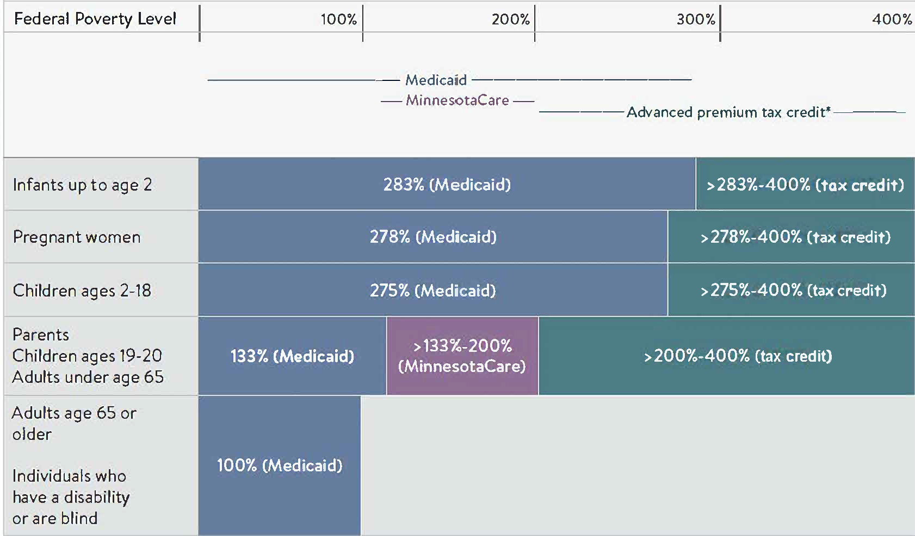
Eligibility
Income standards
Federal poverty guidelines (FPG)
People in household | 100% FPG | 200% FPG | 275% FPG
1 | $12,140 | $24,280 | $33,385
2 | $16,460 | $32,920 | $45,265
3 | $20,780 | $41,560 | $57,145
4 | $25,100 | $50,200 | $69,025
Notes:
KAREN: Program eligibility is determined by factors such as household income, family size, age and disability status. Different income standards exist for the different populations of people. The income standards for kids and pregnant women are much higher than the standards for other populations of people.

Slide 9
Medical Assistance eligibility factors: pregnant women
A woman who is pregnant or within the postpartum period (two months following the month pregnancy ends) may be eligible for Medical Assistance
Income must be at or below 278 percent of federal poverty guidelines (FPG)
$3,813 monthly for a household of two or $45,758 annually
Eligibility continues until the end of the postpartum period, irrespective of any income changes.
Must meet all other Medical Assistance eligibility requirements (e.g., a resident of Minnesota, have a Social Security Number)
There is no asset test
Notes:
KAREN:

Slide 10
Medical Assistance eligibility: infants and children
Newborns: Children born to mothers enrolled in Medical Assistance at the time of their birth have automatic eligibility through 1st year of life as long as the child is a Minnesota resident.
Infants: Children through the month of their 2nd birthday
Household income at or below 283 percent FPG ($3,881 monthly for a family of two or $46,581 annually)
Children ages 2 through 18
Household income at or below 275 percent FPG ($3,772 monthly for a family of two or $45,265 annually)
Children ages 19 and 20
Household Income at or below 133 percent FPG ($1,824 monthly for a family of two or $21,891 annually)
All other Medical Assistance eligibility requirements apply. No asset test.
Notes:
KAREN:
Pregnant women and children may qualify for MA with a spenddown if they have income above the income limits. Spenddowns work like to a deductible, where coverage doesn’t start until you incur a certain amount of medical expenses.

Slide 11
Medical Assistance enrollment process
Application may be made online via the MNsure website at www.mnsure.org or with a paper application and returned to the county, tribal agency or DHS by mail, fax or in person
Application help is available from county or tribal agencies, DHS, the MNsure Contact Center, a navigator, or broker
Once eligibility is determined, applicants receive a notice of the eligibility result
If eligible, new members receive a welcome packet and Minnesota Health Care Programs ID card and select a managed care plan
Notes:
KAREN:

Slide 12

About 75 percent of people enrolled in public health care programs are served by managed care organizations
Notes:
KAREN:
Once enrolled, most Minnesotans who use public health care programs receive services through the state’s contracted managed care organizations, which include both health maintenance organizations and county-based purchasing plans. 75 percent of public health care programs members receive services through a managed care organization. The remaining 25 percent receive services through the traditional fee-for-service system, where providers receive a payment from DHS directly for each service provided to a member.
Federal funding loss grows to $8 billion annually by 2030

Slide 13
Covered services for children under 21
Mandatory benefits | Optional benefits
Inpatient hospital | Prescription drugs
Outpatient hospital | Eyeglasses
Early Periodic Screening Diagnosis and Treatment | Dental services
Lab and X-ray | Chiropractic services
Transportation | Hospice
Physician services | Optometry services
Notes:
Diogo

Slide 14

Early Periodic Screening Diagnosis and Treatment
Child and Teen Checkups
Well child visits
Outreach to children and families
Training with providers
Notes:
Diogo

Slide 15

Doulas
Covered services: up to seven sessions of childbirth education and support services, which include emotional and physical support provided before, during and after childbirth.
Notes:
Diogo
Doulas provide guidance and physical and emotional support to pregnant women.
Eligible providers are registered with MDH and certified by one of the required professional organizations. Doulas must also be under the supervision of physician, nurse practitioner or certified mid-wife.
Covered services are limited to childbirth education and support services, which include emotional and physical support provided before childbirth, labor and delivery, and postpartum. Up to seven session are covered, including one for labor and delivery. The remaining six sessions may be used in the antepartum and postpartum periods as needed.

Slide 16


Community Health Workers
Trained health educators who have completed a specific curriculum
Provide diagnosis-related education, such as:
Chronic disease management
Diabetes prevention
Oral health care
Notes:
Diogo
Community Health Workers are trained health educators who have completed a specific curriculum

Slide 17

Dental services
Medical Assistance covers comprehensive dental benefits for children
In 2016 and 2017, less than 40 percent of kids received any dental service
Notes:
Diogo
Approximately 650,000 kids are enrolled in Medical Assistance
Medical Assistance covers comprehensive dental benefits for children
In 2016 and 2017, less than 40% of kids receive any dental service

Slide 18

Individualized Education Program (IEP)
Services Include:
Physical therapy
Occupational therapy
Speech and audiology
Mental health
Assistive technology
Special transportation
Interpreters
Nursing
Personal care assistant
Notes:
Diogo
Medicaid pays for medical services provided by schools for kids with IEPs

Slide 19

The big picture
Notes:
Diogo
Health care services are important to children’s health but just one of many facets that affect it. Family risk factors and social determinants of health include poverty, serious mental illnesses, substance use disorder diagnoses, homelessness, complex chronic medical condition in children.
Wraparound services to address family risk factors and social determinants of health.

Slide 20
Thank you!

