Slide 1
AURI Overview
January 29, 2019
Agriculture and Food Finance and Policy Division

Slide 2
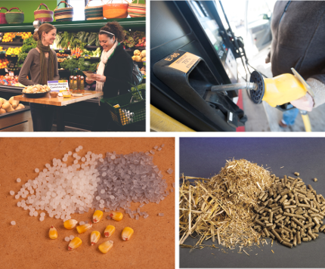
About AURI
The MN Legislature created AURI to help discover new uses and new markets for agricultural commodities.
AURI’s mission is to foster long-term economic benefit through value-added agricultural products.
AURI’s vision is to empower the commercialization of innovative value-added food and agricultural ideas.

Slide 3
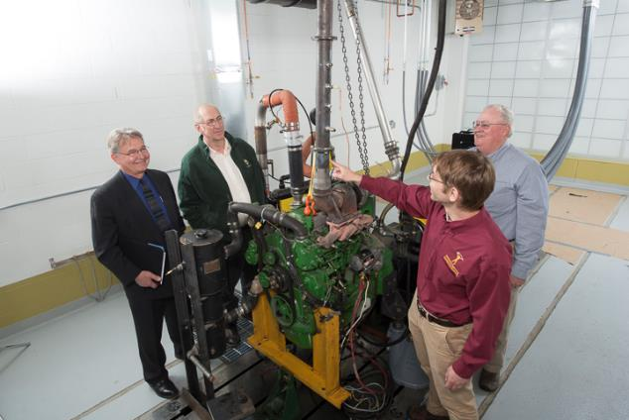
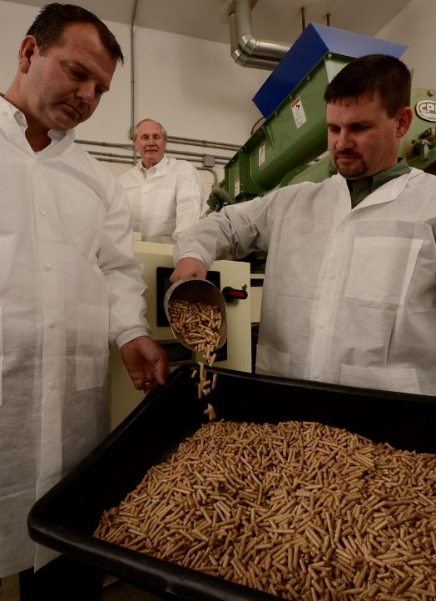
About AURI
AURI provides a unique set of services for Minnesota farmers, processors and entrepreneurs to help create new demand opportunities and commodity utilization.
    Access to subject matter experts
    Hands-on scientific assistance
    Access to laboratory space and equipment
    Commercialization services
    Networking and thought leader platforms

Slide 4
AURI’s Relationship with the Legislature
AURI created by Statute in 1987
  Chapter 386-S.F. No. 1; Sec 9 Subd 1
  “The corporation shall establish an agricultural utilization research institute to promote the establishment of new products and product uses and the expansion of existing markets for the state's agricultural commodities and products.”
Chapter 116V.01 is the guiding statute language
Two Board of Directors seats reserved for legislators
  One seat for the chair of the senate committee with jurisdiction over agricultural finance or the chair’s designee.
  One seat for the chair of the house of representatives standing committee with jurisdiction over agriculture finance or the chair's designee.

Slide 5
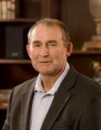
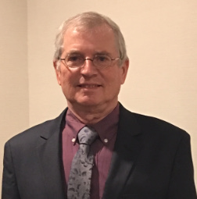
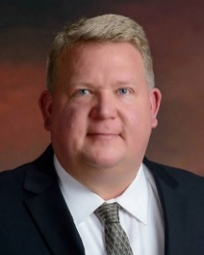
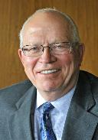
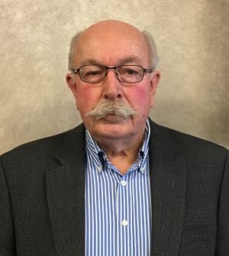
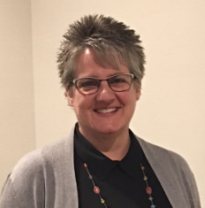

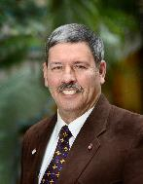
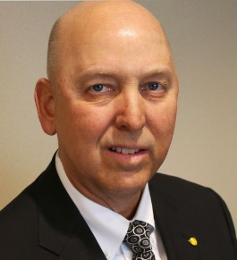
Board of Directors
AURI’s Board consists of farmers, agribusiness representatives and MN legislators
These agricultural leaders guide AURI’s efforts
New at large positions
Ron Obermoller
Minnesota Soybean
Ken Asp
Minnesota Wheat
Rich Draheim
Minnesota Senate
Jerry Hasnedl
Minnesota Farmers Union
Larry Johnson
Agribusiness
1 in 2019*
1 in 2020*
Carolyn Olson
Minnesota Farm Bureau
Jeanne Poppe
Minnesota House of Representatives
John Schafer
Minnesota Beef Council
Jon Veldhouse
Agribusiness Cargill
At Large

Slide 6

Statewide Locations
Crookston
Microbiology lab
Minneapolis and
St. Paul
Client consultation facilities
Marshall
Meat and Food lab
Biobased and Renewable Energy lab
Waseca
Coproducts lab

Slide 7

AURI Focus Areas
Biobased
Products
Coproducts
Food
Renewable
Energy

Slide 8
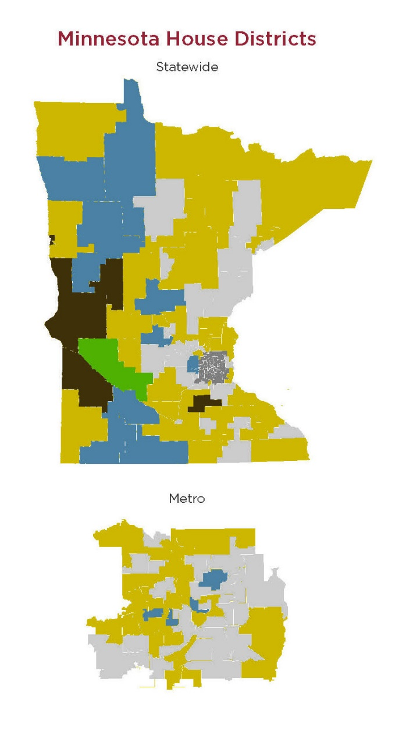
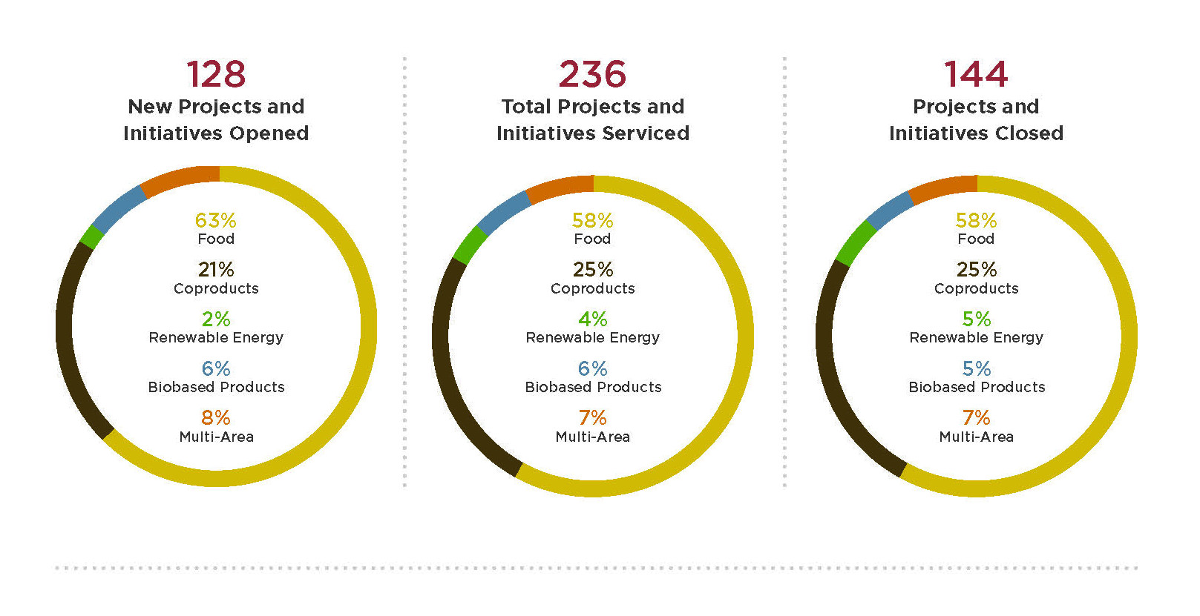
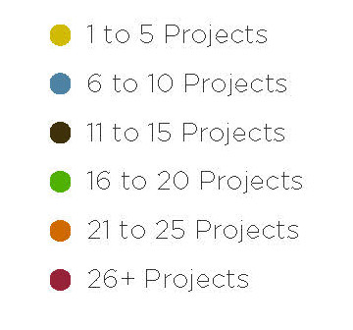
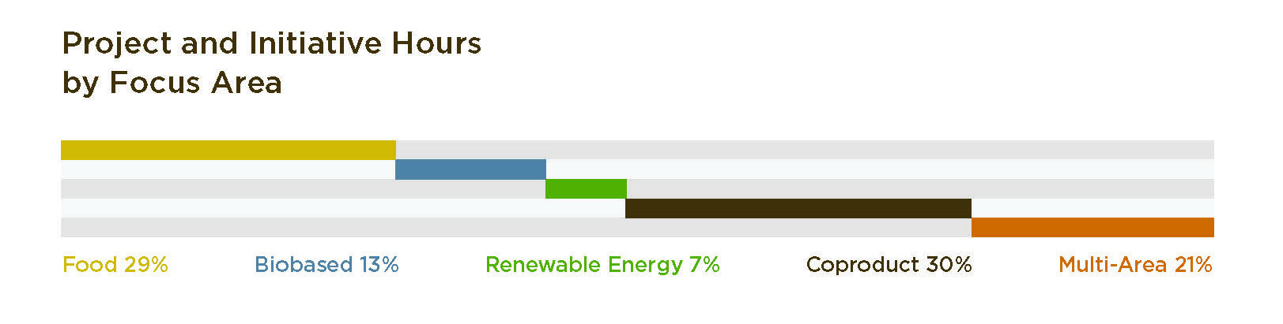
Statewide Project Overview
FY2011-2018
FY2018

Slide 9

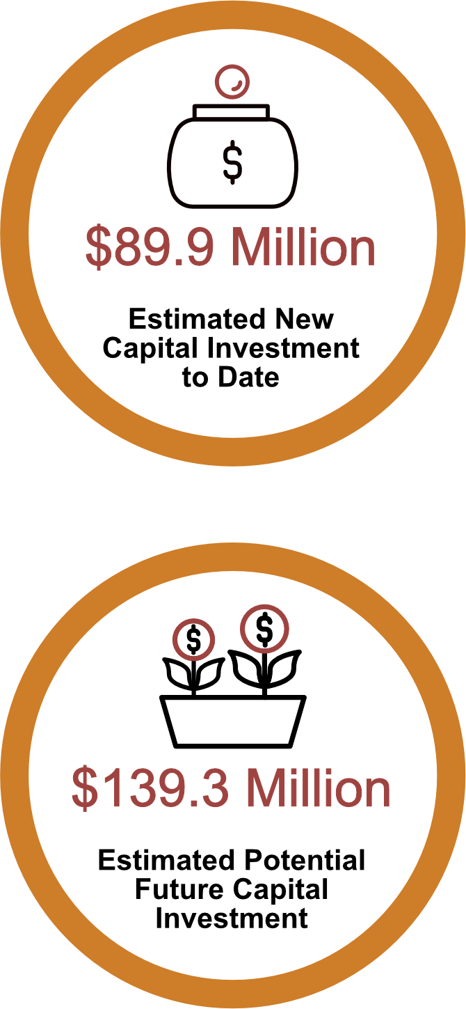

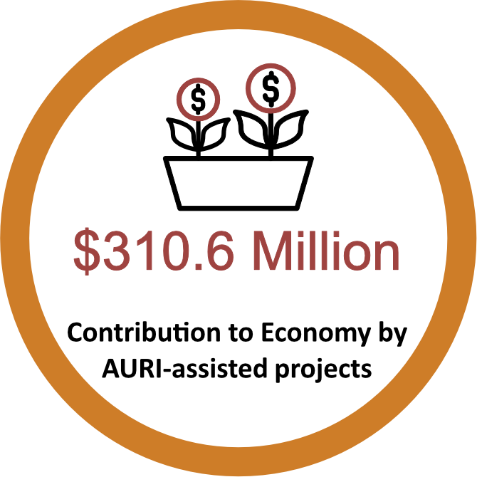
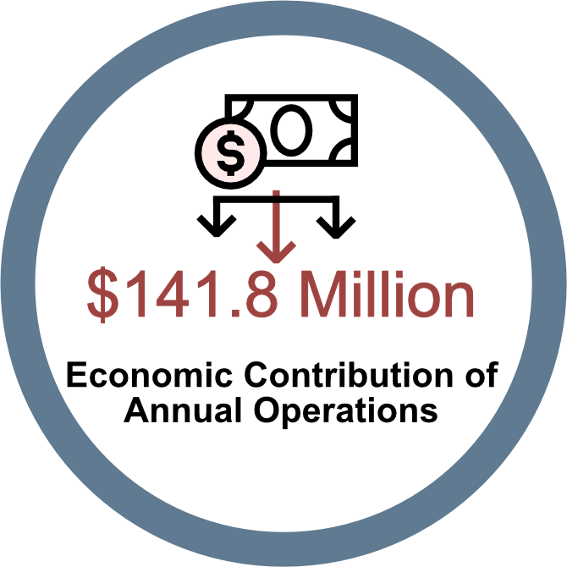
Statewide Economic Impact
Economic Contribution of Projects Leveraged with AURI Assistance: Fiscal Years 2011-2017, U of MN Extension

Slide 10
FY2018 Financial Statement

Slide 11
AURI Program Areas
Five major program areas
Initiatives
Ag Innovation Partnership
Innovation Network Program
Entrepreneur in Residence
Commercialization Services

Slide 12

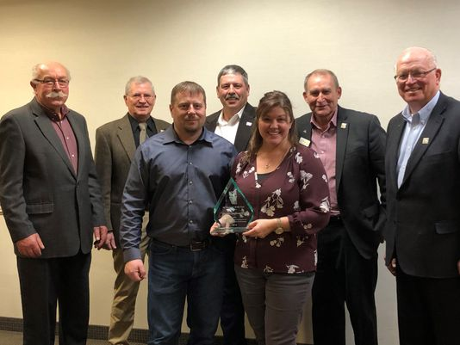
AURI Commercialization Service and Initiatives Examples

Slide 13
AURI Innovation Network Program

Slide 14
Public Initiatives & Innovation Networks Examples
Biobased Road Sealant
New Uses Forum
Industry Thought Leaders
Minnesota Renewable Energy Roundtable
High Oleic Oil Demonstrations
Forever Green Initiative
Hemp Value Chain
School Lunch Initiative
Food Safety / Process Authority
Value Added Meat Products

Slide 15
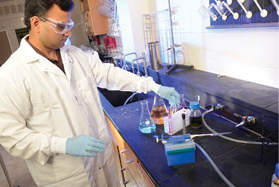
AURI Entrepreneur in Residence and Ag Innovation Partnership

Slide 16
Legislative Update
Bonding Award Progress
Marshall - sensory lab at SMSU underway along with lab safety updates
Waseca – working on square footage expansion and equipment needs
2016 OLA Report Recommendations
Nine major recommendations
Since 2016 each suggestion has been partially or fully implemented

Slide 17





AURI Collaborators

Slide 18
To Learn More About AURI
Visit us online at: auri.org
Download our Annual Reports at: auri.org/annualreports
Call: 218.281.7600
Email: sschlecht@auri.org or dskogen@auri.org

