Slide 1
HIV in Minnesota: Challenges and Opportunities
Kristen Ehresmann
Infectious Disease Epidemiology Prevention and Control Division

Slide 2
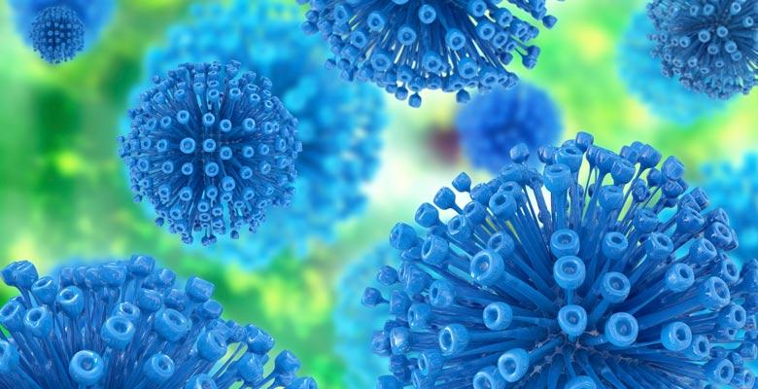
Human Immunodeficiency Virus (HIV)
Human immunodeficiency virus (HIV) is the virus that causes acquired immune deficiency syndrome (AIDS)
HIV is transmitted via:
Anal and vaginal sex
Sharing injection drug equipment
Pregnancy, childbirth or breast feeding

Slide 3
New HIV Diagnoses, Deaths and Prevalent Cases by Year, 1996-2017
Number of Persons Living w/ HIV/AIDS
Notes:
Since 1996, the number of new diagnoses has remained relatively stable in Minnesota at around 300 cases per year. During this same time, deaths among HIV positive people in Minnesota has decreased dramatically. As people with HIV are living longer and healthier lives, the number of people living with HIV in Minnesota continues to grow as seen in the Red line here. At the end of 2017, 8,789 people were estimated to be living with HIV or AIDS in Minnesota.
This number does not include about 1400 persons who were first reported with HIV or AIDs in Minnesota and subsequently moved out of the state. Although it does include about 2000 persons who were first reported with HIV or AIDS elsewhere and subsequently moved to Minnesota.

Slide 4
Living HIV/AIDS Cases by County of Residence, 2017
City of Minneapolis – 3,145
City of Saint Paul – 1,158
Suburban Metro* – 3,007
Greater Minnesota – 1,464
Total number = 8,774
(15 people missing residence information)
*7-county metro area excluding the cities of Minneapolis and Saint Paul
Notes:
The majority (83%) of prevalent cases reside in the seven-county metropolitan area surrounding the Twin Cities of Minneapolis and St. Paul (Hennepin, Ramsey, Anoka, Carver, Dakota, Scott, and Washington counties). Although HIV infection is more common in communities with higher population densities and greater poverty, there are people living with HIV or AIDS in 95% of counties in Minnesota.

Slide 5
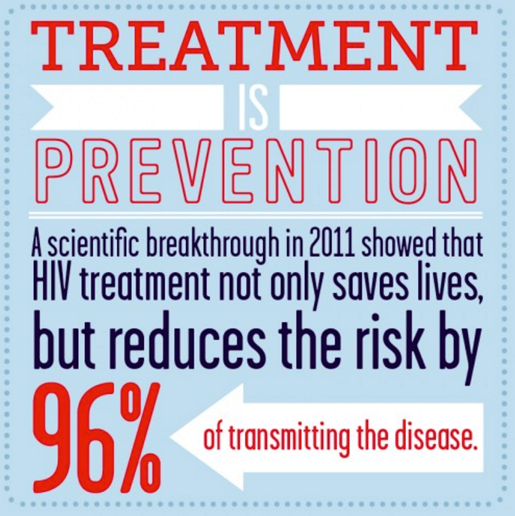
Tools to End the HIV epidemic
Treating HIV prevents new infections from occurring and is known as “treatment as prevention.”
Antiretroviral therapy (ART) decreases the amount of virus in the bodies of people living with HIV to undetectable levels.
Pre-exposure prophylaxis (PrEP) is a daily pill taken by people who do not have HIV in order to prevent infection.
If an HIV negative person is exposed to HIV, they can take post-exposure prophylaxis (PEP) to reduce their risk of infection.

Slide 6
HIV-related Health Disparities
The populations in Minnesota hardest hit by HIV are:
Gay, bisexual and other men who have sex with men (MSM)
Injection drug users (IDU), including MSM who inject drugs (MSM/IDU)
Populations of color and American Indians
Transgender people

Slide 7
HIV Continuum of Care in Minnesota 2017
Undiagnosed 1000
100%
Diagnosed in 2016
Total 9580
82%
73%
64%
88% of retained †
8580
8580
241/293
6243/8580
5508/8580
People living with diagnosed and undiagnosed HIV ª
People living with diagnosed HIV (PLWH) ^{b}
Linked to Care ^{c}
Retained in Care ^{d}
Virally Suppressed ^{e}

Slide 8
How will we get there?
The Minnesota HIV Strategy (the Strategy) is a legislatively mandated plan signed into law May 20, 2017
The law requires the Commissioner of Health, in coordination with the Commissioner of Human Services and in consultation with community stakeholders, to develop a strategic statewide comprehensive plan to end HIV/AIDS in Minnesota.
​The 2017 legislation coincided with work on a statewide HIV strategy already started by MDH and DHS in August of 2016.

Slide 9
Vision of the Minnesota HIV Strategy ​By 2025, Minnesota will be a state where new HIV diagnoses are rare and all people living with HIV and those at high risk of HIV infection will have access to high quality health care and resources they need to live long healthy lives, free from stigma and discrimination.

Slide 10
Prevent new HIV infection

Slide 11
Reduce HIV-related health disparities and promote health equity

Slide 12
Increase retention in care for people living with HIV

Slide 13
Ensure stable housing for people living with HIV and at risk of HIV infection

Slide 14
Achieve a more coordinated statewide response to HIV

Slide 15
Increase the percentage of people living with HIV who know their serostatus to 90 percent by 2025

Slide 16
Increase the percentage of people with diagnosed HIV infection who are retained in care to at least 90 percent by 2025

Slide 17
Increase the percentage of people with diagnosed HIV infection who are virally suppressed to at least 80 percent by 2025

Slide 18
Decrease the annual number of new HIV diagnoses by 25 percent by 2025

Slide 19
In Summary
HIV is still a significant health problem in MN
There are populations experiencing disparities
There has been a legislative mandate to develop a statewide comprehensive plan
Implementing this plan is the pathway to reaching no new HIV diagnoses in MN

Slide 20
Questions?
Kristen Ehresmann
Kristen.Ehresmann@state.mn.us

