Slide 1
Adverse Health Events
Diane Rydrych: Division Director, Health Policy
March 8, 2018

Slide 2
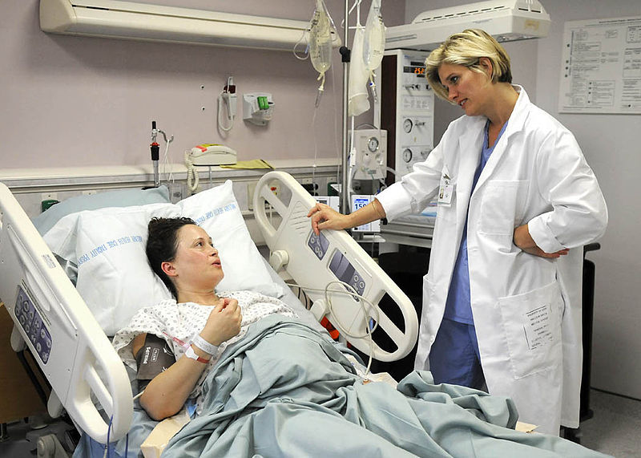
Minnesota Adverse Health Care Events Reporting Act: M.S. 144.706
Nation-leading program established in 2003
Hospitals (except federal) and licensed surgery centers
Funded by per-facility and per-bed fees
Separate from MDH regulatory function
Annual report each February
Facility-specific
Events by category, outcome of each event (no additional detail)
Analysis of trends

Slide 3
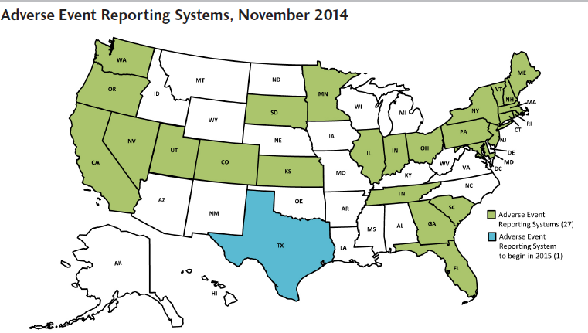
AHE Reporting Nationwide

Slide 4
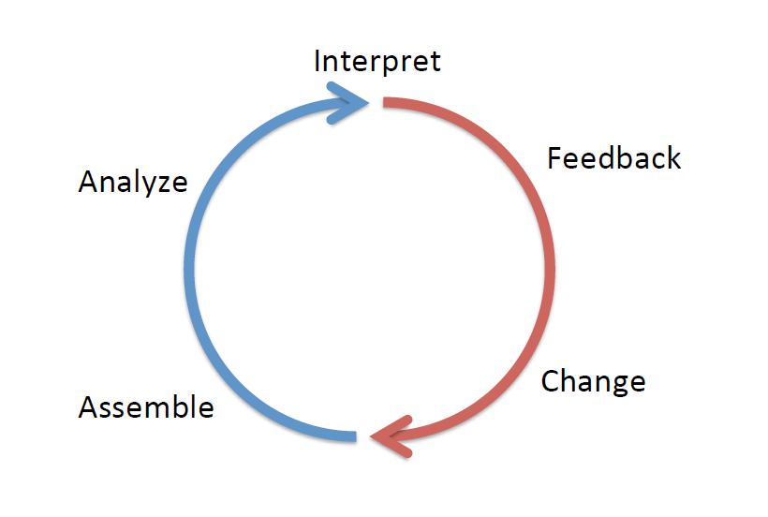
Goals of the law
Not to punish errors by doctors, nurses, or other healthcare providers
Instead…
To hold organizations publicly accountable for addressing problems
To increase transparency and openness about safety
To learn as much as we can about how to prevent these events.
To share that learning with organizations, so they can strengthen their processes

Slide 5
Examples of reportable events (from list of 29 Serious Reportable Events created by the National Quality Forum)
Surgical/Invasive Procedure Events
Wrong surgery
Surgery on wrong body part
Retention of foreign object
Product or Device
Contaminated drugs or blood
Air embolism
Potentially Criminal Events
Abduction
Sexual assault
Physical assault
Care Management
Medication error
Maternal and/or neonatal death
Stage 3, 4 or unstageable pressure ulcers
Serious falls
Environmental Events
Death from electric shock
Wrong gas delivered
Serious burns
Patient Protection
Patient elopement
Suicide/attempted suicide/self harm

Slide 6
How does the system work?
Secure, web-based registry
Team review of all RCA/CAP info
TA/coaching offered to facilities as needed
Focus on learning and quality improvement
Trends
Safety alerts
Existing MDH regulatory responsibilities still in place

Slide 7
What must be reported?
Time, location, injury
Root Cause Analysis findings
Corrective action plan & measurement strategy
Other event-specific questions
Falls
Pressure Ulcers
Surgical Events

Slide 8
Protection of Data
Adverse events do not constitute abuse/ neglect/maltreatment under the MN Vulnerable Adults Act *if* reported timely
Data classified as nonpublic: reporting facility is the subject.
System does not collect information about individual providers or patients
Facilities can provide data to MDH without violating peer review protection

Slide 9
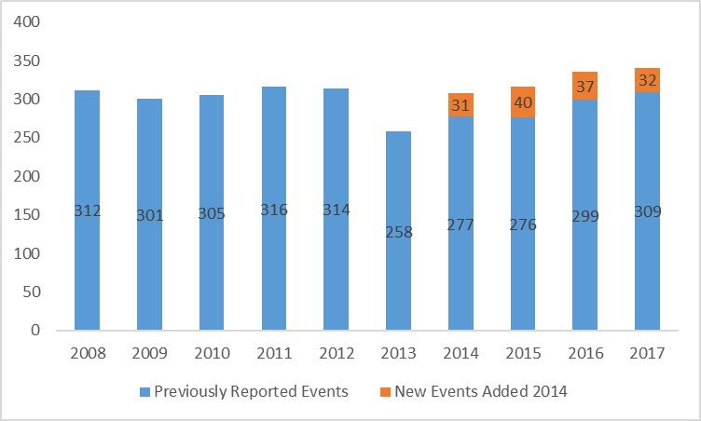
Reported Events 2008-2017

Slide 10
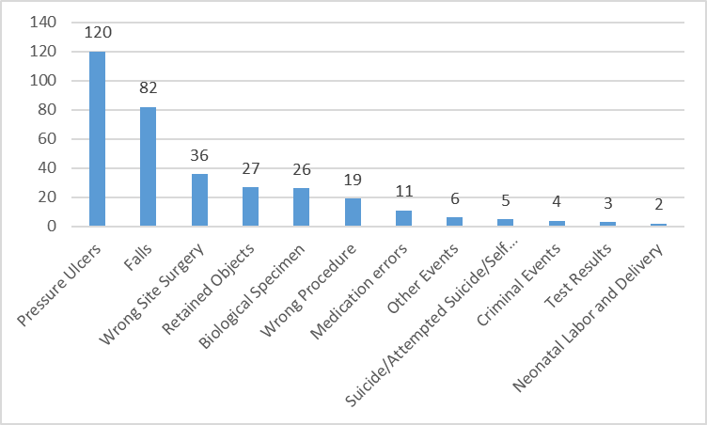
Reported events by category 2017

Slide 11
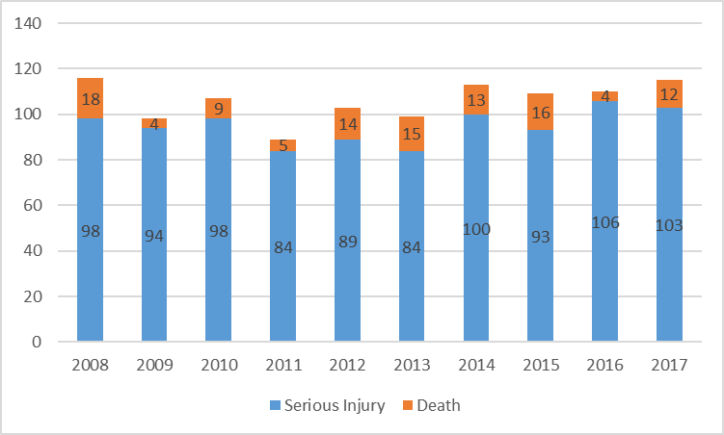
Harm from adverse events 2008-2017
Notes:
Most often, injury/death is associated with falls.

Slide 12
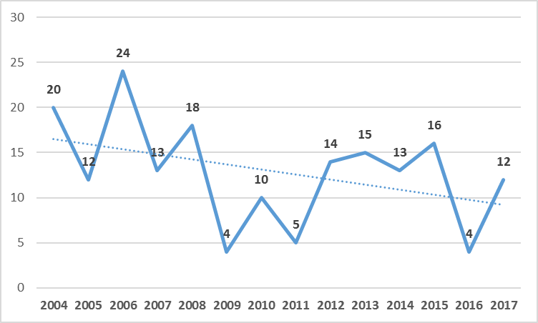
Adverse event related deaths 2003-2017

Slide 13
Common root cause analyses
Pressure Ulcers
Failure of staff to reposition a patient who was physically unable to reposition themselves
Lack of standard skin inspection process around respiratory equipment led to breakdown under tracheostomy tube
Patient’s high risk status not communicated to oncoming staff
Falls
Incomplete hand-off of patient’s fall risk status
Failure of staff to follow fall prevention plan (e.g. allowing patient to ambulate unassisted)
Patient not screened for fall risk upon admission
Notes:
Also – ED rooms not equipped with fall prevention equipment in same was as inpatient units.

Slide 14
Common root cause analyses, continued...
Retention of Foreign Object
Inadequate counting process for sponges used during surgery
Surgeon did not communicate ‘tucked item’ status to staff caring for patient after surgery
Instrument not intact upon removal-lack of process to verify intactness of instruments
Wrong Site Surgery/Invasive Procedure
Process not followed for surgeon to mark the site
Process not followed to visualize a site mark during the Time Out
Process not followed for confirming procedure with source documents during the Time Out

Slide 15
Resources and Tools: Data sharing database
“Data Sharing Database” of events
Annual case study surveys to increase awareness of reporting requirements
Safety alerts
Learning collaboratives/workgroups
Recent Safety Alerts
Epinephrine medication errors on the rise
Ensuring patients are not discharged from ED prior to review of test results
Accountability for objects used during gynecological procedures
Implant verification
Spine level localization

Slide 16
Lessons Learned
Need senior leadership on board with allocation of time and resources for their staff
Much of this work is culture change, which does not happen quickly. It takes dedication, patience, consistency and accountability
As we fix one “issue” another “issue” comes up
Ex. Doing better at retained objects but now seeing more wrong-site surgery
Transparency is good. But transparency that leads to improvement is better.
“Preventability” is a moving target.
We are still learning about these events. But we have to guard against complacency.

Slide 17
Questions and Answers
www.health.state.mn.us/patientsafety
Diane Rydrych
Minnesota Department of Health
Diane.rydrych@state.mn.us

