Slide 1
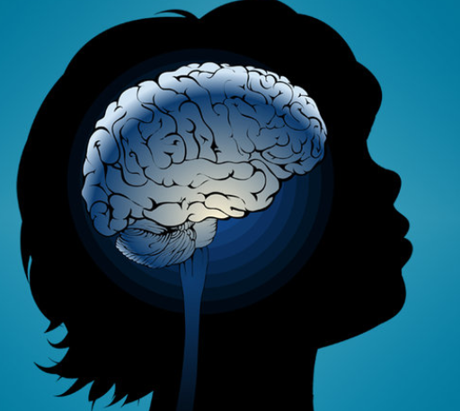

The development of brain architecture:
The importance of the first years of life
Megan R. Gunnar, PhD
Regents Professor and Distinguished McKnight University Professor
Director, Institute of Child Development
January 15, 2019
College of Education and Human Development

Slide 2

The foundation of a successful society is built in early childhood
Strong Communities
Healthy Economy
Successful Parenting of Next Generation
Educational Achievement
Economic Productivity
Responsible Citizenship
Lifelong Health
Healthy Child Development
College of Education and Human Development
Notes:
The overarching message from the science you’re about to see is very simple: how children develop early in life matters later for all of us, because it forms the foundation of a prosperous and successful society.
Why? Recent advances in neuroscience, molecular biology, genomics, the behavioral and social sciences, and hard economic analysis of human capital development all point to one conclusion: healthy development in the early years means children will be more successful in school, and as adults they will be more productive contributors to the economy, more responsible participants their communities, and they will lead healthier, longer lives.
All of that means that when they are adults, the communities they live in will be stronger, the economy they participate in will be healthier, and they will be better parents of the next generation of children. That is the foundation of a successful society. And it’s all based on the early development of children’s brains and bodies,

Slide 3
Take home: Like building a house
Conception through the few years lays down the foundation of brain architecture.
Like a house, if the foundation is weak, it threatens all that is built afterward.
There are no do-overs in development (compensation, work-arounds).
Best and most cost effective to get it right the first time.
College of Education and Human Development
College of Education and Human Development

Slide 4
Experience shapes brain architecture
Circuit
Cellular
Neurochemical
Molecular/Genetic
College of Education and Human Development

Slide 5
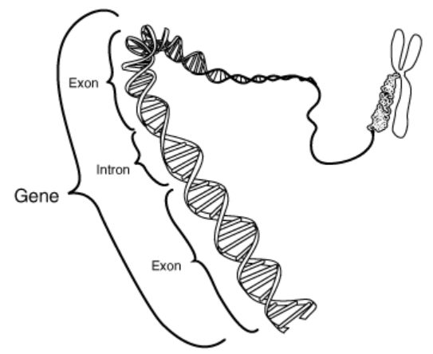
Building healthy brain architecture – the ingredients
Takes more than having the right genes
Takes the right, supportive experiences
Experience literally writes on our genes, determining how our genes work
Chromosome
DNA
College of Education and Human Development

Slide 6
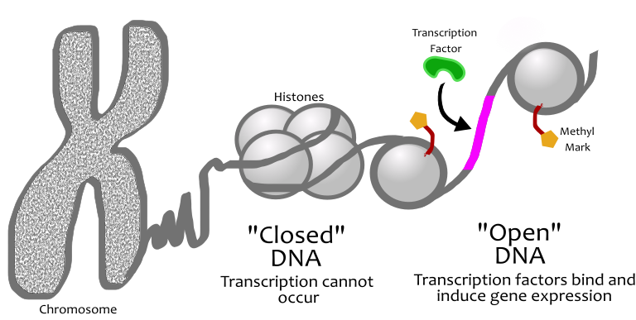
Epigenetics
College of Education and Human Development
College of Education and Human Development

Slide 7
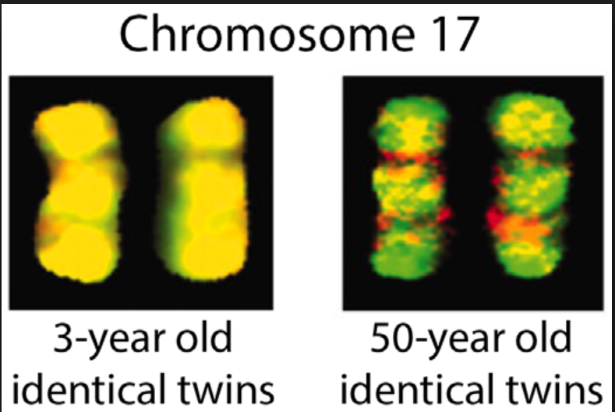
Yellow color same methylation
(pattern of gene regulation)
College of Education and Human Development

Slide 8



Two studies
Babies and mothers
in Child Protection Service
Mother reared
vs.
Peer reared
College of Education and Human Development

Slide 9
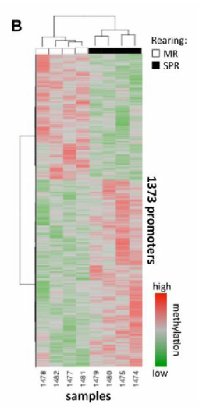
Early adversity and DNA methylation
Monkeys reared with and without their moms
Piece of the Prefrontal Cortex helps you control and guide your behavior
Red=more methylated
Green=less methylated
Each row is a different gene; columns are different animals
Provencal et al., 2012
College of Education and Human Development

Slide 10
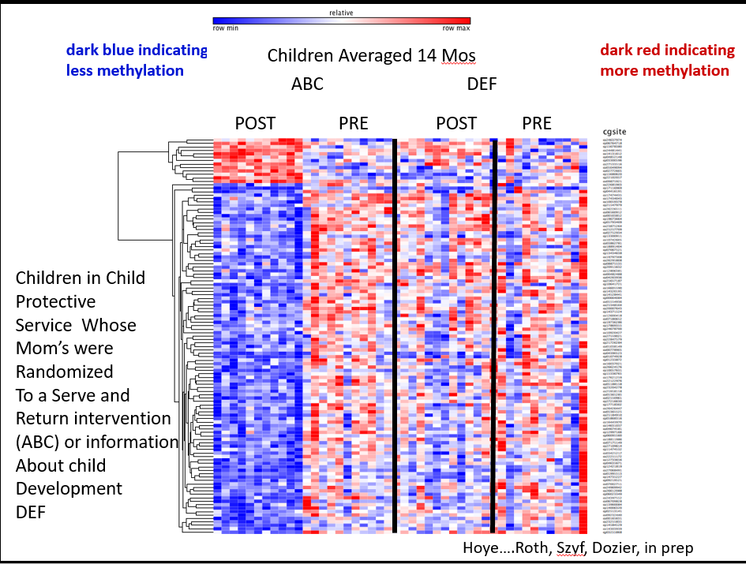
College of Education and Human Development

Slide 11
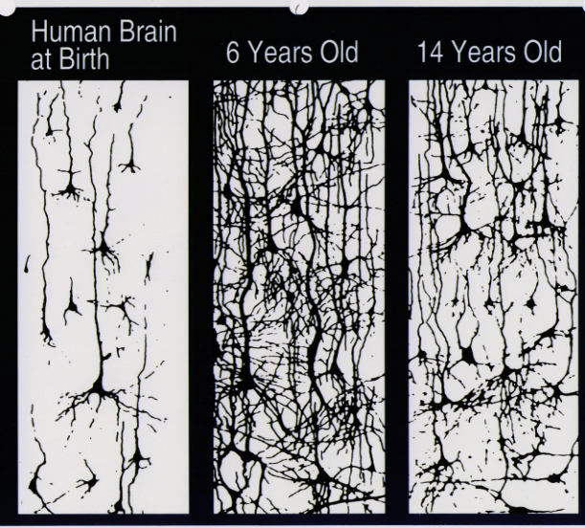
Experience shapes brain architecture by over-production followed by pruning
(700 synapses formed per second in the early years)
birth 6 years 14 years
College of Education and Human Development
Notes:
700 synapses formed per second
As you can see, during childhood and adolescence these neural connections are reduced through experience (which is necessary; even if our entire hereditary makeup were devoted . . . ).
This helps to ensure that the neural connections that are most useful to the developing mind are retained. “Use it or lose it.”
But this is a double-edged sword. On the one hand, positive, healthy, growth-promoting experiences help to develop brains that are efficient and sophisticated (language, sight, movement in gravity). But for some young children, their developing brains are incorporating experiences that are abusive or profoundly neglectful, and these alter the brain’s processing sometimes for life (Seth Pollock’s work on sensitivity to anger expressions). These influences begin early, even prenatally.

Slide 12
Neural circuits are wired in a
bottom-up sequence
Language
Sensory Pathways
(Vision, Hearing)
Higher Cognitive Function
FIRST YEARS
-8 -7 -6 -5 -4 -3 -2 -1 1 2 3 4 5 6 7 8 9 10 11 1 2 3 4 5 6 7 8 9 10 11 12 13 14 15 16 17 18 19
Birth
(Months)
(Years)
Source: C.A. Nelson (2000)
College of Education and Human Development
Notes:
Use this to build the argument that brains are built from the bottom up that earlier developing abilities impact later developing abilities and that the first years of life are critical

Slide 13
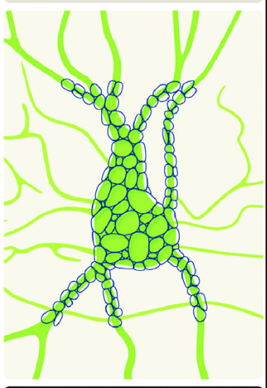
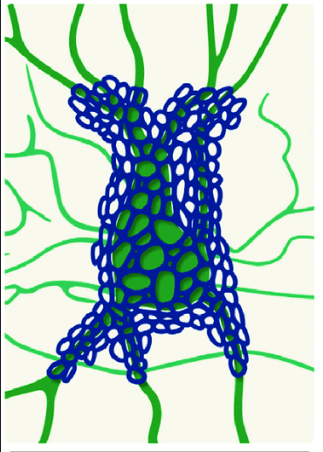

Sensitive periods: Times when different brain functions are established
Chemical
triggers
open the
sensitive
period
Development
Perineuronal nets
College of Education and Human Development
College of Education and Human Development
Notes:
Gabaergic neurons (inhibitory interneurons) that express parvalbumin.

Slide 14
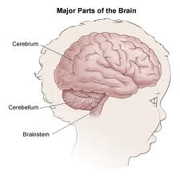

Stimulation is needed
in order for the brain
to develop
Human infant is unable to provide
itself adequate stimulation for normal
brain development
College of Education and Human Development
Notes:
Human brain requires experience in order to develop
Human infant is among the most helpless of mammals. Cannot supply even the most rudimentary types of experiences for many months; indeed, cannot survive on its own for many years

Slide 15
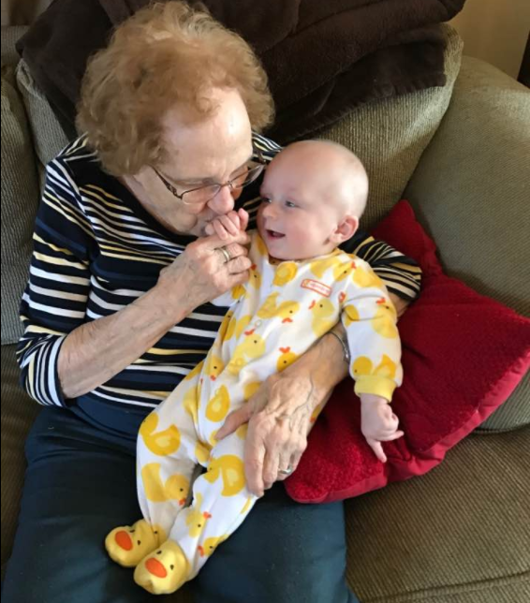

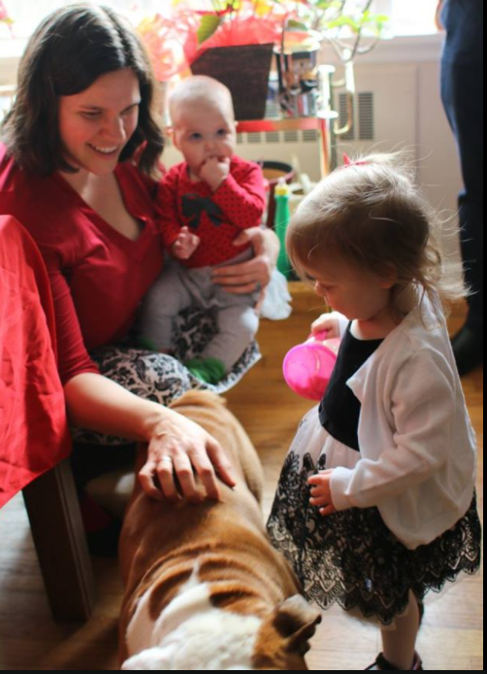


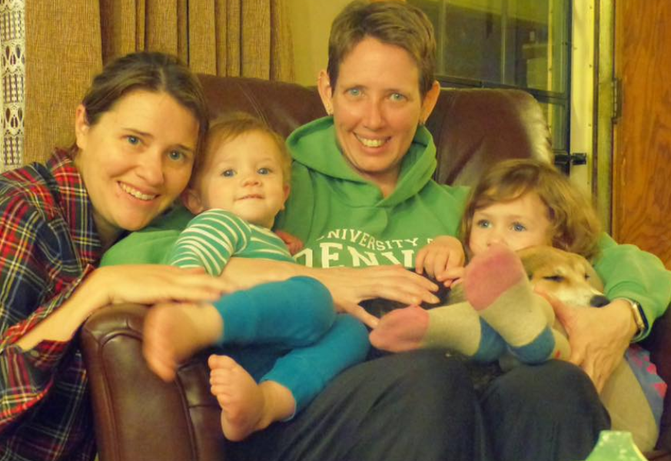
The brain develops in the context of relationships
College of Education and Human Development

Slide 16

“Serve and Return” or “Call and Response”
College of Education and Human Development
Notes:
Human brain requires experience in order to develop
Human infant is among the most helpless of mammals. Cannot supply even the most rudimentary types of experiences for many months; indeed, cannot survive on its own for many years

Slide 17
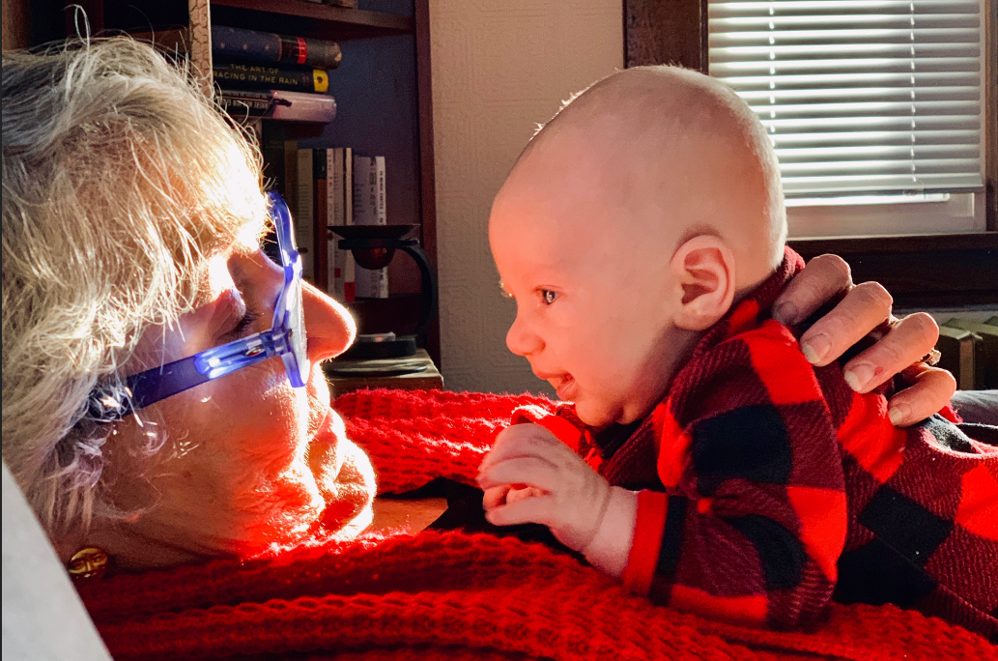
What ‘Serve and Return’ provides
Interesting things to think about and do
Communication rich environment
Warm not harsh or not frightening interactions
College of Education and Human Development

Slide 18
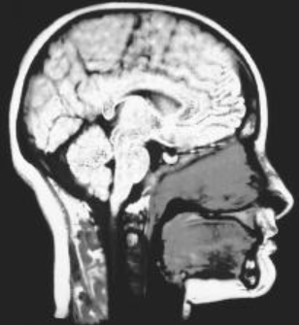
‘Serve and Return’ and Brain Development
Better
Worse
Brain Development
Age 8
Serve and Return Care
Age 3 years
Family Stress Exposure
Age 3 Years
Luby et al., 2013, JAMA
College of Education and Human Development

Slide 19
Three levels of stress
Positive
Brief increases in heart rate,
mild elevations in stress hormone levels.
Tolerable
Serious, temporary stress responses,
buffered by supportive relationships.
Toxic
Prolonged activation of stress response systems
in the absence of protective relationships.
College of Education and Human Development
Notes:
19
We all know that stress is a part of life. Learning how to cope with stress is an important part of a child’s healthy development, whether it’s the stress of meeting new people, learning to walk, or dealing with problems.
There is a range of physiological responses to stress, which most of us are familiar with: increased heart rate and fluctuations in stress hormone levels, such as cortisol. When stress occurs to a young child within an environment of supportive relationships with adults, these physiological effects are buffered and brought back down to baseline. The result is a healthy stress response system.
For larger stressors -- such as the death or serious illness of a loved one, a frightening injury, the divorce of one’s parents, or a natural disaster -- these physiological responses are sustained for a longer period of time.
But still, the buffering effects of supportive adult relationships allow the brain to recover from what might otherwise be damaging effects.
It’s when situations of extreme stress are prolonged and unrelenting, in the absence of supportive adults, that a child is affected by toxic stress. These situations can include extreme poverty, physical or emotional abuse, chronic neglect, severe maternal depression, substance abuse, or family violence. Without the support of a caring network of adults, toxic stress can disrupt brain architecture and lead to stress management systems that respond at relatively lower thresholds, thereby increasing the risk of stress-related physical and mental illness.

Slide 20
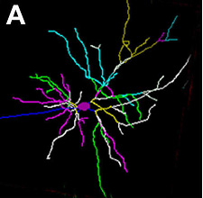
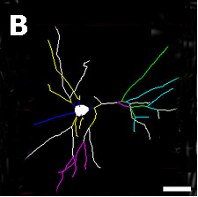
Toxic stress changes brain architecture
Normal
Typical neuron— many connections
Toxic
stress
Damaged neuron— fewer connections
Sources: Radley et al. (2004)
Bock et al. (2005)
Prefrontal Cortex and
Hippocampus
College of Education and Human Development
Notes:
Brain architecture is created by the formation of connections between neurons as a result of interactions with one’s environment, and then the pruning of connections that aren’t used. Neural connections in different areas of the brain are responsible for different kinds of activities. For example, the prefrontal cortex and hippocampus house activities related to memory and decision-making (executive function). As you can see from these depictions of neurons, brains subjected to chronic stress have underdeveloped connections in the areas of the brain most critical for success in school, work, and behavior.

Slide 21
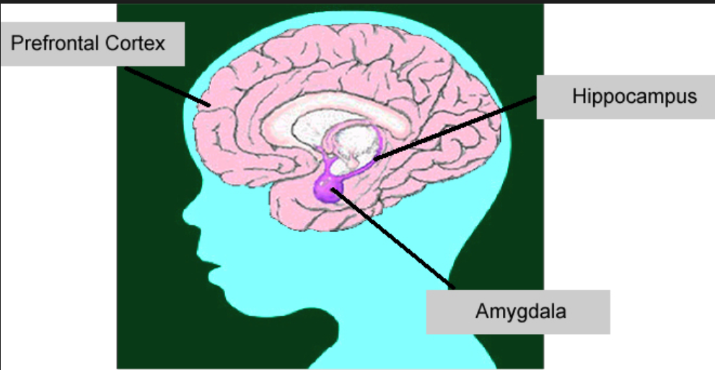
Stress and brain functioning
Reasoning
&
Planning
Planning
Self-Regulation
Memory
Memory &
learning
Fear
Learning
Fear Learning
College of Education and Human Development
Notes:
Brain architecture of memory and learning overlaps heavily with architecture of fear and anxiety. Can’t do one (teach academic skills) without paying attention to the other (emotions, fear, anxiety)

Slide 22

Hippocampus
12 and 13 years at scanning
Controls
4-12 mos
1-5 yrs
Volume corrected for Cortical Volume
Hodel et al., 2015
Left Right
College of Education and Human Development
Notes:
From my own lab, early deprivation associated with smaller brain volumes, especially hippocampus and important area for learning and memory. This is the case even though since about age 2 these teens have lived in highly resourced homes in the US. The hippocampus is highly sensitive to stress and in animal models stress is what reduces its size.

Slide 23
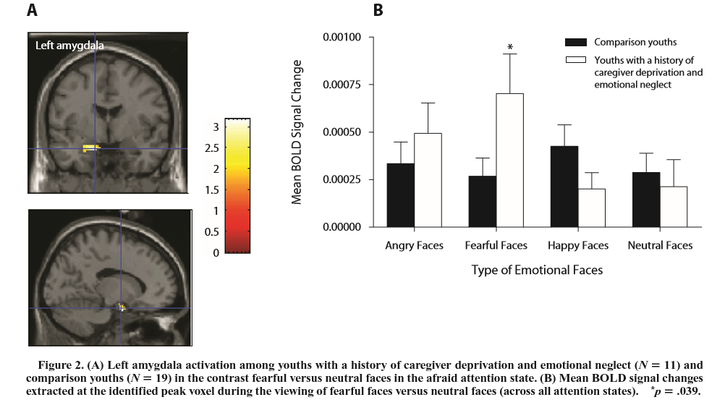
Amygdala=fear learning
Maheu et al., 2010
College of Education and Human Development

Slide 24
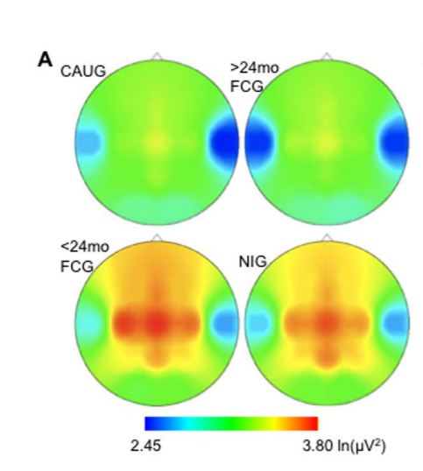
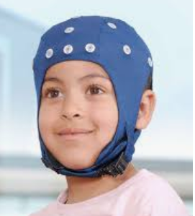
Removal from neglect before, but not after 24 mos, recovers brain power by age 8 years
Stayed in
institution
Placed after 2 yrs
Vanderwert et al., 2010
Placed
before
2 yrs
Heat Map of Brain Electrical Activity
Green and blue low activity
Yellow and red high activity
Family
reared
College of Education and Human Development

Slide 25
Concern for Physical Safety
Risky Developmental Context
Poor Housing/Housing Insecurity
Impair Serve and Return Care
Income Insecurity
Stimulate Toxic Stress
Child Care Anxieties
Health Care Insecurities
College of Education and Human Development

Slide 26
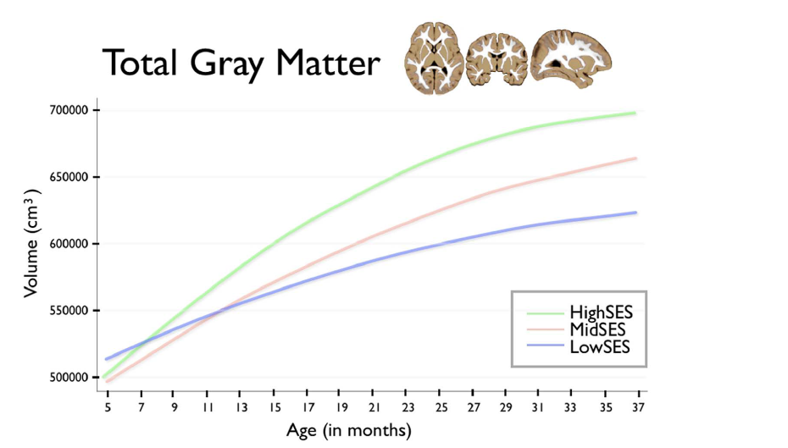
3 years
Hanson et al., 2014
College of Education and Human Development
Notes:
Brain volume associated with poverty, but this emerges over time.

Slide 27
Pre-to-Three Sensitive Period for
Life-long Health
Middle Childhood
Adolescence
Early
Childhood
Adulthood
Biological Embedding during Sensitive Periods
Conception
Disease/
Disorder
Health-Threatening Behavior
Low Educational Achievement
Toxic Stress
Environmental Exposures
Malnutrition
Physiological Disruption
Neurodevelopmental
Immune
Metabolic
Neuroendocrine
Cardiovascular
Early
Death
Low
Income
20%
Cumulative Burden
over Time

Slide 28
Early Intervention and Adolescent Inflammation
IL 1b IL 6 TNF
Standardized Scores
Before After Never Before After Never Before After Never
College of Education and Human Development

Slide 29
Take home: Like building a house
Conception through the few years lays down the foundation of brain architecture.
Like a house, if the foundation is weak, it threatens all that is built afterward.
There are no do-overs in development (compensation, work-arounds).
Best and most cost effective to get it right the first time.
College of Education and Human Development
College of Education and Human Development

Slide 30
Get it right the first time
The basic principles of neuroscience indicate that creating the right conditions for early childhood development will be more effective and less costly than addressing problems at a later age.
Brains: more physiological energy needed to compensate for poorly formed neural circuits.
Society: higher cost of remedial education, clinical treatment, crime.
College of Education and Human Development
College of Education and Human Development
Notes:
Return on investment may seem like a cold way to think about early childhood, but it’s a measure that, as responsible managers of society’s money and programs, policymkaers must consider. What is the return we will get from investing in programs for young children?
Fortunately, both neuroscience and economics arrive at the same conclusion: it is less expensive to get things right at the beginning than to try to fix them later. Less costly for brains in terms of the sheer energy required to work around a weak foundation, and less costly for society in many ways.

Slide 31
Preventive Intervention is More Efficient and Produces Higher Returns than Later Remediation
Programs targeting the earliest years
Rates of return to human capital investment
Preschool programs
K-12
interventions
Heckman, J. (2007)
Job training
0-3
4-5
6-18
19+
Age
College of Education and Human Development
Notes:
He created this theoretical model to show what he found: the early years are by far the smartest investment. It’s important to note that this model is based on interventions for disadvantaged kids, not school or college for average kids.
So it’s not intended to indicate that investments at the other times are not worthwhile or important -- only that we might need to invest less in remediation if we invest more up front. The kids who need help the most later in life will be served better -- and will ultimately benefit society’s bottom line better -- if we serve their developmental needs in the earliest years instead of playing catch-up down the road.
Heckman, J. “Investing in Disadvantaged Young Children Is Good Economics and Good Public Policy,” Testimony before the Joint Economic Committee, Washington D.C., June 27, 2007

Slide 32

Icd.umn.edu
Google:
National
Scientific
Council
On the
Developing
Child
College of Education and Human Development
The University of Minnesota is an equal opportunity educator and employer.

